Slide 1
Dubai
A look into how oil money has transformed a once small desert town into a large wealthy city through westernization.

Slide 2
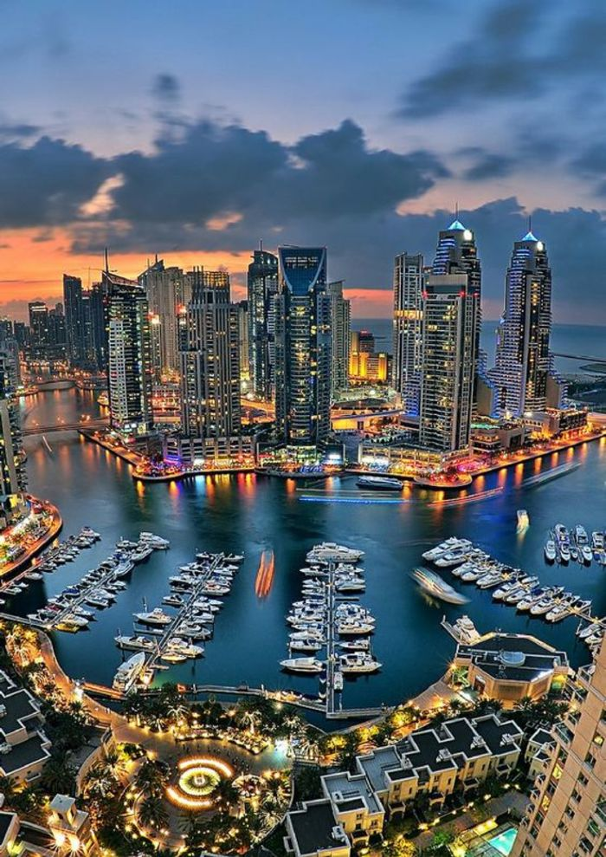
Dubai Then and now

Slide 5
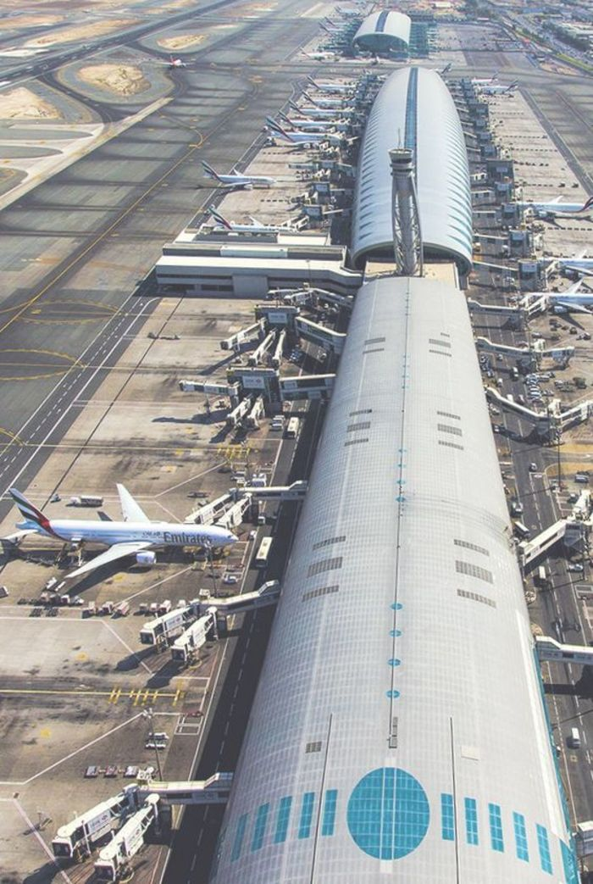

Slide 6
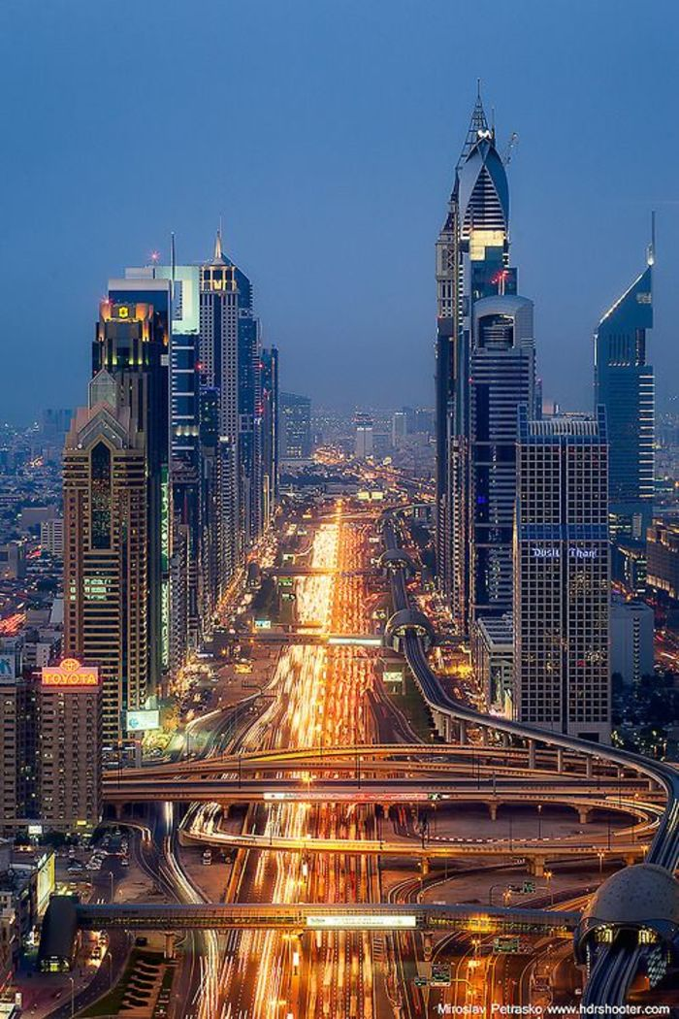

Slide 7
Westernization
Western culture is a broad term used to describe the social norms, belief systems, traditions, customs, values, and so forth that have their origin in Europe or North America
In other words, it is when a place becomes more materialistic and like the Western World.

Slide 8
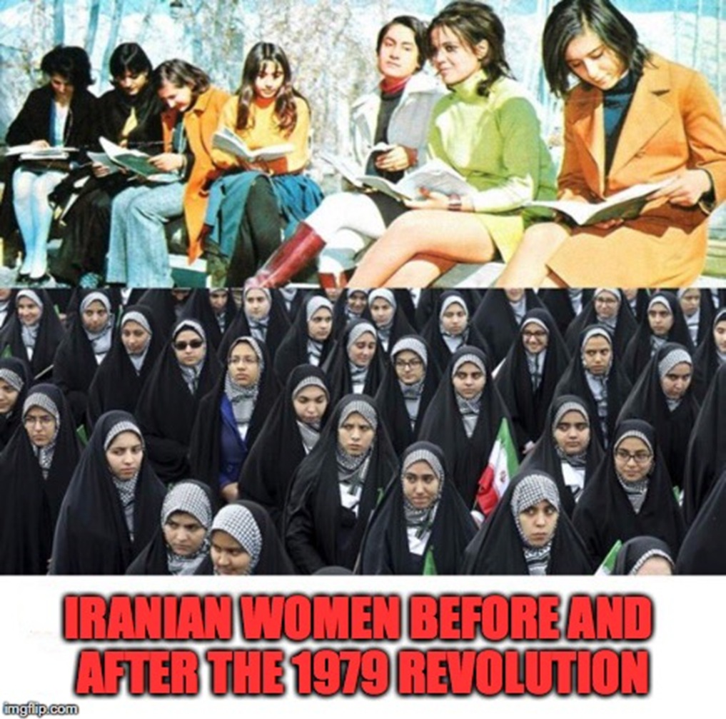
Western Culture Vs. Eastern Culture
The picture to the right shows two concepts of culture. Note the top women wore modern clothes, did their hair and makeup, attended school. They look like women you’d see in the United States
These traits were seen by many as too “western” and some felt that it was erasing their own culture. As a result, there was a rejection of these material things

Slide 9
Materialistic
Materialistic means that you value material things like fancy clothes, cars, property, etc. Basically, you are showing off wealth
Problem: These cultures in the East value modesty, giving money to charity, and religion creating a CULTURE CLASH

Slide 10
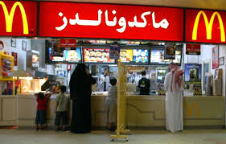
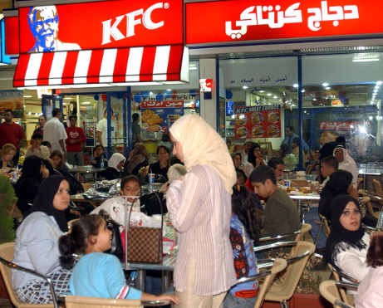
Western influence on Food
https://www.youtube.com/watch?v=WyMTSvVAtWM

Slide 11
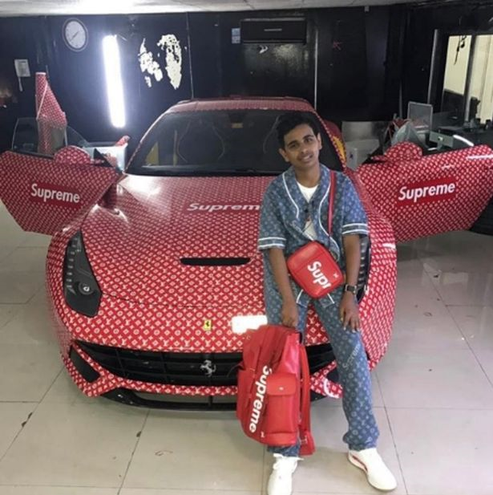
Rich Kids of dubai
Western influence on cars, appearances, clothes, buildings, pets, and other material goods

Slide 12
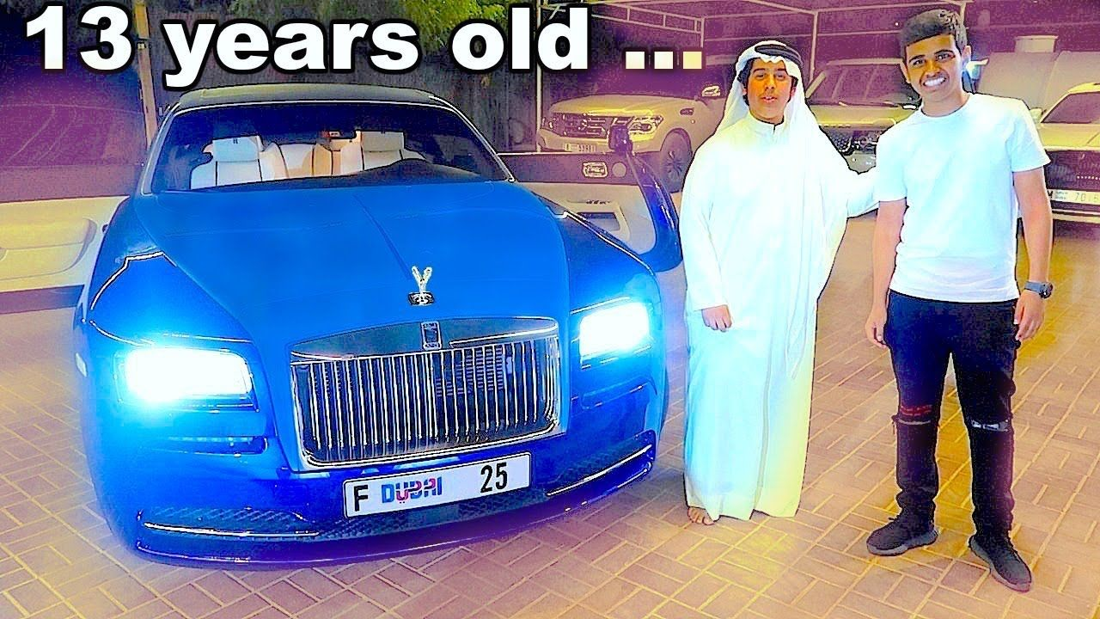

Slide 15
points TO Ponder…
Even though these pictures are all from the Middle East, these pictures look like they were taken in United States
Do any of these rich kids look like they’re concerned with religion?
Do they look like they pray five times a day? Give to the poor? Fast during Ramadan?
Do they value God or material goods?

