Slide 1
War in the Far East
Japan in World War 2 and Beyond…

Slide 2
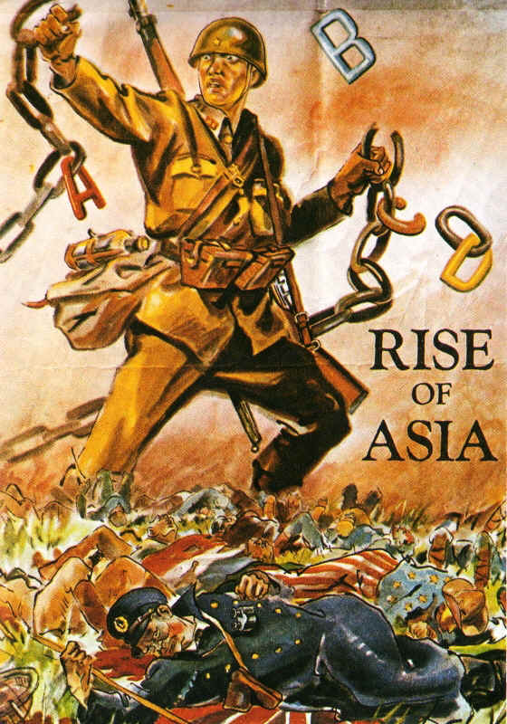
Feelings of Nationalism and Militarism swept through Japan in the 1930s.
Despite the Great Depression, Japan built up its Army, Navy, and Air Force and invaded eastern China in 1931.
Japan followed the Imperialist model Europe and the U.S. had created
Raw Materials were needed to grow the Japanese Empire

Slide 3
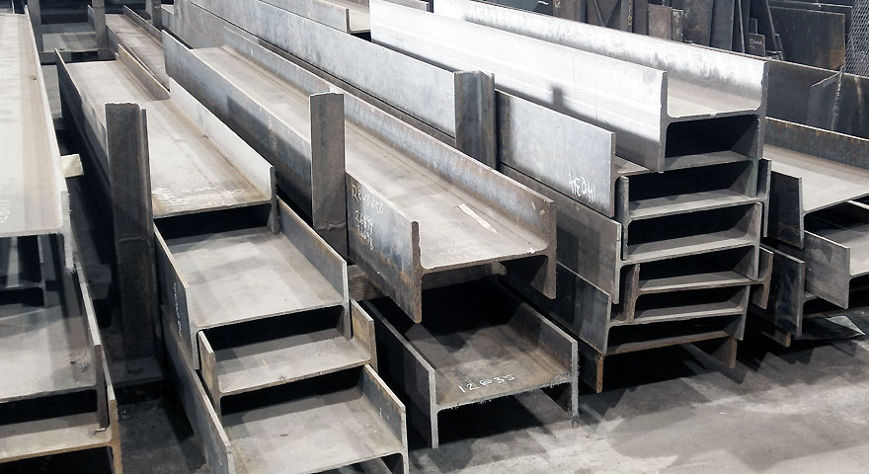
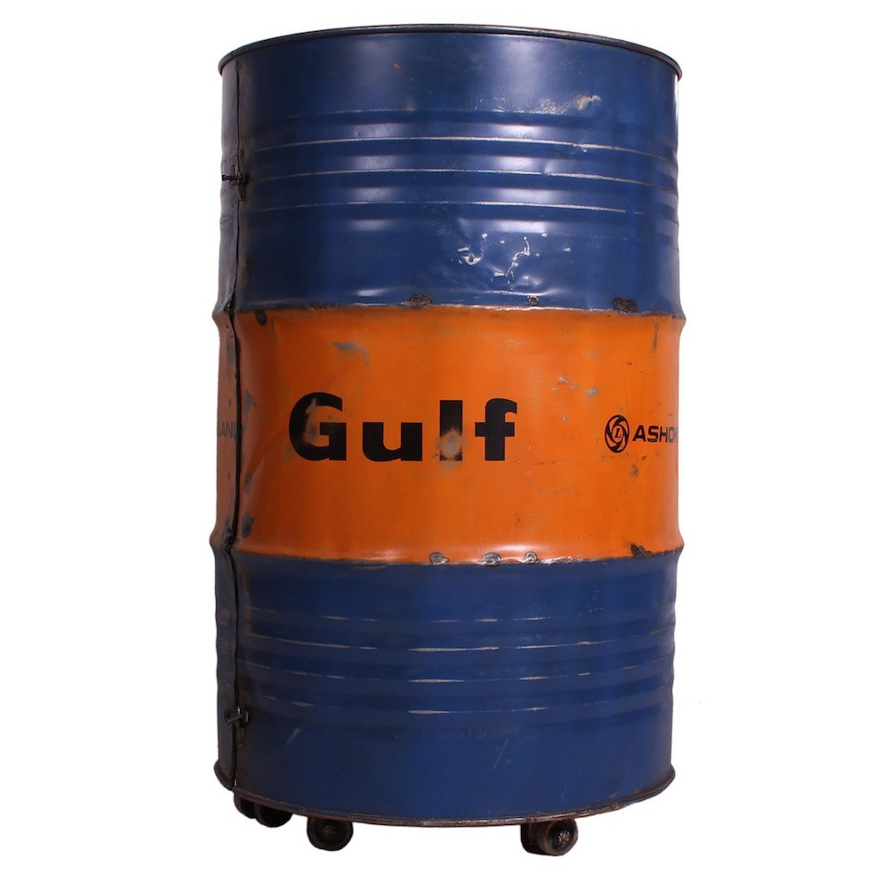
The U.S. were isolationist and did not want to get involved…
President Roosevelt, seeing that something must be done to curb Japanese ambition, chose to put Sanctions on them.
U.S. Oil and Steel exports were halted by 1940.
Japan’s brilliant Admiral Yamamoto devised a plan to reduce American power in the Pacific.

Slide 5
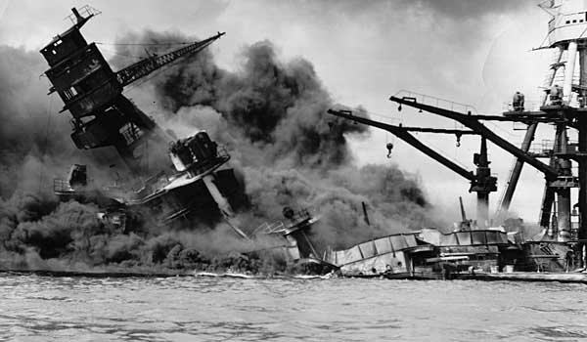
Remember Pearl Harbor!!!
The Japanese sank or destroyed
18 US battleships and 188 airplanes.
Over 3,700 people lost their lives
The U.S. Declared War against Japan and the Axis the next day
Japan was already advancing on the other islands. American forces were cornered on the Island of Bataan in the Philippines. The death march afterward claimed 650 U.S. military and over 5,000 Filipino lives.

Slide 6
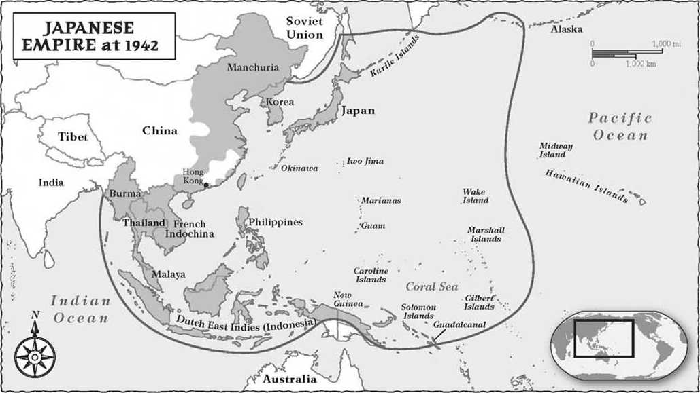

Slide 7
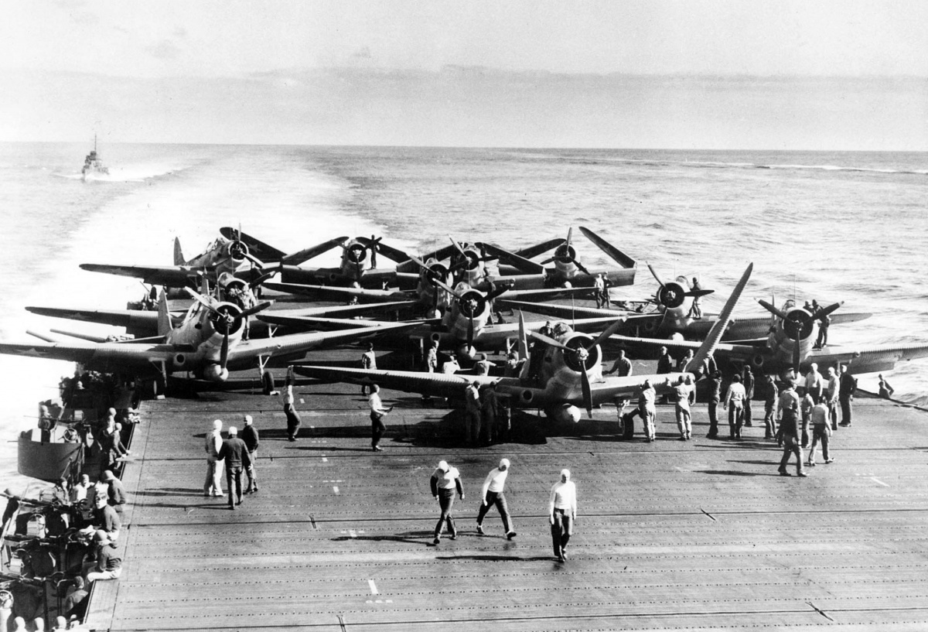
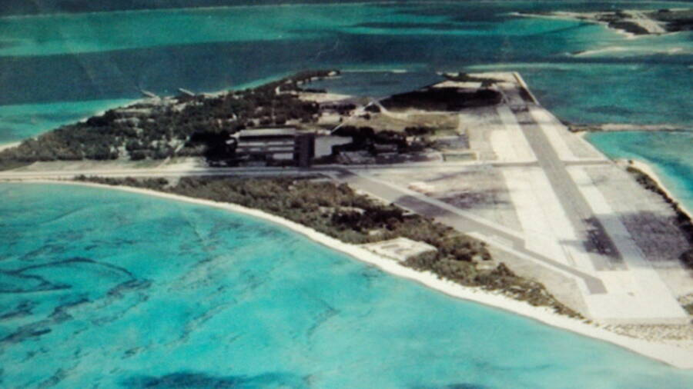
Sea Power is Support Air Superiority Wins the War
By mid 1942, “the Arsenal of Democracy" was running at full speed. The U.S. Pacific Fleet was repaired or replaced.
Flying armadas on Aircraft Carriers, and Super Bombers take the war back to the enemy island by island.
Midway Island was a narrow strip of land where the Japanese forces had to be stopped!

Slide 9
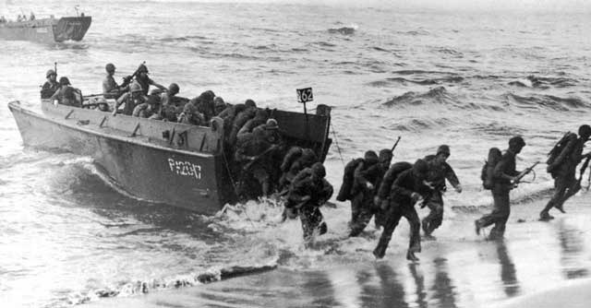
After Midway... We “returned to the Philippines”, fighting an Island-hopping War.
The Japanese captured Pacific Island chains and weren't going to give them up without a fight!
Iwo Jima was a barren volcanic island that had been fortified with tunnels, guns, and Japanese troops that were willing to die rather than let the U.S. Marines have it.

Slide 11
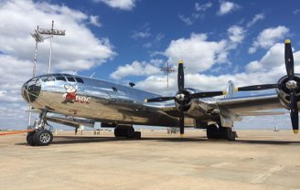
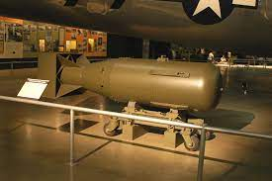
New Technology allows America to Fly higher and Fly farther.
The B-29 Superfortress - Marietta, GA assembled 668 and sent them to war. Thousands more were built in 5 other aircraft plants. Thirty seconds over Tokyo became daily raids with explosives and napalm (fire-bombs) killing thousands.
A special squadron trained on Tinian island in the Summer of 1945 to deliver the "gadget“ to end the war....But, would it work?

Slide 12
It was just one American plane….

Slide 13
3 days later…Nagasaki

Slide 14
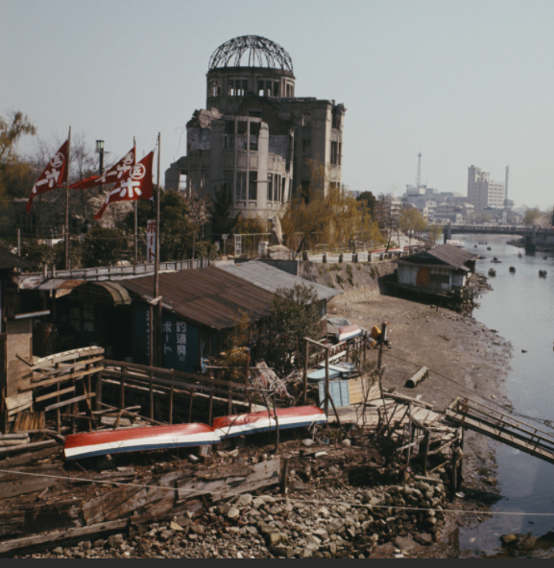
Japan enters the Atomic Age… Hiroshima and Nagasaki cease to exist.
70,000 killed immediately in each location – (Pica-Don)
Thousands more die in the weeks after of burns and radiation poisoning
Pres. Truman warns of a “rain of destruction” if the Japanese don’t surrender.

Slide 15
Newsreels recorded the Aftermath…
Stop video at 1:19

Slide 16
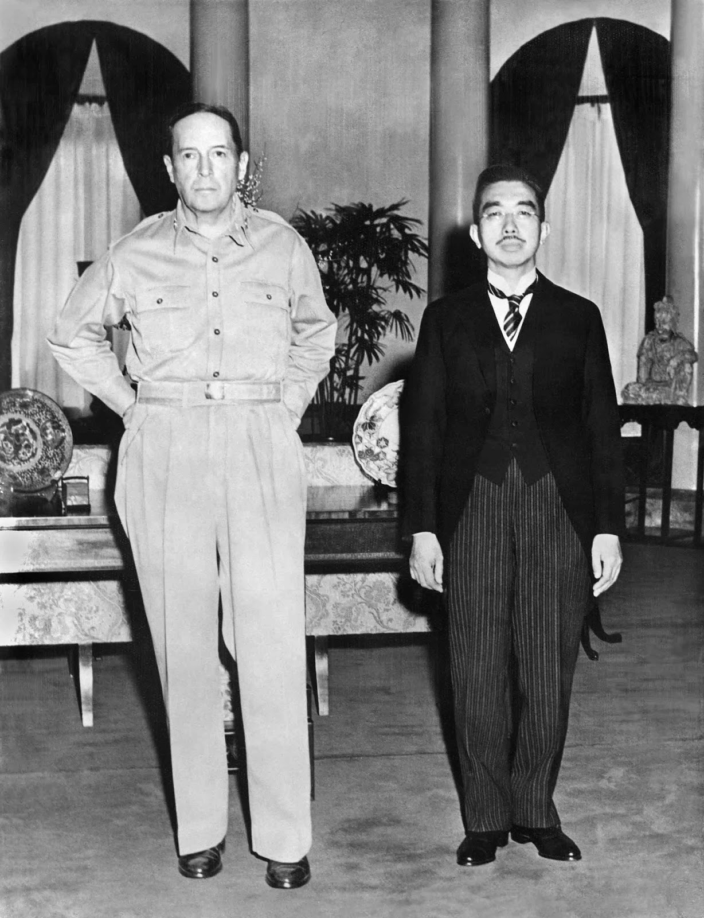
McArthur reigns over an Emperor
Japan endures “the Unendurable” and America occupies the Islands.
The “Divine” Emperor becomes a Constitutional Monarch.
Westernization changes everything – culture, construction, clothing, cars,
And creates new things…like Christmas holidays!

Slide 17
Reforms in Japan during Rebuilding
REFORMS
POLITICAL
ECONOMIC
SOCIAL
New
Constitution
Improve
Infrastructure
English as
2nd language
Constitutional
Monarchy
Market Economy
Japan adopts
US culture
Emperor Stripped
of Power
Invest in Human and
Capital Resources
Women’s
Suffrage

Slide 18
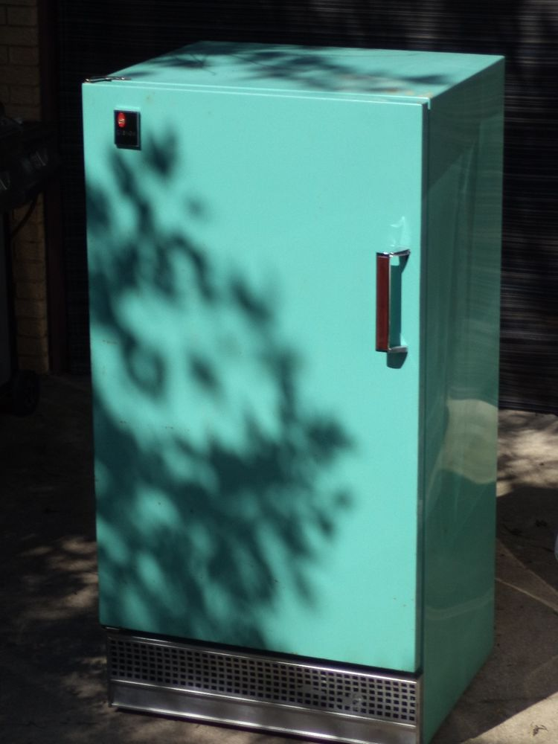
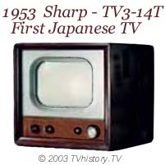
Japan becomes an Allied Power And the U.S. Faces a new Threat
Japan Re-Industrializes in the late 1940’s as new products emerge – the Refrigerator (Hitachi), TV (Toshiba), Cars like Toyota, Honda, and Nissan
Ground and Water Pollution harms a weakened population – “Itai-Itai”
As Japan regains its strength, North Korea is preparing for War in 1950.

Slide 19
Japan debuts as a Global Debutante! Hosting world events...
1964 Summer Olympics – Tokyo;
1970 World’s Fair – Osaka;1972 Sapporo Winter Olympics; 1980’s Bullet Trains and a Building Boom with earthquake resistant buildings of Ferro concrete.
But China was changing too…
Though Communist, by the 1990’s it had become a manufacturing giant.

Slide 20
JAPAN TODAY
World’s 3rd largest economy
Location for many of the world’s Largest Companies and most famous Brands
The Gateway to Asia for the West
Affluent and loyal consumer base
Less exposed to high energy prices
Japan has one of the Top 5 GDP’s
$48,200/capita / Unemployment 2.34%
$1 U.S. = 108.90 Japanese Yen (2021)

