Slide 1
War in the Far East
The rise and fall of japan from WWII

Slide 2
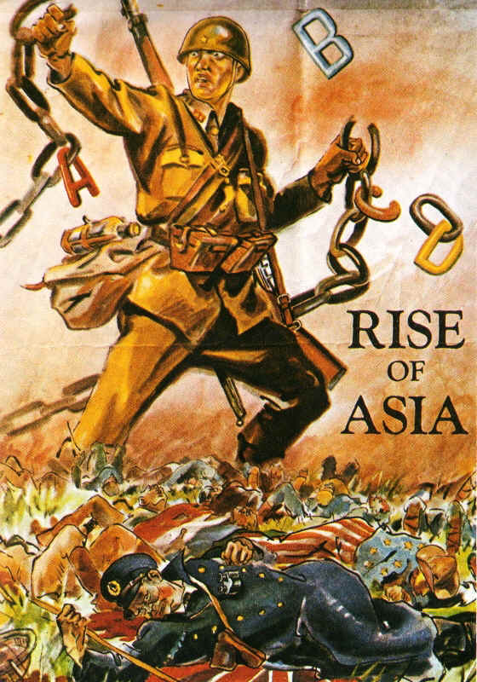
Feelings of Nationalism and Militarism swept through Japan in the 1930s.
Despite the Great Depression, Japan built up its Army, Navy, and Air Force and invaded eastern China in 1931.
Japan followed the Imperialist model Europe and the U.S. had created
Raw Materials were needed to grow the Japanese Empire

Slide 3
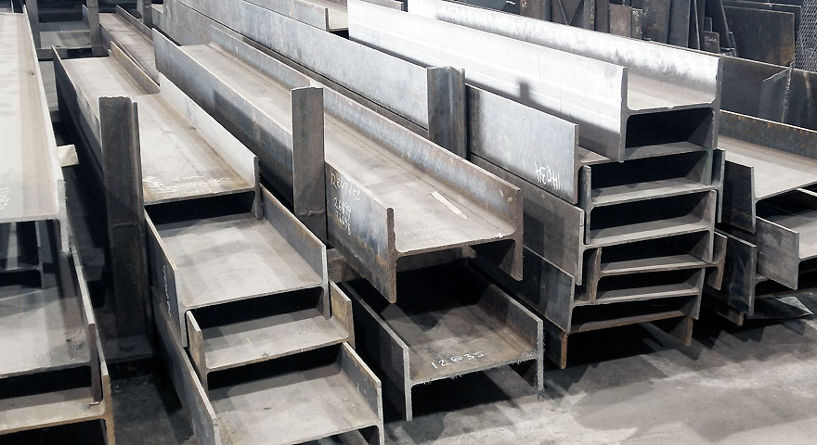
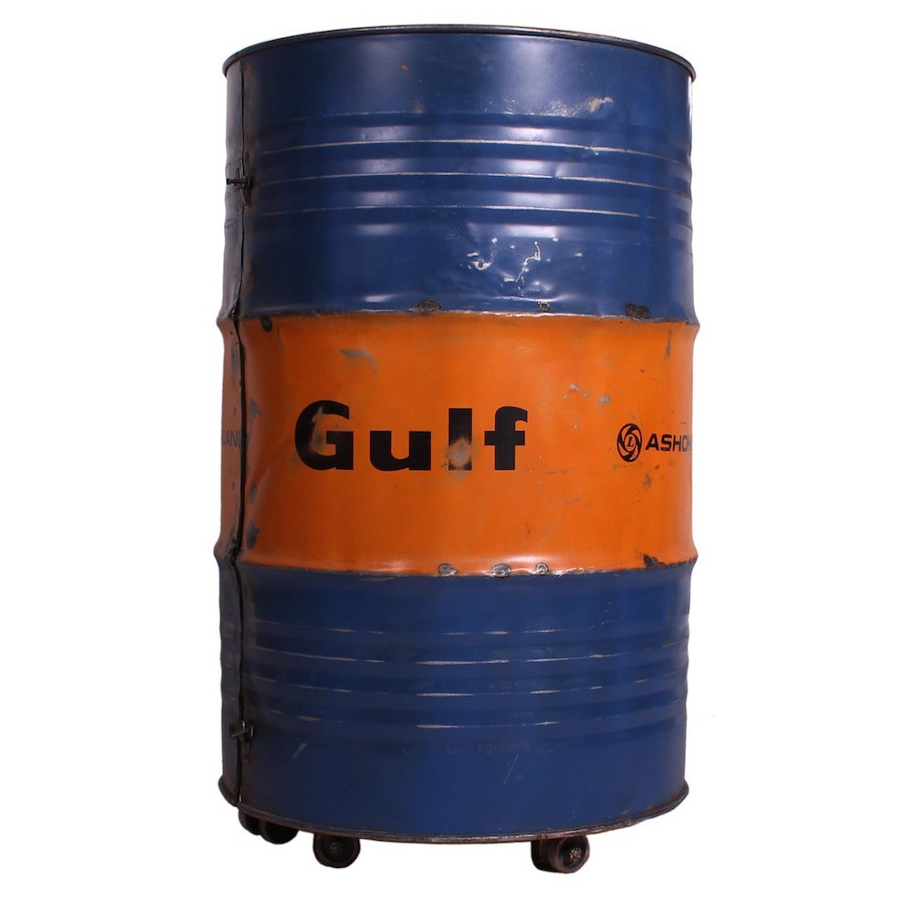
The U.S. were isolationist and did not want to get involved…
President Roosevelt, seeing that
something must be done to curb Japanese ambition, chose to put sanctions on them.
U.S. Oil and Steel exports were halted by 1940.
Japan’s brilliant Admiral Yamamoto devised a plan to reduce American power in the Pacific.

Slide 4
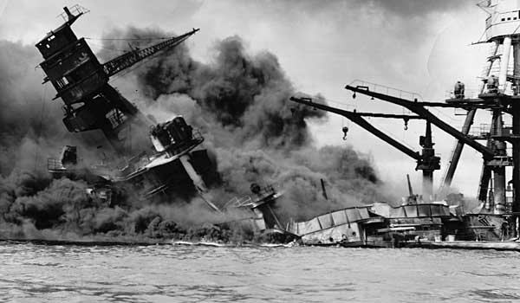
Remember Pearl Harbor!!!
The Japanese sank or destroyed
18 US battleships and 188 airplanes.
Over 3,700 people lost their lives
The U.S. Declared War against Japan and the Axis the next day
Japan was already advancing on the other islands. American forces were cornered on the Island of Bataan.

Slide 5
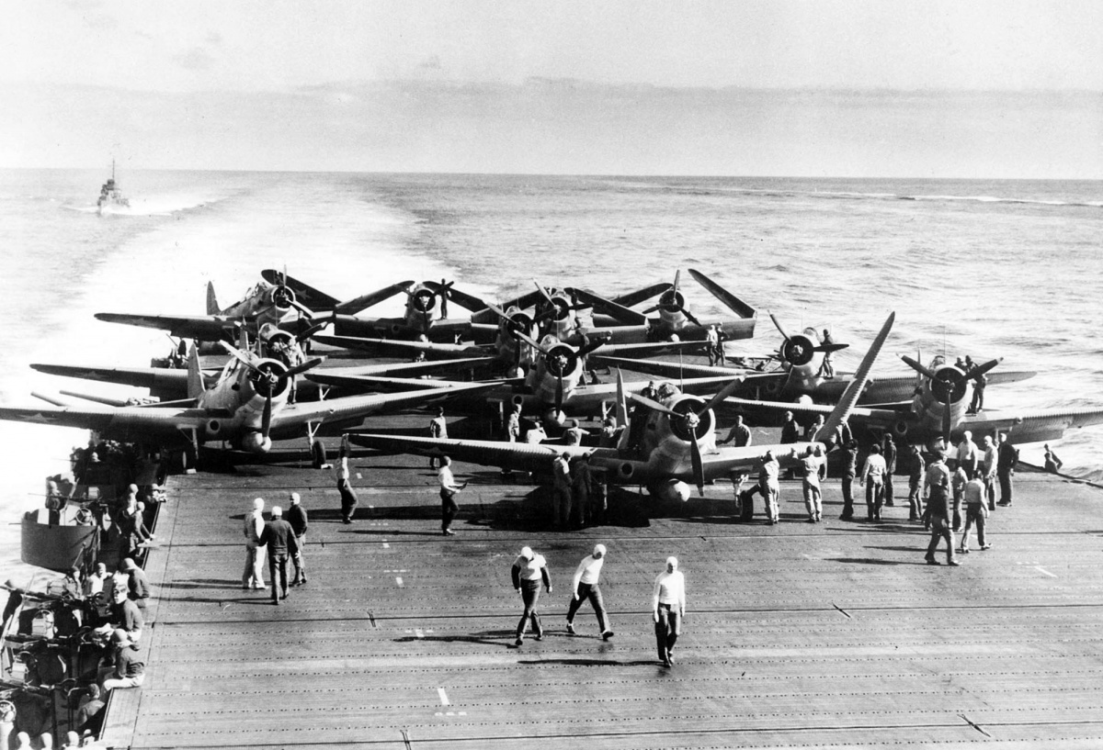
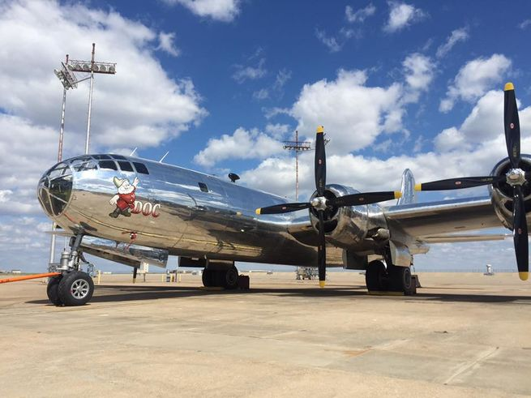
Sea Power is Support Air Superiority Wins the War
By mid 1942, “the Arsenal
of Democracy” was running
at full speed.
Flying armadas on Air Craft
Carriers, and Super Bombers
take the war back to the enemy.

Slide 6
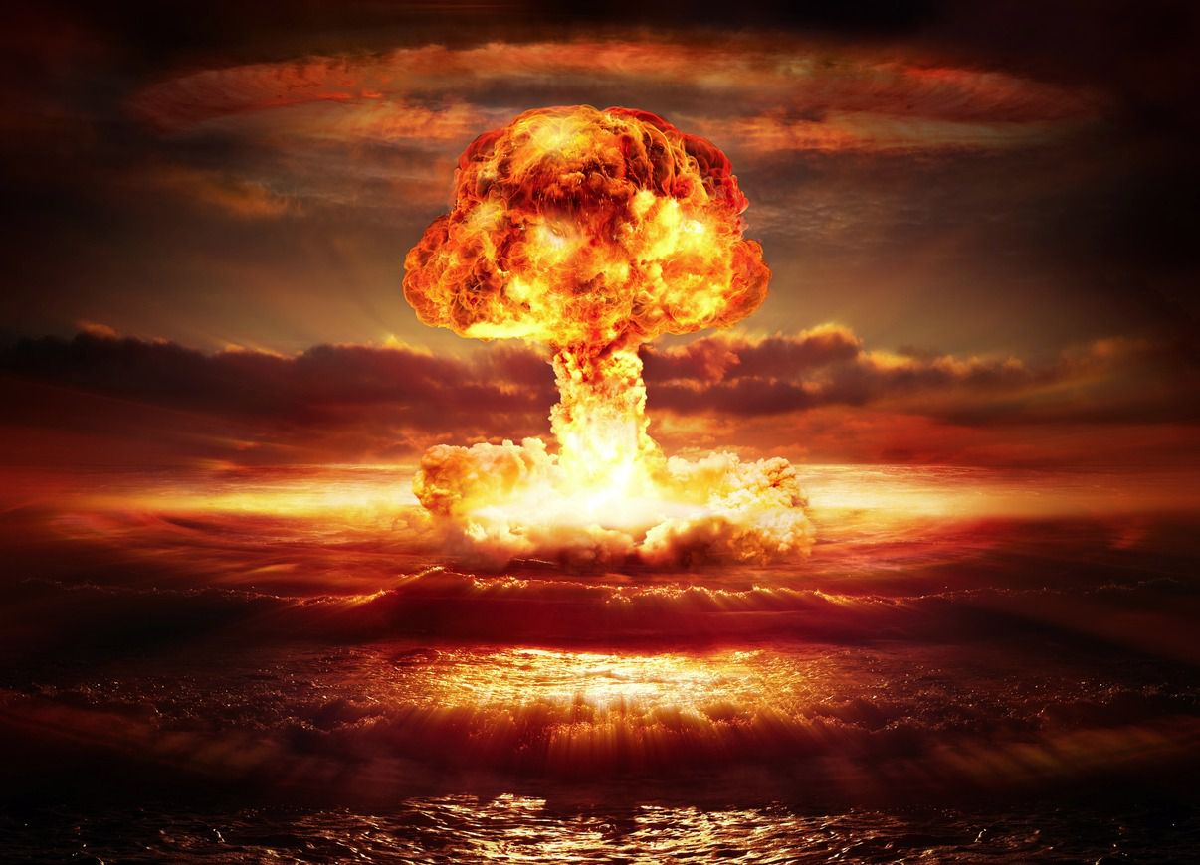
Japan enters the Atomic Age… Hiroshima and Nagasaki cease to exist.
Before – play all
70,000 killed immediately in each location – (Pica-Don)
Thousands more die in the weeks after of burns and radiation poisoning
Pres. Truman warns of a “rain of destruction” if the Japanese don’t surrender.
After – stop at 1:19

Slide 7
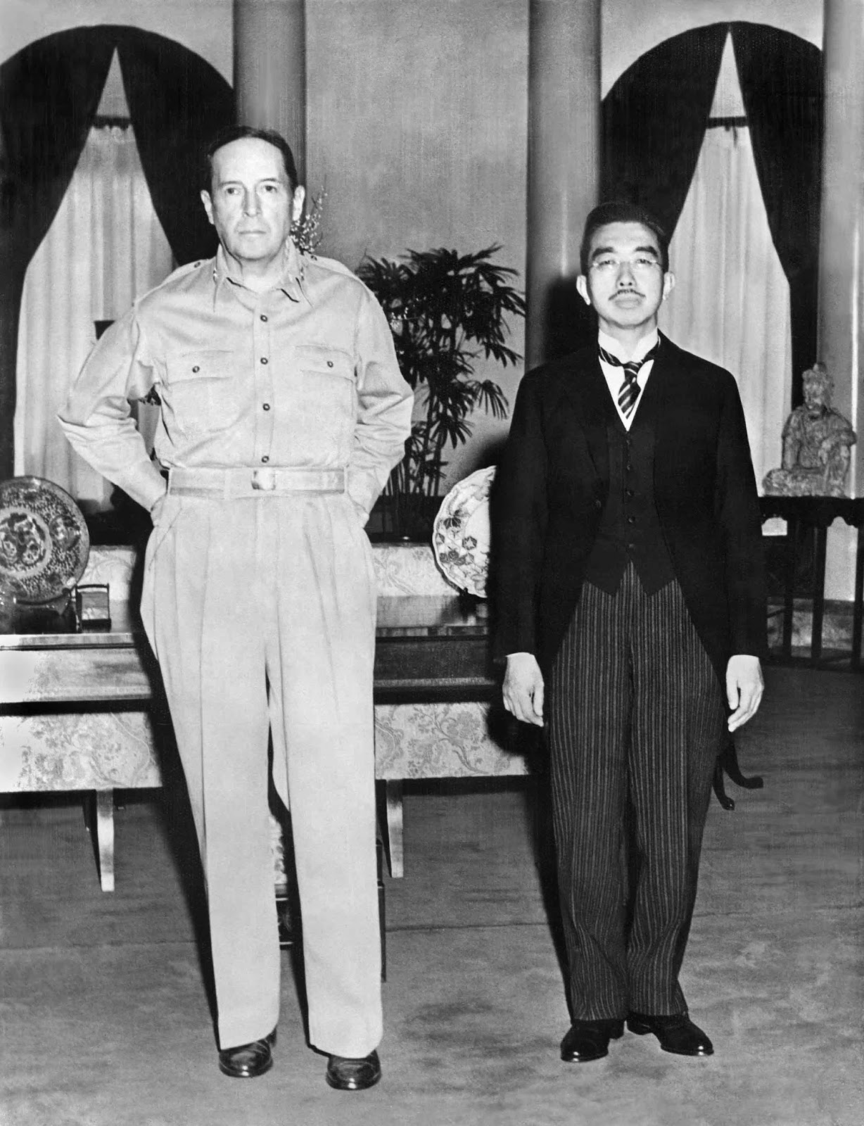
McArthur reigns over an Emperor
Japan endures “the Unendurable” and America occupies the Islands.
The “Divine” Emperor becomes a Constitutional Monarch.
Westernization changes everything – culture, construction, clothing, cars,
And creates new things…like Christmas holidays!

Slide 8
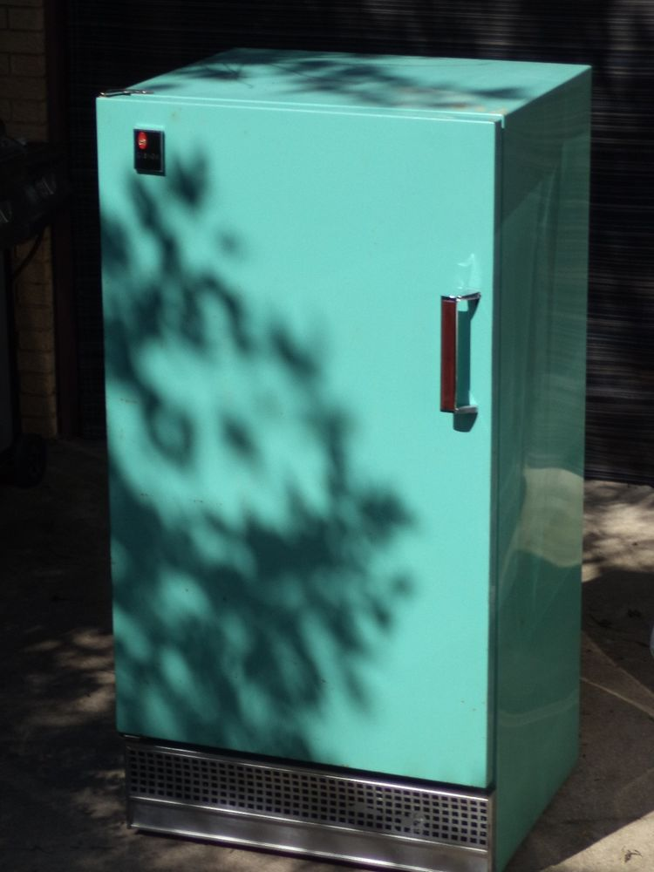
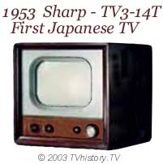
Japan becomes an Allied Power And the U.S. Faces a new Threat
Japan Re-Industrializes in the late 1940’s as new products emerge – the Refrigerator (Hitachi), TV (Toshiba), Cars like Toyota, Honda, and Nissan
Ground and Water Pollution harm a weakened population – “Itai-Itai”
As Japan regains its strength, North Korea is preparing for War in 1950.

