Slide 1
SWA History: Wars
Lingual / Visual Dictionary

Slide 2
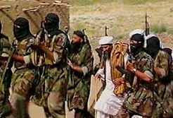
Al-Qaeda
Terrorist group founded by Osama bin Laden and responsible for the September 11 attacks.

Slide 3
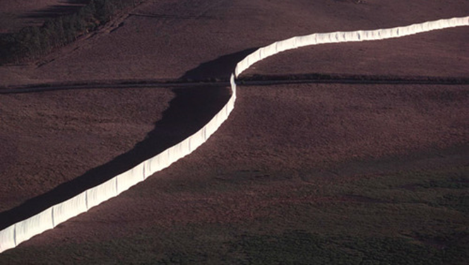
Artificial Political Boundaries Man-made borders)
country borders drawn by European colonial rulers who did not respect the ethnic and religious groups

Slide 4
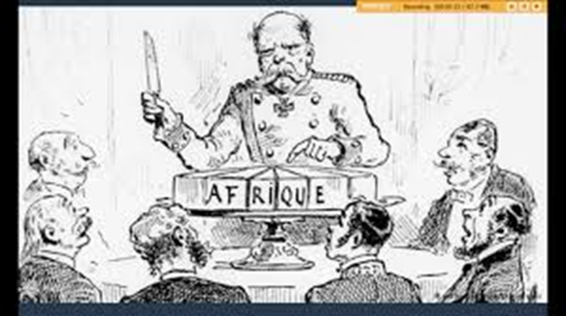
Colonialism
When one country takes political and economic control of another country.

Slide 5
Operation Iraqi Freedom (Iraq War)
A war fought from 2003-2011 mostly by the U.S. and U.K. who were afraid that Saddam Hussein had WMD's (Weapons of Mass Destruction)

Slide 6
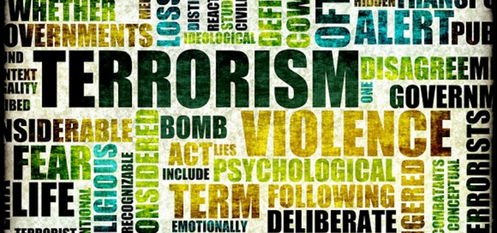
Oil, Money, and Terrorism
Reasons for US interest in Southwest Asia (Middle East)

Slide 7
Organization of Petroleum Exporting Countries (OPEC)
Controls the price and amount of oil sold in the world market by major oil exporting countries.

Slide 8
Osama bin Laden
founder of al-Queda; Arab Muslim terrorist responsible for the 9/11 attacks. Killed by U.S. forces in 2011

Slide 9
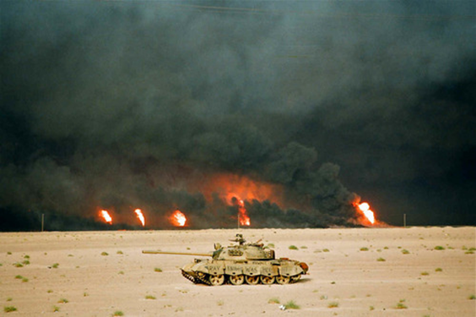
Persian Gulf War
War fought from 1990- 1991 by 34 United Nation member countries.

Slide 10
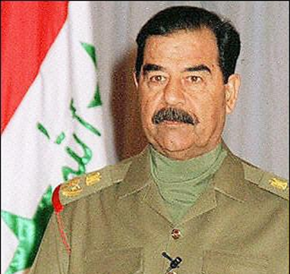
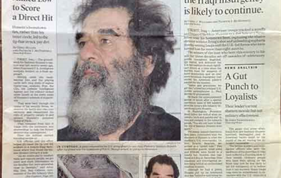
Saddam Hussein
"President" of Iraq from 1979-2003. Defeated by US led invasion in 2003.

Slide 11
September 11, 2001 (9/11 Attacks)
Suicide attacks carried out by a militant Muslim group who hijacked passenger jets and crashed them into the World Trade Center and Pentagon. This is the cause of the invasion of Afghanistan.

Slide 12
United Nations
Organization founded in 1945 to promote worldwide peace; created the nation of Israel in 1948.

Slide 13
Weapons of Mass Destruction (WMD’s)
Chemical, biological, or nuclear weapons that can kill thousands.

Slide 14
Slant Drilling
Is a non-vertical form of well drilling typically used in natural gas and oil production.

Slide 15
Taliban
A group of fundamentalist Muslims who controlled the government of Afghanistan; provided a safe haven for Osama bin Laden, after the 9/11 attacks.

