Slide 1
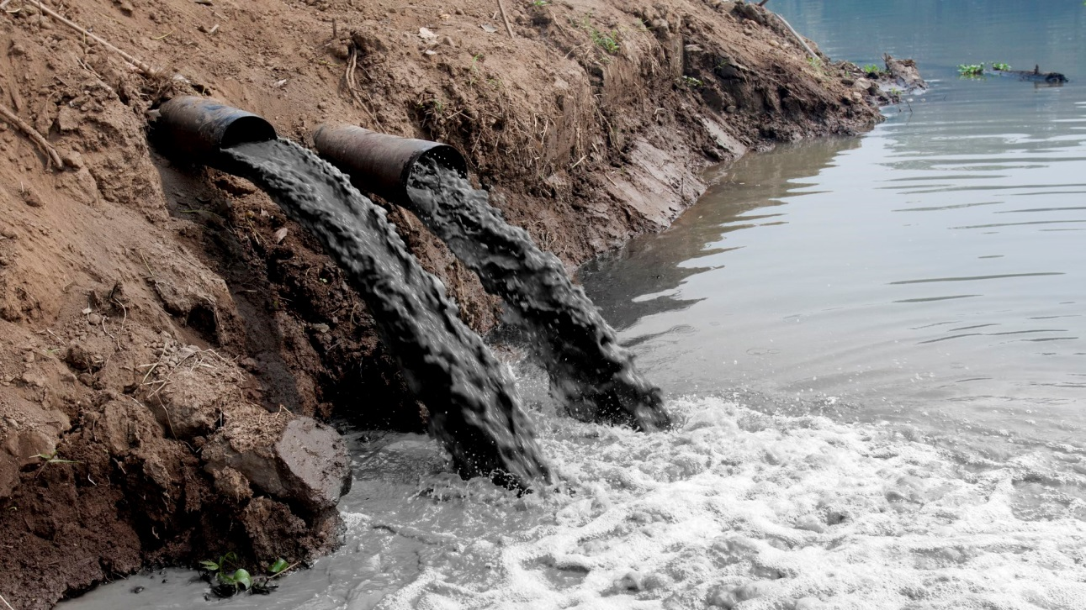
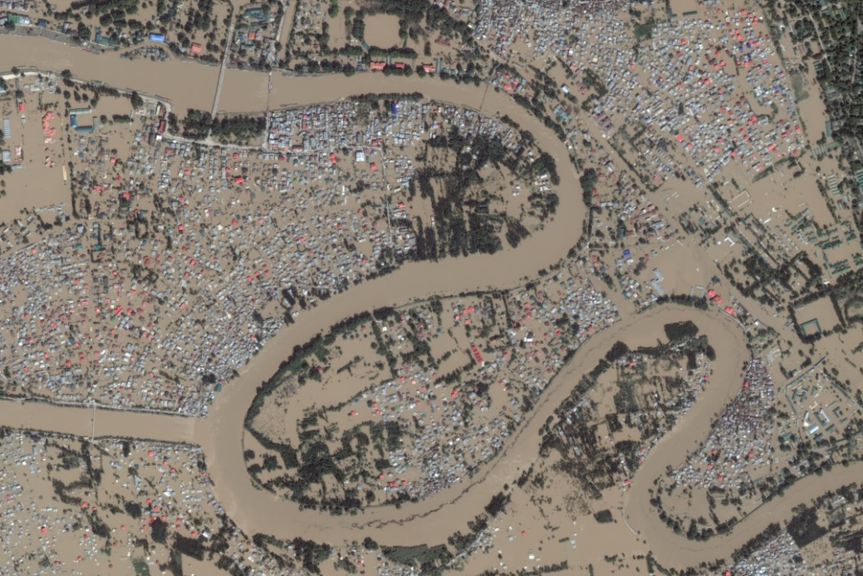
What environmental issues are illustrated in the pictures?

Slide 2
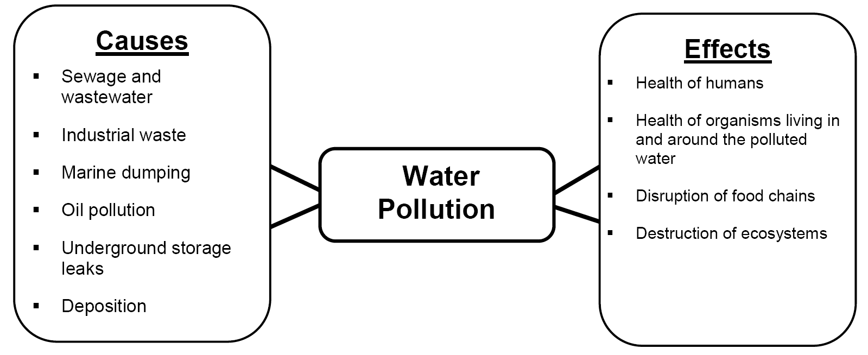

Slide 3
Essential Question:
How has pollution and flooding affected Southern & Eastern Asia?

Slide 4
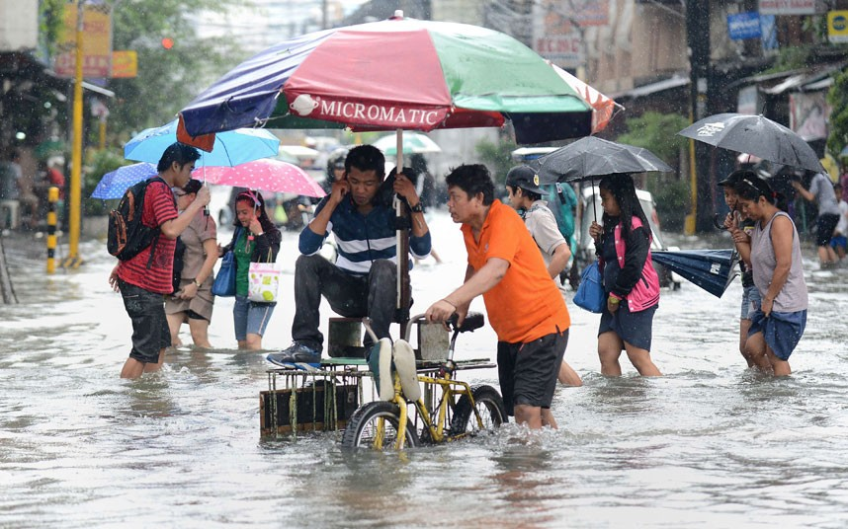
Flooding in India and China

Slide 5
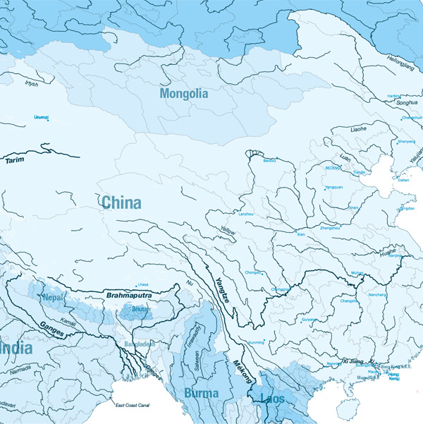
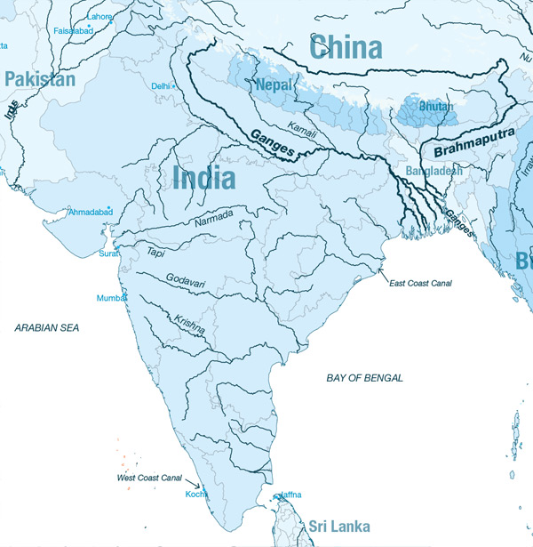
Because parts of China and India are located along waterways, they are subject to flooding, which can damage the soil and make areas practically uninhabitable.

Slide 6
Monsoons cause the majority of flooding in India and China. What are monsoons?
A monsoon is a seasonal change in the direction of the strongest winds of a region. Monsoons cause wet and dry seasons. Flooding can occur during the wet season.

Slide 7
Think, Pair, Share
Why are monsoons a mixed blessing?
Monsoons help farmers because they rely on rainfall. Water from the rainfall can also be used to generate electricity.

Slide 8
What types of human activity increase the effects of rainfall during the monsoon season?
Deforestation, Land Development, Removing Wetlands

Slide 9
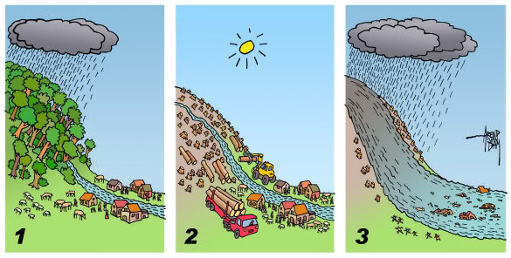
Human Activities that can Affect Flooding

Slide 10
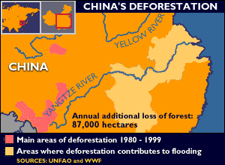
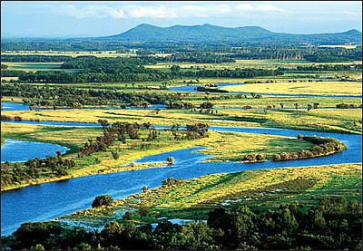
Deforestation and the loss of wetlands has increased the effects of flooding in China.

Slide 11
Summarize the Cause(s) and Effect(s) of Flooding in India and China on your graphic organizer.

Slide 12
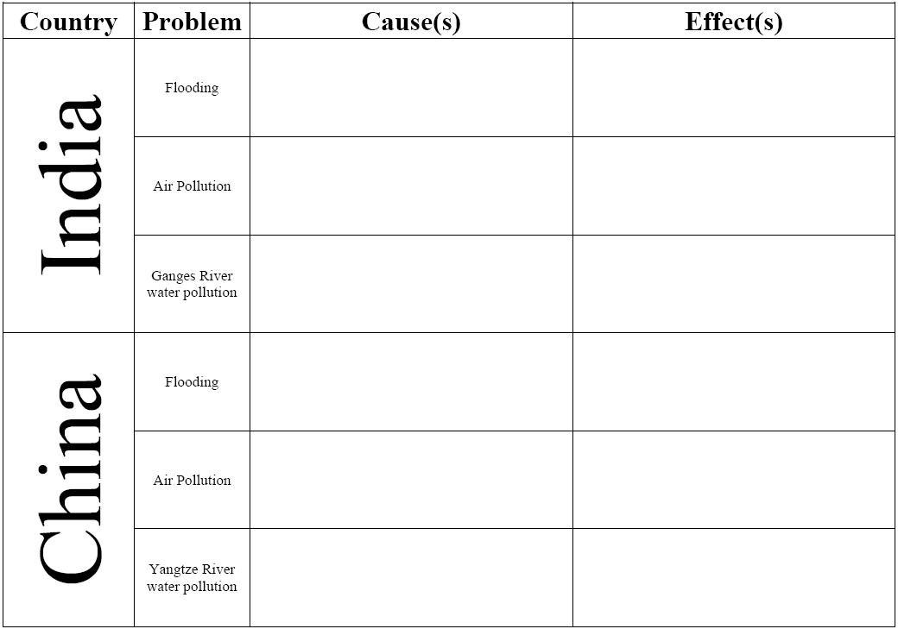
Monsoons (seasonal winds that bring rain) cause flooding in India. However, rain during the monsoon wet season helps farmers and is used to generate electricity.
Flooding caused by monsoons can harm living organisms (death or water borne illnesses), damage property and the environment, disrupt communication and transportation, cause economic losses.
Monsoons (seasonal winds that bring rain) cause flooding in India. However, rain during the monsoon wet season helps farmers. Over the years, China has cut down trees and drained wetlands which has increased flooding.
Flooding caused by monsoons can harm living organisms (death or water borne illnesses),
damage property and the environment, disrupt communication and transportation, cause
economic losses. Huang He causes more deaths
than any other in the world.

Slide 13
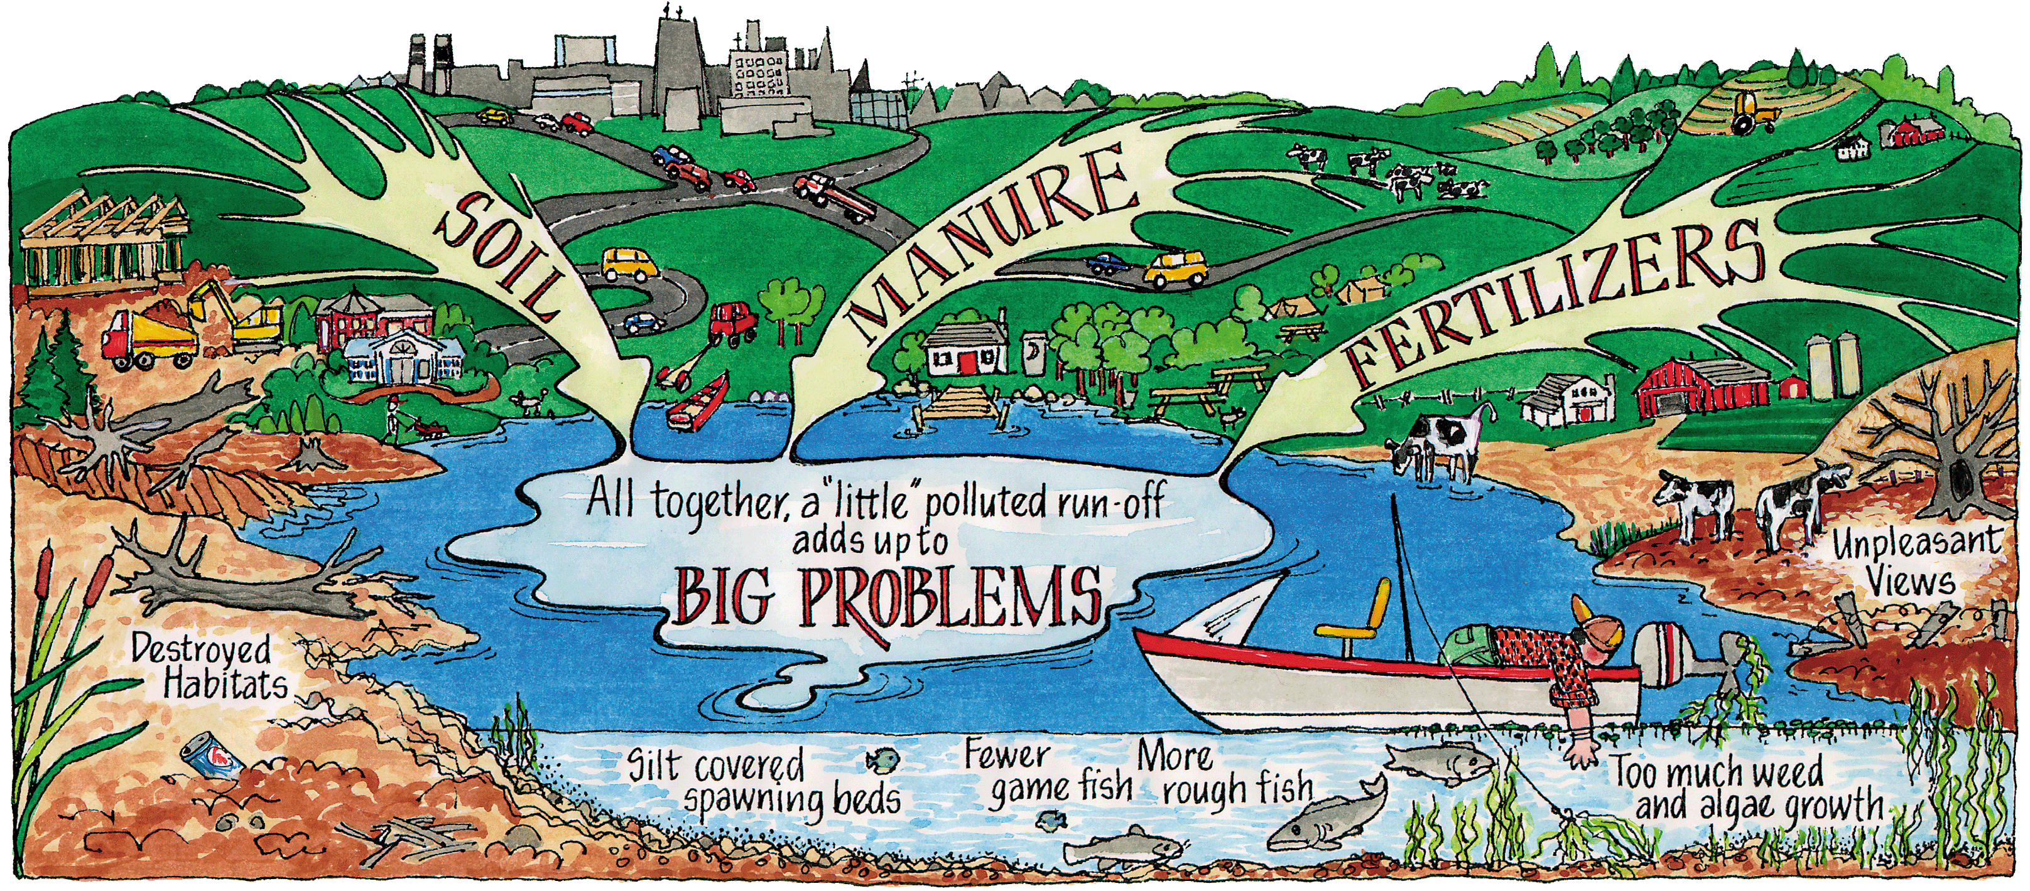
Water Pollution
Dumping sewage and industrial and agricultural wastes cause river pollution, which in turn threatens plant and wildlife species.

Slide 14
Water Pollution in India
Water pollution only worsens India’s water shortage problems.
Artificial fertilizers from farming and industrial waste from factories seep into India’s rivers and pollute them.
India’s Ganges River has been heavily polluted by industrial waste, sewage, and even human remains.

Slide 15
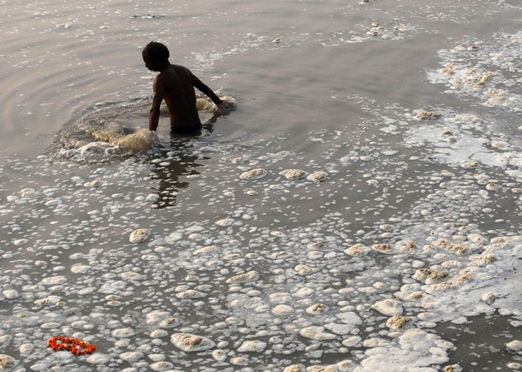
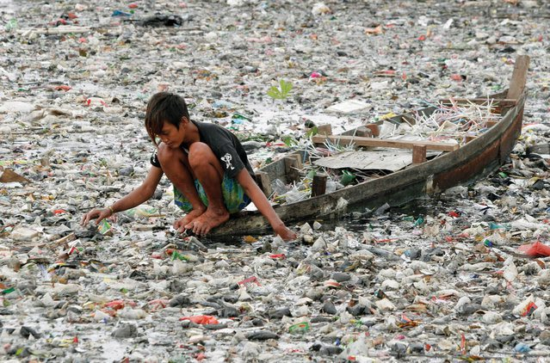
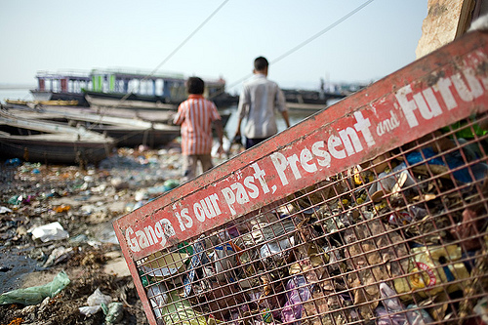
Water
Pollution in India

Slide 16
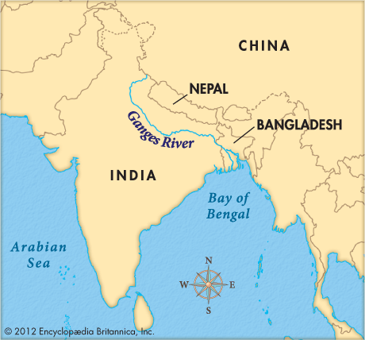
Pollution in India’s Ganges River

Slide 17
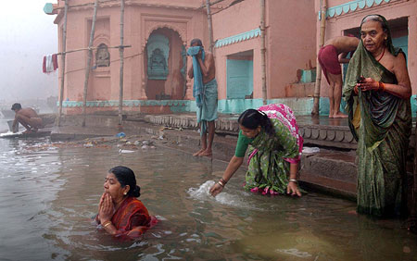
Pollution in India’s Ganges River
The Ganges River serves 500 million people, most of whom believe it is of religious significance.
As a result, many people bathe in the river, which contributes to the pollution.

Slide 18
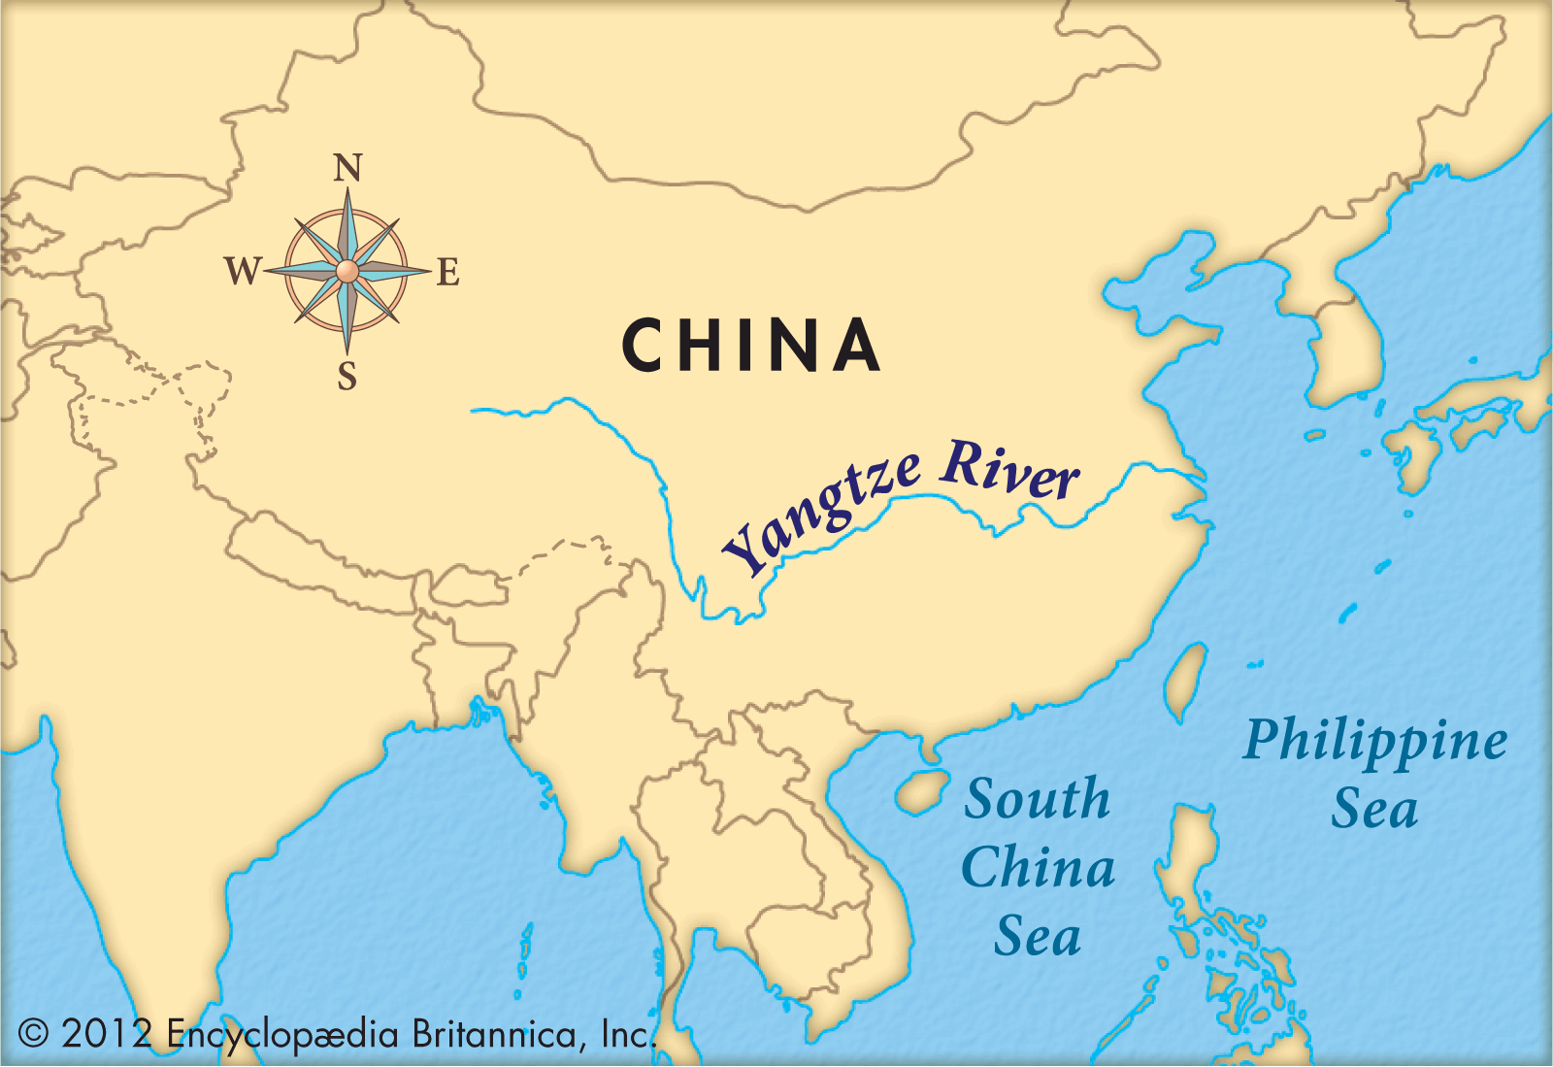
Pollution in China’s Yangtze River

Slide 19
Water Pollution in China
Pollution in the river has increased over 73% in the past 50 years.
Most agree the pollution is caused by large-scale industrial and domestic development, as well as agricultural runoff.
Hundreds of cities located along the river contribute to the pollution.

Slide 20
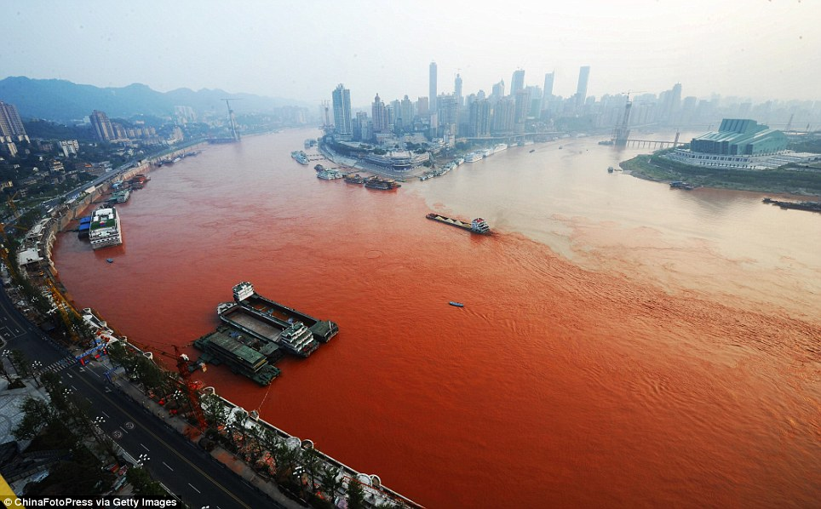
Pollution in China’s Yangtze River

Slide 21
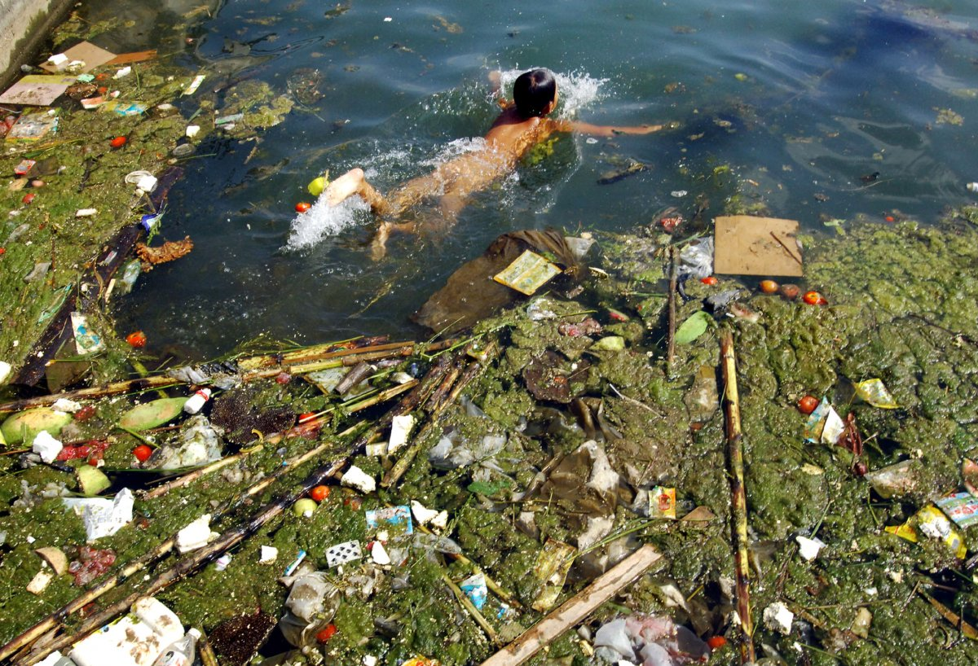
Pollution in China’s Yangtze River

Slide 22
Think, Pair, Share
What are the causes of water pollution in India and China?
What are some of the effects of water pollution?

Slide 23
Summarize the Cause(s) and Effect(s) of Water Pollution in India and China on your graphic organizer.

Slide 24
Most Indians believe it is of religious significance. As a result, many people bathe in the river, which contributes to the pollution. Industrial, agricultural, and human wastes contribute to the pollution.
Dumping sewage and industrial and agricultural wastes cause river pollution, which in turn threatens human, plant and animal life.
Most agree the pollution is caused by large-scale industrial and domestic development, as well as agricultural runoff. Hundreds of cities located along the river contribute to the pollution.
Dumping sewage and industrial and agricultural wastes cause river pollution, which in turn threatens human, plant and animal life.

Slide 25
Summarizer
Identify the causes of air pollution in India and China.
Identify the effects of air pollution.
Identify the causes of water pollution in the Ganges River.
Identify the causes of water pollution in the Yangtze River.
Identify the effects of water pollution.

