Slide 1
Parliamentary & Presidential
DEMOCRACIES
How we the people choose
Legislatures and Executive Leaders

Slide 2

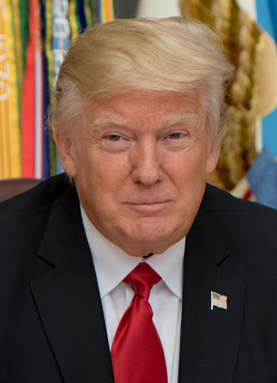
Presidential Democracy
  Democratic form of government where the head of government (executive leader) is directly elected and legislators are chosen in a different election.
Separate branches
(separate elections)
President
Donald Trump
Legislature
House of Representatives
Senate

Slide 3
Presidential Democracy
Is a ________________________________ (the citizens vote for people who do our voting for us)
Has a ________________ (written set of laws)
Answers to the people (people have the power)
_________________ (President) is elected by the ___________
The legislature has no part in selecting the executive leader (the __________ choose the president, ________________ )
The ___________ leader can be from either party
The citizens vote ________ (once for Executive and once for Legislative)
Executive
Legislative
Elect
Elect
Citizens

Slide 4
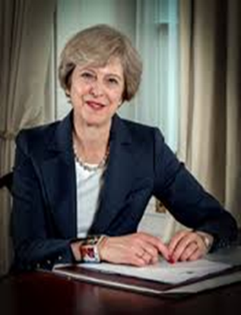
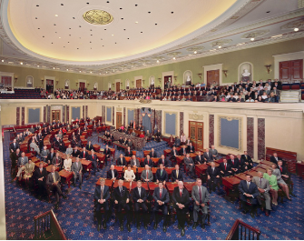
Parliamentary Democracy
  Democratic form of government where the political party with the greatest representation in the parliament (legislature) forms the government. Its leader becomes executive leader.
Citizens vote for Parliament
Parliament chooses Prime Minister
Prime Minister
Theresa May
Parliament

Slide 5
Parliamentary Democracy
Is a Representative Democracy (the __________ for __________ who do our voting for us)
Has a constitution (written set of _________)
Answers to the people (people have the ______)
____ political party (the executive leader and the legislature are from the _______ _______ party)
The _________ Leader is from the majority party
Executive leader (_____ called a____________), is selected by the legislature, ____ by the people
The citizens vote ________ (for the legislature)
Executive
Select
Legislative
Elect
Citizens

