Slide 1
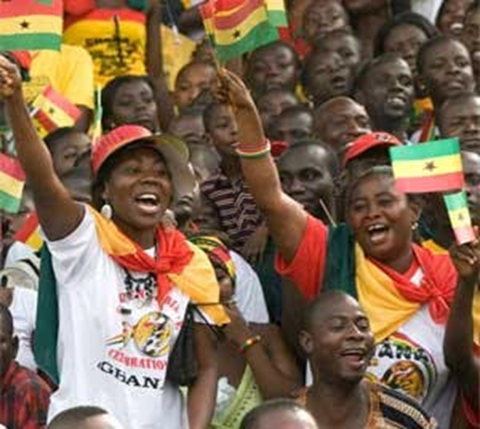
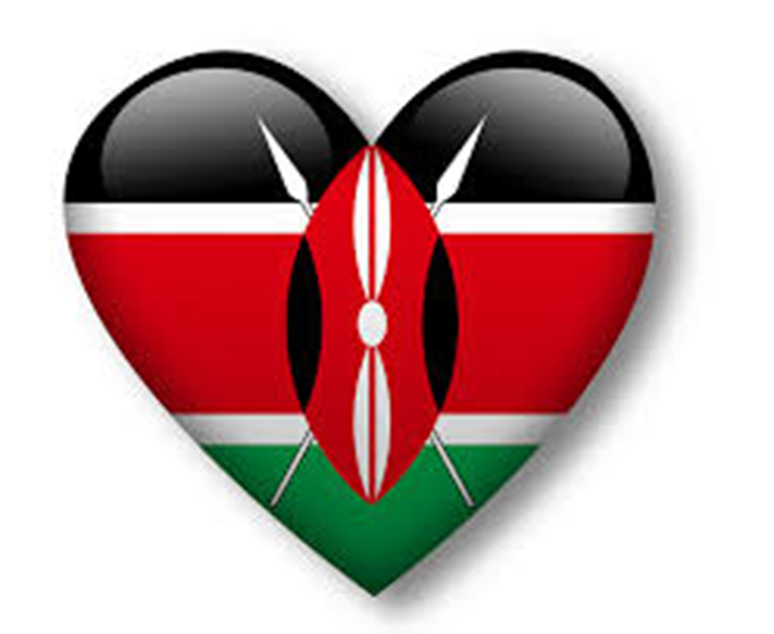
Define in your own words
Image/ Illustration
Define in your own words
Image/
Illustration
Actions taken to be free from
foreign control.
a strong sense of pride in one's nation, so
much so, that you want self rule.
Independence
Movement
Nationalism
Synonyms/ Antonyms
Synonyms/
Antonyms
Sentence
Sentence

Slide 2
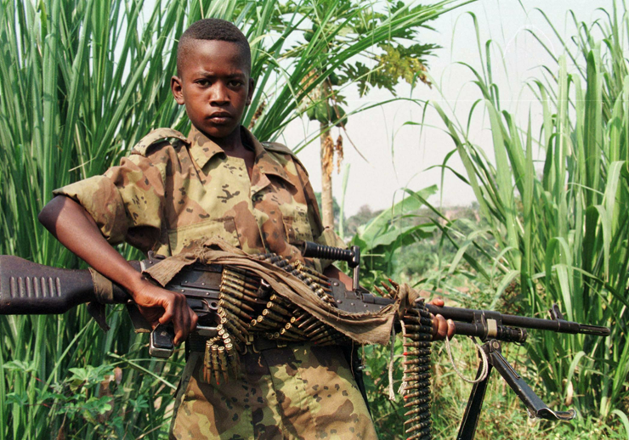
Define in your own words
Image/ Illustration
Define in your own words
Image/
Illustration
Fighting within a county.
Geographic spreading of
Africans around the world.
Civil War
Diaspora
Synonyms/ Antonyms
Synonyms/
Antonyms
Sentence
Sentence

Slide 3
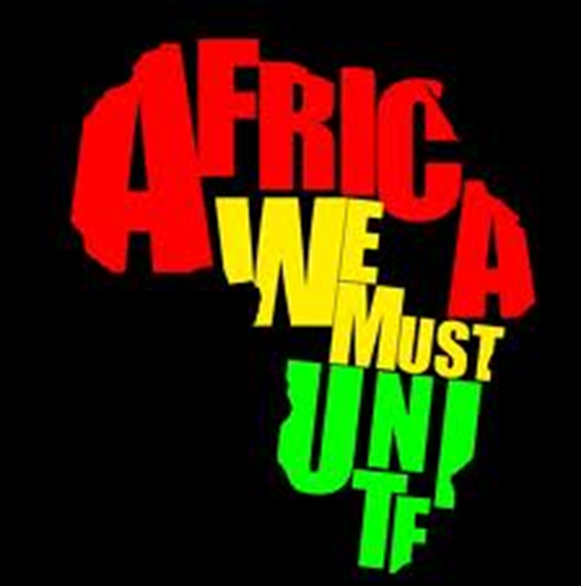
Define in your own words
Image/ Illustration
Define in your own words
Image/
Illustration
movement which began in the 1920's that emphasized the unity and strength of Africans on the main continent and people of African descent around the world.
Pan- African
Movement
Synonyms/ Antonyms
Synonyms/
Antonyms
Sentence
Sentence

