Slide 1
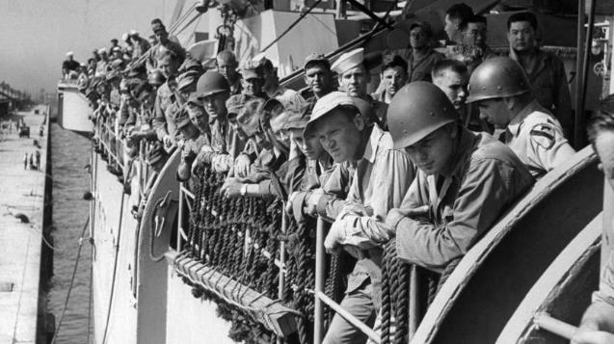
The Korean War
Understanding the Causes & Outcomes

Slide 2
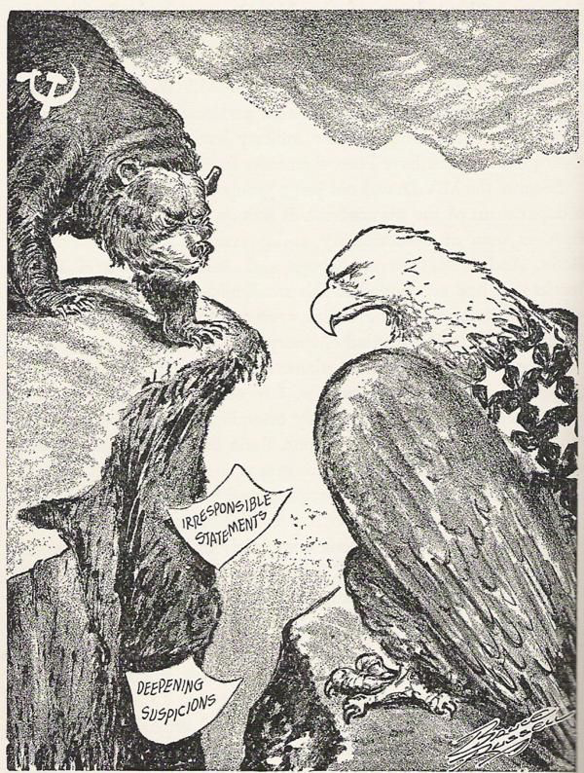
What do you see?
What do you think?
What do you wonder?

Slide 3
Korean War BrainPop
Click to start

Slide 4
The Korean War was the first major conflict during the Cold War.
Following World War II, two countries, the United States and the Soviet Union, vied to be the leading superpower.
The United States promoted capitalism – a system based on individual liberty, private business, and entrepreneurship. The Soviet Union promoted communism – a system based on government control of business.

Slide 5
Background
However, no physical war was ever fought between the United States and the Soviet Union; the Cold War was a war of ideologies, over whose system was the better one, and it emerged immediately after WWII.
This does not mean the Cold War was peaceful; several proxy wars were fought where the United States and the Soviet Union stood in the shadows and secretly aided those who did fight.
Proxy war: a conflict between two countries where neither directly engages the other.

Slide 6
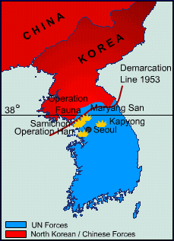
Background
The first of these proxy wars was the Korean War. North Korea (communists) invaded South Korea (capitalists) and the United States went to war to help the South Koreans and to stop the spread of communism.

Slide 7
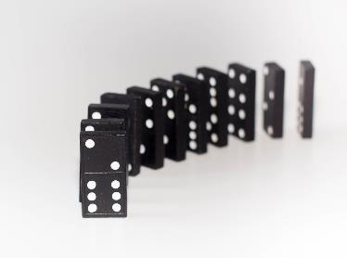
Why get involved in Korea?
1.) The Domino Theory

Slide 8
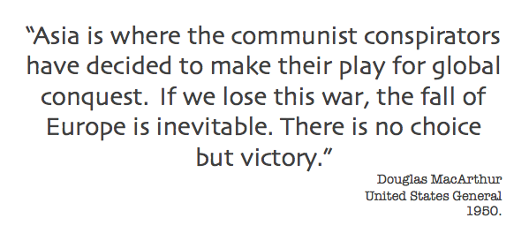
In your own words, summarize what General MacArthur and President Truman are saying…

Slide 9
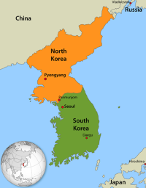
What caused the Korean War?
The northern part of Korea was given to the Soviet Union to manage.
Prior to the end of World War II, Korea was part of Japan’s empire. As terms of Japan and Germany’s surrender, both agreed to cede certain territories that
would be split
among the West
(United States, France, UK)
and East (Soviet Union). The
Germans lost control of Berlin
while Japan lost control of
Korea.
In August 1945, Korea was divided along the 38th parallel
The US manages the southern part of Korea.

Slide 10
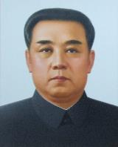
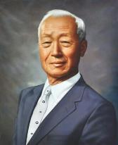
What caused the Korean War?
As expected (thanks to the Soviets), Communism took hold in North Korea while. . .
The Communist dictator, Kim Il Sung, was loved and well supported by the Soviets.
the United States supported Capitalism in South Korea.
The US supported Syngman Rhee to lead South Korea, despite his ineffectiveness
Rhee acted like an authoritarian, frequently provoked the North Koreans, and did little to help the war-torn South Koreans. So, why did the US stay with him? He was an ardent anti-Communist!
This Photo by Unknown Author is licensed under CC BY-SA

Slide 11
What caused the Korean War?
And then, on June 25, 1950, North Korean forces invaded South Korea…
Border skirmishes were common along the 38th parallel before war was official -- as many as 10,000 soldiers were killed prior to 1950.
US President Harry Truman quickly dispatched air, land, and sea forces to aid the South Koreans. The war had started.

Slide 12
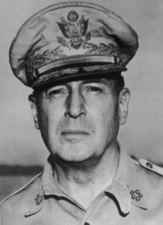
What were the major events of the war?
MacArthur bragged, “We’ll be home by Christmas.”
North Korea invaded on June 25, 1950; by September, they had control of 95% of the peninsula.
The United States responded by sending over 260,000 soldiers (plus an additional 40,000 UN soldiers) led by Douglas MacArthur.
By November 1950, South Korea (and the US) had reclaimed all of the South plus most of the North!

Slide 13
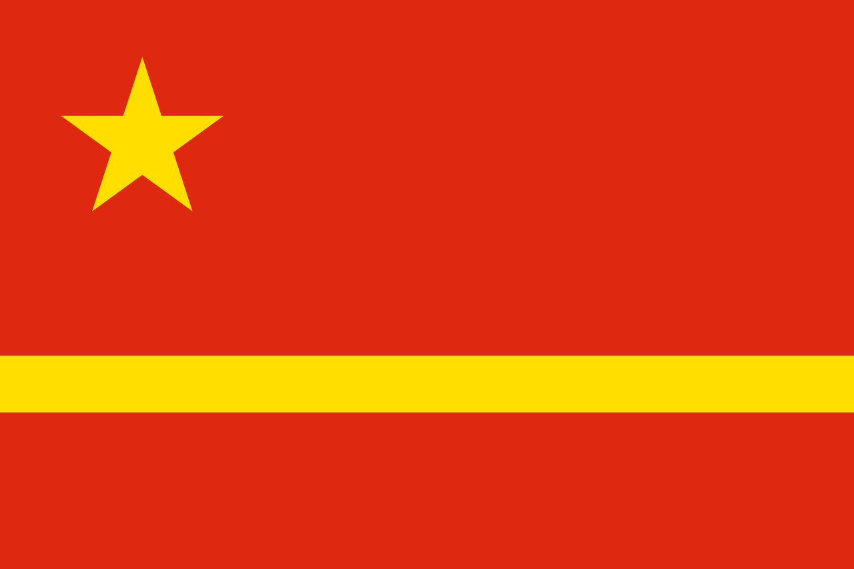
What were the major events of the war?
the Chinese and North Korean soldiers are supplied weapons from Russia.
“There is no substitute for victory against Communism.”
In late November 1950, 200,000 Chinese troops march on South Korea and…
By early 1951, 500,000 more Chinese soldiers enter the war and push US back.
MacArthur reclaims land to the 38th parallel and wants to go further, even to declare war on China. This is worrisome since Truman does not wish to escalate war with China.
MacArthur is fired, the war reaches a stalemate, and peace talks begin in July 1951.

Slide 14
What was the outcome?
The 38th parallel was reinstated, and both North and South Korea agreed to respect the boundary.
North Korea remained Communist (like before the war)…
… and South Korea remained Capitalist (like before the war)…
In 1953, the United States and North Korea signed a cease-fire that ended the Korean War.
… and 55,000 American troops died in the process!
So why fight? The US government believed the war was necessary to prevent World War III, which was inevitable if Communism was permitted to spread.

Slide 15
What was the war like?
Over 100F degrees in summer!
Constant rain, mud, and heavy downpours …
Many lost fingers, toes, hands, and feet to frostbite…
Temperatures as low as -40F degrees!
Freezing winters with heavy snow…
Constant trekking of hills, mountains!

Slide 16
How did the American people respond to war?
They did not like it. Period.
Americans were used to winning (after WWII), and Korea ended the same as it was before the war started. Was it a “win?”
The goal was never to have a total defeat, like in WWII. The goal was simply to protect South Korea. This was new, and begged the question “Was it worth it?”

Slide 17
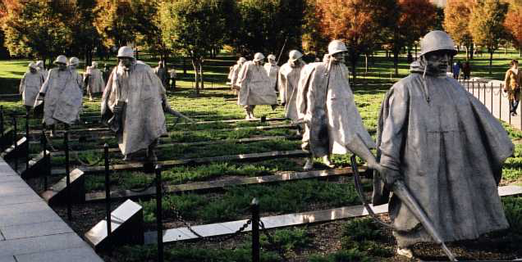
How is the war remembered today?
The Korean War Memorial, located in Washington D.C., was dedicated in 1995 to honor the 5.8 million Americans who served.
The troops are wearing ponchos to show the miserable weather conditions…
19 soldiers, each roughly 7-feet-tall, represent the diverse ethnic makeup of the soldiers who gave their lives.
14 are from the Army, 3 Marines, 1 each from the Navy and Air Force!

Slide 18
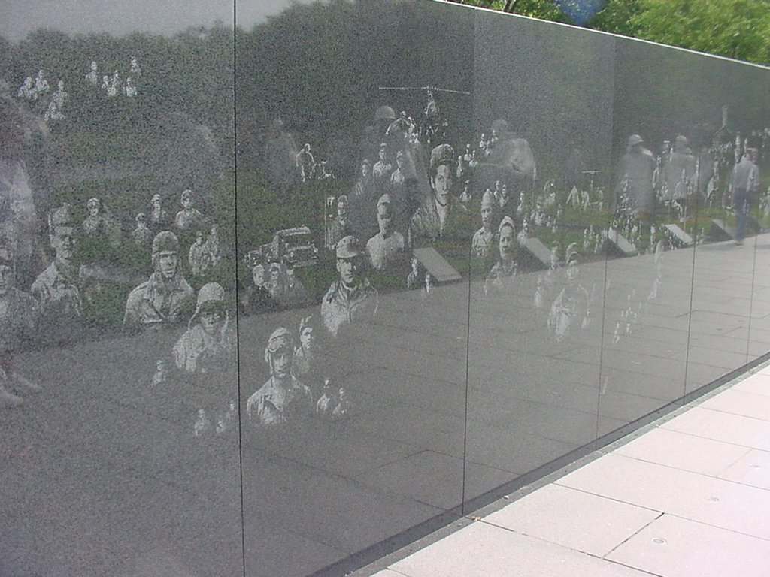
How is the war remembered today?
There are more! The mural goes for quite a bit further...
If you look closely, you can see the reflection of the 19 soldier statues…
This is symbolic because…
The 19 soldier statues + the 19 relfections = 38
The bondary between North and South Korea was established at the 38th parallel.
On the side of the memorial is a mural where pictures taken from the war were etched into marble. The mural honors the service personnel who supported the soldiers (nurses, surgeons, etc).

Slide 19
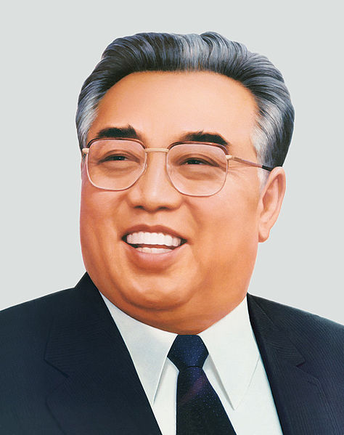
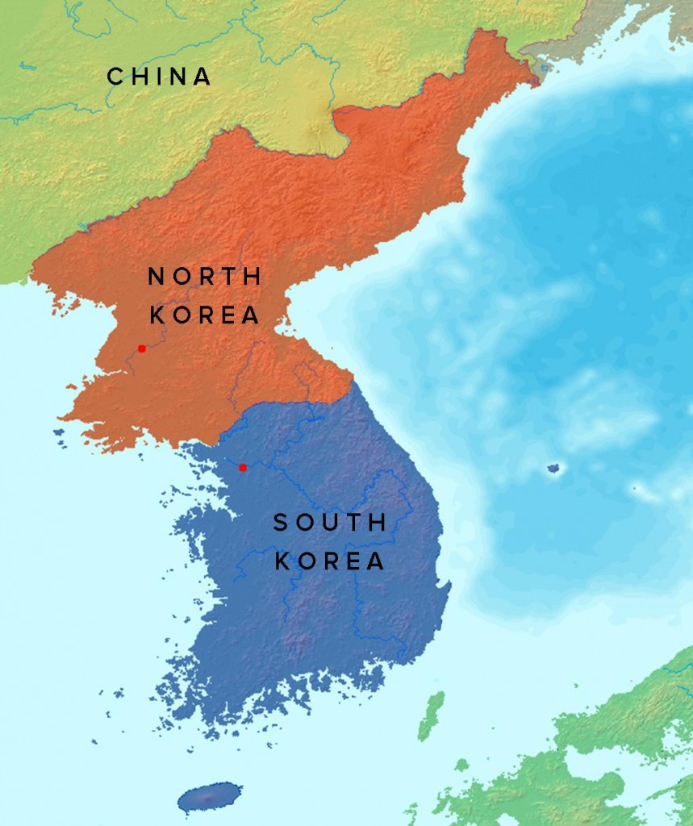
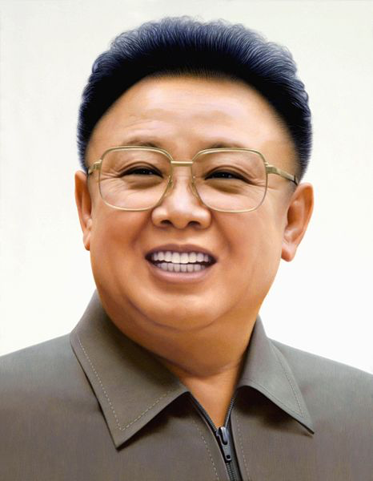
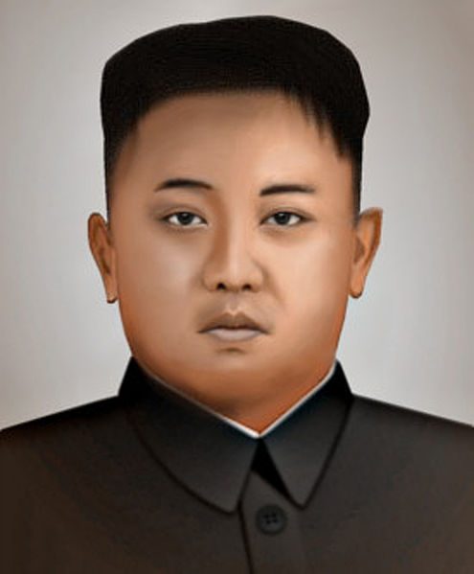
What is Korea like today?
North Korea is still Communist and has few international friends (Russia and Bulgaria).
There are no elections and one family has had complete control since the country was split following WWII.
Kim Il Sung
(1948-1994)
China is still considered a “friend” but in 2015 North Korea angered the Chinese with their nuclear program.
Son
Despite calling themselves the “Democratic People’s Republic of Korea,” they are anything but that!
North Korea operates more like a Communist Totalitarian state.
Kim Jong-Il
(1994-2011)
We still have troops stationed in South Korea along the 155.3 mile long DMZ Zone (Demilitarized Zone)
Son
Kim Jong-un
(2011-)

Slide 20
What is Korea like today?
Elections are similar to other democratic countries; local elections take place every 4 years and presidential elections every 5.
South Korea has maintained Capitalism since WWII. It has grown from one of the poorest to one of the wealthiest countries in the world.
Unlike in North Korea, in South Korea…
Citizens do not need permission to leave the country
Foreign tourists are free to visit
People have access to information via the internet
Major tech companies such as Samsung and LG, as well as auto giants Hyundai and Kia Motors are headquartered here.

Slide 21
Korean War Map Activity
Create a map of Korea during the war…
Create a Color code in your Key…
Color the Map so you can Identify locations
1. Label the physical features and cities…
2. Label the Countries and their borders…
3. Name Battles and dates they were fought
4. Answer the Questions about the war

