Slide 1
How is Economic Growth Measured?
Economic growth in a country is measured by the country’s Gross Domestic Product (GDP) in one year.
GDP= the total amount of goods and services produced in one year within a country.
For Example:
United States GDP $19.49 Trillion (2017)= $19,490,000,000,000.00
Israel GDP $350.7 Billion (2017)= $350,700,000,000.00

Slide 2
Gross Domestic Product
GDP is the total value of all the goods and services produced in that county in one year
Tells how rich or poor a country is
Shows if the country’s economy is getting better or worse
Raising the GDP of a country can improve the country’s standard of living.
For Example:
United States GDP $19.49 Trillion (2017)= $19,490,000,000,000.00 (2)
Israel GDP $317.1 Billion (2017)= $317,100,000,000.00 (54)
Afghanistan GDP $69.45 Billion (2017) $69,450,000,000.00 (101)

Slide 3
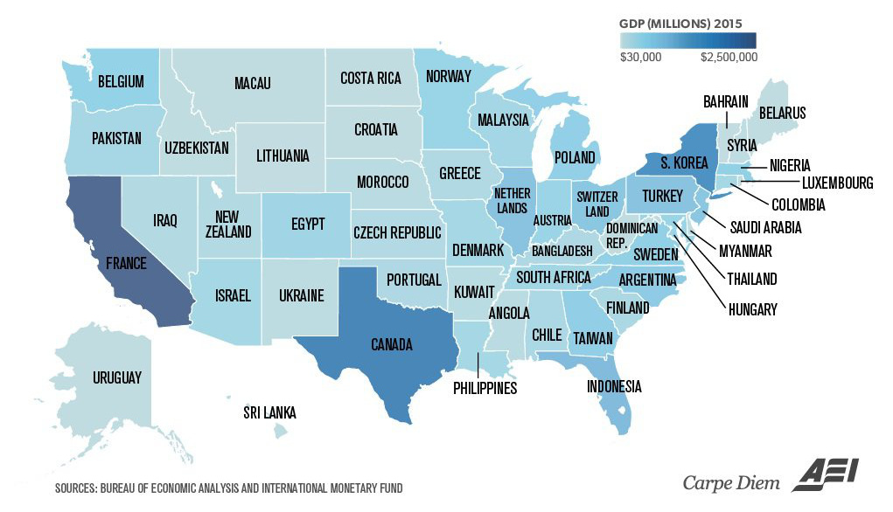
U.S. States Renamed for countries with Similar GDPs

Slide 4
Investing in Human Capital and GDP
Raising the GDP of a country can mean a higher standard of living for the country’s people. To increase the GDP, countries must invest in human capital. Investing in human capital includes:
Education, training, skills, and healthcare of the workers.
A country’s literacy rate (the percent of the population over 15 that can read and write) impacts GDP.
Investing in human capital helps to increase the GDP of a country and improve the standard of living for all.

Slide 5
Investing in Capital Goods and GDP
To increase the GDP, countries must also invest in capital goods. Capital Goods are the factories, machines, technologies, buildings, and property needed for a business to operate. If a business is to be successful, it cannot let its equipment break down or allow its buildings to fall apart.
The more capital goods a country has=
The more goods they are able to produce=
The more money they will make!

