Slide 1
Government Stability & Standard of living
Public Service Announcement Assignment

Slide 2
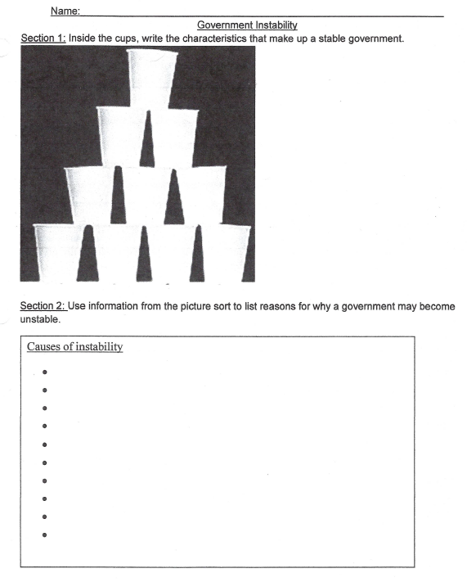
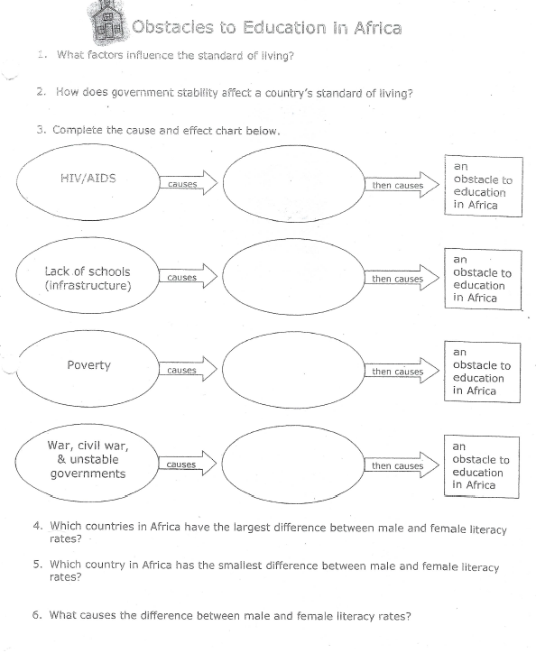
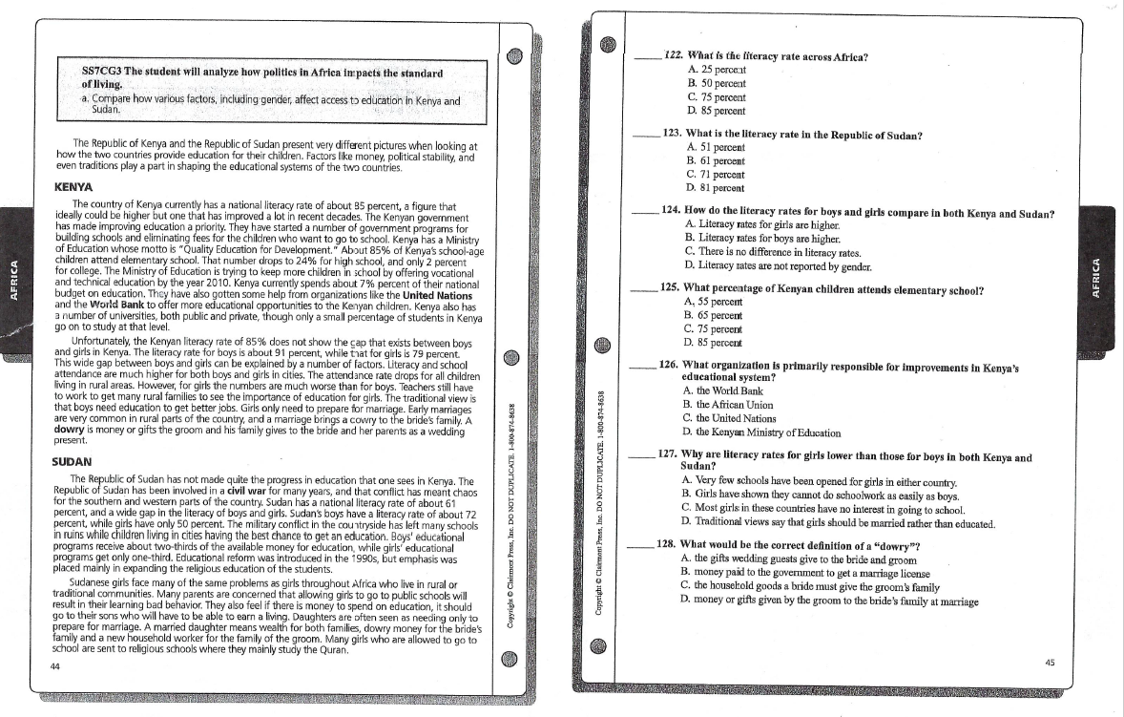
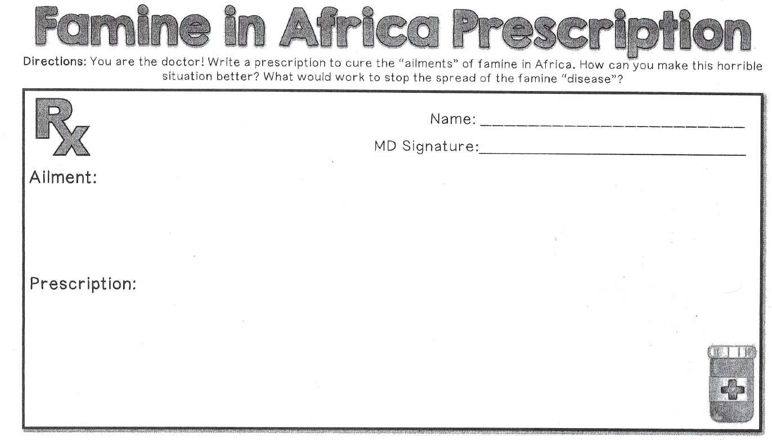
Make sure you have the following notes:
2. Government Instability Notes
4. Obstacles to Education
1. Reading & Questions:
3. Famine Notes

Slide 3
Review: What is Government instability?
Instability is when a government does not have the money, time, or focus to invest in its people. It can produce disastrous results.
The next slides show how unstable governments can become overwhelmed by different scenarios

Slide 4
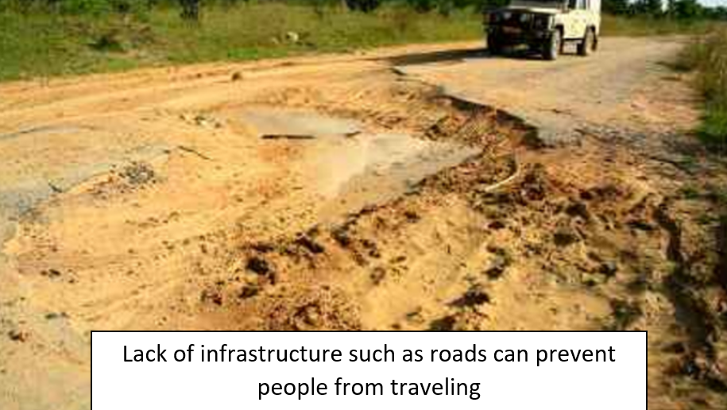

Slide 5
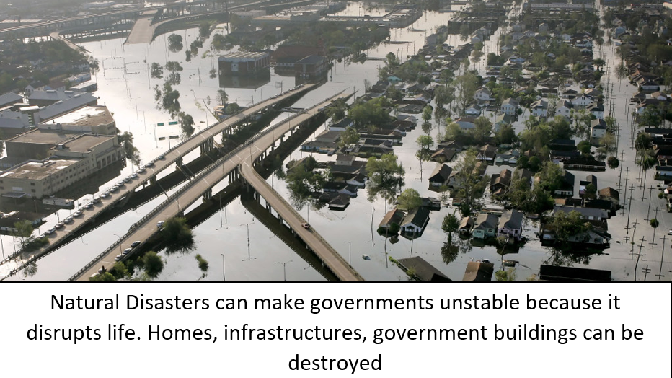

Slide 6
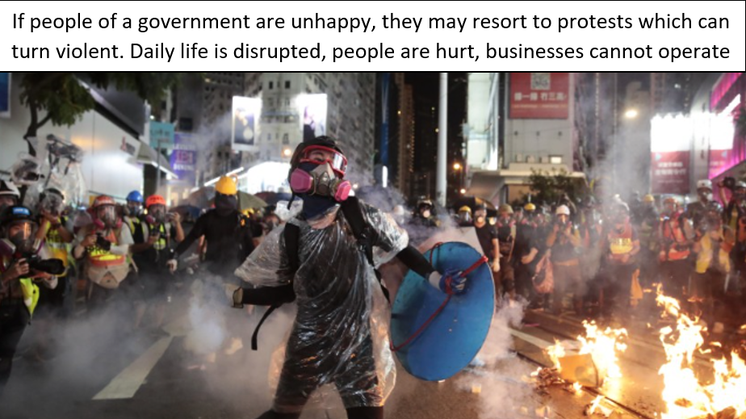

Slide 7
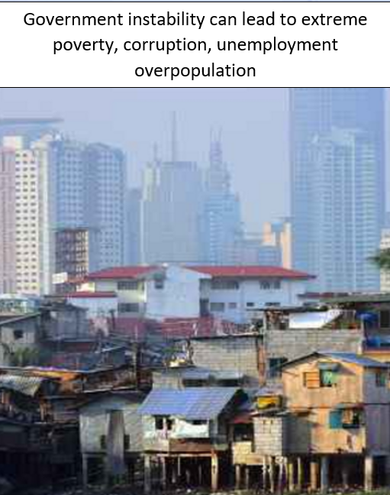

Slide 8
Review: What is Standard of living?
A standard of living is the level of wealth, comfort, material goods, and necessities available to people.
The standard of living is closely related to quality of life, which can also include factors such as economic and political stability, political and religious freedom, environmental quality, climate, and safety.

Slide 9
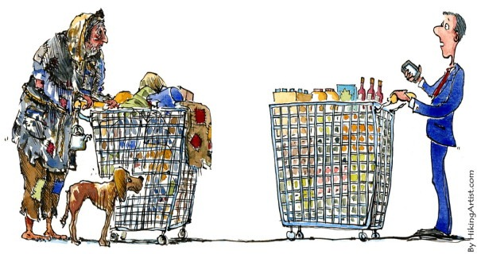
ILLUSTRATION OF LOW STANDARD OF LIVING VERSUS HIGH STANDARD OF LIVING

Slide 10
In other words….
Stable governments = higher standard of living ☺
Unstable governments = lower standard of living ☹

Slide 11
Review: What makes government unstable?
Famine- not enough food which leads to mass starvation
Epidemics- widespread diseases such as HIV/AIDS virus can prevent people from working, orphans children, and can lead to death.
Lack of Education- low literacy rates lead to lower GDP which can lead to poverty (no money).
War / Conflict- daily life is disrupted, people must flee from homes as refugees or fight.

Slide 12
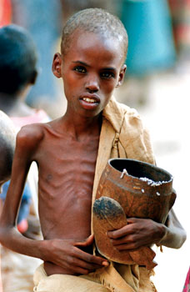
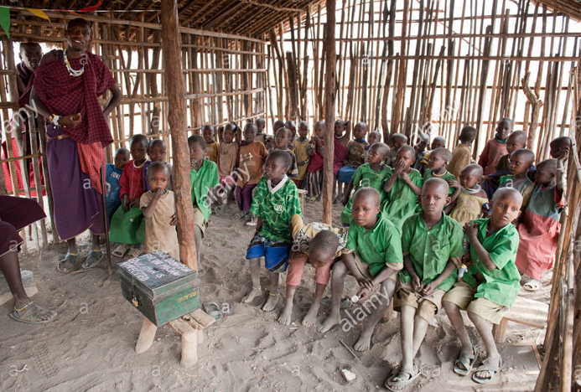
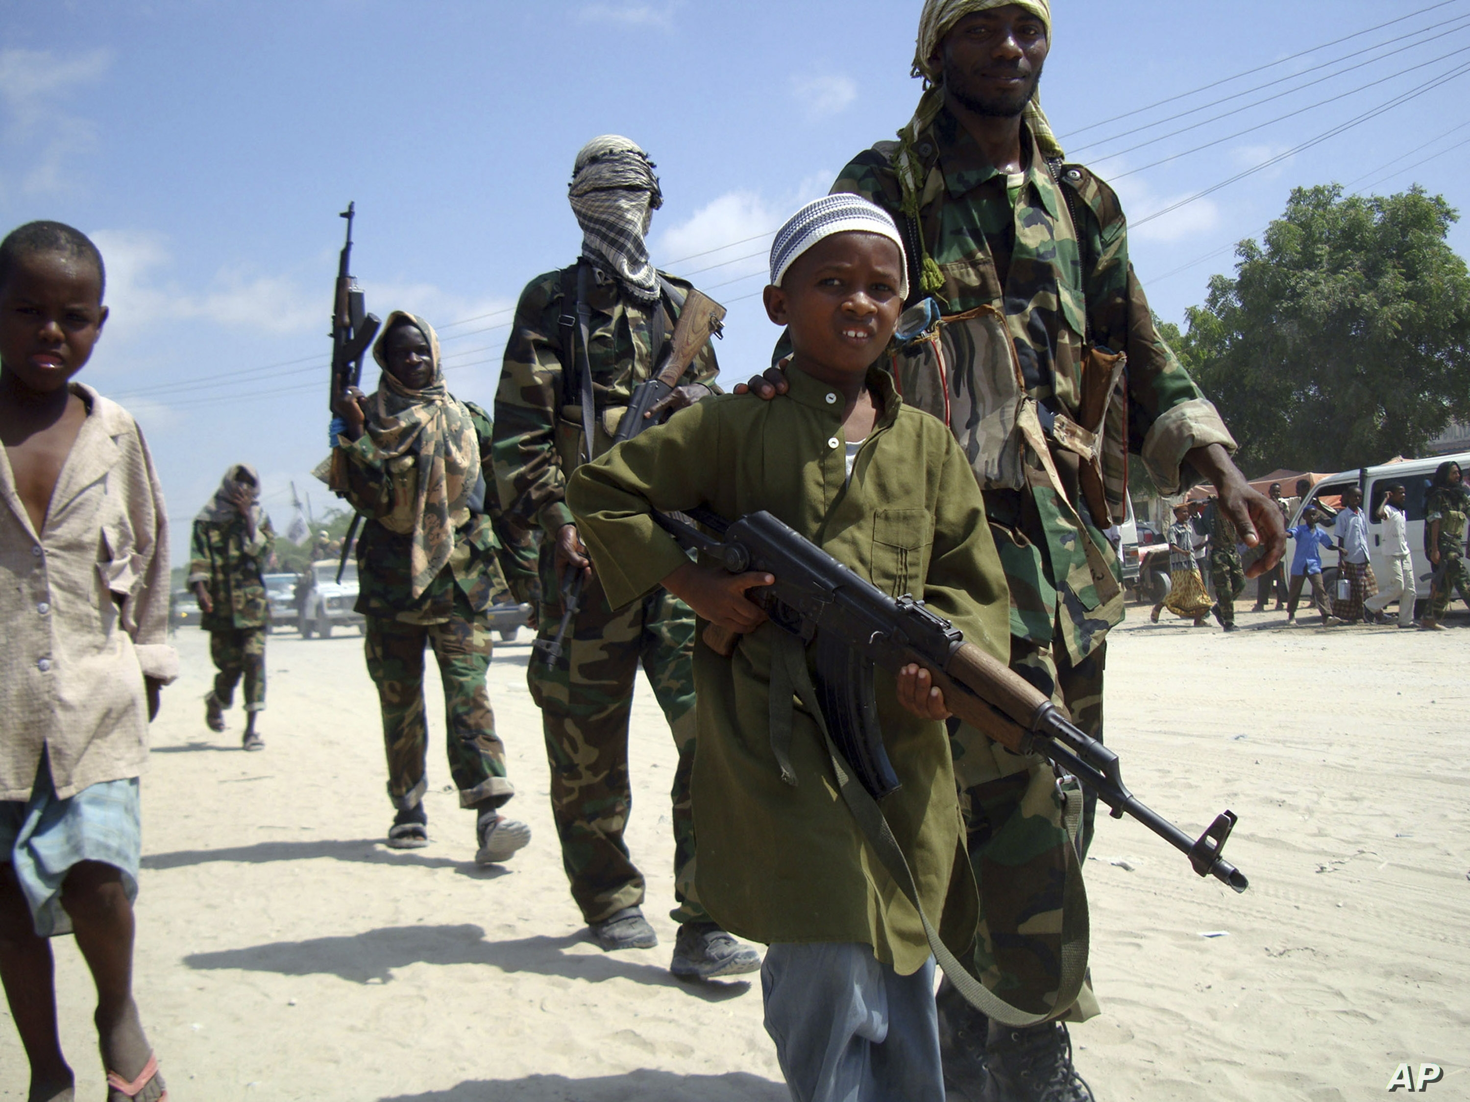
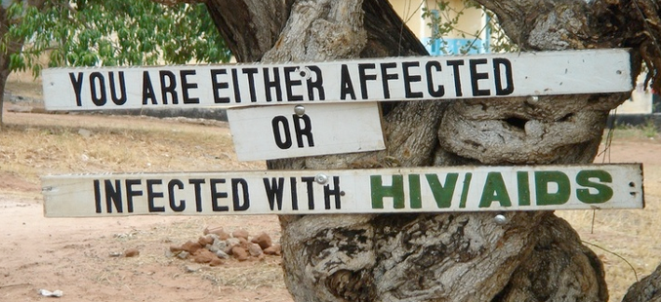
Visual Examples
of Famine, War,
lack of infrastructure / schools, and HIV/AIDS

Slide 13
Your task
Using the laptops, you will create a Public Service Announcement based on one of the reasons why governments can become unstable. A public service announcement is a message that raises awareness and aims to change public attitudes and behavior towards, a social issue.

Slide 14
PSA examples
If time permits, we can take a look at some examples of PSAs
Anti-Smoking
https://youtu.be/5zWB4dLYChM
Anti-Pollution
https://youtu.be/exEUZS6bH3w
Drug addiction – “All American Girl”
https://youtu.be/P-i6PlKdMug

Slide 15
Research: go to the blog and you can find the following websites to assist with your research
Famine:
https://www.sos-usa.org/about-us/where-we-work/africa/hunger-in-africa
https://www.worldvision.org/hunger-news-stories/africa-hunger-famine-facts
https://www.worldhunger.org/africa-hunger-poverty-facts-2018/
https://www.actionagainsthunger.org/africa-hunger-relief-facts-charity-aid
HIV/AIDS:
World Health Organization – HIV/AIDS in Africa
https://www.who.int/hiv/en/
Obstacles to Education:
https://www.globalcitizen.org/en/content/10-barriers-to-education-around-the-world-2/
https://www.habitatforhumanity.org.uk/blog/2017/04/poverty-and-education-east-africa/
https://borgenproject.org/10-facts-about-education-in-africa/
https://valentinammaka.net/facts-about-education-in-africa/

Slide 16
Directions : Create a Powerpoint following the format below
Slide 1: Define government instability in one sentence.
Slide 2: State the problem your group has selected in one complete sentence.
Slide 3: Name a specific country that is affected by the problem. Include a picture of this country on a map.
Slide 4: State why the country is affected by the problem. In other words, how is the standard of living affected by this problem?
Slide 5: Offer statistics (numbers, percentages, data, etc.)
Slide 6: Include at least 3 images of the problem.
Slide 7: State some possible solutions to this problem.
Slide 8: A call to action. Include a statement or a slogan to encourage those to take up action and get involved to help stop the problem.
Slide 9 : Citations. Include websites used. Copy and paste the URLs into the slide

Slide 17
Don’t forget! You will be graded on participation by your peers

Slide 18
Questions????

