Slide 1
Geography Skills Review
You and your partner will be asked to complete a Think-Pair activity where you will attempt to define each of the following Geography Vocabulary terms. During the activity, each of you will be asked to:
Think – Think about each of the vocabulary terms and define each one individually.
Pair – Discuss your definition with a partner to try and make a group definition.

Slide 2
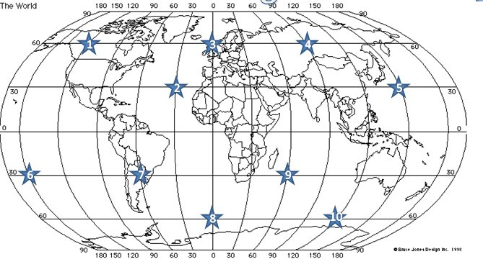
What is Absolute Location?
Definition of Absolute Location – Identifies a place’s exact location when using both latitude and longitude.

Slide 3
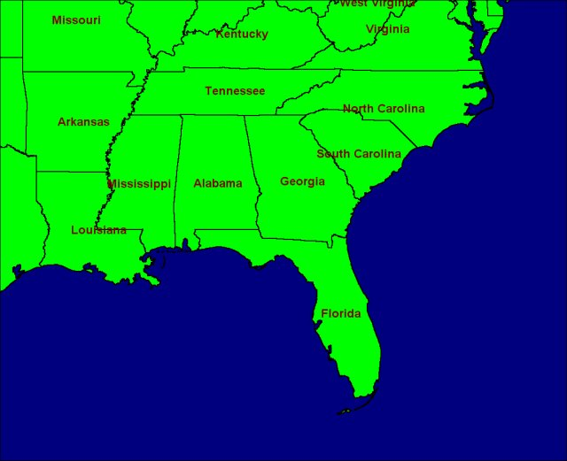
What is Relative Location?
Definition of Relative Location – Gives a place’s estimated location.

Slide 4
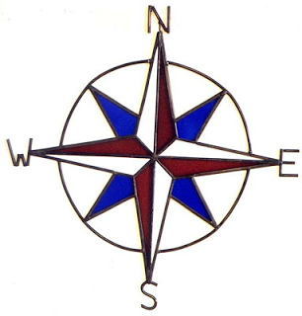
What are Cardinal Directions?
Definition of Cardinal Direction – The four basic points on a compass: north, south, east, and west.

Slide 5
What are Intermediate Directions?
Definition of Intermediate Direction – Fall between cardinal directions; assist in finding a shorter way to destination (northeast, northwest, southeast, and southwest).

Slide 6
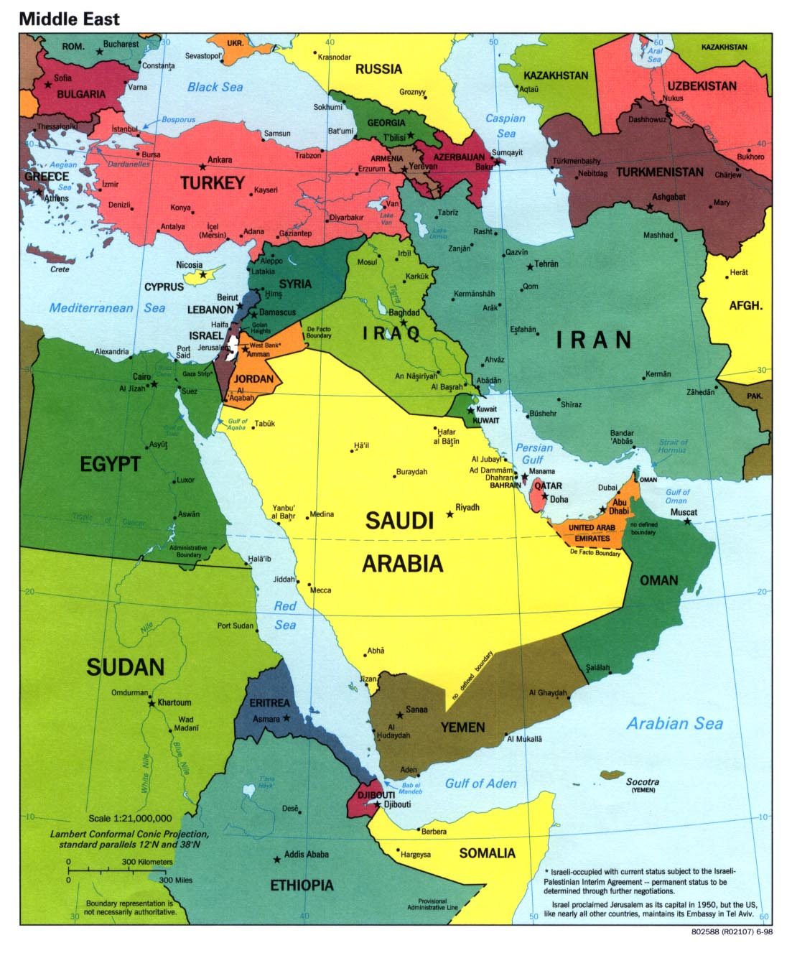
What are Political Maps?
Definition of Political Maps – Maps that contain features such as cities, states, borders, and capitals.

Slide 7
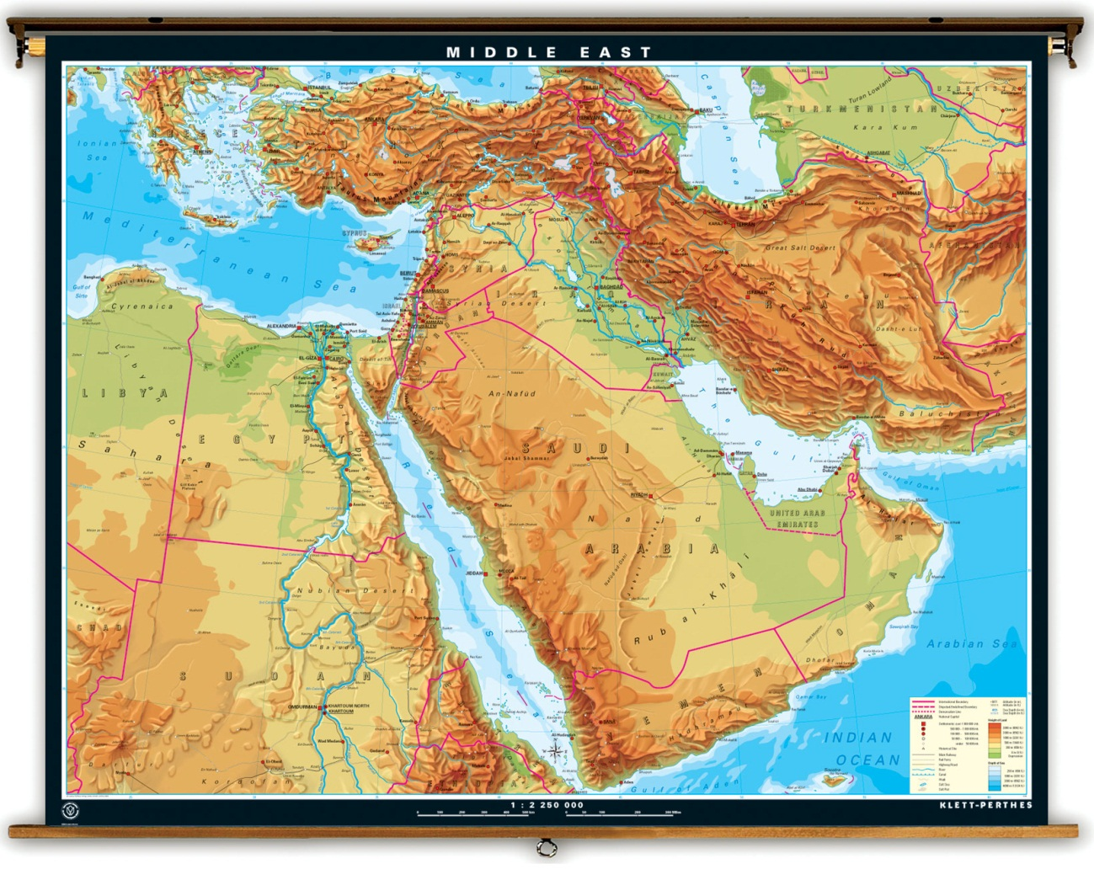
What are Physical Maps?
Definition of Physical Maps – Maps that contain features such as rivers, mountains, deserts, lakes, etc.

Slide 8
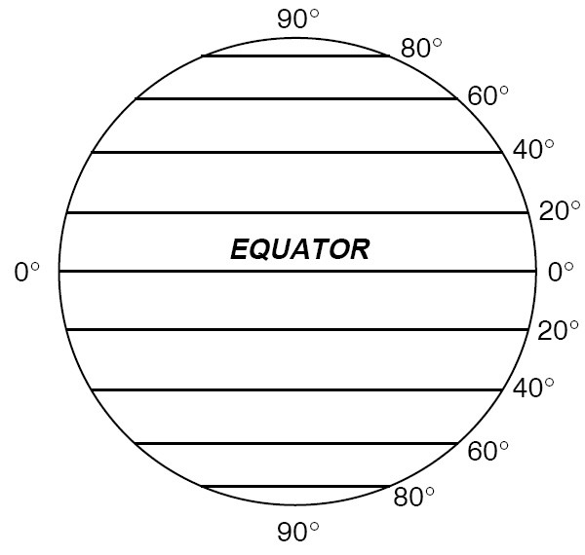
What are Lines of Latitude?
Definition of Lines of Latitude – Imaginary lines/circles that run east to west around a globe, but measure north or south of the equator; also called parallels.

Slide 9
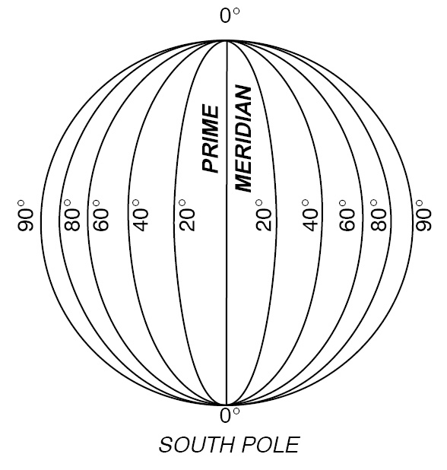
What are Lines of Longitude?
Definition of Lines of Longitude – Imaginary lines/circles that run north to south; tells if a location is east or west of the prime meridian (lines are also called meridians).

Slide 10
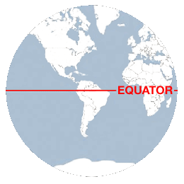
What is the Equator?
Definition of Equator – Imaginary line of latitude at 0 degrees, located halfway between the north and south poles.

Slide 11
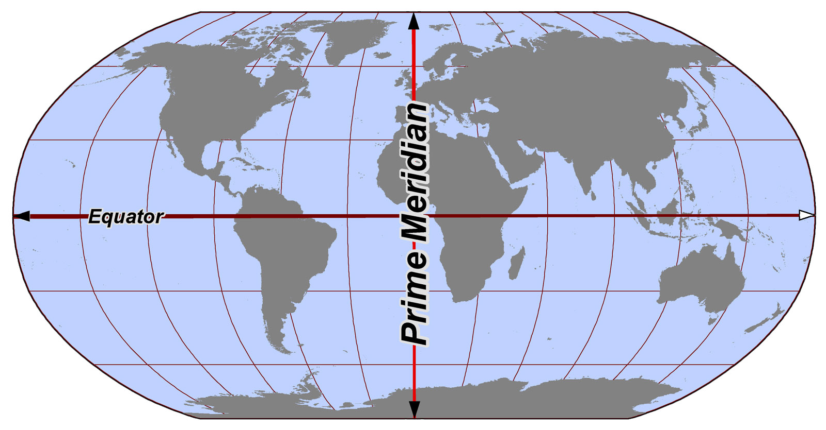
What is the Prime Meridian?
Definition of Prime Meridian – Imaginary line of longitude at 0 degrees that divides the earth into east and west hemispheres.

Slide 12
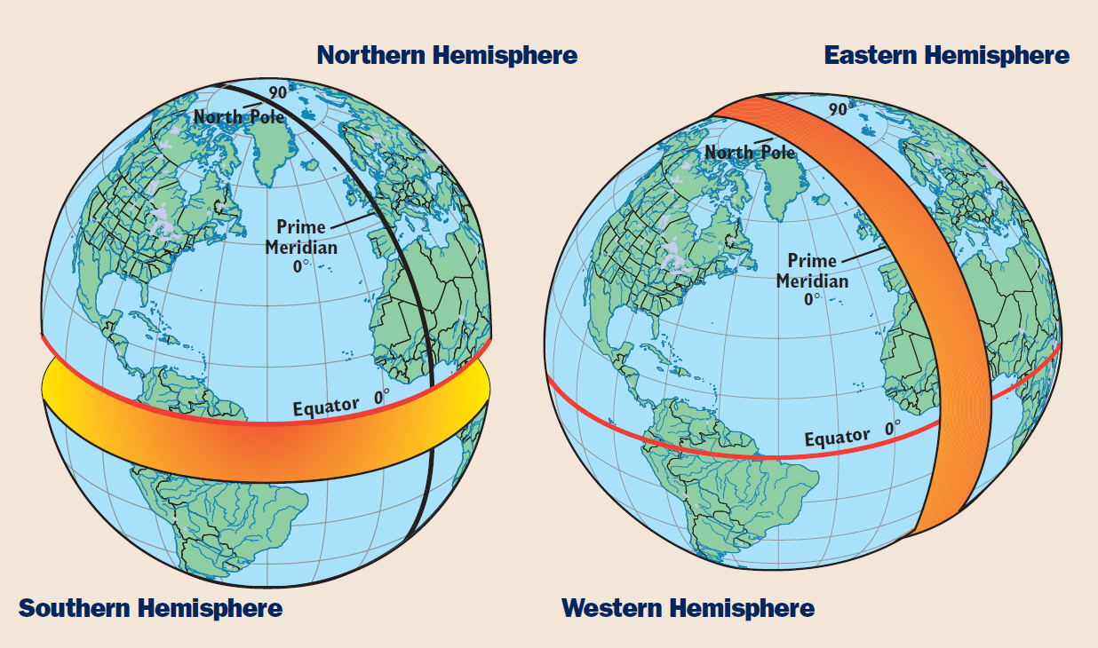
What is a Hemisphere?
Definition of Hemisphere – Half of the earth (hemi means half); the earth is divided into four hemispheres (the equator divides the earth into northern and southern hemispheres; the prime meridian divides the earth into eastern and western hemispheres).

Slide 13
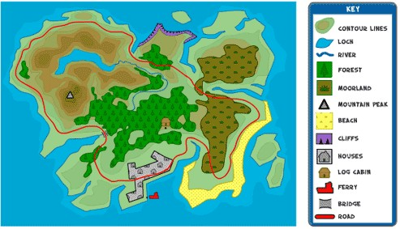
What is a Map’s Key/Legend?
Definition of Key/Legend – Explains the symbols, colors, and lines on a map.

Slide 14
The Parts of a Map
Compass Rose
A compass rose is a model of a compass. It tells the cardinal directions, which are north, south, east, and west.
Scale
The scale on a map tells you the relative distance on the map to the real world. For example, a map’s scale may tell you that one inch on the map equals one mile in the real world.

Slide 15
Key
The key, or legend, on a map explains what the symbols on a map represent, such as triangles representing trees.
Grids
Some maps use a grid of parallels and meridians. On a map of a small area, letters and numbers are often used to help you find your location.

Slide 16
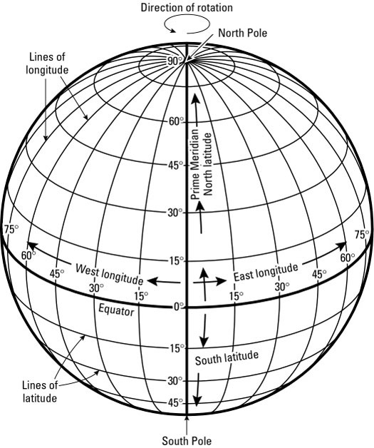
How Latitude and Longitude Form the Global Grid
Parallels of Latitude
Meridians of Longitude
Global Grid

