Slide 1
FAMINE
In Africa

Slide 2
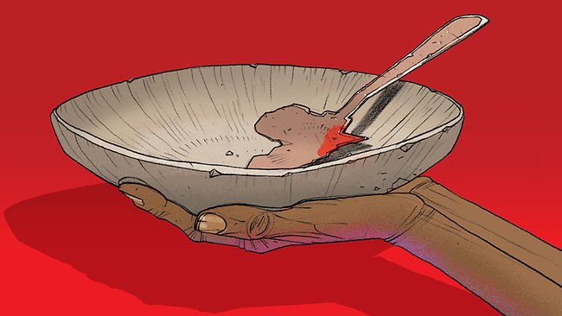

Slide 3
Famine in Africa
Along with AIDS, famine is one of Africa’s biggest problems.
Famine occurs when a region does not have enough food for a long period of time.
People who are starving can die from malnutrition.
Famines are both human-made and natural.

Slide 4
Famine in Africa….

Slide 5
Climate and Famine…?
Many African countries face drought because of climate changes.
Repeated drought has plagued Africa since the 1970s.
Soil infertility and erosion have decreased the amount of crops grown.

Slide 6
Government Stability in Africa
The stability of a country’s government directly impacts the country’s ability to provide enough food to prevent famine.
Civil wars interrupt daily life for most people, including farmers, which causes food shortages.
Some governments have built armies instead of investing in food for their people.
Other governments have used food as a weapon by denying food shipments to political enemies.

