Slide 1
Essential Question: What factors encourage and/or hinder voluntary trade?

Slide 2
Use the Factors of Voluntary Trade Graphic Organizer to take notes during this presentation.

Slide 3
Standard(s):
SS7E2a, SS7E6a, SS7E9a Explain how specialization encourages trade between countries. Compare and contrast different types of trade barriers, such as tariffs, quotas, and embargos.
SS7E2b, SS7E6b, SS7E9b Explain why international trade requires a system for exchanging currencies between nations.

Slide 4
Why do we trade?
Countries trade because no country has all of the resources it needs to provide for its people.
Trading is based on a country’s resources (what they have a lot of)
Example: United States buys oil from the Middle East. Other countries may buy things like meat, auto parts, airplanes, etc. from the United States

Slide 5
What are resources?
What are some examples of resources?
What happens when do you not have the resources you need?

Slide 6
We have a global economy because countries trade with others from all over the world.
The global economy makes countries interdependent.
Notes:
Instructional Approach(s): The teacher should present the information on the slide

Slide 7
Voluntary Trade (somewhere on your paper write these terms down)
Voluntary Trade =countries expect to gain from trade.
Interdependent = you must trade with others to survive
Domestic trade = trade within a country
International trade = trade between different countries
Example: Think about how you trade Halloween candy or items from your lunch. You make trades based on your wants or needs.
The “buyer” country receives goods and the “seller” country makes money.

Slide 8
What helps trade?
Currency = money
Exchange rates –the value of one’s currency in terms of another’s currency.
Example: The United States uses dollars as currency. If you travel outside the country, you need to exchange dollars for that country’s currency.
The US: dollars Japan: yen
Mexico: pesos
European Union: euros
Countries can get what they need at the lowest cost
Without this, it would be difficult to do international trade (trading with countries around the world)

Slide 9
What helps / hinders trade?
Specialization uses limited resources to focus on industries
Example: Saudi Arabia specializes in oil
If countries focus most of their efforts into one industry, they will not have a lot of workers trained for other jobs
Example: Oil-rich countries know that oil will run out one day. Therefore, they must create other industries like tourism (as seen in the city of Dubai)

Slide 10
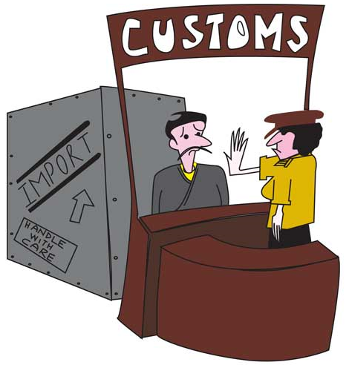
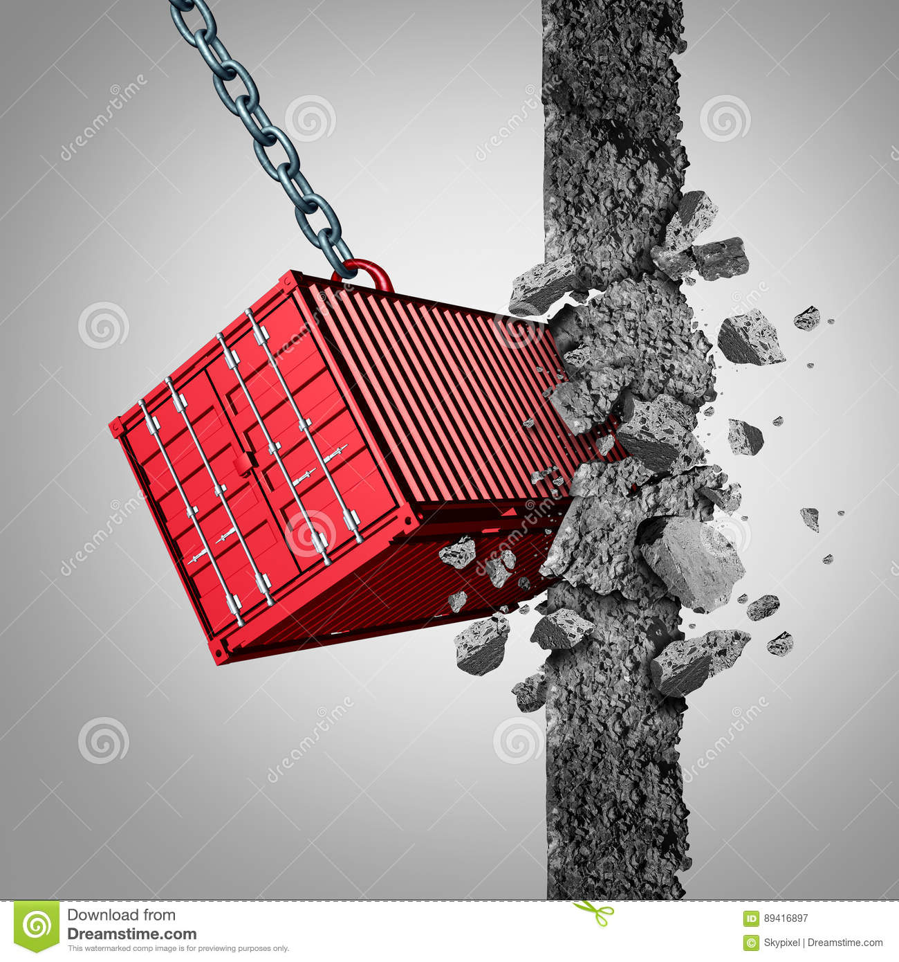
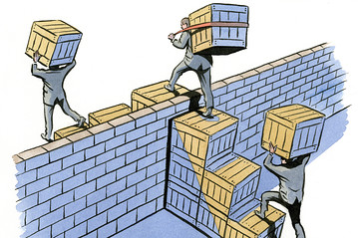
Trade barriers hinder trade
Trade Barriers = restrictions that make it difficult to trade

Slide 11
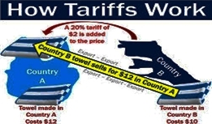
Trade barrier: tariff
Tariffs are taxes placed on imported goods.
Tariffs cause the consumer to pay a higher price for an imported item, increasing the demand for a lower-priced item produced domestically.

Slide 12
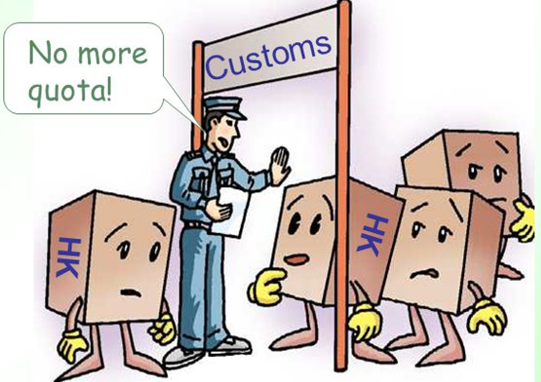
Trade Barrier: Quotas
Quotas are limits on the amount of a good that can be imported into a country.
Quotas can cause shortages that cause prices to rise.

Slide 13
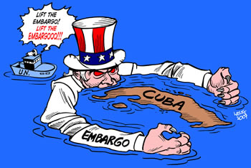
Trade Barrier: Embargoes
Embargoes forbid trade with another country.
Usually happen for political reasons. Because the U.S. does not want to support countries that may support terrorism, it has used embargoes against Iran, Iraq, and Syria.

Slide 14
Trading game activity
You will divide into groups of 3 based on your tables (group 1 is the closest to the window, group 2 is in the middle, group 3 is closest to the exit)
Pick one person to be the “banker” (you may use calculator on phone)
Everyone will receive a “gift certificate”
Chances are, you may not like what you received and THAT’S OK! Hold on to it for now (you will trade it later) DO NOT PASS OUT “FAVORITES” TO FRIENDS! DO NOT TRADE UNTIL I SAY SO!!!!!
Rate your gift certificate on a scale of 1-10 depending on how much you personally value it (1 being lowest, 10 being the best)

Slide 15
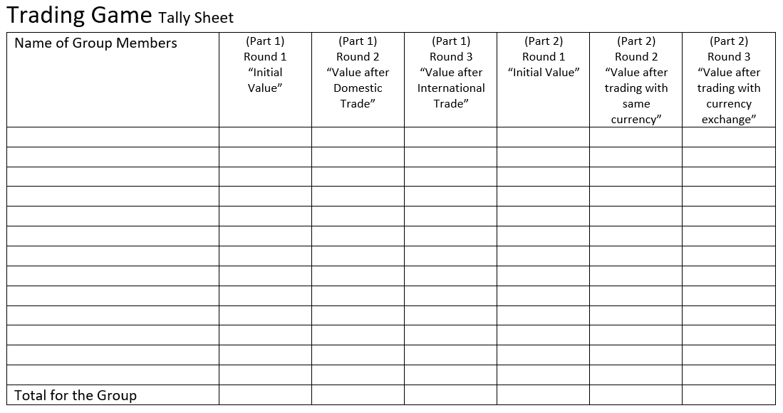
Tell the “banker” of your group what value you gave your gift certificate (1-10)
Write down your group members names (or initials) in this column
The value you gave your first card (1-10)
The value you gave your first card (1-10)
After you trade with different colors
After you trade within your color group

Slide 16
Trade part 1
Round 1- rate your gift certificate
Round II- trade with people in your group (who share your color) rate your new gift certificate
Round III- trade with people all over the classroom (color doesn’t matter)
Note what happens to the total after each round

Slide 17
Write down your group members names (or initials) in this column
The value you gave your first card (1-10)
The value you gave your first card (1-10)
After you trade with different colors
After you trade within your color group
Example: John Doe or J.D
What do you notice about the totals after each round?

Slide 18
Trading part II
Round 1- rate your gift certificate
Round II- trade with people in your group (who share your currency) rate your new gift certificate
Round III- trade with people all over the classroom (color currency doesn’t matter)
Note what happens to the total after each round

Slide 19
Summarize:
In the Trading Game, you participated in Voluntary Trade.
Overall, most of you were happy (or happier) with your end result because you got what you wanted based on your wants.
The total amount increased after each round
Our global economy is successful because of Voluntary Trade

Slide 20
Think about it:
Describe a time when you exchanged a good for another good.
Identify a hobby, sport, subject, etc. in which you could specialize. Explain why.
Identify something in your life in which you would be willing to pay a tariff. Explain why.
Identify something in your life in which your parent or teacher might place a quota. Explain why.
Identify something in your life in which your parent or teacher might place an embargo. Explain why.

Slide 21
Review: trade

Slide 22
Review: currency

Slide 23
Ticket out the door:

