Slide 1
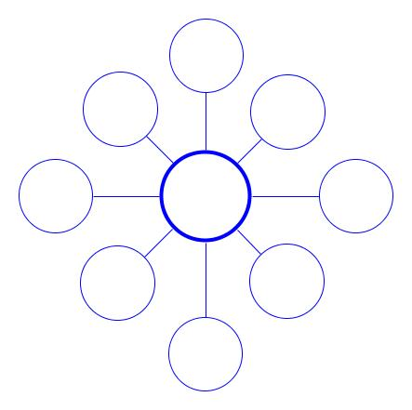
Economics Simulation Activity Factory work in different countries around the world yields different results. This activity allows you to experience how different Economic Systems affect workers and their ability to work and live (produce). Students: At certain points in the lesson; you will Record your reactions to each phase of the activity on a Bubble map on these pages. We will discuss all of these at the end as a class.
Traditional

Slide 2
Command
Market

