Slide 1



Why was Israel created as a
Jewish state in 1948?
Overview: Of the modern world conflicts, few, if any, have lasted as long as the fight between the Palestinians and Israelis. This conflict has its origins in the creation of Israel as a Jewish state in 1948. Since Israel’s formation, the Jewish Israelis and Arab Muslim Palestinians have fought over who should control the country. The focus of this DBQ is on why such a controversial Jewish state was allowed to form in the first place.
Israelis (Jewish)
Palestinians (Muslim & Arab)

Slide 2
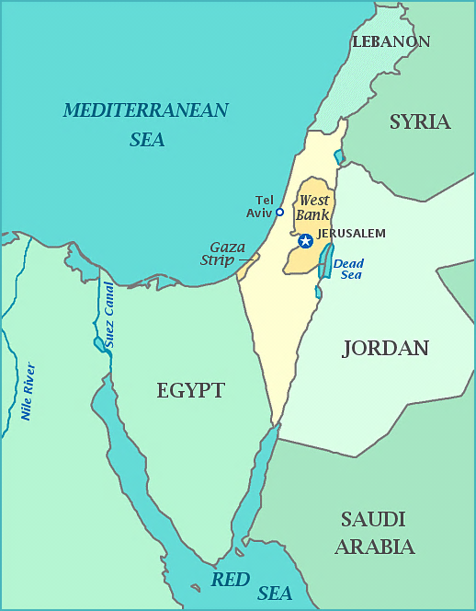
Why was Israel created as a
Jewish state in 1948?
Background Essay

Slide 3
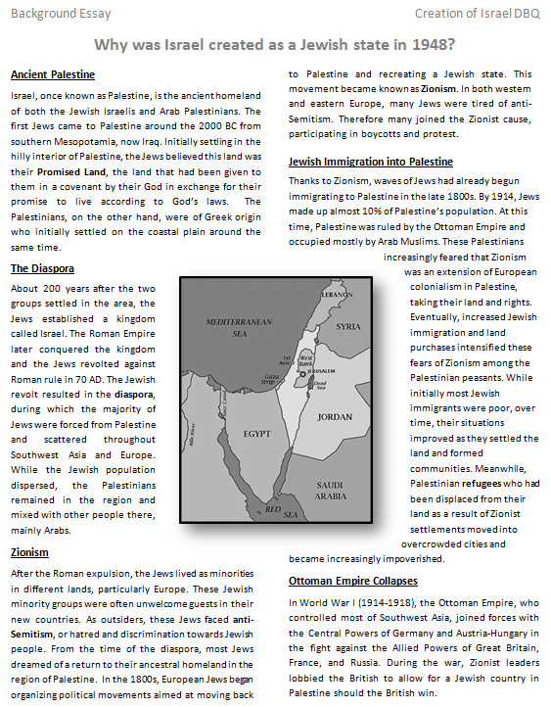
1
2
5
12
3
4
6

Slide 4
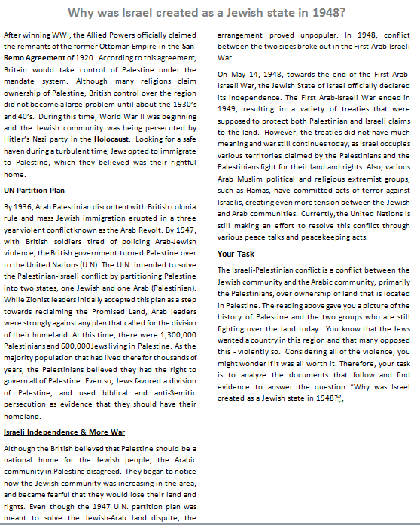
7
10
8
11
9

Slide 5
1 Why was Israel created as a Jewish state in 1948?
2 | 3
4 | 5
6 | 7
8 | 9
10 | 11

Slide 6
1 Why was Israel created as a Jewish state in 1948?
2 Both the Jewish Israelis and Arab Palestinians both claimed the land of Palestine. | 3 The Jews were forced into Diaspora, out of Palestine and into Europe and Asia.
4 Zionism = European Jews wanting to move Jews back to Palestine. Anti-Semitism is discrimination against Jewish people. | 5 Jews immigrate back to Palestine. Arabs are worried because their land is being taken away.
6 Ottoman Empire loses WW1. Jews allied with the British; since the British won, the Jews got to return to the land of Palestine. | 7
8 The Partition Plan, meant to keep it peaceful, starts conflict. | 9
10 | 11

Slide 7

What are the reasons for Israel being created as a Jewish state in 1948?
What are the reasons?
After reading the background essay, what are the three or four reasons that led to the Creation of Israel as a Jewish State in 1948? Support your reasons with evidence from the background essay.

Slide 8
What are the reasons for Israel being created as a Jewish state in 1948?
What are the buckets?
Biblical support
International support
Jewish persecution

Slide 9
FACT | INFERENCE | ARGUMENT
an educated guess about the importance of the fact
uses your background knowledge
NOT directly stated in the text
a “true” statement taken directly from the document text
A conclusion about the fact that answers the DBQ question
Text + Background Knowledge
Why does the fact matter? What do you know about the fact that makes it important to answering the DQB question?
Fact + Inference
How would you answer the DBQ question using your fact and inference?
Text
What fact can help you to answer the DBQ question?

Slide 10
Facts, Inferences, & Arguments
FACT | INFERENCE | ARGUMENT
a “true” statement taken directly from the document
an educated guess about the importance of the fact
uses your background knowledge
NOT directly stated in the text
A conclusion about the fact that answers the DBQ question
Since Helen is a doctor, she must have gone to medical school.
Helen is a doctor.
All doctors must go to medical school.

Slide 11
Quoting Text
1) Direct quote
“After being forcibly exiled from their land, the people kept faith with it throughout their Dispersion [Diaspora] and never ceased to pray and hope for their return to it and for the restoration in it of their political freedom” (Doc B).
2) Paraphrased/summarized
After being forced out of their land in the Diaspora, the Jews kept praying and hoping to get their land back (Doc B).
3) Quote fragment
The Jews “never ceased to pray and hope for their return to [Israel] and for the restoration in [Israel] of their political freedom” (Doc B).
The Jews were “forcibly exiled from their land” (Doc B).
“ . . . The people kept faith with [Israel] throughout their Dispersion [Diaspora]” (Doc B).

Slide 12
Document C
SOURCE: Theodor Herzl. On the Jewish State. 1896.
Note: There were Jewish leaders who called for the return of the Jews to Palestine for decades before Theodor Herzl (1860­-1904) wrote his influential pamphlet, The Jewish State. But Herzl's work pushed the formation of a political movement to establish a Jewish homeland in Palestine. The first Zionist Congress, convened by Herzl, was held in Basel, Switzerland, in 1897. Herzl was less attached to Palestine than some other "Zionists", and considered at one stage the creation of a Jewish state in what is now Uganda.

Slide 13
How to make an inference
Document C
Ask yourself, “Why would the Jews ‘call’ for a Jewish state?”
Jews were experiencing anti-Semitism or persecution everywhere.
Jews didn’t feel safe.
Jewish houses, businesses, synagogues, families, and possessions destroyed. Life as they knew it was gone.
Jews didn’t feel protected under the law.

Slide 14
FACT | INFERENCE | ARGUMENT
a “true” statement taken directly from the document
an educated guess about the fact (using your background knowledge)
NOT directly stated in the fact
a logical series of statements leading from a fact to a conclusion
Your answer to the DBQ question based on the fact and inference.
“Wherever they live…they are more or less persecuted.” (Doc C)
Since the Jews did not have their own homeland everywhere they went or were, they faced harsh treatment.
To protect Jews from persecution and further acts of anti-Semitism, a safe place or their own country would be needed. For this reason they should have been allowed to make Israel a Jewish state in 1948.

Slide 15
What is a Political Cartoon?
A political cartoon is an illustration published online or in a newspaper or magazine that attempts to make a point about a political event or situation.
Political cartons often defend, criticize or mock government officials and government policies.
Look at the following images. What do you think the author is trying to bring awareness to? What would you put in the thought bubble?

Slide 16
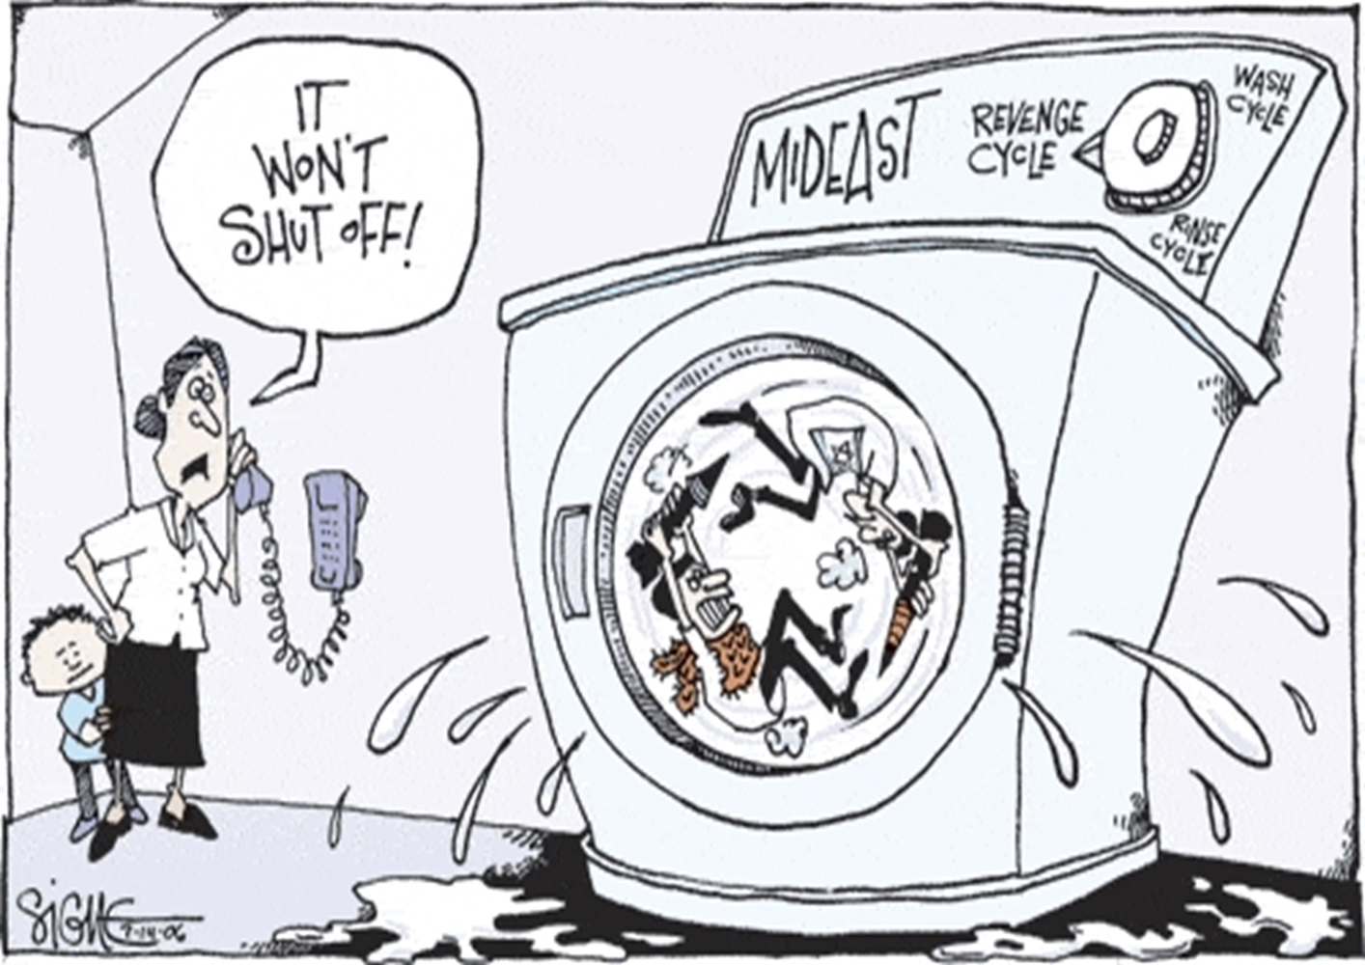

Slide 17


Slide 18
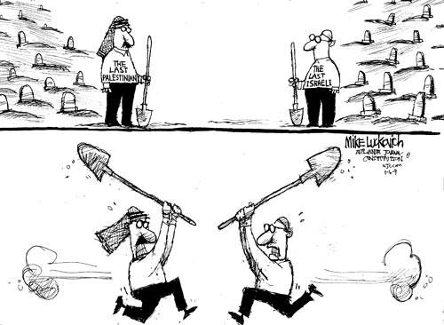

Slide 19


