Slide 1
Paper Doll Assignment
You will be making a paper doll based on one of four ethnic groups: Arab, Ashanti, Bantu, or Swahili.
You will research their clothing and then color their traditional clothing onto the paper doll
You will then write a letter from the perspective of the paper doll (much like your postcard assignment)
You will research the following…..

Slide 2
Research:
Go to my blog http://marydenney.edublogs.org/
Look under today’s date for links to research
You are going to write down:
Your ethnic group
Language spoken
Include a greeting from what language your group speaks
Country you reside in and draw its flag
Religion practiced
Pick a traditional African name and write down what it means
Include an interesting fact about the history of the people
Be sure to save any images of traditional clothing

Slide 3
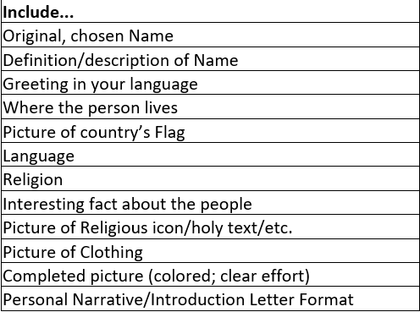

Slide 4
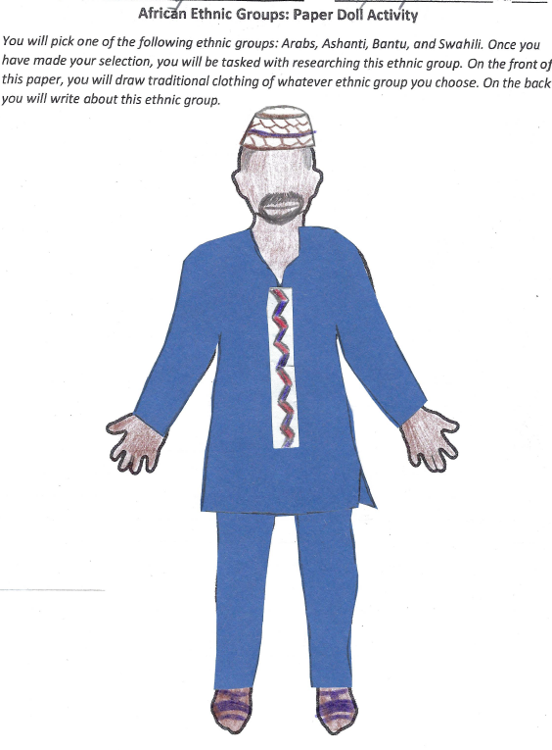

Slide 5
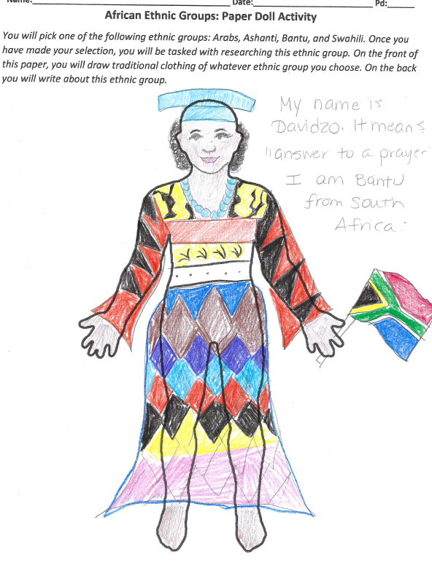

Slide 6
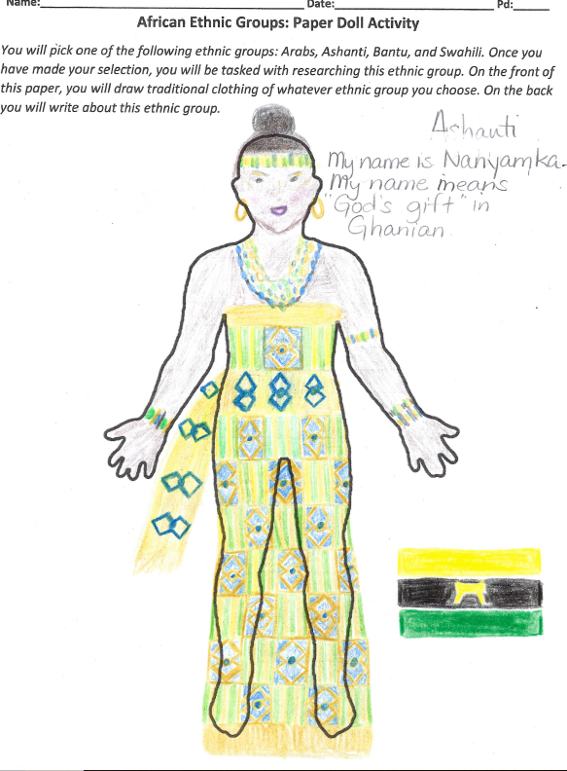

Slide 7
Letter Example:
Dear Mrs. Denney,
Sawubona! That means “hello” in Bantu.
My name is Davidzo which means “answered prayer” in my language. Bantu is both my ethnicity and my language. I currently live in South Africa and I practice animist religion. This means I believe spirits live in natural objects all around us. Did you know that the Bantu people have lived in Africa for 2,000 years? Did you also know that there are over 3,000 dialects of Bantu? Wow! Hope all is well!
Davidzo

Slide 8
Letter Requirements
Picture Requirements
Greet me in your native language
Introduce your self with your name and what it means
Tell me your ethnic group
Tell me where you live
Tell me what your religion is
Tell me an interesting fact about your ethnic group (you can use the reading I gave you as a reference)
Draw traditional clothing
Include your country’s flag
Include a religious symbol

