Slide 1
How did Communism influence China?
SS7H3d. Describe the impact of Communism in China in terms of Mao Zedong, the Great Leap Forward, the Cultural Revolution, and Tiananmen Square.

Slide 2
Use your graphic organizer to summarize the events

Slide 3
Great Leap Forward
In an effort to make farming more productive, collective farms with large communes (communities) of people were created to grow crops, run industries, educate the children, and have healthcare.

Slide 4
Great Leap Forward
The people in the communes did not own the land they worked on and the Communist Party controlled their economy, work schedule, and social lives.

Slide 5
Communist Propaganda
Propaganda is information, especially of a misleading nature, used to promote or publicize a particular political cause or point of view.
The Communist Party used a lot of propaganda to promote its reforms.

Slide 6
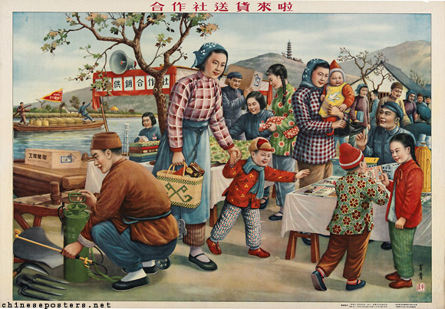
Communist Propaganda of the Great Leap Forward
Do the people look happy in the picture? Should they be?

Slide 7
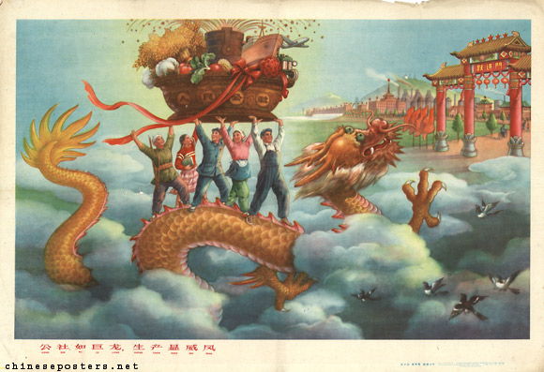
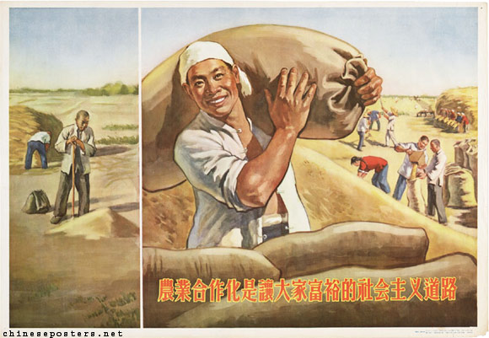
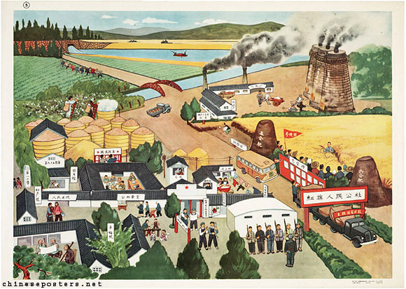
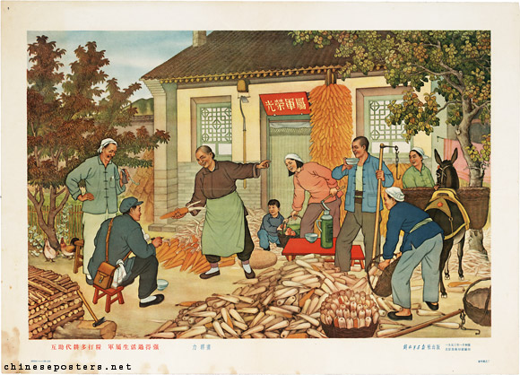
Communist Propaganda of the Great Leap Forward

Slide 8
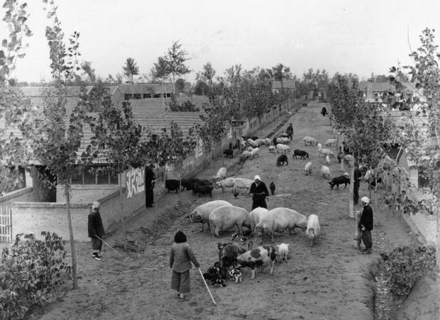
Great Leap Forward

Slide 9
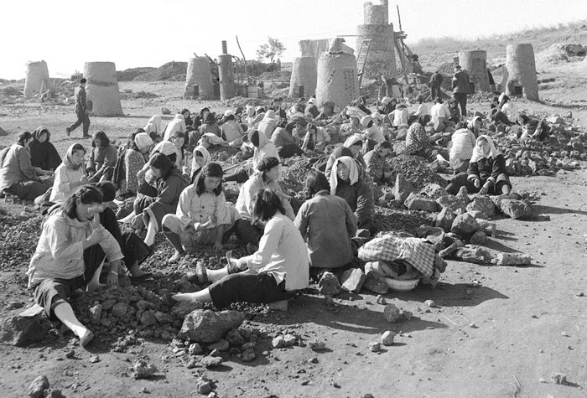
Great Leap Forward

Slide 10
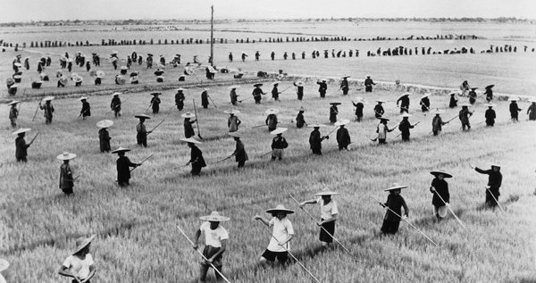
Great Leap Forward

Slide 11
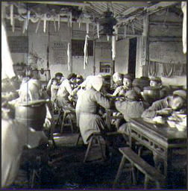
Great Leap Forward

Slide 12
Great Leap Forward
How do the real pictures of the Great Leap Forward compare to the communist propaganda pictures?
What would be the advantages and disadvantages of living and working on a collective farm?

Slide 13
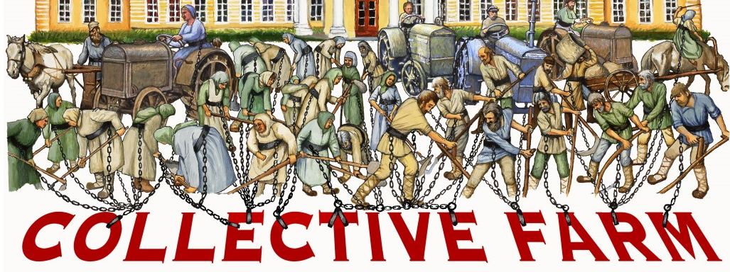
What does this image mean?

Slide 14
Effects of the Great Leap Forward
It was a huge disaster that failed within a year
Droughts and floods damaged China’s food supply and the communes failed to provide enough quality industry and food to feed the country
An estimated 20 million people died during one of the largest famines in history

Slide 15
Great Leap Forward
https://www.youtube.com/watch?v=hlbB3cmgPmo
What new information about the Great Leap Forward did you learn from the video?

Slide 16
After the Great Leap Forward
Many Chinese lost confidence in Mao Zedong after the Great Leap Forward
Chinese began calling for reforms again to prevent another disaster
Mao did not like the opposition and was afraid they would make China a capitalist country
In 1966, Mao started the Cultural Revolution to stop all opposition to Communism.

