Slide 1
How did Communism influence China?
SS7H3d. Describe the impact of Communism in China in terms of Mao Zedong, the Great Leap Forward, the Cultural Revolution, and Tiananmen Square.

Slide 2
Cultural Revolution
Mao Zedong shut down schools and recruited students into his Red Guards which attacked and punished any person who opposed communism
Factories closed and China’s economy weakened
The government denied healthcare and transportation
It caused more distrust of the communists

Slide 3
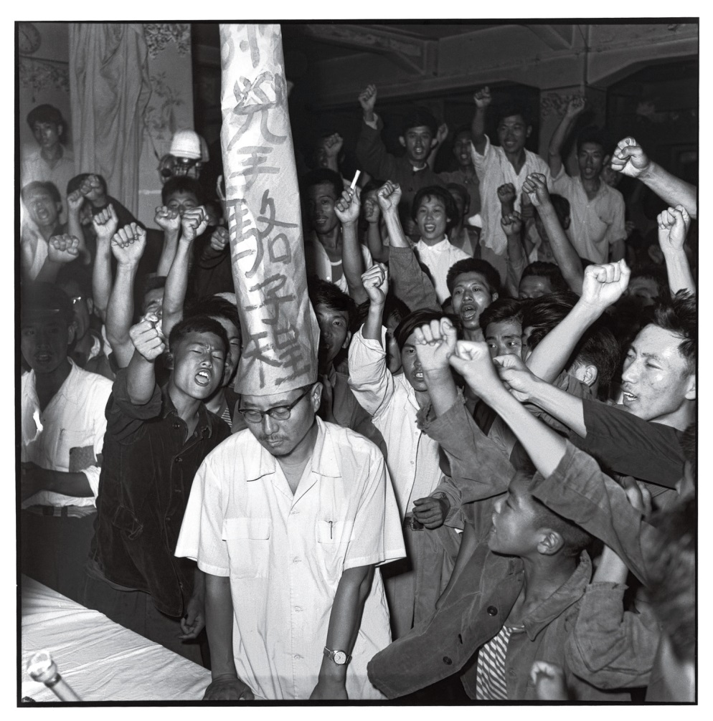
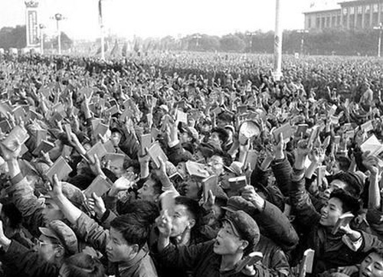
Cultural Revolution

Slide 4
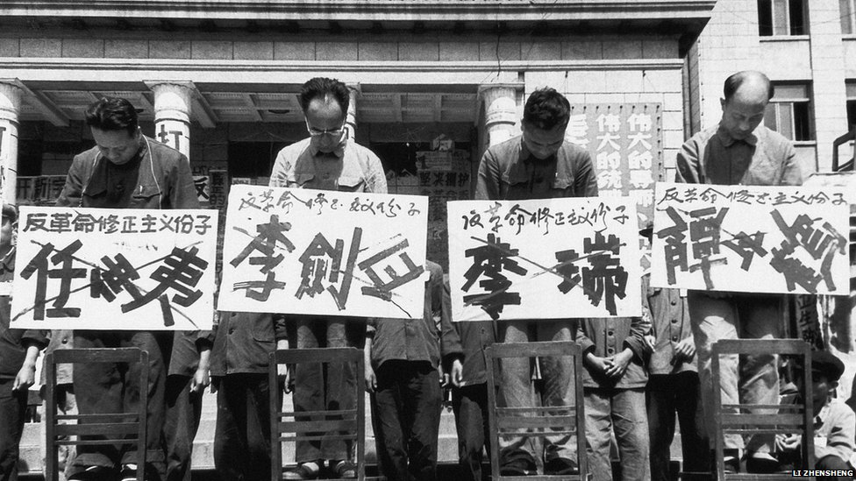
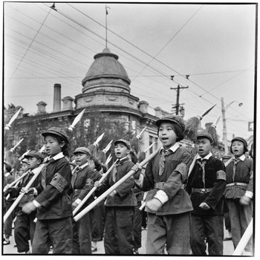
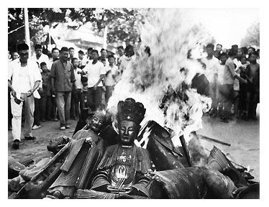
Cultural Revolution

Slide 5
Cultural Revolution
https://www.youtube.com/watch?v=LGpmVs0_Dbc

Slide 6
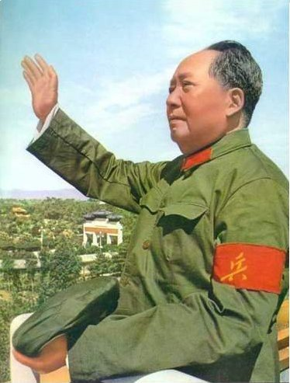
Turn to a seat partner and discuss again: do you believe Mao Zedong was good for China?
Use examples discussed in your reasoning.

Slide 7
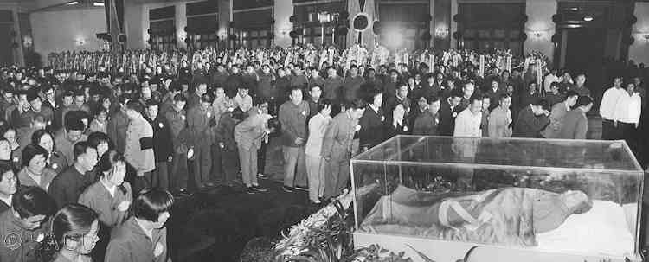
Mao Zedong’s death in 1976 brought an end to the Cultural Revolution

Slide 8
After Mao Zedong
The new leader Deng Xiaoping became leader and made many reforms to Mao’s policies, but the government still stuck to its communist rules and would not give up control over the people
The Chinese people were not given basic rights like freedom of speech or the right to a fair trial

Slide 9
Tiananmen Square
In 1989, protestors filled Tiananmen Square for weeks peacefully speaking against communism and calling for democracy
Protests began to spread all over China
After warning the protestors, the Chinese government sent tanks into the square and opened fire killing hundreds of people

Slide 10
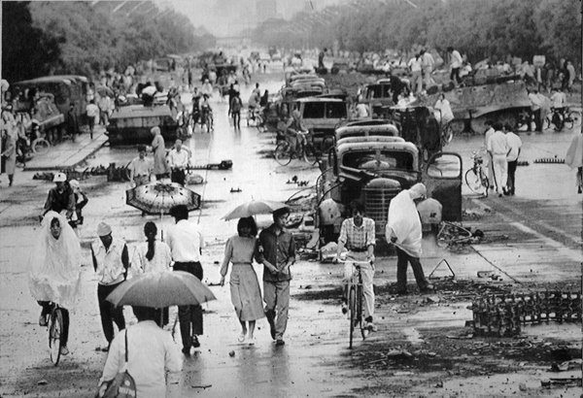
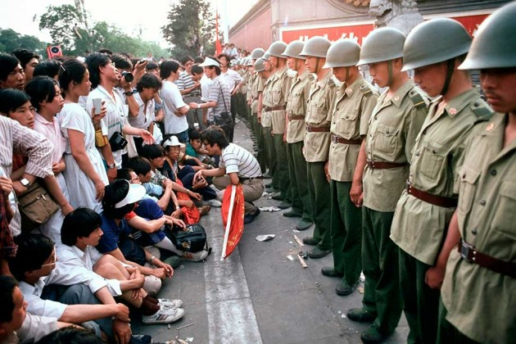
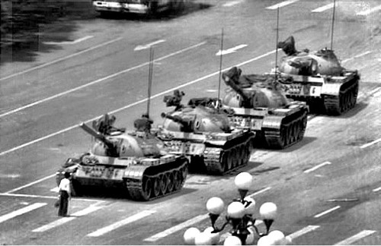
Tiananmen Square

Slide 11
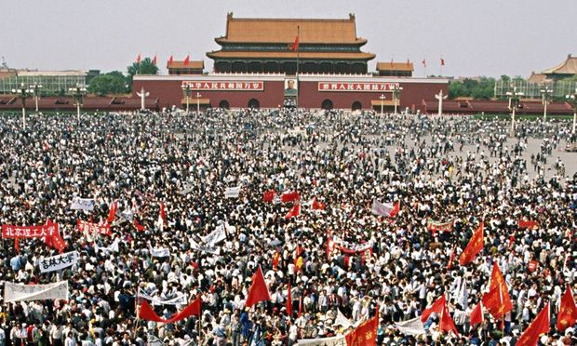
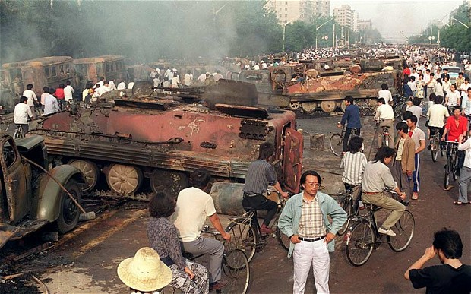
Tiananmen Square

Slide 12
Tiananmen Square
Countries around the world condemned the violence against human rights
The worldwide disapproval of the events at Tiananmen Square convinced the Chinese government to begin supporting and improving human rights

