Slide 1
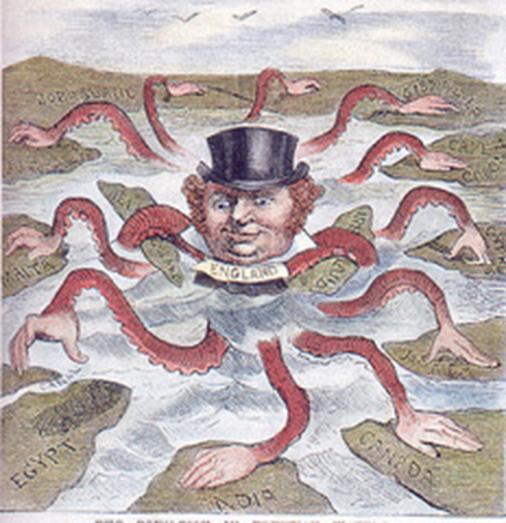
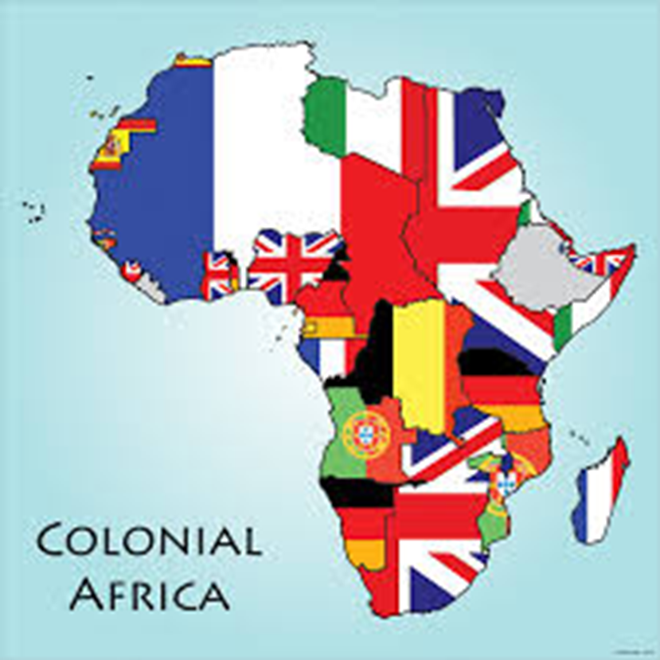
Define in your own words
Image/ Illustration
Define in your own words
Image/
Illustration
countries expanded their empires by
aggressively establishing colonies.
a system were a strong country takes wealth and raw materials from another country.
Imperialism
Colonialism
Synonyms/ Antonyms
Synonyms/
Antonyms
Sentence
Sentence

Slide 2
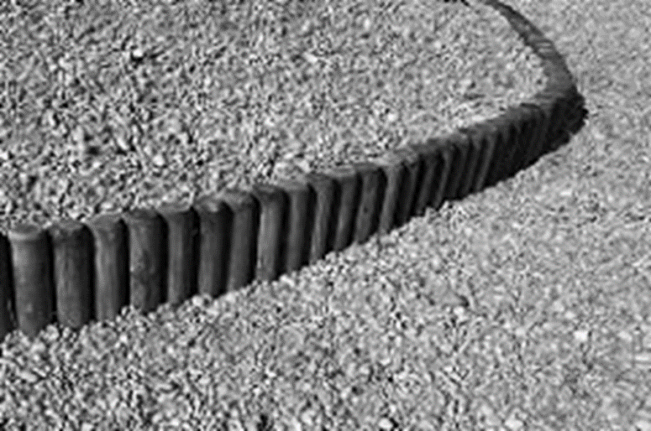
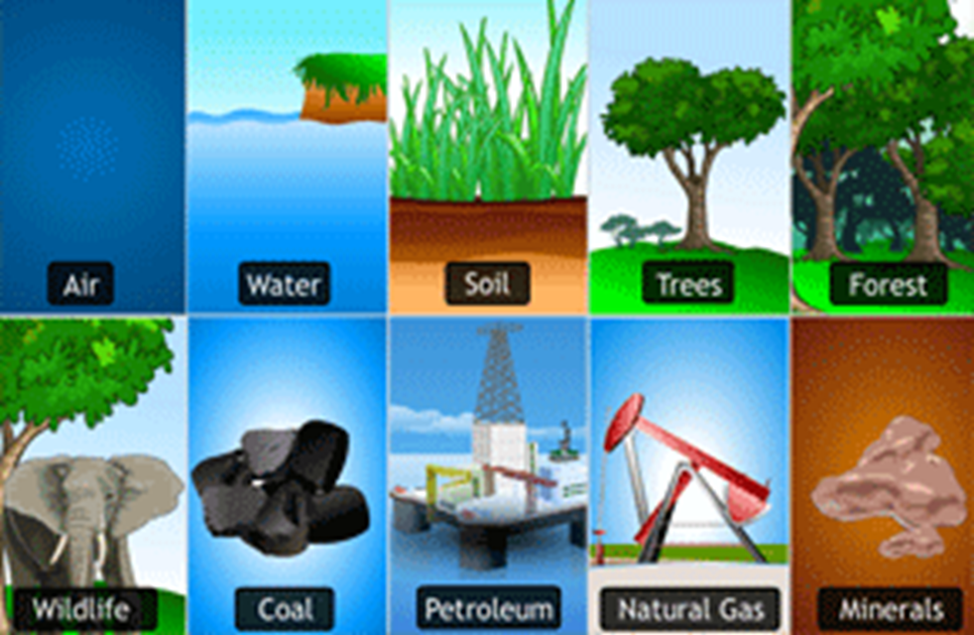
Define in your own words
Image/ Illustration
Define in your own words
Image/
Illustration
Raw materials supplied by nature that
come from the earth, the water, or the
air and are used to produce goods.
a separation, of two or more things
Partitioning
Natural
Resources
Synonyms/ Antonyms
Synonyms/
Antonyms
Sentence
Sentence

Slide 3
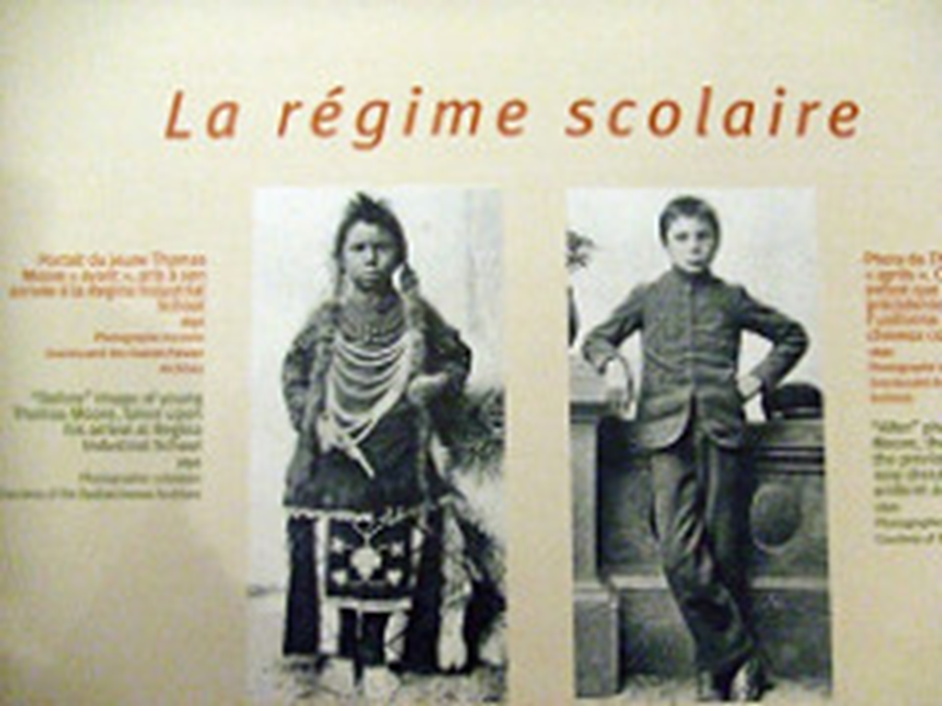
Define in your own words
Image/ Illustration
Define in your own words
Image/
Illustration
Giving up ones customs and adopting those of another culture
The two European Countries that
dominated African colonization.
Great Britain & France
Assimilation
Synonyms/ Antonyms
Synonyms/
Antonyms
Sentence
Sentence

Slide 4
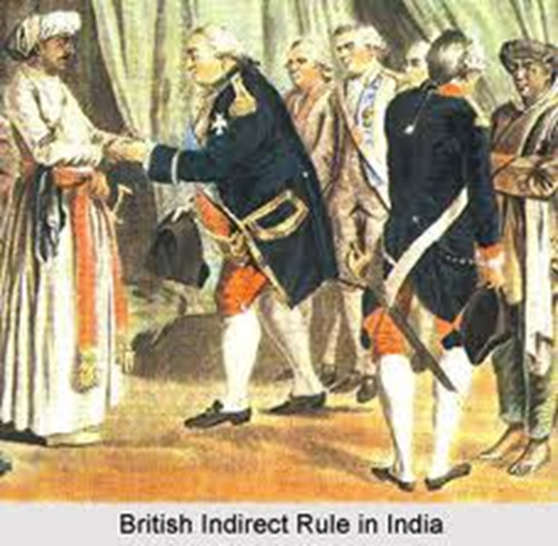
Define in your own words
Image/ Illustration
Define in your own words
Image/
Illustration
British and other colonial procedures through which "natives" were used to carry out colonial rule
Indirect Rule
Synonyms/ Antonyms
Synonyms/
Antonyms
Sentence
Sentence

