Slide 1
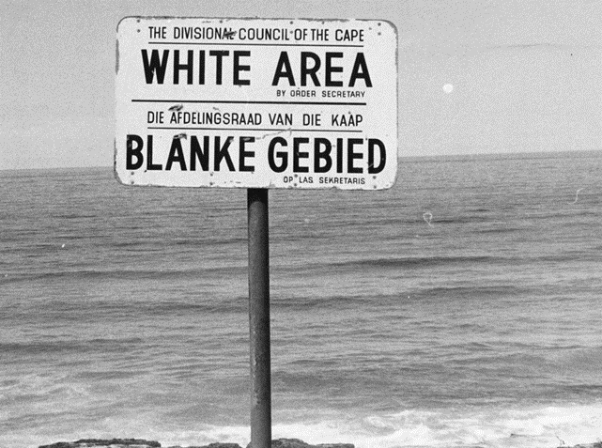
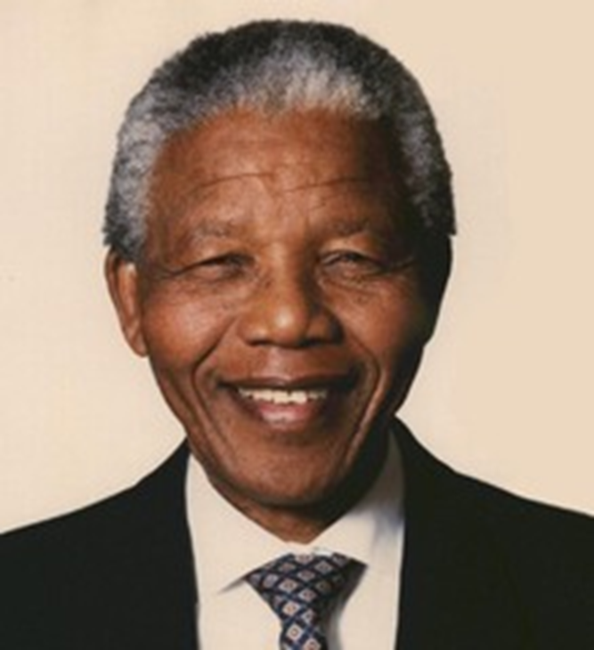
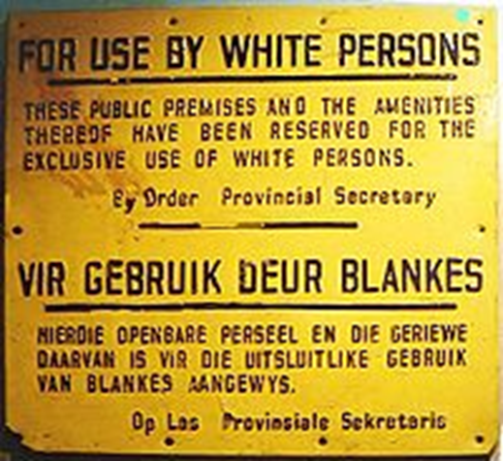
Define in your own words
Image/ Illustration
Define in your own words
Image/
Illustration
leader of the ANC who was jailed for his opposition (against) to apartheid in South Africa. He was later elected president in 1994 when free elections were established.
the legalized segregation (separation) of the races in South Africa
Apartheid
Nelson
Mandela
Synonyms/ Antonyms
Synonyms/
Antonyms
Sentence
Sentence

Slide 2
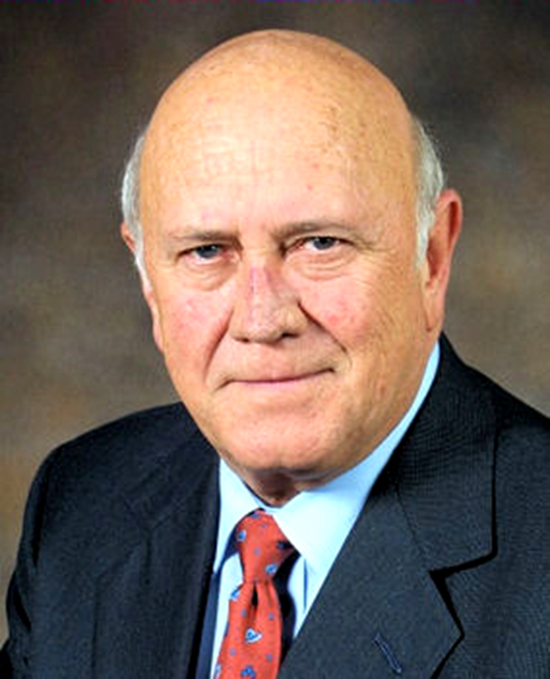
Define in your own words
Image/ Illustration
Define in your own words
Image/
Illustration
Formed by black Africans, in 1912 to fight for their rights. They organized strikes and boycotts to protest racist policies. Nelson Mandela was a leader in this organization.
the former President of South Africa who released Nelson Mandela from prison and repealed (removed) the apartheid laws.
African
National Congress
F.W. de Klerk
Synonyms/ Antonyms
Synonyms/
Antonyms
Sentence
Sentence

