Slide 1
APARTHEID Passbook
Vocabulary

Slide 2
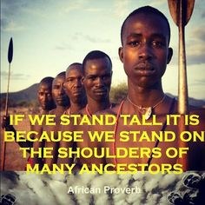
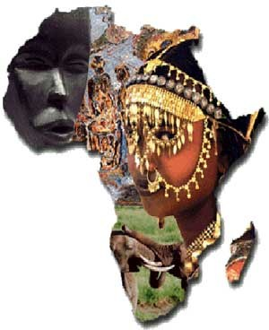
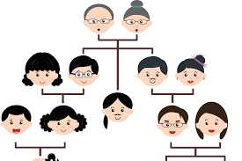
ancestry
one's family or ethnic descent.

Slide 3
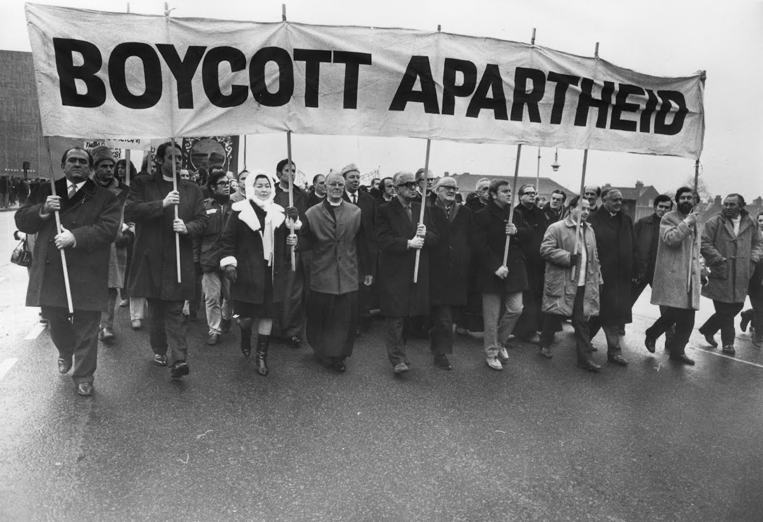
boycott
to abstain from buying or using product from a country as a punishment

Slide 4
censor
to delete (a word or passage of text)

Slide 5
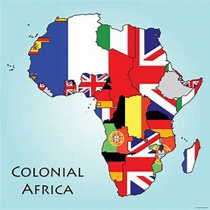
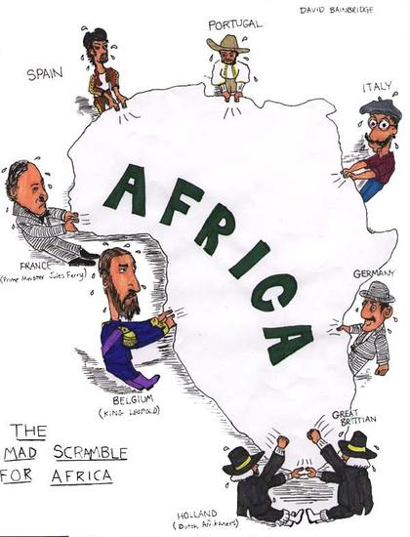
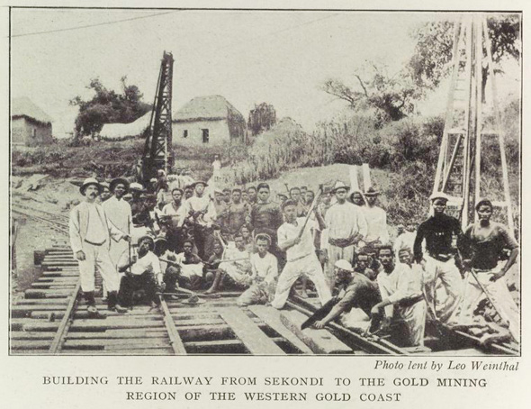
colonize
to form a colony

Slide 6
condemn
to judge or pronounce guilty

Slide 7
descendant
A person related to someone from an earlier generation (you)

Slide 8
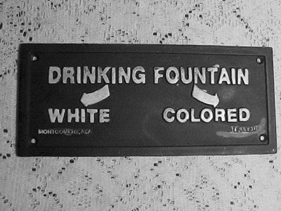
discrimination
treatment in favor of or against, a person based on race or class

Slide 9
prohibit
to forbid an action or activity

Slide 10
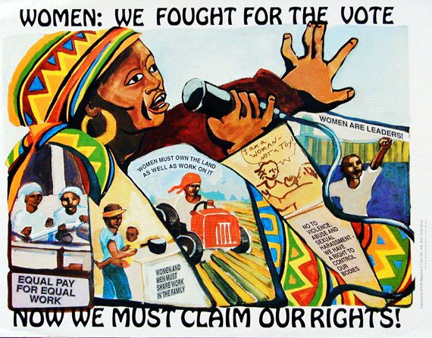
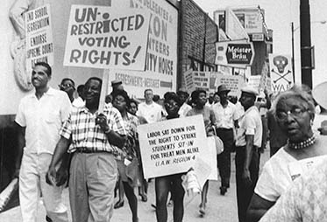
suffrage
the right to vote

Slide 11
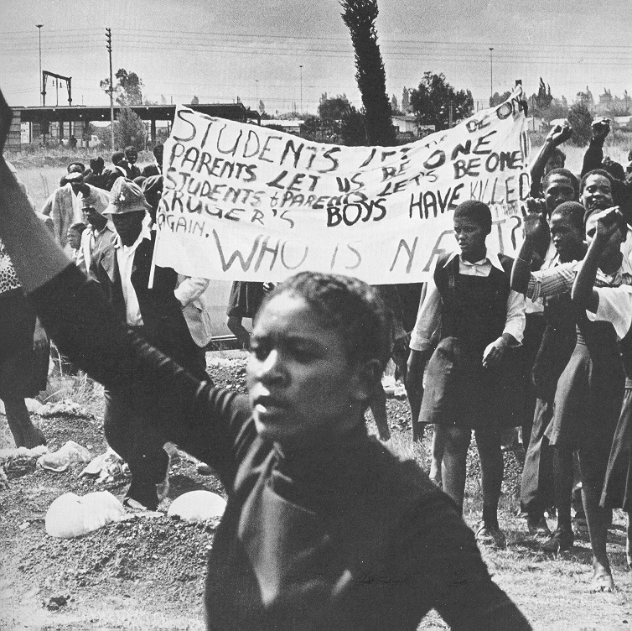
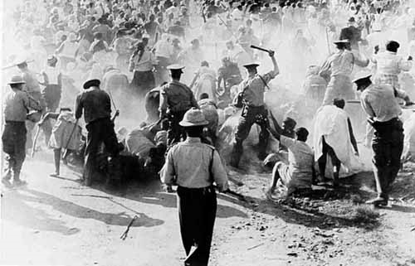
unrest
a state of dissatisfaction

