Slide 1
Apartheid
Dates = 1948 - 1993
In Afrikaans, “Apartheid” means “seperateness”
Apartheid = official policy of racial segregation in South Africa
In 1961, Nelson Mandela became the leader of the ANC (African National Congress) that stood up against the white Afrikaners.
Because he was the leader, they threw him in jail… for 27 years!!! (He was originally sentenced to life!)

Slide 2
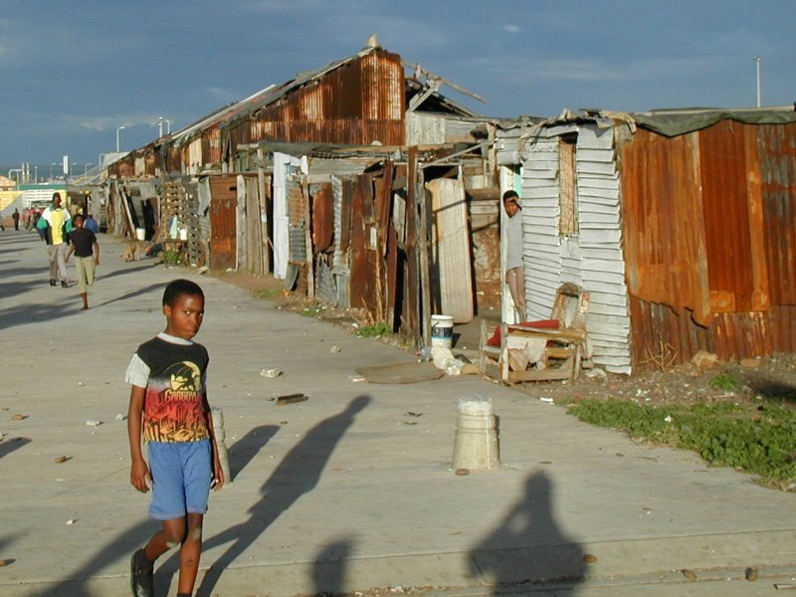
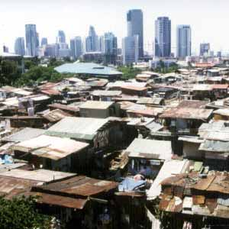
Apartheid…Life for Blacks
In 1958, the government forced blacks to live in homelands.

Slide 3
Nelson Mandela
Spent 1962-1990 in prison because the whites in power knew how much influence he had over the blacks.
Released from jail by a white politician - F.W. de Klerk - in 1990.
In 1993, F.W. de Klerk and Nelson Mandela worked together to end Apartheid. They shared the Nobel Peace Prize for their efforts.
In 1994, Mandela was elected the 1st black President of South Africa.

Slide 4
F.W. de Klerk
White president of South Africa from 1989 – 1994.
Began repealing (getting rid of) Apartheid laws in the early 1990’s.

