Slide 1
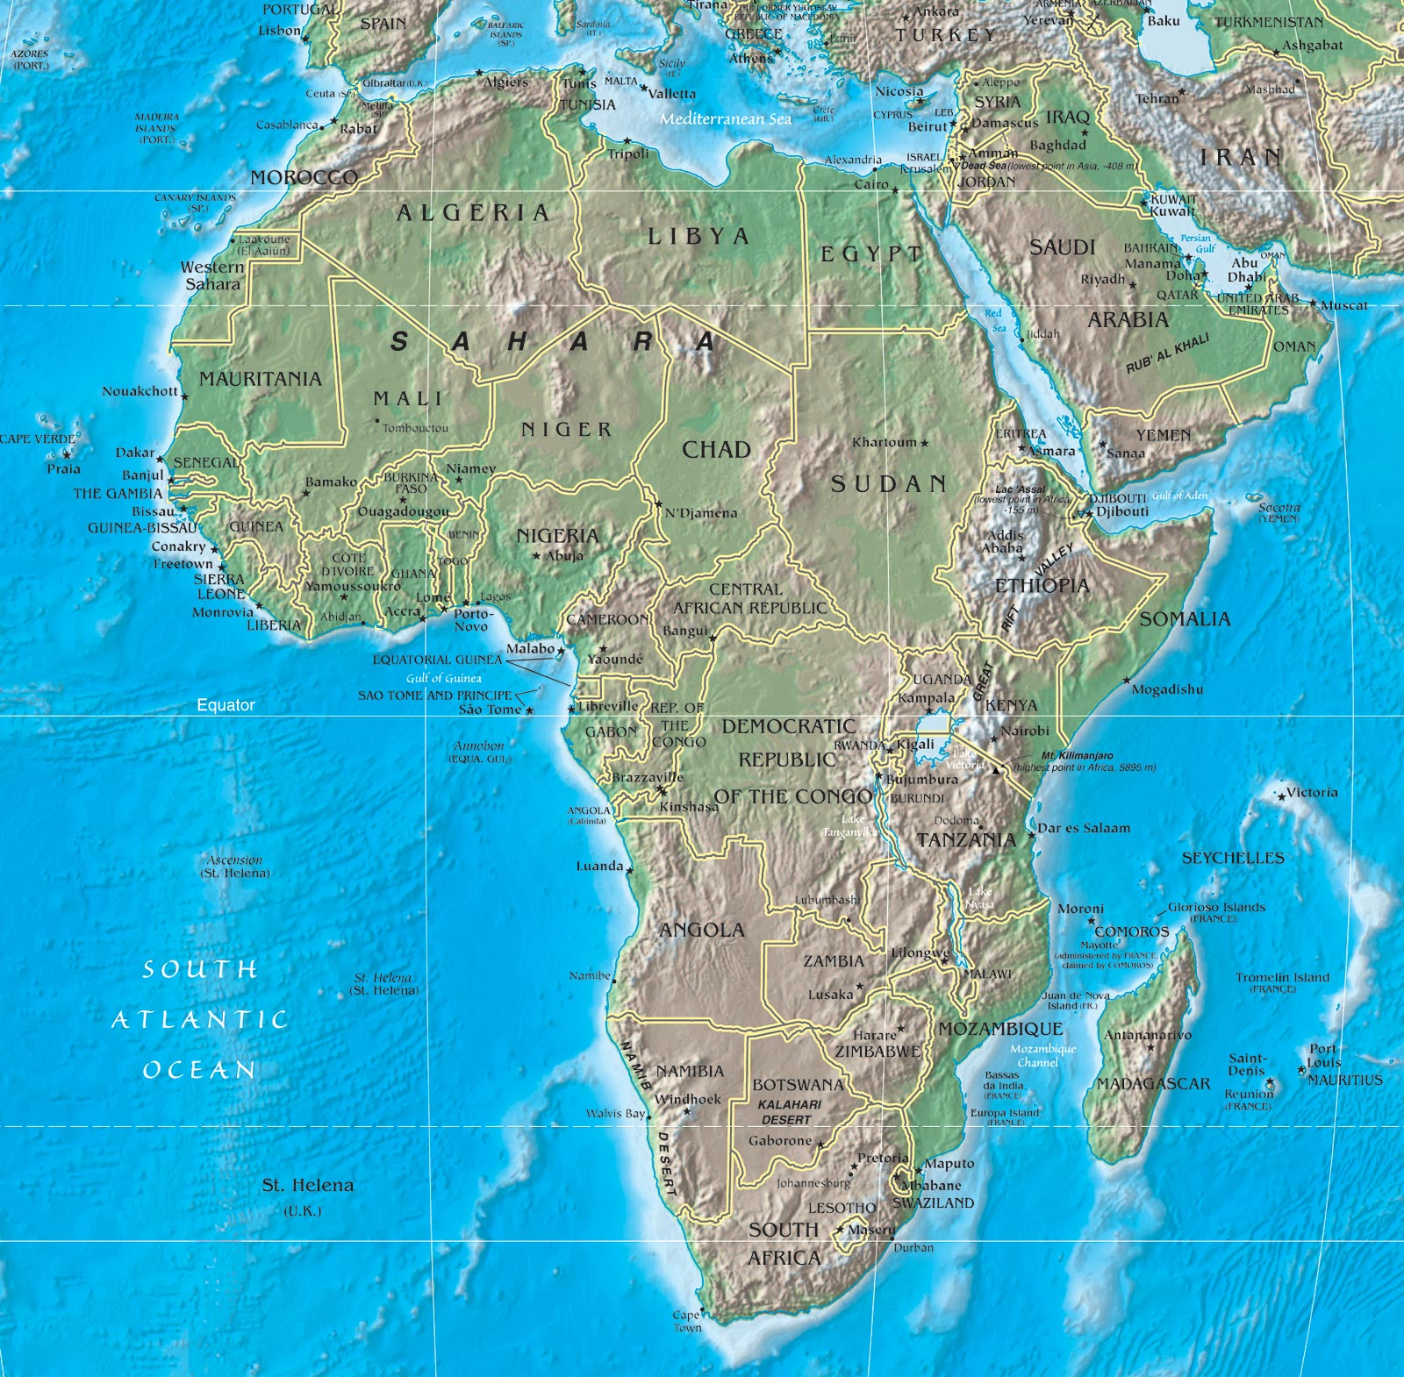
SOUTH SUDAN

Slide 2
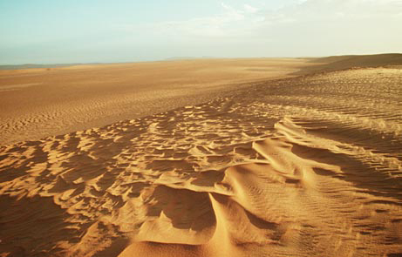
SS7G1 The student will locate selected features of Africa.
Locate on a world and physical map:
• The Sahara

Slide 3
Sahara Desert
SOUTH SUDAN

Slide 4
Sahara
• The Sahara is the world’s largest
“hot” desert.
• It is the second largest desert after
Antarctica.
• It covers Northern Africa, from the
Red Sea to the Atlantic Ocean.

Slide 5
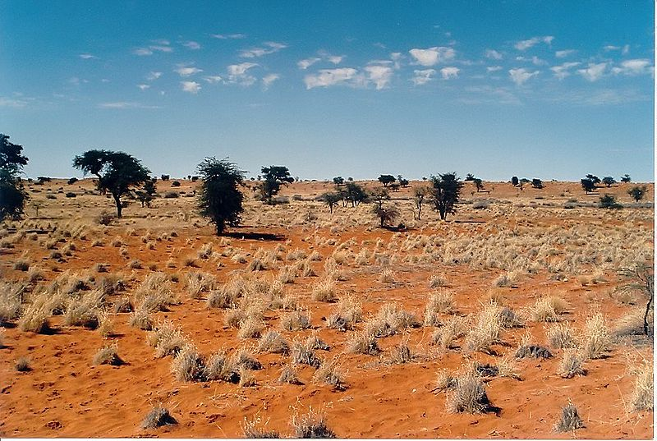
SS7G1 The student will locate selected features of Africa.
Locate on a world and physical map:
• The Sahara
• Kalahari Desert

Slide 6
Kalahari Desert

Slide 7
Kalahari Desert
• The Kalahari is located in Southwestern
Sub-Saharan Africa.
• The area provides for excellent grazing,
especially after rains.
• Because parts of the Kalahari receive
more than 10 inches of rain per year,
much of it does not fit the definition of a
desert.

Slide 8
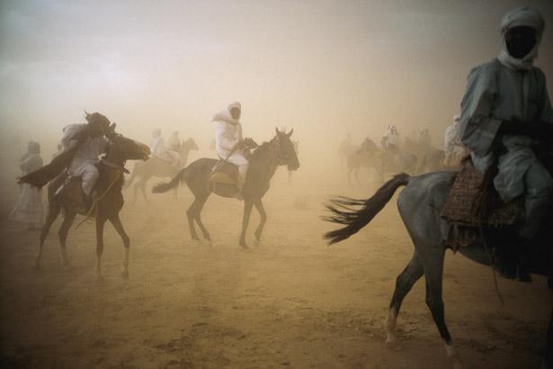
SS7G1 The student will locate selected features of Africa.
Locate on a world and physical map:
• The Sahara
• Kalahari Desert
• Sahel

Slide 9
Sahel
SOUTH SUDAN

Slide 10
Sahel
• The Sahel runs from the Red Sea to the
Atlantic Ocean.
• It separates North Africa’s Sahara Desert
from the a semi-arid savanna.
• The Sahel is mostly covered with
grasslands and savanna.
• Many kingdoms, known as
Sahelian Kingdoms, flourished here
because it was an excellent trade route.

Slide 11
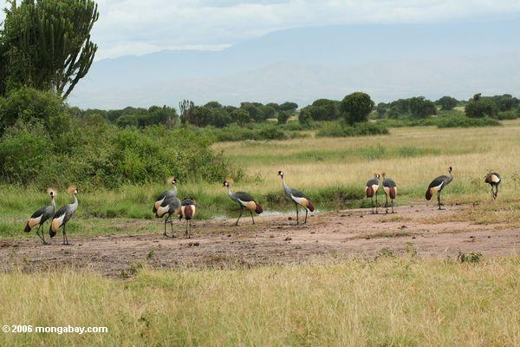
SS7G1 The student will locate selected features of Africa.
Locate on a world and physical map:
• The Sahara
• Kalahari Desert
• Sahel
• Savanna

Slide 12
SOUTH SUDAN
Savanna

Slide 13
Savanna
• A savanna is a tropical or semi-arid
woodland area. About 4.5 million square
miles of Africa are considered savanna.
• In a savanna, the trees are typically very
small and widely spaced.
• Savannas are typically well-suited for
grazing animals. In Africa, these include
lions, elephants, giraffes, and zebras.

Slide 14
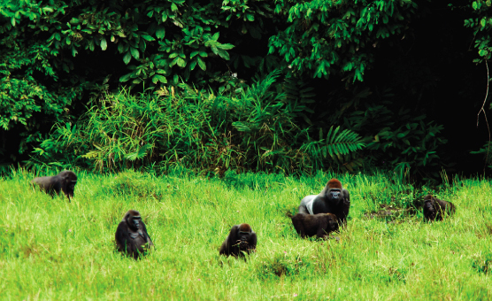
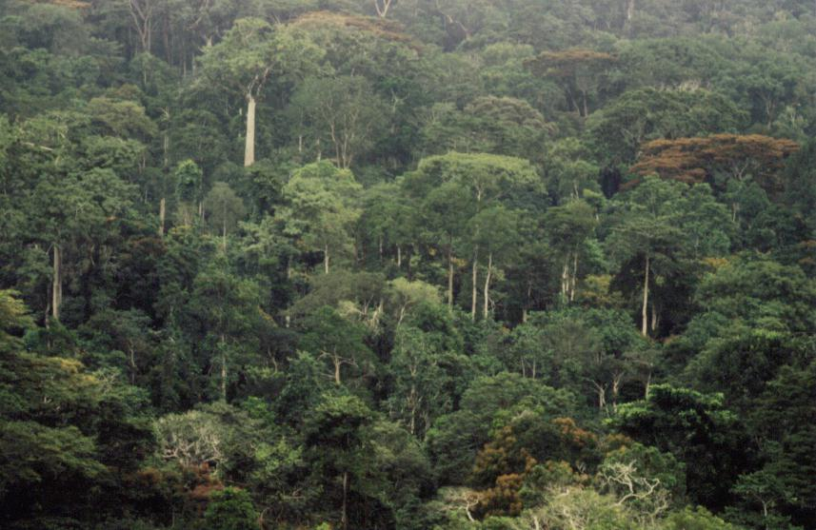
SS7G1 The student will locate selected features of Africa.
Locate on a world and physical map:
• The Sahara
• Kalahari Desert
• Sahel
• Savanna
• Tropical rain forest

Slide 15
SOUTH SUDAN
Tropical Rain Forest

Slide 16
Tropical Rain Forest
• The equatorial region of Africa has high
temperatures year-round.
• These areas typically have 50-60 inches of
rain per year.
• The rain forests suit animals such as
chimpanzees, gorillas, hippos, and
African gray parrots.

Slide 17
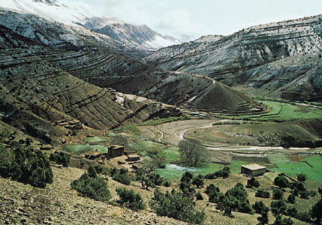
SS7G1 The student will locate selected features of Africa.
Locate on a world and physical map:
• The Sahara
• Kalahari Desert
• Sahel
• Savanna
• Tropical rain forest
• Atlas Mountains

Slide 18
SOUTH SUDAN
Atlas Mountains

Slide 19
Atlas Mountains
• This range extends nearly 1500 miles
through Northern Africa.
• It has been home to many of the Berber
tribes.
• There is a fascinating connection (literally)
to some mountains in the United States.

Slide 20
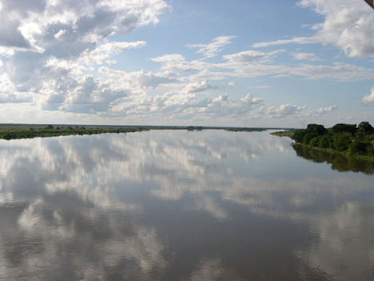
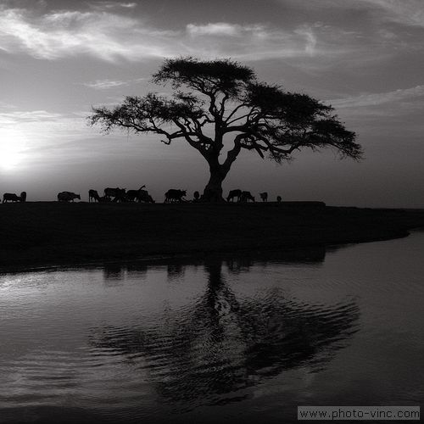
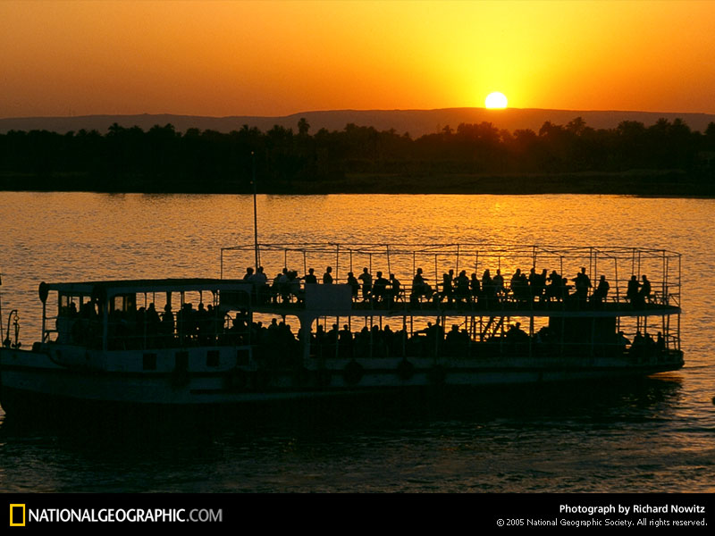
SS7G1 The student will locate selected features of Africa.
Locate on a world and physical map:
• Congo River
• Niger River
• Nile River

Slide 21
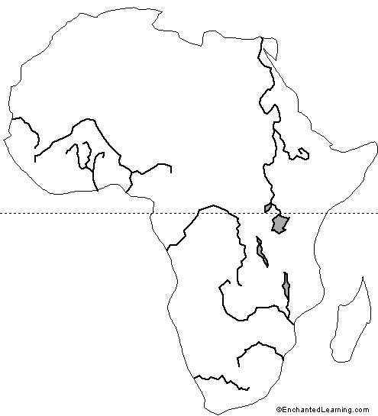
Nile
Niger
Congo

Slide 22
Congo River
• The Congo is the largest river in western
central Africa. It is the second largest river
on the entire African continent.
• It flows through the second largest rain
forest in the world.
• The Congo River is the very reason why
the Democratic Republic of Congo,
Republic of Congo, and Angola are
separate countries.

Slide 23
Niger River
• This crescent shaped river is the main
river in Western Africa.
• This very “clear” river has the Guinea
Highlands as its source.
• The Niger River empties into the
Guinea basin.

Slide 24
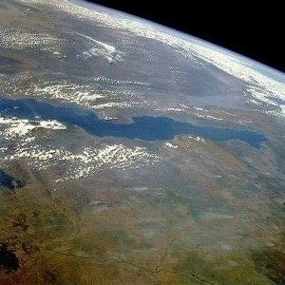
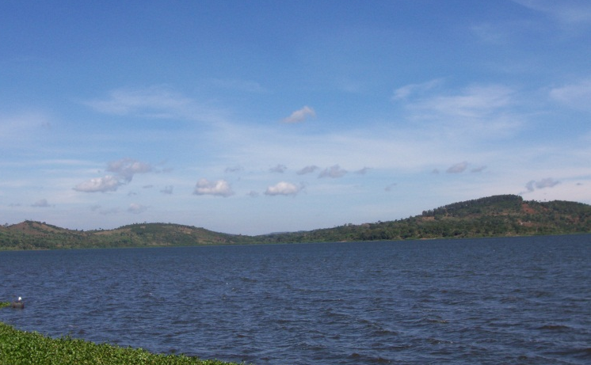
SS7G1 The student will locate selected features of Africa.
Locate on a world and physical map:
• Congo River
• Niger River
• Nile River
• LakeTanganyika
• Lake Victoria

Slide 25
Nile
Niger
Lake
Victoria
Congo
Lake
Tanganyika

Slide 26
Lake Tanganyika
• It is estimated to be the world’s second
largest fresh water lake
• The lake is divided between four countries;
Burundi, Democratic Republic of the
Congo (DRC), Tanzania and Zambia.
• The water flows into the Atlantic Ocean.
• This lake is very important to the daily
lives of people living in Africa. It has
almost 250 species of fish.

Slide 27
Lake Victoria
• This is a very “young” lake.
• The eco-system has been nearly
devastated by human influence.
• Lake Victoria empties into the country of
Uganda.

Slide 28
Egypt
Sudan
Nigeria
South Sudan
SOUTH SUDAN
Kenya
Democratic Republic of the Congo (Zaire)
South Africa

