Slide 1
AFRICA’S
Independence Movements
Kenya and Nigeria
© Brain Wrinkles

Slide 2
Nationalism Reading
Highlight the following information:
P1 Nationalism & its definition
P1 European Partitioning
P1 Why there was conflict & tension
P3 Pan-African movement & its definition (what did it call on people to do?
P4 What was Kenya’s independent movement like?
P4 Mau Mau Revolt
P5 What was Nigeria’s independent movement like?
P5 Jomo Kenyatta

Slide 3
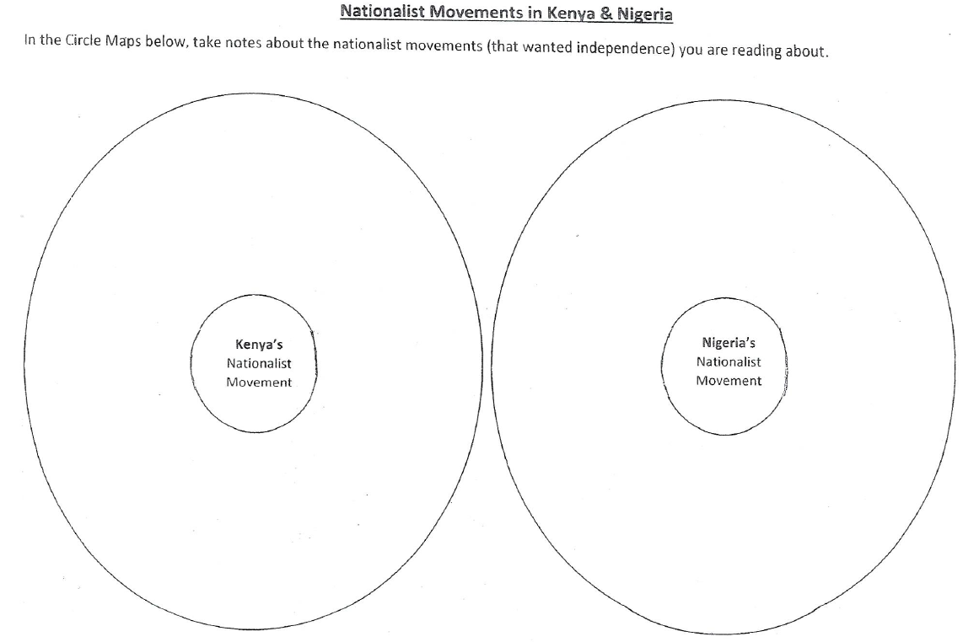
In your packet, turn to the last page. Instead of making a poster, you will draw two circle maps as seen below

Slide 4
Colonization
By the 20th century, European powers had colonized the majority of Africa.
The only independent countries were Liberia and Ethiopia.
Liberia was founded in 1822 by former American slaves.
© Brain Wrinkles

Slide 5
Nationalism
Africans resented their unequal status and lack of political rights under European control.
They wanted to take control of their own governments, land, and resources.
Nationalism, a feeling of strong pride in one’s own country, began to sweep across Africa and fed the desire for independence from European rule.
© Brain Wrinkles

Slide 6
Changes
Africa began to change by the 1940s.
The rule of tribal chiefs had weakened because of their links with colonial governments, thus limiting their ability to control people.
An educated middle class that disliked colonial life began to grow in the cities.
© Brain Wrinkles

Slide 7
Unrest
The cost for European countries to maintain colonies was rising.
By the second half of the century, unrest arose throughout the continent and African nations fought to free themselves from European control.
© Brain Wrinkles

Slide 8
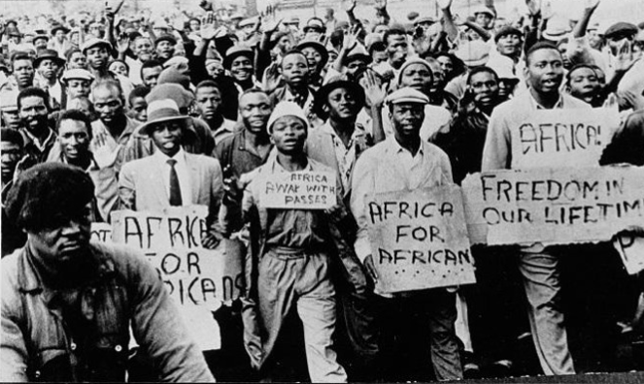
© Brain Wrinkles

Slide 9
KENYA
© Brain Wrinkles

Slide 10
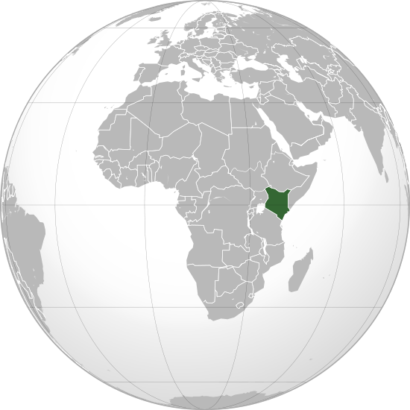
Republic of Kenya
© Brain Wrinkles

Slide 11
Colonization
For hundreds of years, outsiders did not enter the region now known as Kenya because of the fierce warrior tribes that inhabited the area.
Under British rule, native Kenyans had to pay high taxes and did not have the same access to education and jobs that whites did.
The government also took land and gave it to British settlers and war veterans.
© Brain Wrinkles

Slide 12
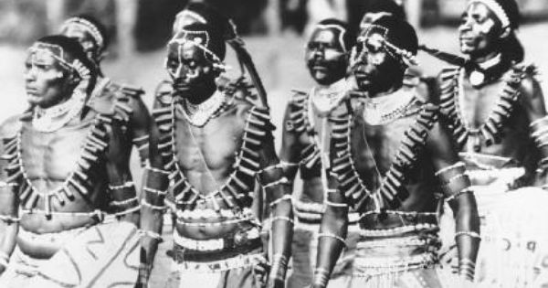
© Brain Wrinkles

Slide 13
Opposition
Most Kenyans were upset by their loss of rights as landowners to the British.
They believed that their land was taken unfairly and opposition groups began to form.
For several decades, small bands of armed resistance forces (guerillas)called the Mau Mau fought to eliminate white settlers in Kenya.
© Brain Wrinkles

Slide 14
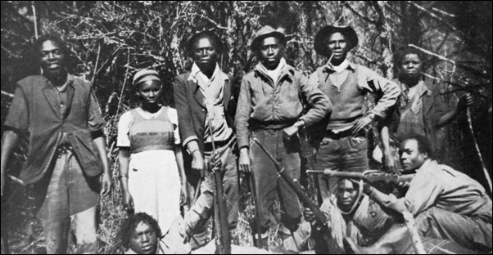
The Mau Mau was a secret society that believed force was the only way to win Kenyan rights and independence.
© Brain Wrinkles

Slide 15
Rebellion
In 1956, there was a violent rebellion that resulted in the deaths of thousands of Mau Mau fighters.
Although the British army mostly defeated the guerillas, this movement gained a great deal of support among Kenyans.
© Brain Wrinkles

Slide 16
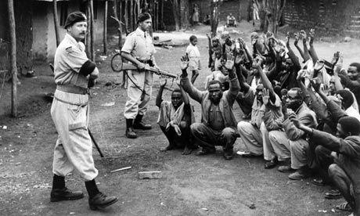
© Brain Wrinkles

Slide 17
Change
The Mau Mau uprising had spread nationalism throughout Kenya.
It showed the British that Africans would fight back and raised global awareness about the struggle for independence in Kenya.
Great Britain slowly began returning land to Kenya’s African citizens and also granting them improved rights.
© Brain Wrinkles

Slide 18
Independence
Kenyans were tired of being treated unfairly, and demanded to be free.
On December 12th, 1963, the British Empire granted Kenya its independence.
Jomo Kenyatta was the most influential leader of the freedom movement in Kenya, and was appointed as the nation’s first president.
© Brain Wrinkles

Slide 19
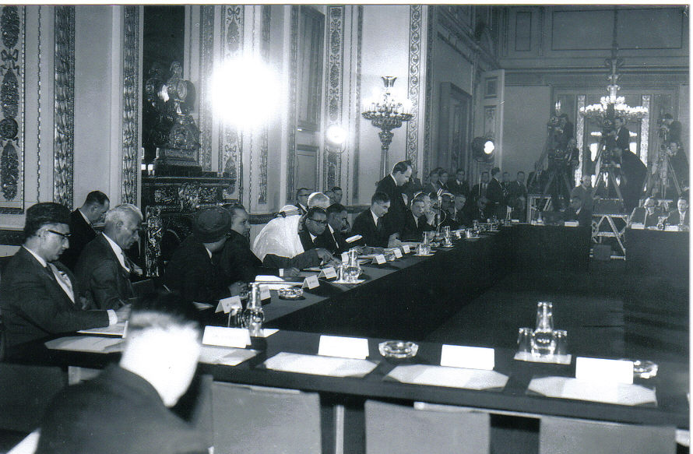
Lancaster House Conference for Kenya’s Independence in 1963.
© Brain Wrinkles

Slide 20
Kenyatta
Kenyatta was a leader of the Kenyan African National Union, and during his presidency, began a campaign called harambee, which is Swahili for “let’s pull together.”
Under Kenyatta and his successor, Daniel arap Moi, the KNAU ran unopposed in elections until the 1990s.
The country remains a multi-party state, but the reality is that the KNAU is in control of the government.
© Brain Wrinkles

Slide 21
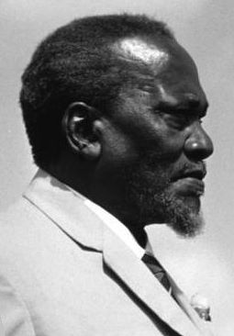
Jomo Kenyatta -- The first president and “founding father” of Kenya.
© Brain Wrinkles

Slide 22
Today
By the time of his death in 1978, Kenyatta had helped Kenya become one of the most stable and economically dynamic countries in Africa.
Even though there has been improvement in the political rights of Kenya’s people, more is still needed as there is a great deal of corruption within the country’s government.
© Brain Wrinkles

Slide 23
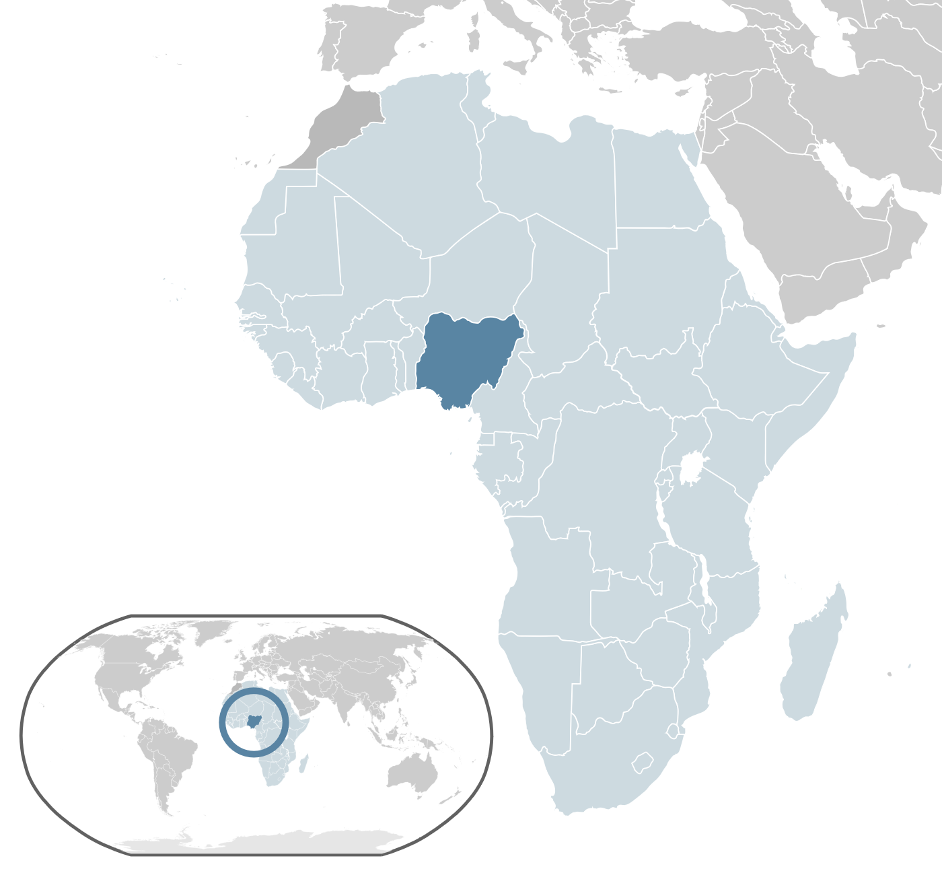
Federal Republic of Nigeria
© Brain Wrinkles

Slide 24
NIGERIA
© Brain Wrinkles

Slide 25
Nigeria
The country now known as Nigeria was a diverse region with more than 250 ethnic groups.
Nigeria had maintained its independence until 1914 when Great Britain took over the area.
© Brain Wrinkles

Slide 26
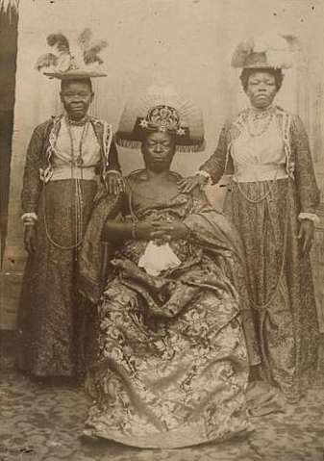
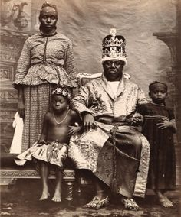
Nigerian Tribal Royalty – late 1800s
© Brain Wrinkles

Slide 27
Unrest
The British government took land from the Nigeria’s tribes and controlled most of the country’s resources.
This angered many Nigerians so they started political parties to work for independence.
Most Nigerians believed that the only way to have rights was to be completely free of European rule.
© Brain Wrinkles

Slide 28
Change
At first, they protested peacefully.
After World War II, more and more Nigerians encouraged nationalism and demanded self-rule.
Nationalism and the cause for independence from the British united the majority of Nigeria’s ethnic groups.
© Brain Wrinkles

Slide 29
Independence
After many (mostly) peaceful protests, Great Britain allowed Nigeria to elect its own government.
On October 1st, 1960, Great Britain granted Nigeria independence and an independent government was established.
At first, it was one of the most stable governments of the new African countries.
© Brain Wrinkles

Slide 30
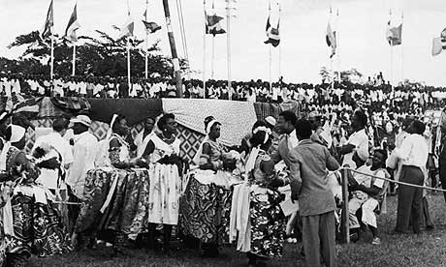
Nigerian Independence - 1960
© Brain Wrinkles

Slide 31
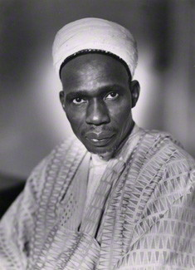
Abubakar Tafawa Balewa – Nigeria’s first prime minister. He was overthrown and murdered in a military coup in 1966.
© Brain Wrinkles

Slide 32
Power
Nigeria did not remain peaceful for long.
Unfortunately, struggles for power between different ethnic groups have resulted in three military coups and a civil war.
© Brain Wrinkles

Slide 33
Today
Nigeria suffered from violence and military rule until 1999, when a democratic government was established.
In recent years, political instability, religious competition, ethnic differences and the need to become more modern continue to plague Nigeria.
© Brain Wrinkles

Slide 34
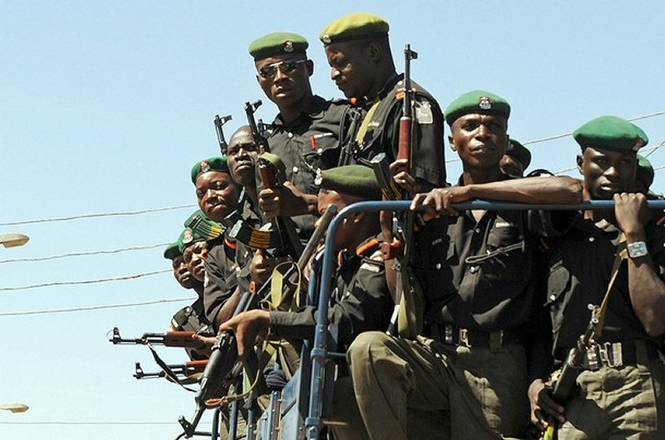
Nigerian Soldiers
© Brain Wrinkles

Slide 35
Africa Today
By 1966, all but six African countries were independent nation-states.
Unfortunately, once the countries were independent of European rule, they still faced many challenges.
Many of the new governments were politically unstable.
© Brain Wrinkles

Slide 36
Africa Today
European powers did not teach new leaders how to self-govern after granting them independence.
Ethnic groups continue to clash over political power in many African nations.
In some African countries, military dictators took over the governments.
© Brain Wrinkles

Slide 37
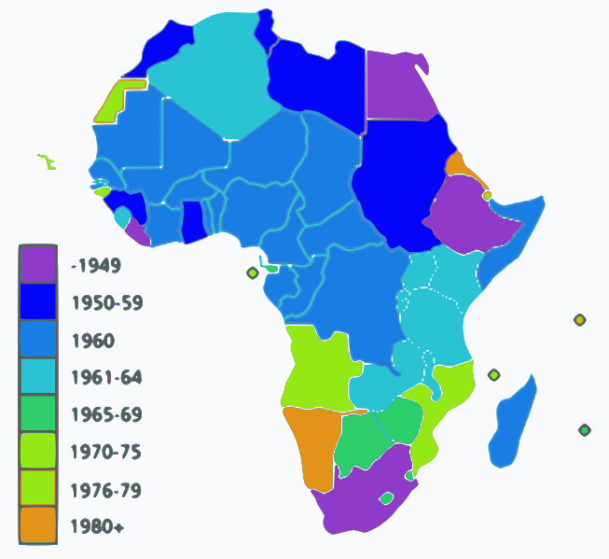
African Independence Dates
© Brain Wrinkles

Slide 38
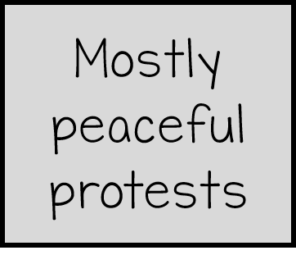
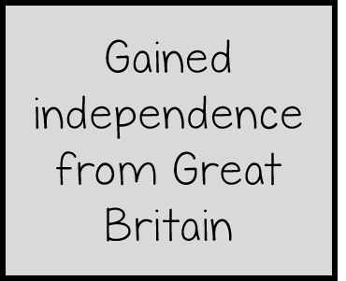
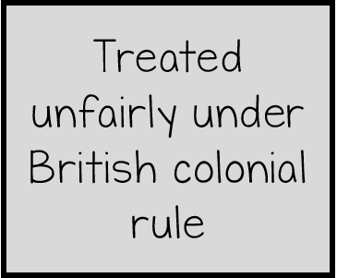
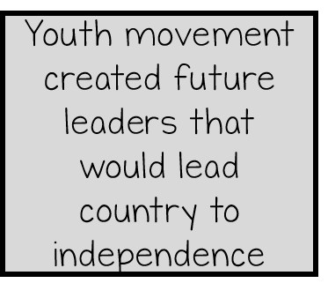
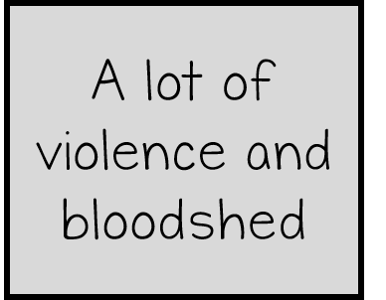
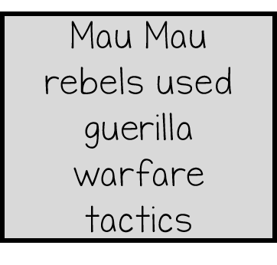
Drag the facts to the correct location on the Venn diagram.
NIGERIA
KENYA

Slide 39
1. Which African country was founded by former American slaves?
Liberia
2. What is nationalism?
A feeling of strong pride for one’s home country
3. What was the purpose of the Pan-African movement?
To support Africa’s common heritage and freedom
4. After the Pan-African movement pushed the cause of nationalism forward, what did many Africans begin to do?
Develop national pride and demand freedom from European rule
5. Why did it take so long for foreigners to enter the area now known as Kenya?
Fierce warrior tribes inhabited the area
6. What guerilla group staged a huge rebellion in 1956?
Mau Mau
7. Even though the British army defeated the Mau Mau, how could the rebellion be considered a success for Kenyan independence?
It showed the British that Kenyans would fight back & raised global awareness
8. Why were the Nigerian people upset under colonial rule?
British government controlled Nigeria’s resources and took land from its tribes
9. About how many ethnic groups made up the area now known as Nigeria?
250
10. What united all of these ethnic groups?
Nationalism and the desire for independence
11. Which European power granted both Kenya and Nigeria their independence?
Great Britain
12. What was Nigeria’s government like after it gained independence (from 1966 to 1999)?
Military rule (opposite of democracy); three military coups and a civil war
© Brain Wrinkles
Pan-African & Independence
Comprehension Check KEY

