Slide 1
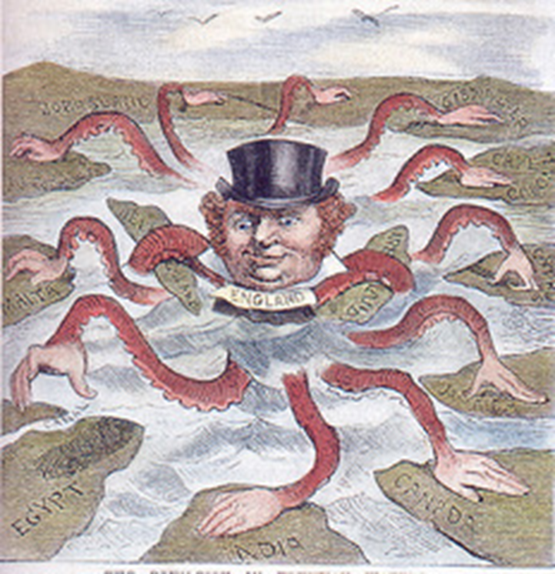
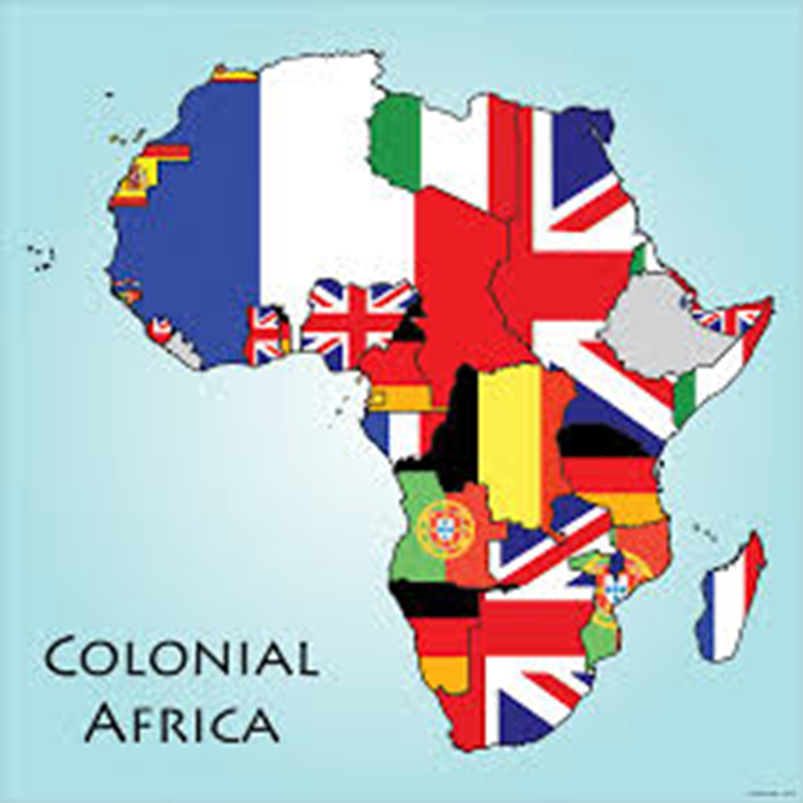
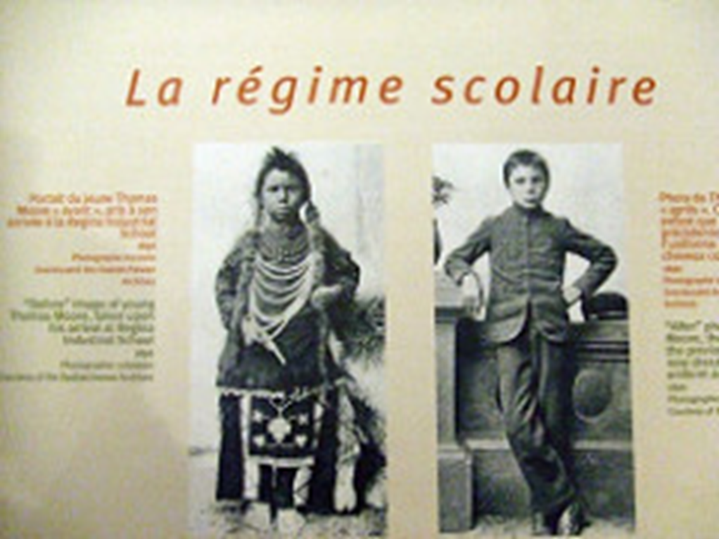
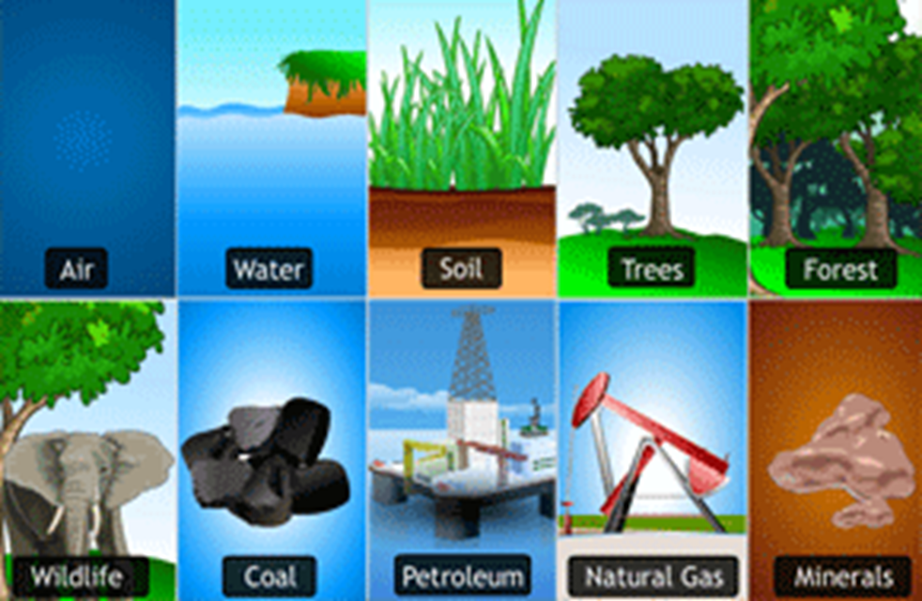
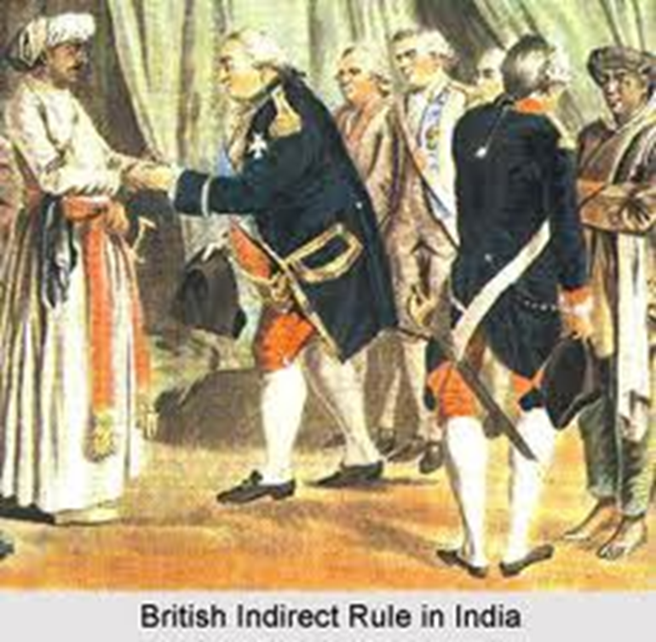

African History Vocabulary: Colonialism

Slide 2
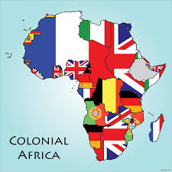
Colonization/ Colonialism
countries expanded their empires by
aggressively establishing colonies.
Colonization Colonisation
Colonização 定植
استعمار 식민지화

Slide 3
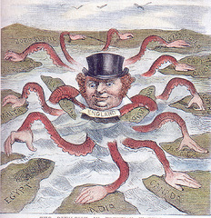
Imperialism
a system were a strong country takes wealth and raw materials from another country.
Imperialismo
Imperialismo
امپریالیسم
Impérialisme
帝国主义
제정

Slide 4

Indirect Rule
British and other colonial procedures through which "natives" were used to carry out colonial rule
indirect Rule حکومت غیر مستقیم
间接统治 Regla indirecta
간접 규칙 Regra indireta

Slide 5

Assimilation
Giving up ones customs and adopting those of another culture
Assimilação Assimilation
Asimilación 同化
جذب 동화

Slide 6

Partitioning
a separation, of two or more things
پارتیشن بندی Partitioning
분할 Partitionnement
分区 Particiones

Slide 7

Natural Resources
Raw materials supplied by nature that
come from the earth, the water, or the
air and are used to produce goods.
Recursos naturales منابع طبیعی
Recursos naturais 自然资源
Ressources naturelles 천연 자원

Slide 8

Great Britain and France
The two European Countries that
dominated African colonization.
영국과 프랑스 بریتانیا و فرانسه
Gran Bretaña y Francia 英国和法国
Grã-Bretanha e França
La Grande-Bretagne et la France

