Slide 1
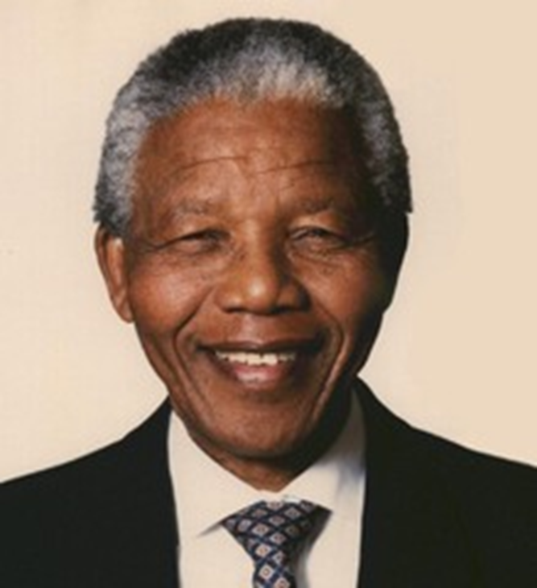
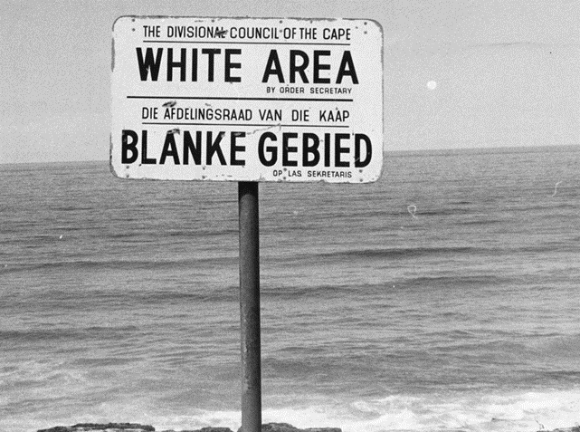
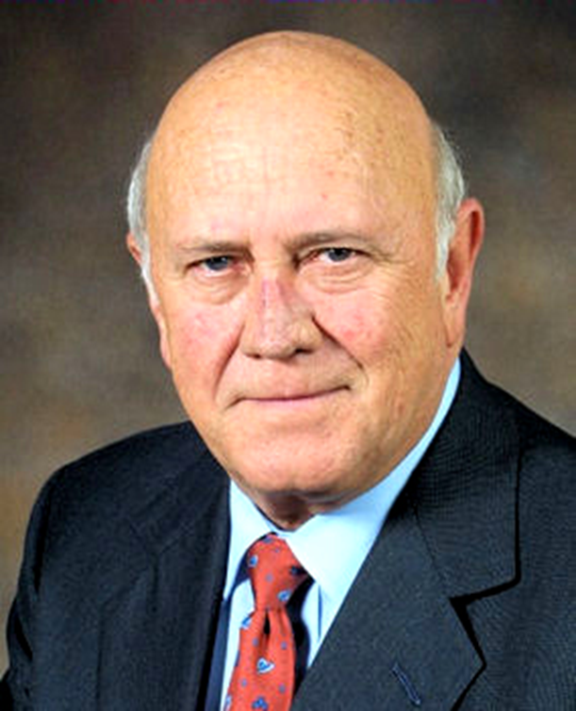
African History Vocabulary: Apartheid

Slide 2
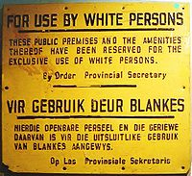
Apartheid
the legalized segregation (separation) of the races in South Africa
Segregación racial Apartheid
Apartheid 种族隔离
آپارتاید 인종 차별 정책

Slide 3
Nelson Mandela
leader of the ANC who was jailed for his opposition (against) to apartheid in South Africa. He was later elected president in 1994 when free elections were established.
넬슨 만델라
نلسون ماندلا
纳尔逊·曼德拉
Nelson Mandela

Slide 4
African National Congress (ANC)
Formed by black Africans, in 1912 to fight for their rights. They organized strikes and boyotts to protest racist policies. Nelson Mandela was a leader in this organization.
El Congreso Nacional Africano (ANC)
Congresso Nacional Africano (ANC)
Congrès national africain (ANC)
南非非洲人国民大会（非国大）
아프리카 민족 회의 (ANC)
کنگره ملی آفریقا (ANC)

Slide 5
F.W. de Klerk
the former President of South Africa who released Nelson Mandela from prison and repealed (removed) the apartheid laws.
F.W. دکلرک F.W. 드 클레르 크
F.W。德克勒克 F. W. de Klerk

