Slide 1
7TH GRADE World geography text Photo analysis

Slide 2
SEE... THINK... WONDER... ??????

Slide 4
IMAGE #1
TEXTBOOK PAGE 48

Slide 5
IMAGE #2TEXTBOOK PAGE 75

Slide 6
IMAGE #3
TEXTBOOK PAGE 79

Slide 7
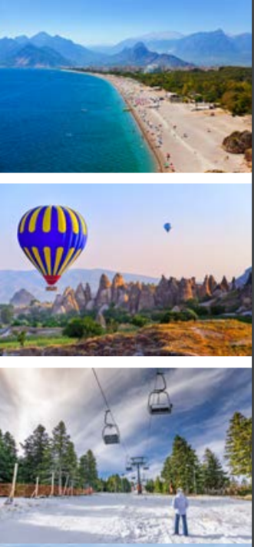
IMAGE #4 TEXTBOOK PAGE 157
HINT: IT’S ALL IN THE SAME COUNTRY

Slide 8
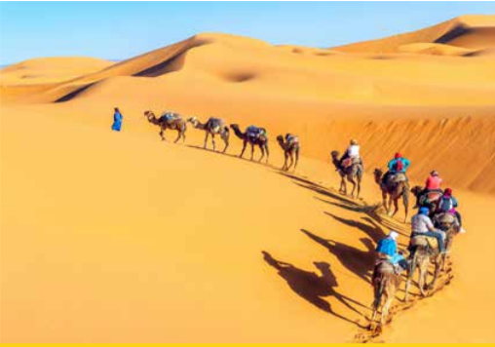
IMAGE #5 TEXTBOOK PAGE 193

Slide 9
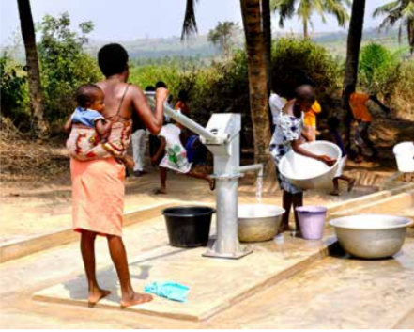
IMAGE #6 TEXTBOOK PAGE 199

Slide 10
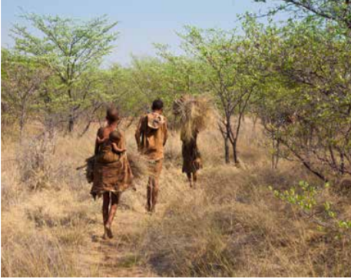
IMAGE #7 TEXTBOOK PAGE 201

Slide 11
IMAGE #8 TEXTBOOK PAGE 215

Slide 12
IMAGE #9…TEXTBOOK PAGE 355

Slide 13
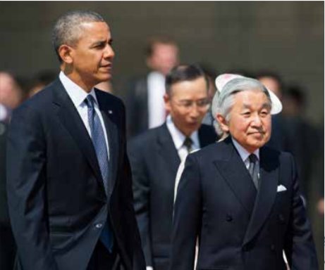
IMAGE #10 TEXTBOOK PAGE 424

Slide 14
EXTENSION ACTIVITY...
Based off your photo analysis, pretend you are traveling the world, taking pictures for a popular magazine. Write a story about what you saw, the struggles and triumphs of the people.
Furthermore, create a pictorial flow map that aligns with your story...

