Slide 1
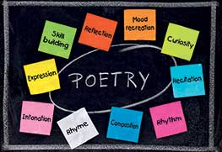
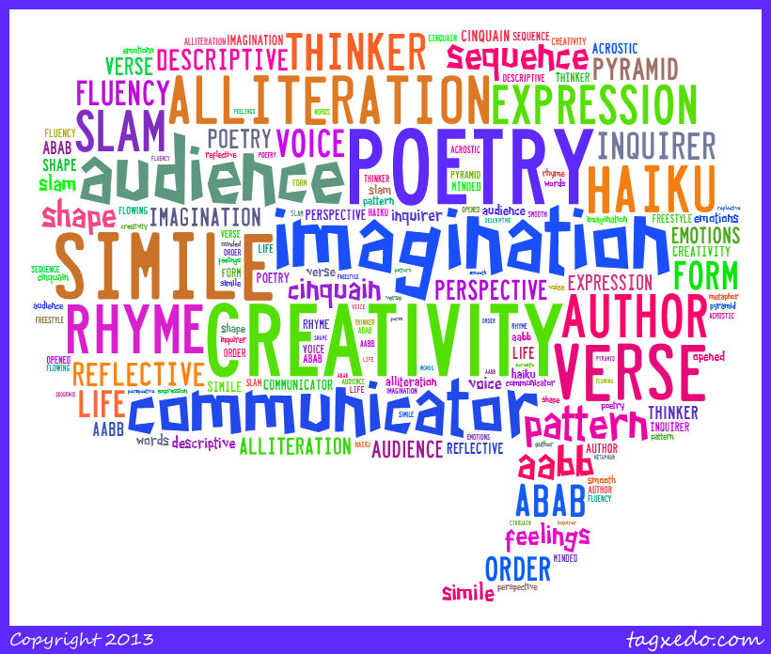
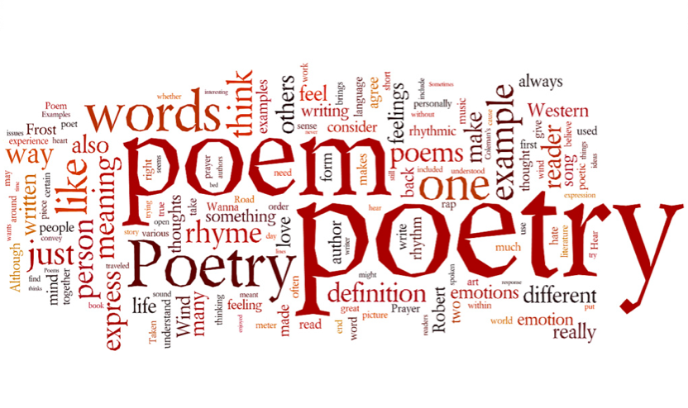
This Photo by Unknown Author is licensed under CC BY-NC-ND
This Photo by Unknown Author is licensed under CC BY-NC-ND
This Photo by Unknown Author is licensed under CC BY

Slide 2
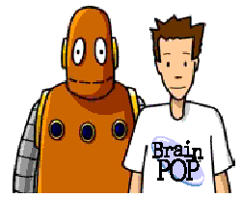
Poetry Video
This Photo by Unknown Author is licensed under CC BY-SA

Slide 3
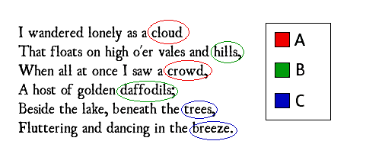
What is the rhyme scheme?
This Photo by Unknown Author is licensed under CC BY-SA

Slide 4
Now, you try. Identify the rhyme scheme of the Fresh Prince of Bel-Air’s Theme Song.
Now, this is a story all about how, my life got twisted upside down. And I'd like to take a minute just sit right there, I'll tell you how I became the prince of a town called Bel-Air.
In west Philadelphia, born and raised, on the playground is where I spent most of my days. Chillin' out maxin', relaxin' all cool, and all shootin' some b-ball outside of the school.

Slide 5
I whistled for a cab and when it came near, the license plate said "Fresh" and had dice in the mirror! If anything, I could say that this cab was rare, But I said, "Naw forget it. Yo homes to Bel-Air!"
I pulled up to a house about seven or eight, and I yelled to the cabby, "Yo homes, smell ya later!" Looked at my kingdom, I was finally there. To sit on my throne as the Prince of Bel-Air.

Slide 6
What is Rhyme Scheme?
A consistent pattern of end rhyme throughout a poem.
A rhyme scheme is designated by which last word in its lines rhyme with each other.
For instance, the following lines have an AABB rhyme scheme:
Now, this is a story all about how, my life got twisted upside down. And I'd like to take a minute just sit right there, I'll tell you how I became the prince of a town called Bel-Air.
Most raps rhyme in ‘couplets. That means lines rhyme two at a time. Lines one and two rhyme with each other, but not with the other lines. Lines 3 and 4 rhyme with each other, but not with the other lines. And so on. The two lines that rhyme together are a “couplet.”

Slide 7
What is Slant Rhyme?
Many times poets will create a rhythm with their writing by using words that sound similar but do not rhyme perfectly.
Here are some examples of words that sound similar but do not rhyme exactly:
Now, this is a story all about how, my life got twisted upside down.
In west Philadelphia, born and raised, on the playground is where I spent most of my days.
Check out Rhymezone.com or Rhymes.net to help find words that rhyme.

Slide 8
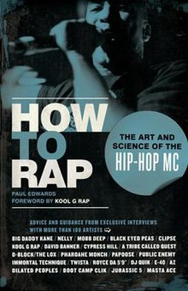
This Photo by Unknown Author is licensed under CC BY-SA

