Slide 1
Oil wealth and the middle east
A look into how oil money has transformed the Middle East

Slide 2
Vocabulary to know:
Oil / Petroleum- fuels including gasoline and diesel oil; Most valuable natural resource in the Middle East
Specialization- a nation concentrates its productive efforts on producing a certain variety of goods (like oil)
OPEC (Organization of Petroleum Exporting Countries) organization that controls the world’s oil market
Export - send (goods or services) to another country for sale.
Import- bring (goods or services) into a country from abroad for sale
Standard of Living- the degree of wealth and material comfort available to a person or community.
Population Density- statistic that tells you how many people live in a certain area.
Westernization- when a place becomes materialistic like western countries (such as the United States)
Materialism- the belief that having money and possessions is the most important thing in life

Slide 3
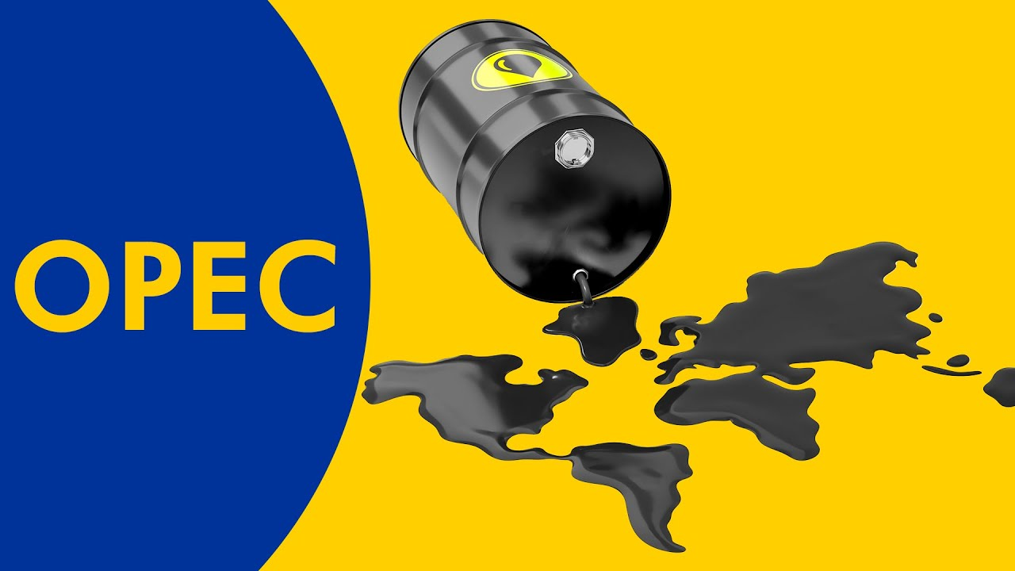
OPEC
Organization of Petroleum Exporting Countries
Founded in 1960, the goal was to regulate the price and supply of oil around the world
Includes Middle Eastern countries such as: Iran, Iraq, Kuwait, Libya, Saudi Arabia, United Arab Emirates, and Qatar
Watch the video above to learn more about OPEC

Slide 4
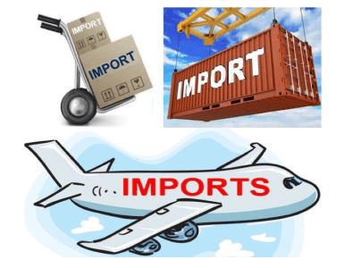
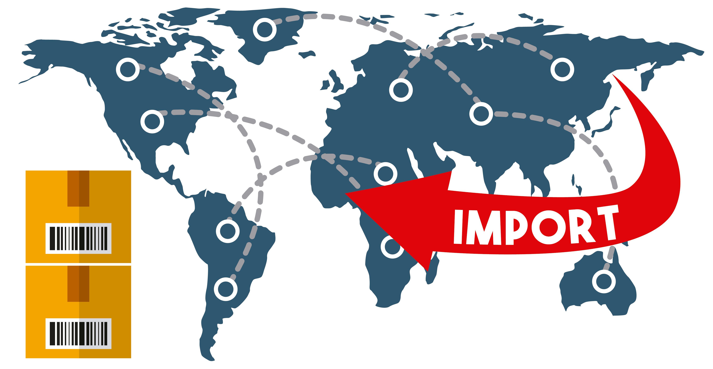
Import
Import- Many countries around the world must import their oil, meaning they purchase it from other countries *hint: if it’s important to you, you import it from another country

Slide 5
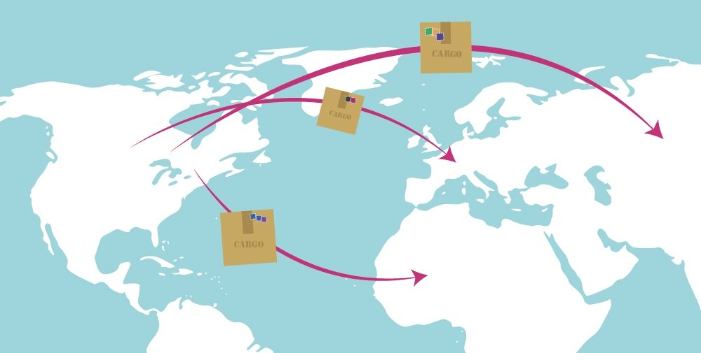
EXPORT
Export- Oil-rich countries such as Saudi Arabia export their oil, meaning they sell it to other countries for money.
*hint: exports- goods exit a country.

Slide 6
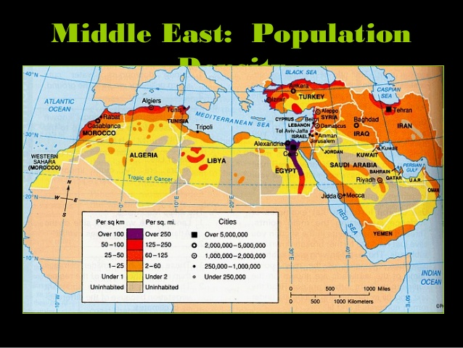
Population density
how many people live in a certain area
Note that the darker the area is, more people live there
People live near sources of water such as rivers and shorelines
People also tend to live in cities because there are more job opportunities there

Slide 7
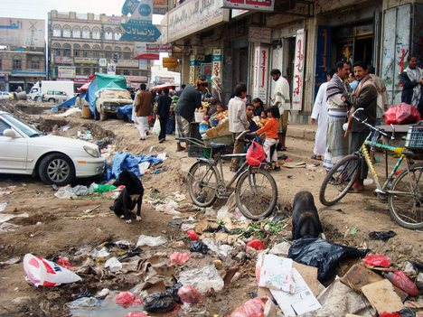
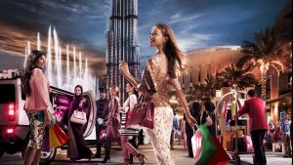
Standard of living
The degree of wealth and material comfort available to a person or community.
Oil has increased national wealth, which has led to an improved standard of living.
Countries without oil reserves have had a much more difficult time improving conditions
This difference in wealth in some of the Southwest Asia countries has led to conflicts among the nations
On the left: low standard of living. Right: high standard of living

Slide 8
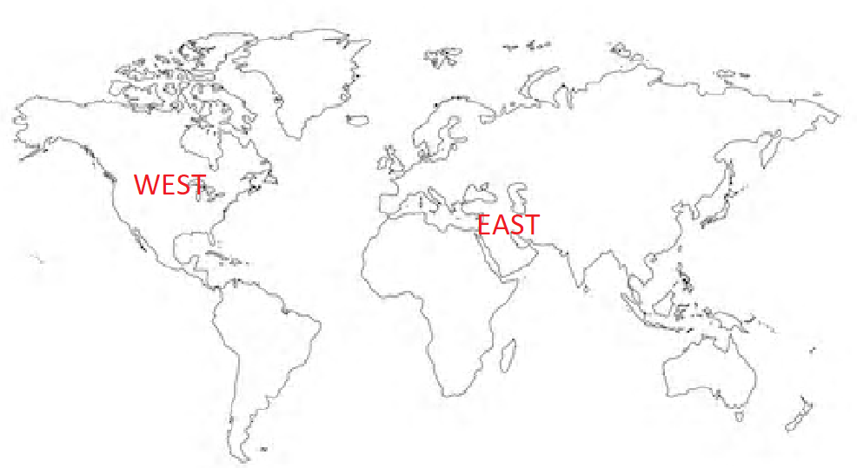
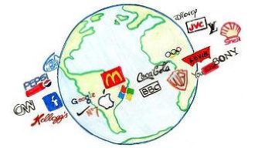
Westernization
Western culture is a term used to describe the social norms, belief systems, traditions, customs, and values that have their origin in Europe or North America
In other words, it is when a place becomes more materialistic and like the Western World.
This sometimes creates a clash between eastern and western cultures
Note how the US is located west on the map
Note all the US brands that you can find all over the world.

Slide 9
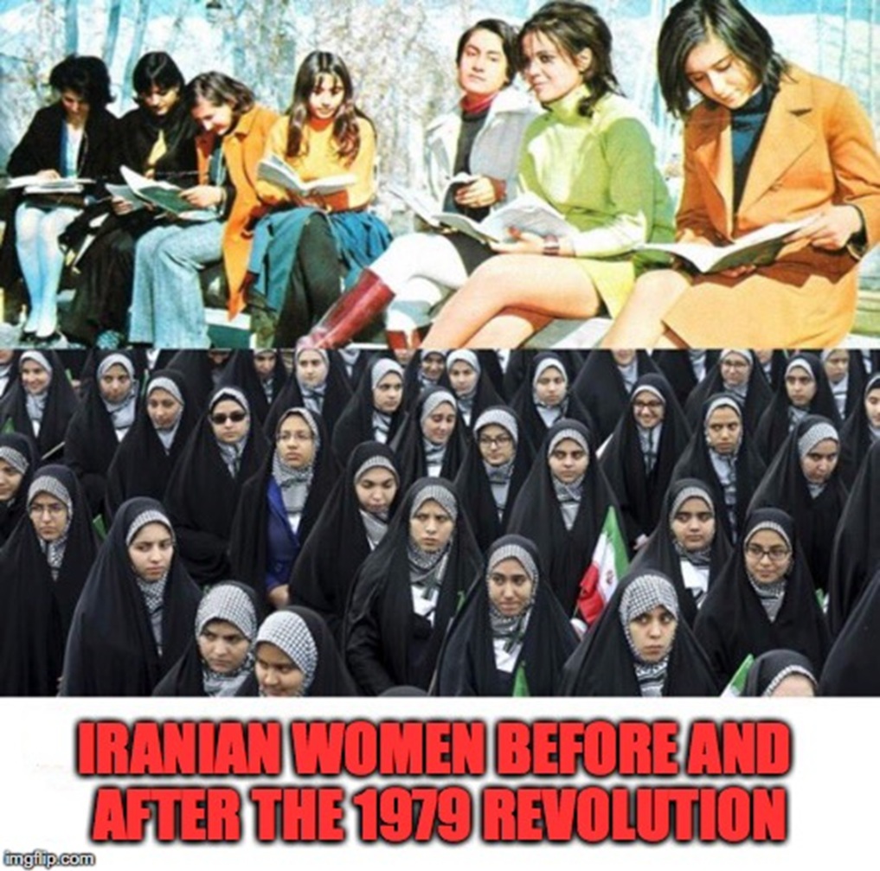
Western Culture Vs. Eastern Culture
The picture to the right shows two concepts of culture. Note the top women wore modern clothes, did their hair and makeup, attended school, etc. They look like women you might see in the United States
These traits were seen by many as too “western” and some felt that it was erasing their own culture. As a result, there was a rejection of these ideas

Slide 10
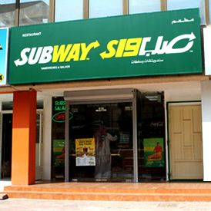
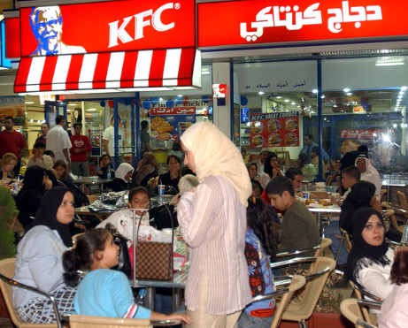
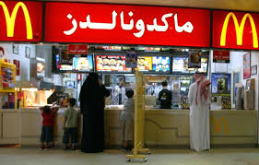
Western influence on Food
Western fast-food restaurants have created an obesity epidemic in the Middle East!
If there is time, feel free to check out the video As you watch, note how similar some of these places look like in the US and how it is changing the Middle Eastern population

Slide 11
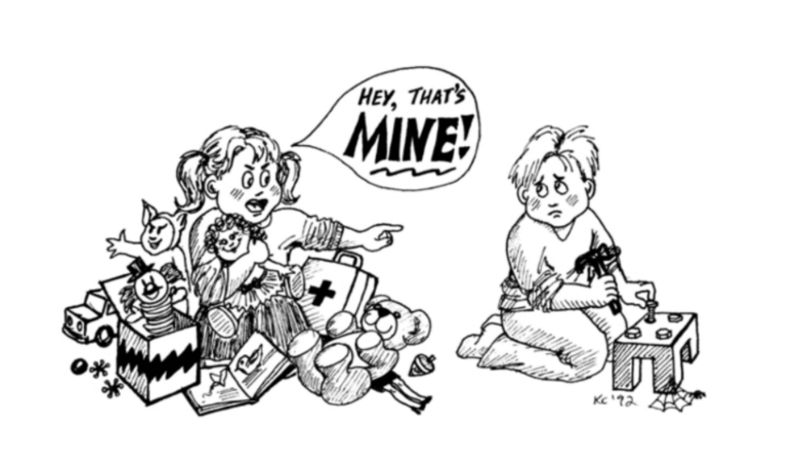
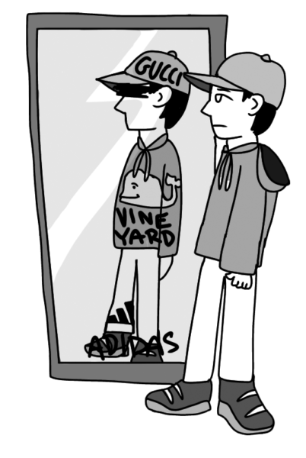
materialism
the belief that having money and possessions is the most important thing in life
In her music video “Material Girl” as seen above, Madonna throws around cash, wears diamonds, and declares that she is “living in a material world” and is a material girl.

Slide 12
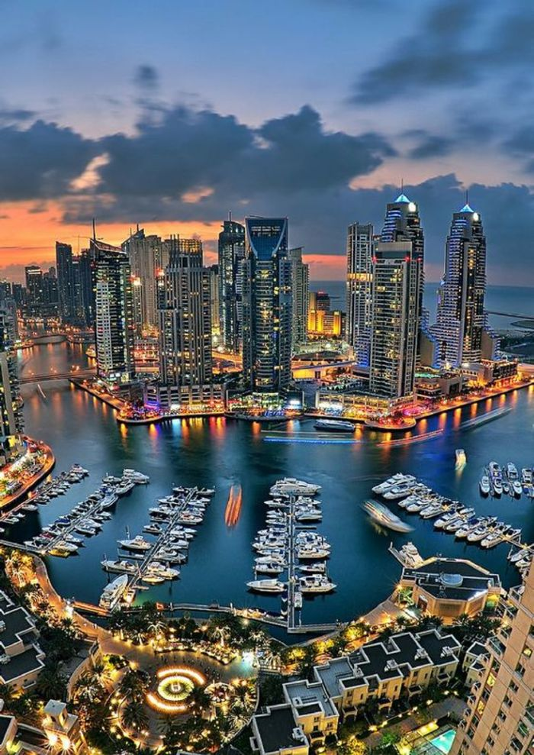
Dubai Then and now
As your scroll through the next few slides, note how Dubai has changed in just the past 30 years

Slide 14
Those are man-made islands below! People can purchase property and access them by private boat

Slide 15
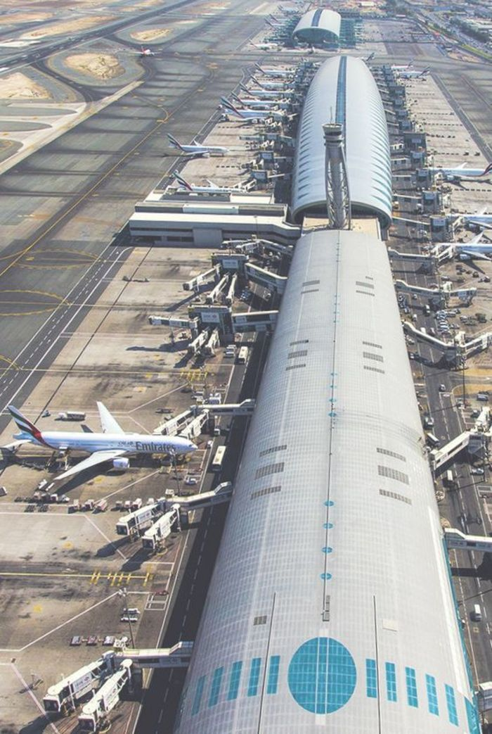

Slide 16
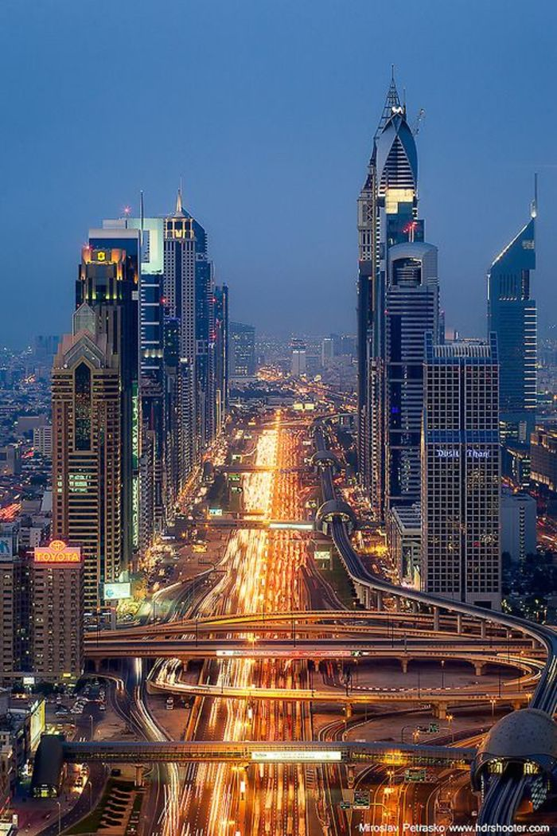

Slide 17
WATCH THE FOLLOWING VIDEO AND WRITE DOWN AT LEAST FIVE OBSERVATIONS ABOUT THE CITY OF DUBAI
https://www.youtube.com/watch?v=IdejM6wCkxA

Slide 18
Rich Kids of dubai
Western influence on cars, appearances, clothes, buildings, pets, and other material goods

Slide 19
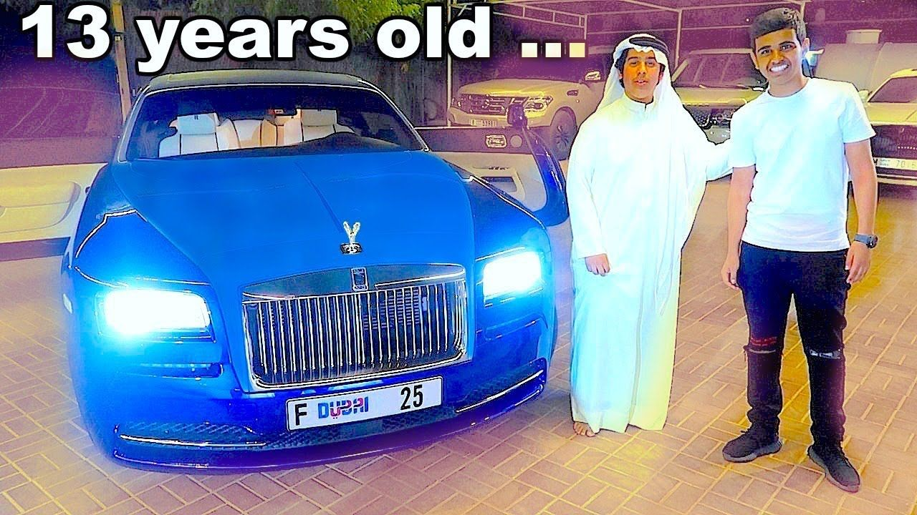

Slide 22
Tying the vocabulary all together….
Read the paragraph below to check and see if you fully understand the vocabulary in its context.
The most valuable natural resource in the Middle East is oil. Several countries in the Middle East founded OPEC (Organization of Petroleum Exporting Countries) in order to control the supply and price of oil. Countries such as Saudi Arabia specialize in oil and export their goods to other countries. Countries that do not naturally have oil must import it. Oil has increased the standard of living for many countries so their citizens live very well. Other results from increased standard of living include a higher population density, westernization and materialism. More and more younger generations in the Middle East like to live like people in the United States and show off their immense wealth/material goods as seen in the city of Dubai.

