Slide 1
Dubai
A look into how oil money has transformed a once small desert town into a large wealthy city through westernization.

Slide 2
Warm up:
As you look at the next images on the slides, observe the changes you notice over time.

Slide 3
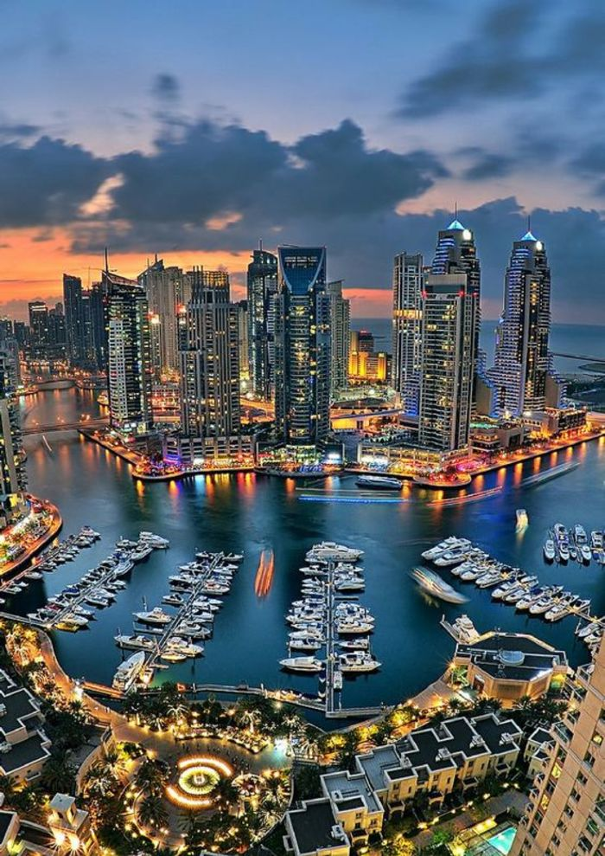
Dubai Then and now

Slide 6
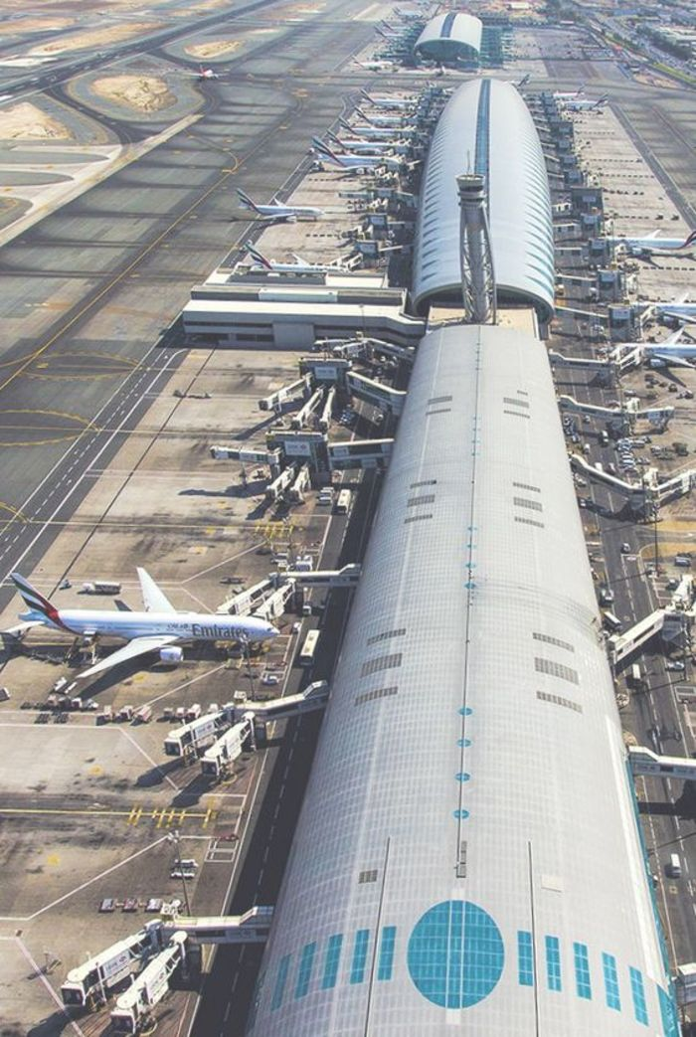

Slide 7
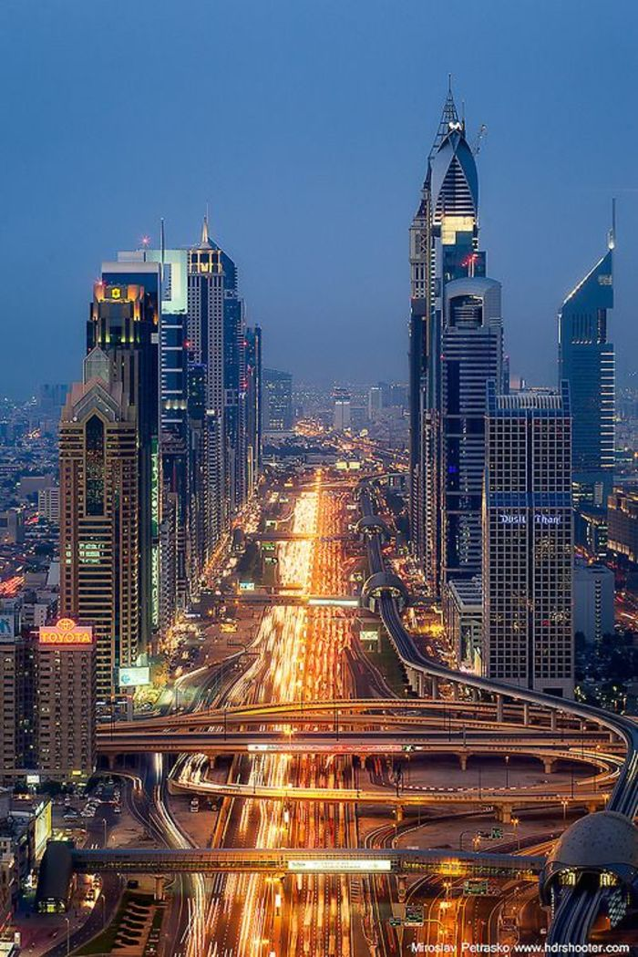

Slide 9
Video of dubai

Slide 10
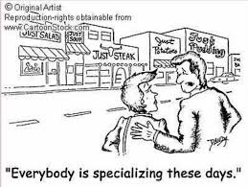
Specialization: Where does the Middle east get its money?
Specialization- when a nation or individual concentrates its efforts on producing a limited variety of goods
The Middle East specializes in oil which enabled cities like Dubai to rapidly grow!

Slide 11
Oil wealth leads to Westernization
Western culture is a broad term used to describe the social norms, belief systems, traditions, customs, values, and so forth that have their origin in Europe or North America
In other words, it is when a place becomes more materialistic and like the Western World, as seen in Dubai

Slide 12
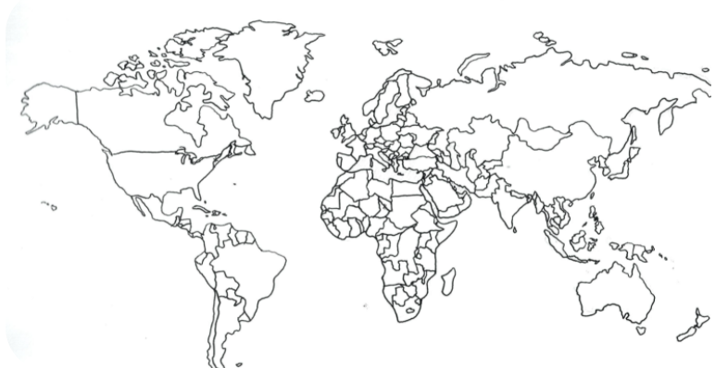
See how the United States is “western” compared to the rest of the world

Slide 13
Westernization Continued
Not all Middle Eastern countries embraced the idea of “Westernization” though.
Westernization is viewed by some as destroying “Eastern” way of life
As a result, there has been many conflicts over the years of some cultures fighting back against Western culture
Example: The Taliban, the group you may have heard about recently in the news, rejects many aspects of Westernization

Slide 14
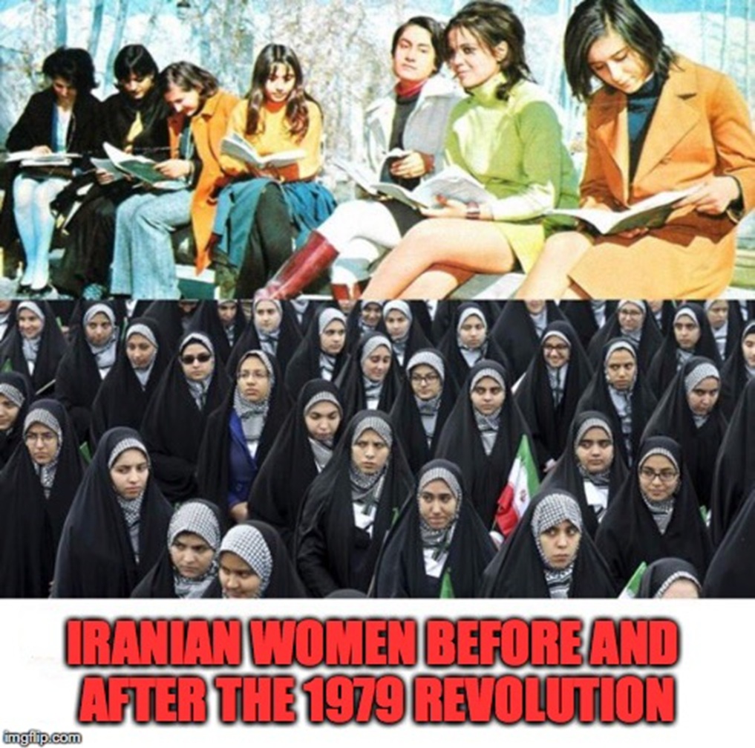
Western Culture Vs. Eastern Culture
Top picture: Influences of Westernization in women’s fashion
These traits were seen by many as too “western” and some felt that it was erasing their own culture. As a result, there was a rejection of these material things as seen in the Iranian Revolution in 1979

Slide 15
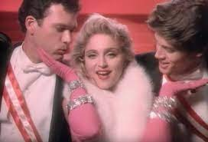
Materialistic
Materialistic means that you value material things like fancy clothes, cars, property, etc. Basically, you are showing off wealth
Problem: These cultures in the East value modesty, giving money to charity, and religion creating a CULTURE CLASH!
Madonna famously sang “We are living in a material world, and I am a material girl!” Note her diamonds and fur- she is materialistic.

Slide 16
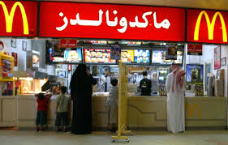
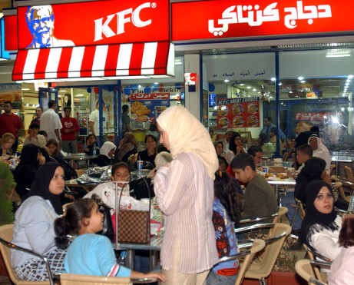
Western influence even affects Middle eastern diet and health

Slide 17
American Fast Food Took Over Kuwait And Made Its People Obese

Slide 18
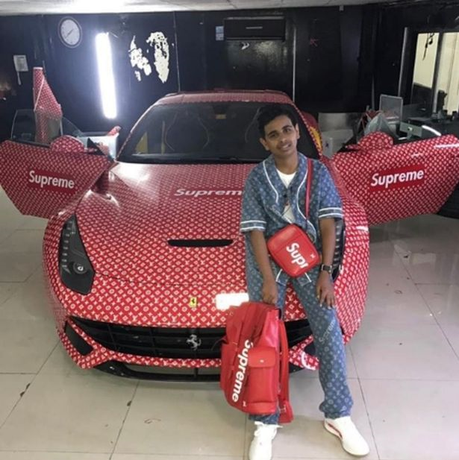
Rich Kids of dubai
Western influence on cars, appearances, clothes, buildings, pets, and other material goods

Slide 19
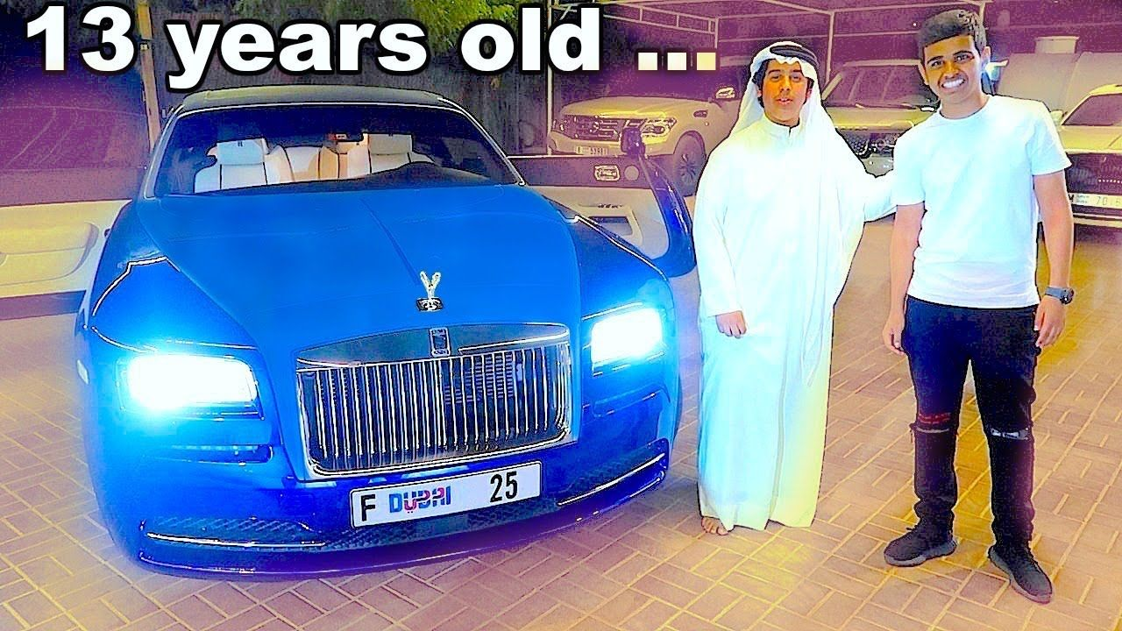

Slide 22
points TO Ponder…
Even though these pictures are all from the Middle East, these pictures look like they were taken in United States
Do any of these rich kids look like they’re concerned with religion?
Do they look like they pray five times a day? Give to the poor? Fast during Ramadan?
Do they value God or material goods?

