Slide 1
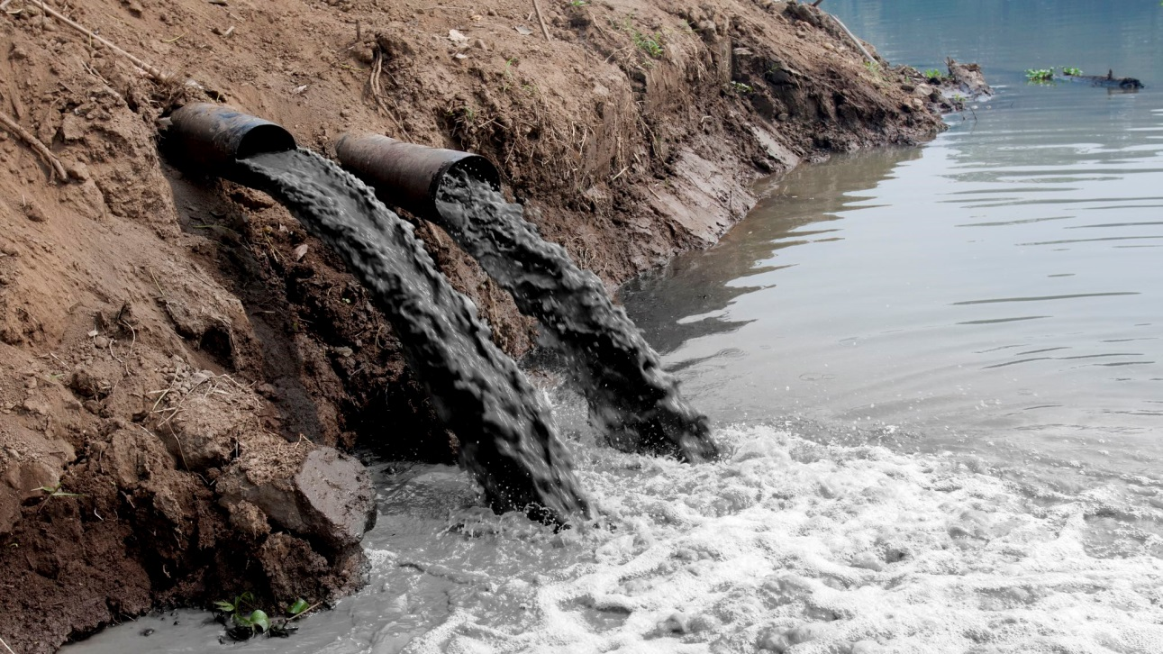
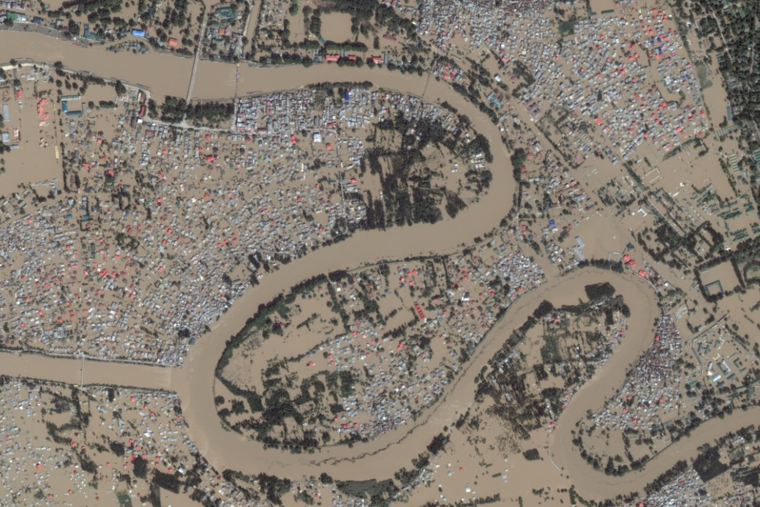
What environmental issues are illustrated in the pictures?

Slide 2
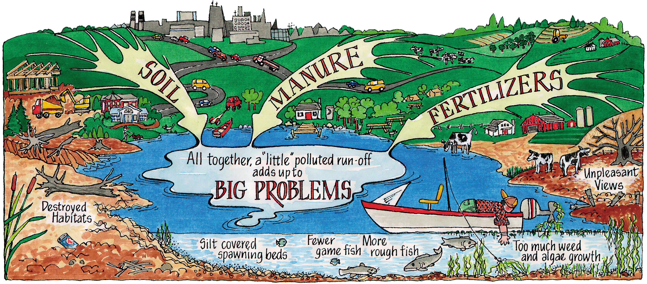
Water Pollution
Dumping sewage and industrial and agricultural wastes cause river pollution, which in turn threatens plant and wildlife species.

Slide 3
Water Pollution in India
Water pollution only worsens India’s water shortage problems.
Artificial fertilizers from farming and industrial waste from factories seep into India’s rivers and pollute them.
India’s Ganges River has been heavily polluted by industrial waste, sewage, and even human remains.

Slide 4
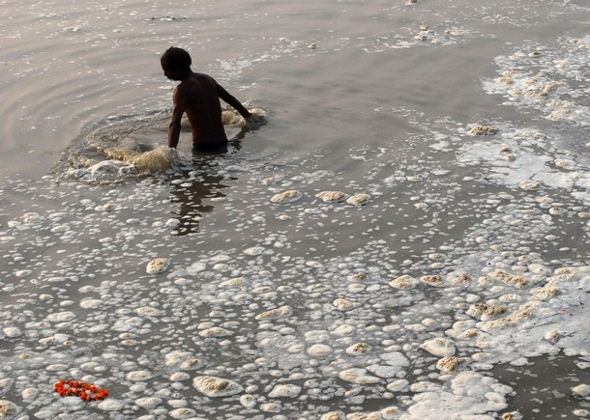
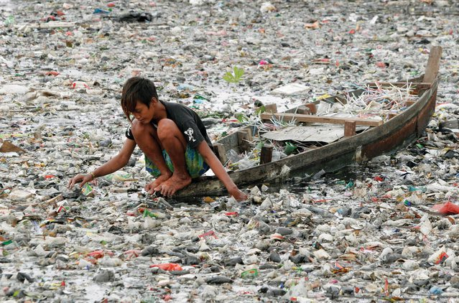
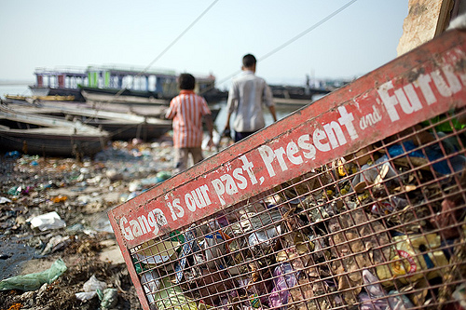
Water
Pollution in India

Slide 5
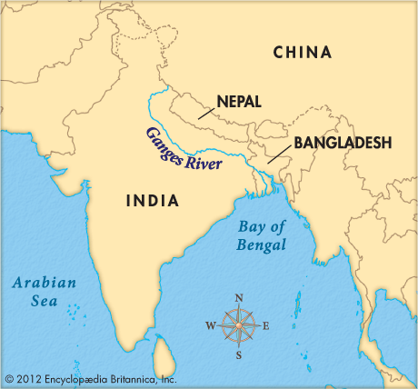
Pollution in India’s Ganges River

Slide 6
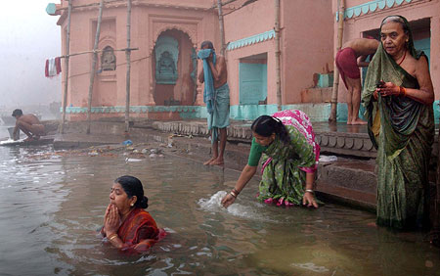
Pollution in India’s Ganges River
The Ganges River serves 500 million people, most of whom believe it is of religious significance.
As a result, many people bathe in the river, which contributes to the pollution.

Slide 7
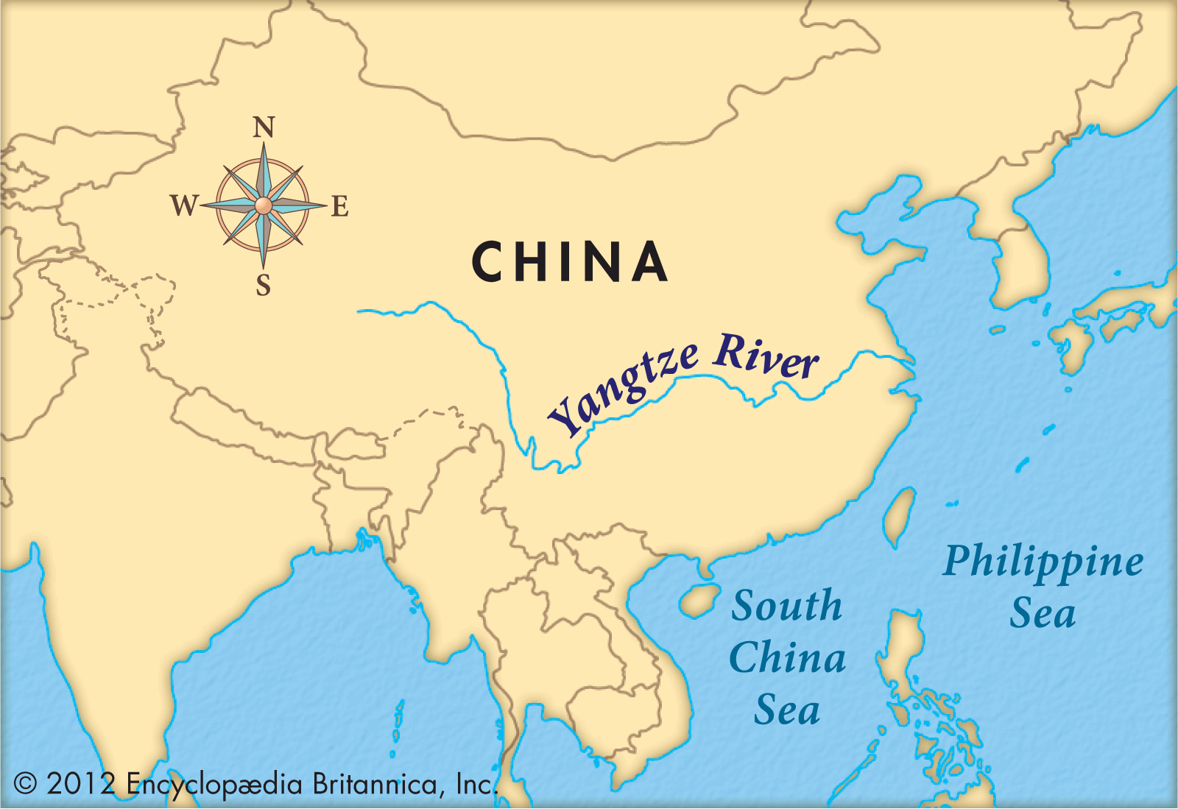
Pollution in China’s Yangtze River

Slide 8
Water Pollution in China
Pollution in the river has increased over 73% in the past 50 years.
Most agree the pollution is caused by large-scale industrial and domestic development, as well as agricultural runoff.
Hundreds of cities located along the river contribute to the pollution.

Slide 9
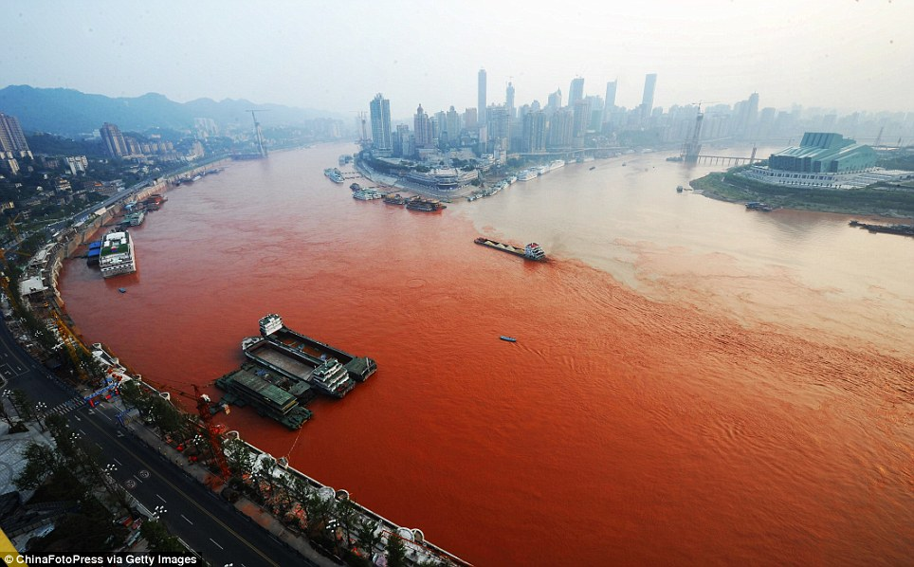
Pollution in China’s Yangtze River

Slide 10
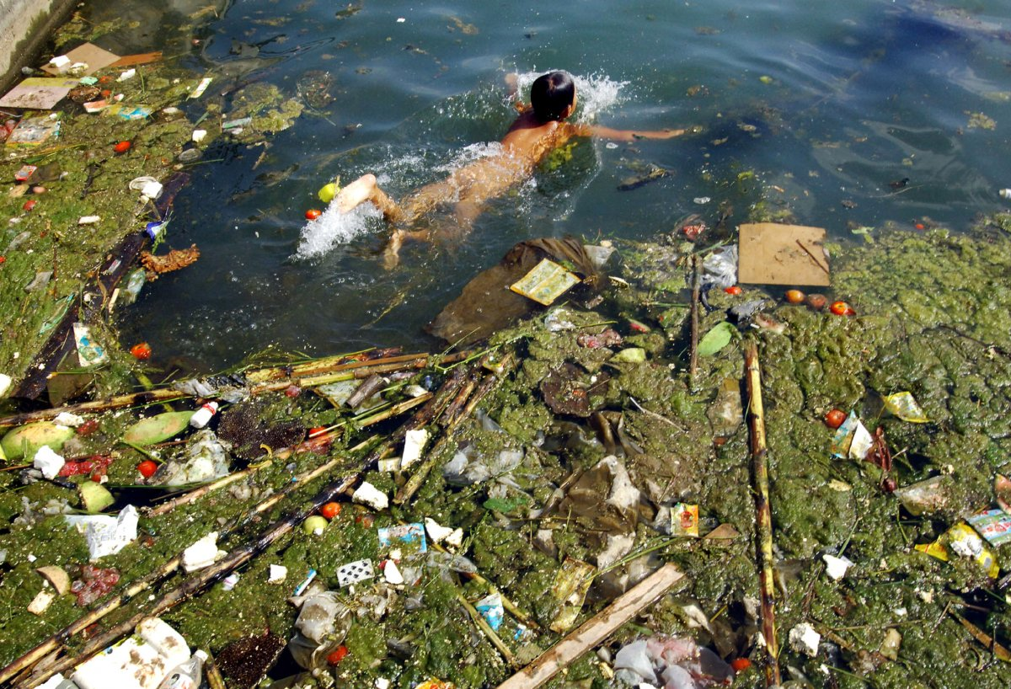
Pollution in China’s Yangtze River

Slide 11
Think, Pair, Share
What are the causes of water pollution in India and China?
What are some of the effects of water pollution?

Slide 12
Summarize the Cause(s) and Effect(s) of Water Pollution in India and China on your graphic organizer.

Slide 13
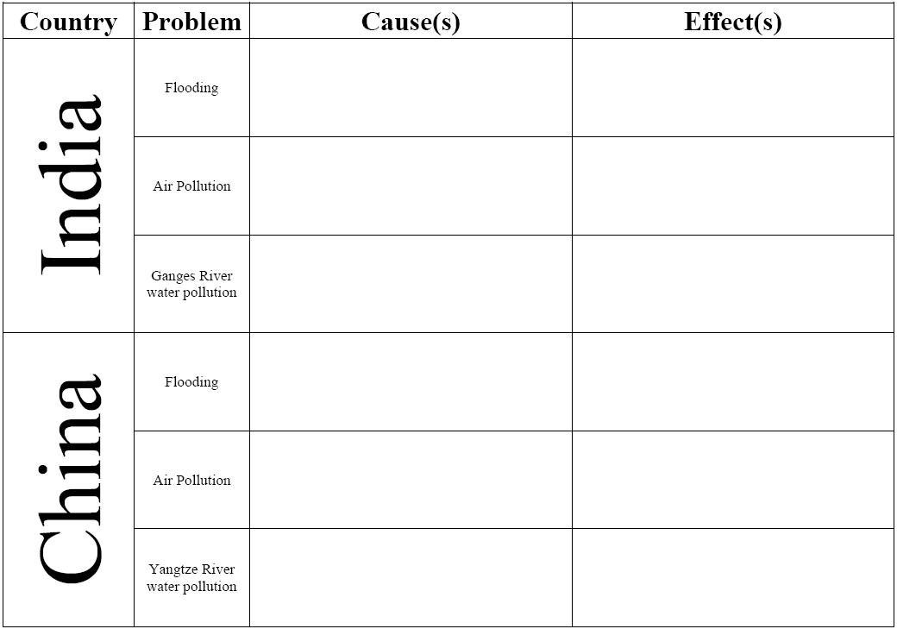
Most Indians believe it is of religious significance. As a result, many people bathe in the river, which contributes to the pollution. Industrial, agricultural, and human wastes contribute to the pollution.
Dumping sewage and industrial and agricultural wastes cause river pollution, which in turn threatens human, plant and animal life.
Most agree the pollution is caused by large-scale industrial and domestic development, as well as agricultural runoff. Hundreds of cities located along the river contribute to the pollution.
Dumping sewage and industrial and agricultural wastes cause river pollution, which in turn threatens human, plant and animal life.

Slide 14
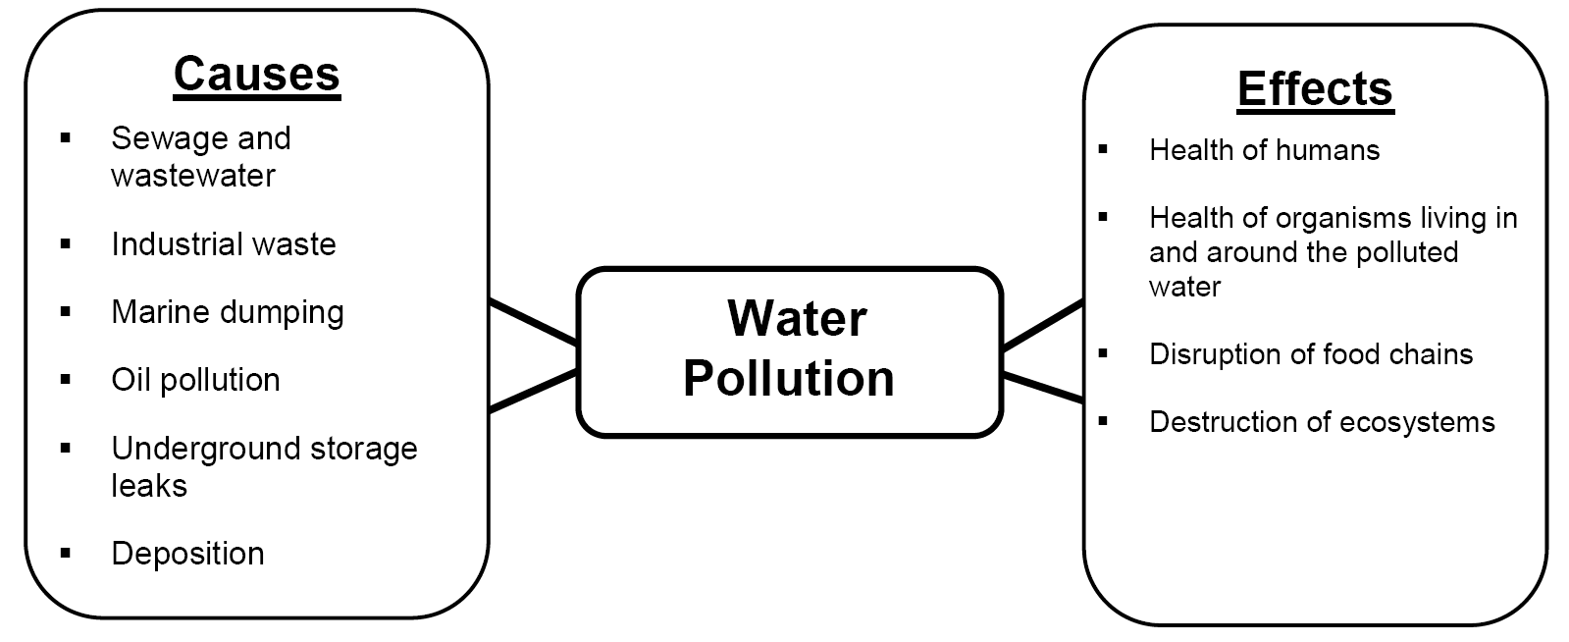

Slide 15
Watch the video clips below about water pollution in India and China:
Move Over Smog: China’s Water Pollution Off the Charts [3:45]
India’s Polluted Water Systems [4:53]

