Slide 1
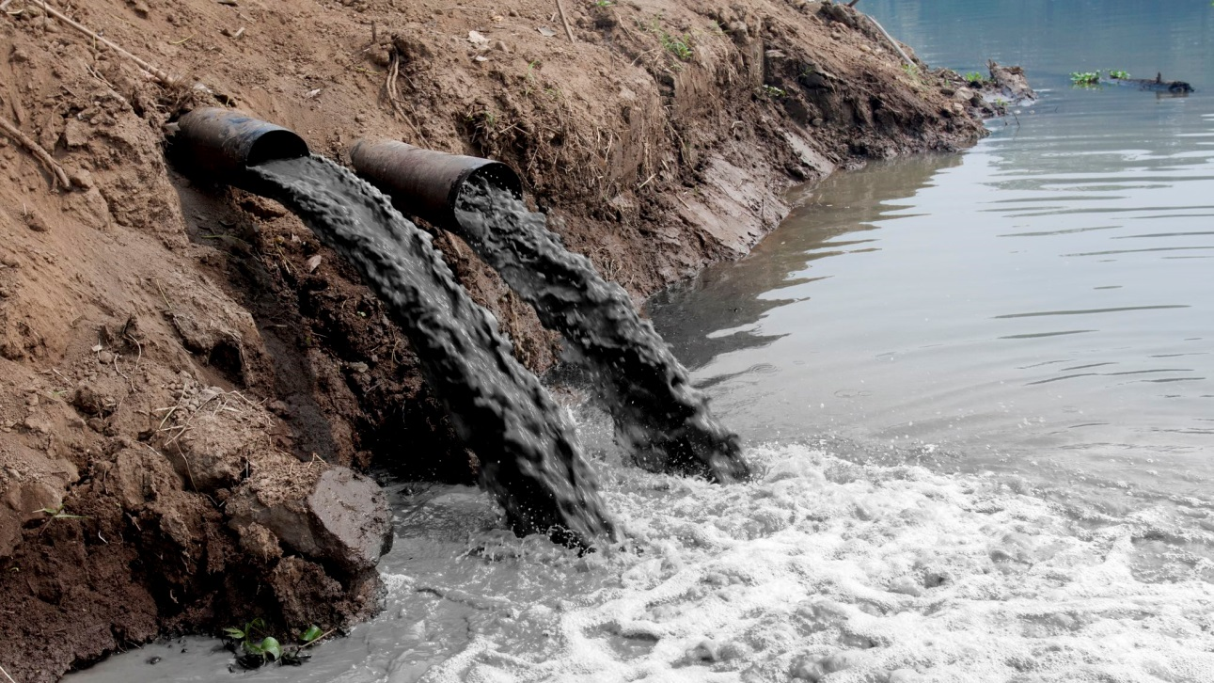
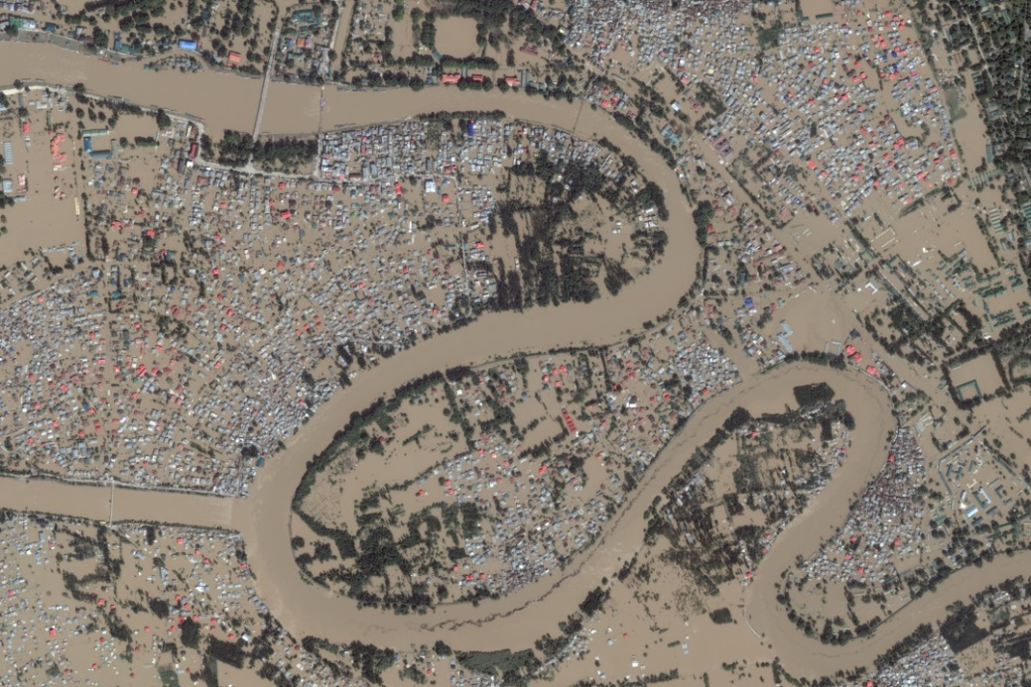
What environmental issues are illustrated in the pictures?

Slide 2
Essential Question:
How has pollution and flooding affected Southern & Eastern Asia?
Standard:
SS7G10a. Describe the causes and effects of pollution on the Yangtze and Ganges Rivers.
SS7G10b. Describe the causes and effects of air pollution and flooding in India and China.

Slide 3
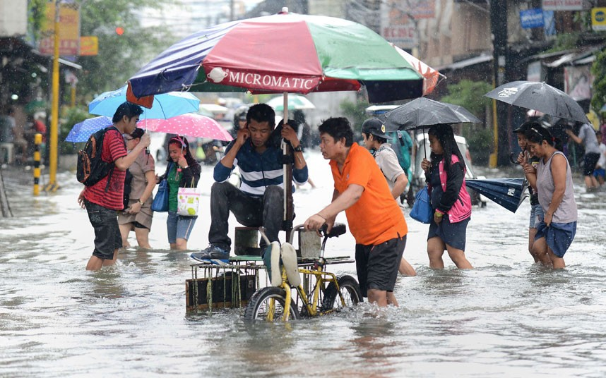
Flooding in India and China

Slide 4
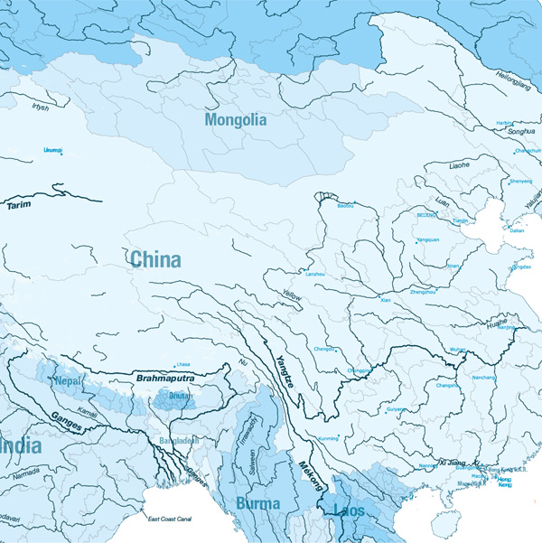
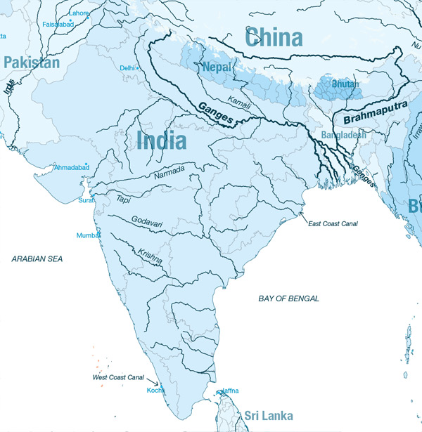
Because parts of China and India are located along waterways, they are subject to flooding, which can damage the soil and make areas practically uninhabitable.

Slide 5
Monsoons cause the majority of flooding in India and China. What are monsoons?
A monsoon is a seasonal change in the direction of the strongest winds of a region. Monsoons cause wet and dry seasons. Flooding can occur during the wet season.

Slide 6
Monsoons
[select one or two videos below]
Indian Monsoon Mechanism Animation
[3:08 animation explaining monsoons but there is no audio]
Monsoon in Kerala, India [1:22]
Effects of Monsoon Rain on India [3:25]

Slide 7
Think About It!
Why are monsoons a mixed blessing?
Monsoons help farmers because they rely on rainfall. Water from the rainfall can also be used to generate electricity.

Slide 8
What types of human activity increase the effects of rainfall during the monsoon season?
Deforestation, Land Development, Removing Wetlands

Slide 9
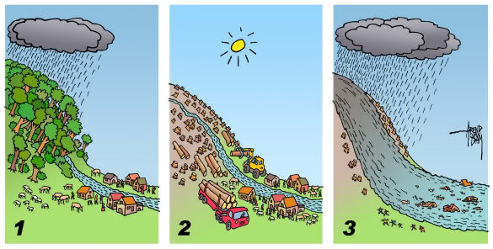
Human Activities that can Affect Flooding

Slide 10
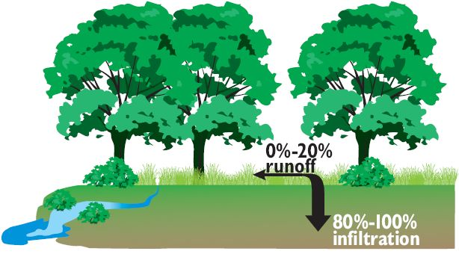
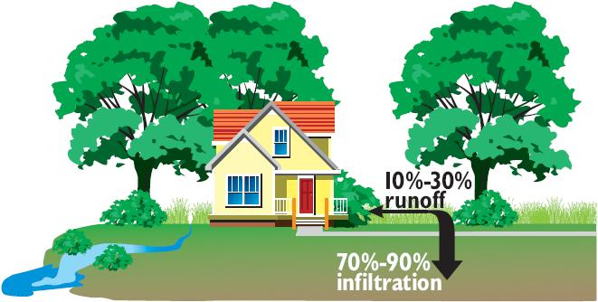
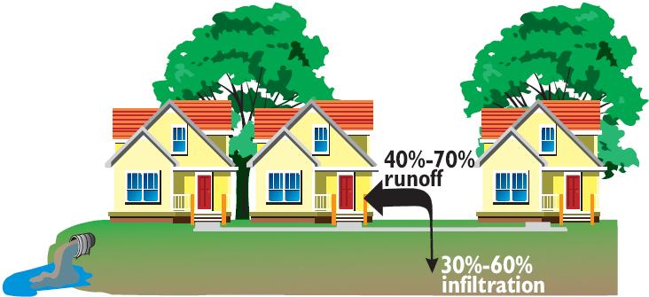

Slide 11
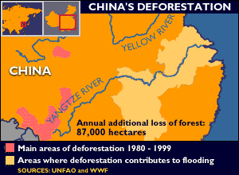
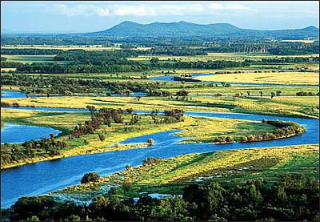
Deforestation and the loss of wetlands has increased the effects of flooding in China.

Slide 12
Summarize the Cause(s) and Effect(s) of Flooding in India and China on your graphic organizer.

Slide 13
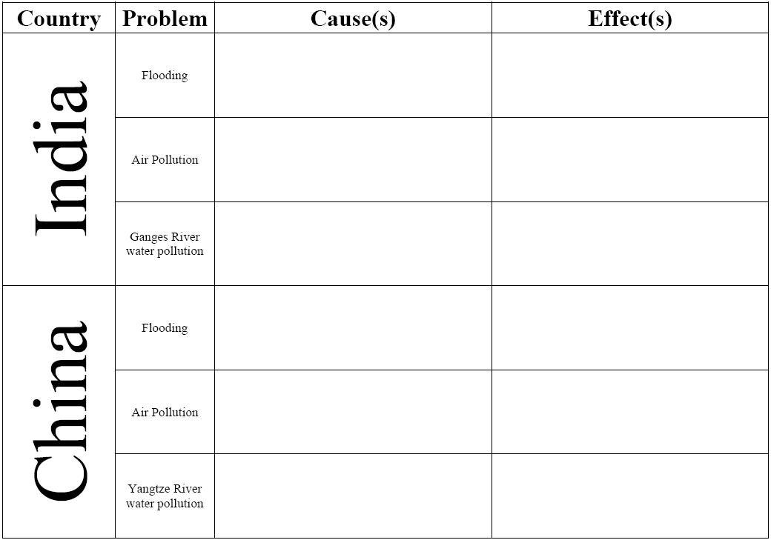
Monsoons (seasonal winds that bring rain) cause flooding in India. However, rain during the monsoon wet season helps farmers and is used to generate electricity.
Flooding caused by monsoons can harm living organisms (death or water borne illnesses), damage property and the environment, disrupt communication and transportation, cause economic losses.
Monsoons (seasonal winds that bring rain) cause flooding in India. However, rain during the monsoon wet season helps farmers. Over the years, China has cut down trees and drained wetlands which has increased flooding.
Flooding caused by monsoons can harm living organisms (death or water borne illnesses),
damage property and the environment, disrupt communication and transportation, cause
economic losses. Huang He causes more deaths
than any other in the world.

Slide 14
