Slide 1
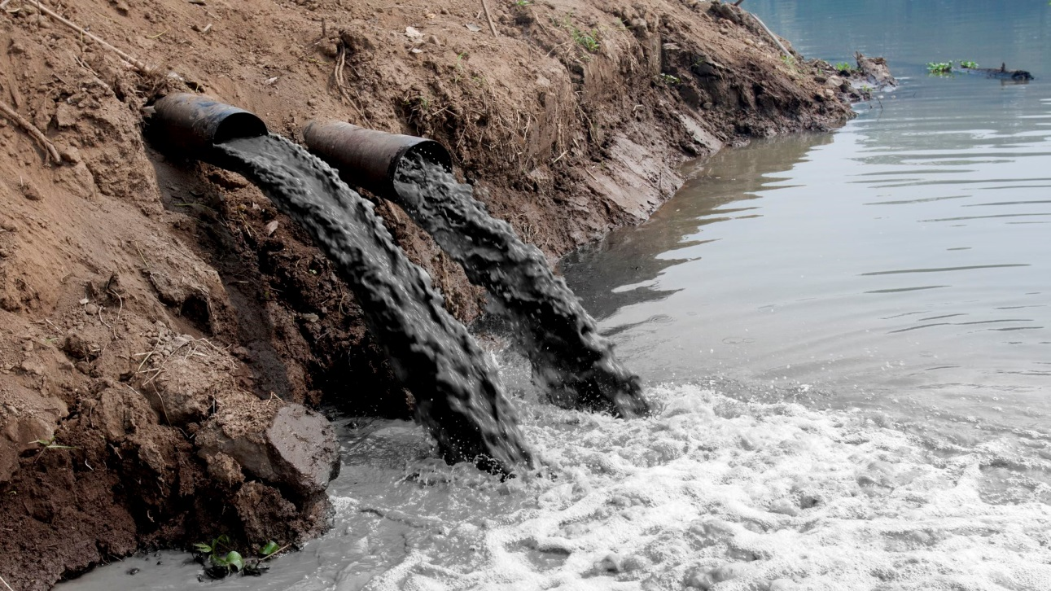
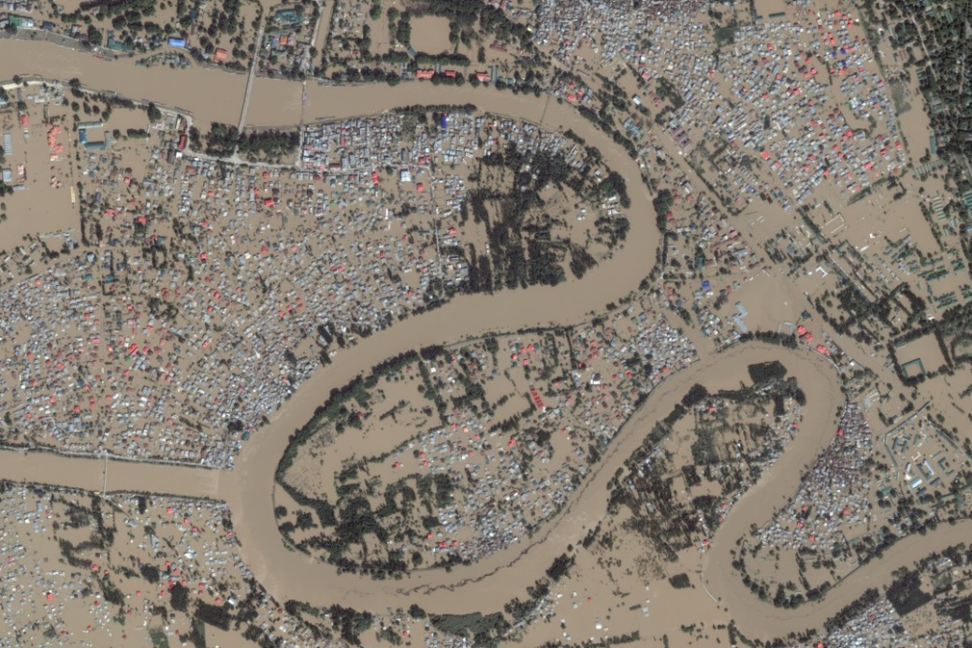
What environmental issues are illustrated in the pictures?

Slide 2
Essential Question:
How has pollution and flooding affected Southern & Eastern Asia?
Standard:
SS7G10a. Describe the causes and effects of pollution on the Yangtze and Ganges Rivers.
SS7G10b. Describe the causes and effects of air pollution and flooding in India and China.

Slide 3
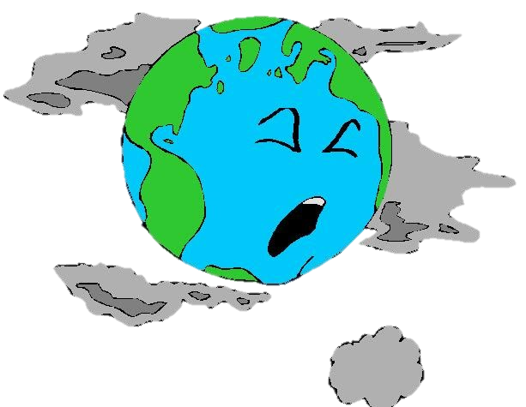
Air pollution is the introduction of harmful materials into the Earth’s atmosphere.

Slide 4
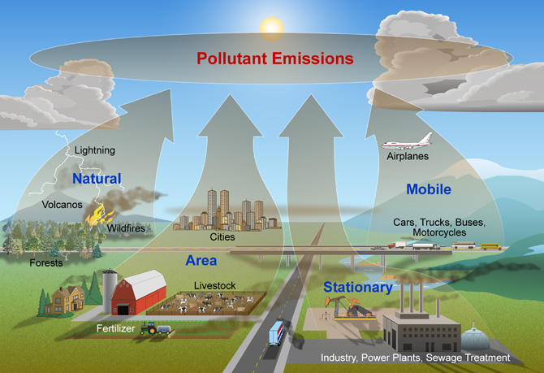
Causes of Air Pollution

Slide 5
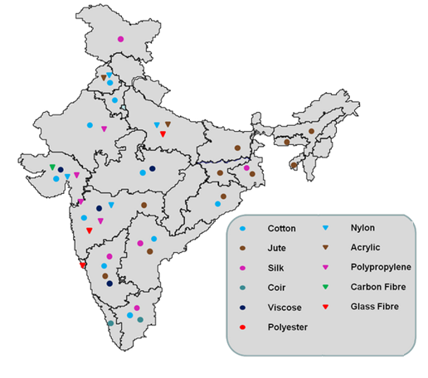
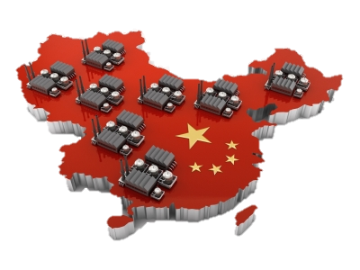
The growth of industry has increased air pollution in India and China (burns fossil fuels).

Slide 6
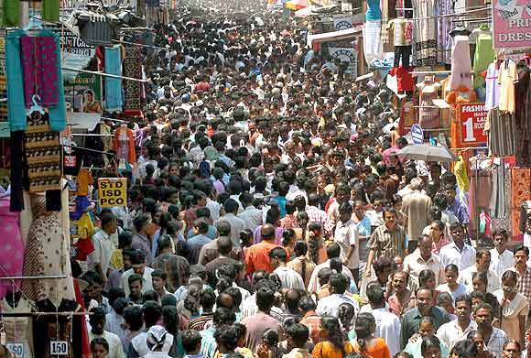
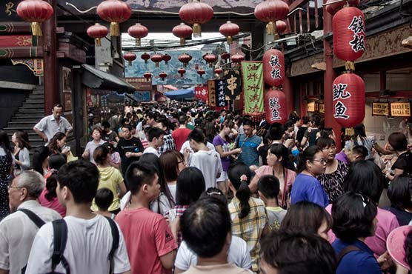
Population growth has increased air pollution in India and China.

Slide 7
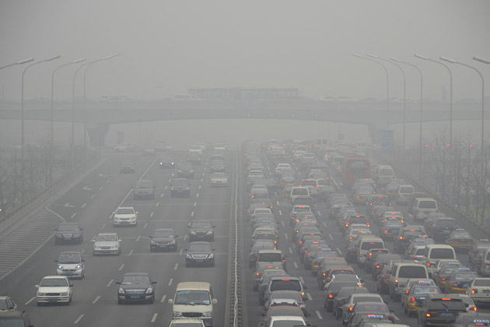
Vehicle emissions has increased air pollution in India and China.

Slide 8
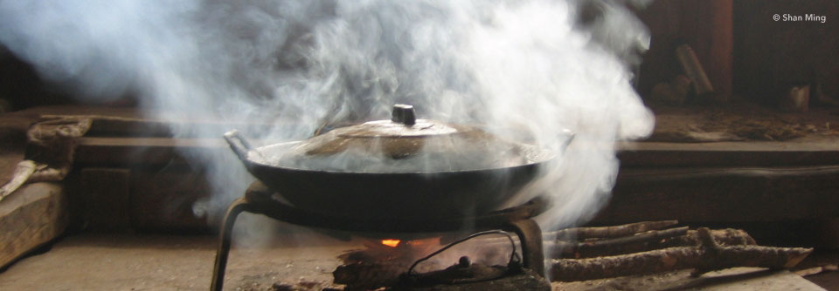
Indoor Air Pollution is an increasing problem in India and China.

Slide 9
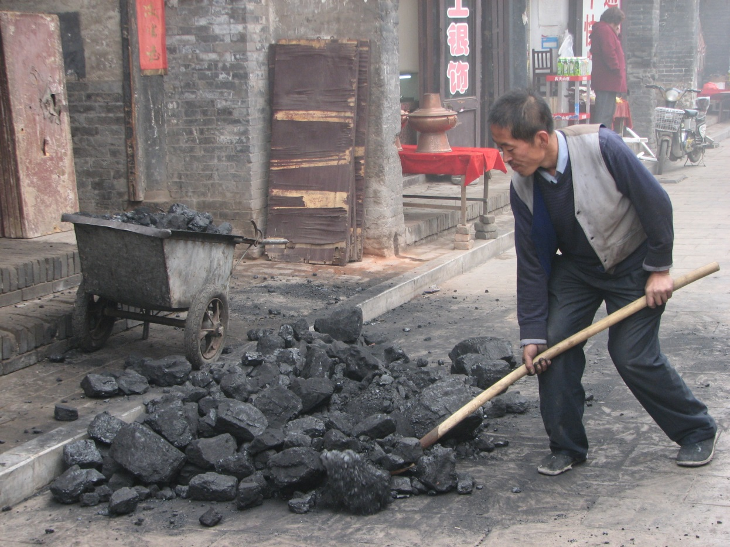
Many Chinese people use coal (fossil fuel) to heat their homes which increases air pollution.

Slide 10
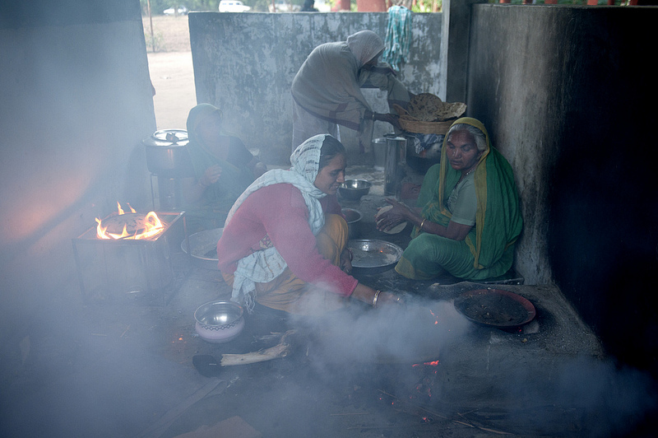
The use of biomass fuels for cooking has increased indoor air pollution.

Slide 11
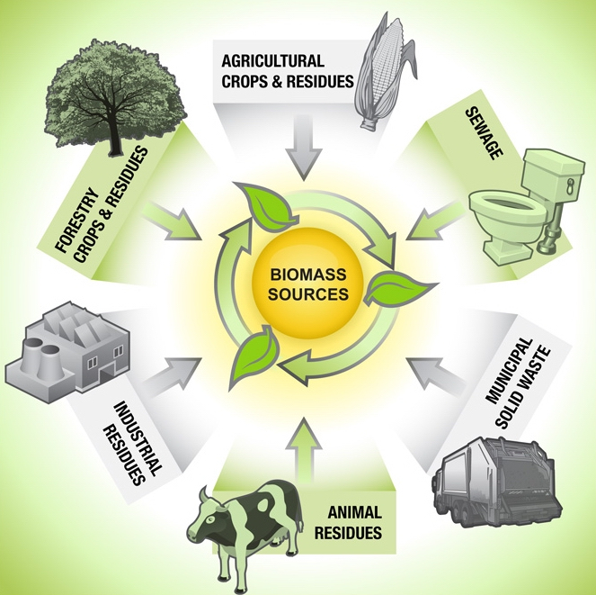
Biomass is biological material derived from living, or recently living organisms

Slide 12
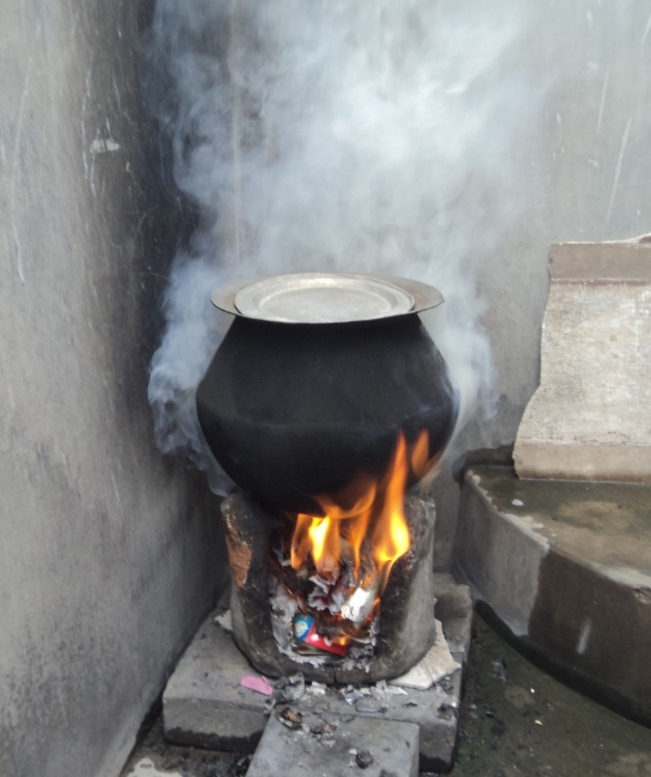
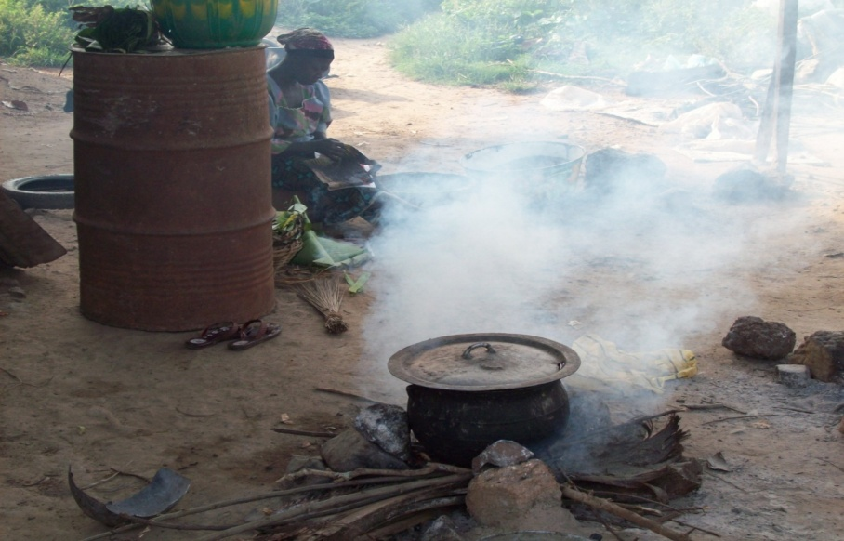
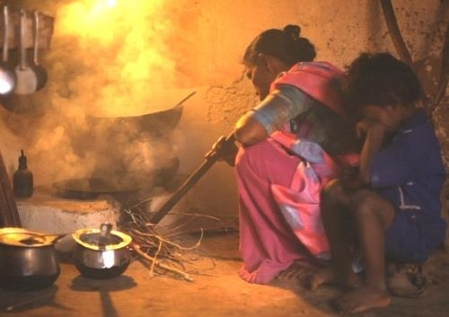
Cooking that Kills [3:00]

Slide 13
Think About It!
What are the causes of air pollution in India and China?
What are some of the effects of air pollution?

Slide 14
Summarize the Cause(s) and Effect(s) of Air Pollution in India and China on your graphic organizer.

Slide 15
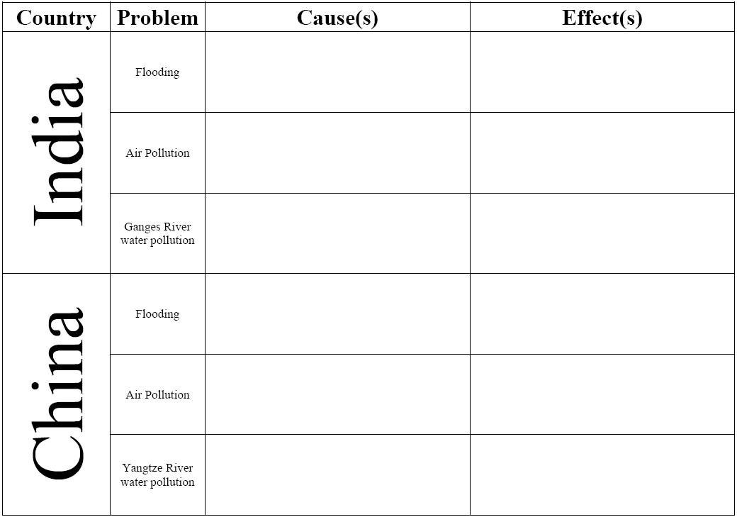
The burning of fossil fuels and car and factory emissions are polluting the air. Additionally, people in India use biomass for indoor cooking purposes which adds to indoor pollution.
Burning fossil fuels pollutes the air which can lead to health problems. Additionally, air pollution leads to acid rain which can damage buildings and natural locations.
The burning of fossil fuels and car and factory emissions are polluting the air. Additionally, people in China use coal (fossil fuel) to heat their homes which adds to indoor pollution.
Burning fossil fuels pollutes the air which can lead to health problems. Additionally, air pollution leads to acid rain which can damage buildings and natural locations.

Slide 16
Watch the video clips below about air pollution in China:
  Air Pollution becoming life-and-death Issue in China [1:56]
  4,000 People in China Die Every day from Air Pollution [44 seconds]
  China Pollution Levels Hit 20 Times Safe Limit [59 seconds]

Slide 17
