Slide 1
Parliamentary & Presidential
DEMOCRACIES
How we the people choose
Legislatures and Executive Leaders

Slide 2

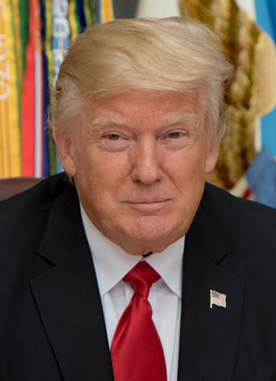
Presidential Democracy
  Democratic form of government where the head of government (executive leader) is directly elected and legislators are chosen in a different election.
Separate branches
(separate elections)
President
Donald Trump
Legislature
House of Representatives
Senate

Slide 3
Presidential Democracy
Is a Representative Democracy (the citizens vote for people who do our voting for us)
Has a constitution (written set of laws)
Answers to the people (people have the power)
Executive leader (President) is elected by the people
The legislature has no part in selecting the executive leader (the people choose the president, not the Congress)
The Executive leader can be from either party
The citizens vote TWICE (once for Executive and once for Legislative)
Executive
Legislative
Elect
Elect
Citizens

Slide 4
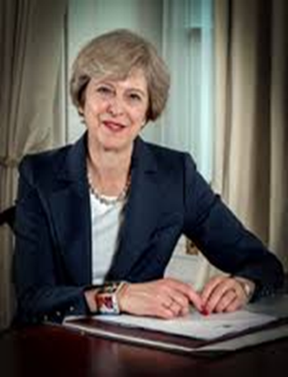
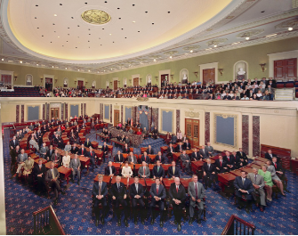
Parliamentary Democracy
  Democratic form of government where the political party with the greatest representation in the parliament (legislature) forms the government. Its leader becomes executive leader.
Citizens vote for Parliament
Parliament chooses Prime Minister
Prime Minister
Theresa May
Parliament

Slide 5
Parliamentary Democracy
Is a Representative Democracy (the citizens vote for people who do our voting for us)
Has a constitution (written set of laws)
Answers to the people (people have the power)
One political party (the executive leader and the legislature are from the same political party)
The Executive Leader is from the majority party
Executive leader (often called a Prime Minister), is selected by the legislature, NOT by the people
The citizens vote ONCE (for the legislature)
Executive
Select
Legislative
Elect
Citizens

