Slide 1
Southwest Asia’s
Oil Distribution

Slide 2
Standards
SS7G7 The student will explain the impact of location, climate, physical characteristics, distribution of natural resources, and population distribution on Southwest Asia (Middle East).
a. Explain how the distribution of oil has affected the development of Southwest Asia (Middle East).

Slide 3
Southwest Asia’s
Oil Distribution

Slide 4
Oil in the Middle East
One of the most important resources in this region is oil.
It was discovered in Persia (now Iran) in 1908.
In the 1930s, more oil was found on the Arabian Peninsula and around the Persian Gulf.
The Middle East became extremely important to other countries as they began to take control of oil production.

Slide 5
Oil in the Middle East
This region has been completely transformed due to the discovery of oil.
Southwest Asia has the world’s largest known oil reserves.
Saudi Arabia and Iran have the largest deposits of oil.
Oil and natural gas have brought much wealth to some countries in this region.

Slide 6
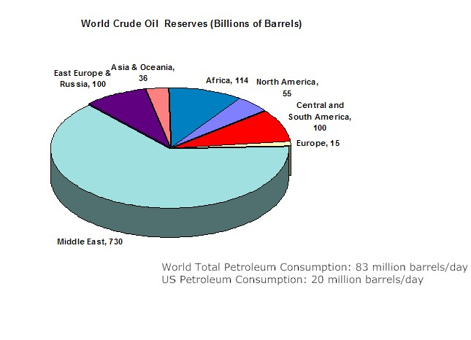

Slide 7
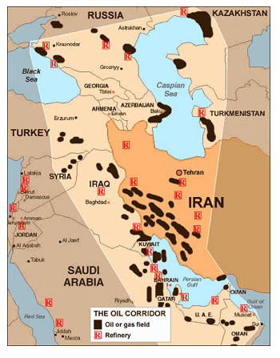

Slide 8
Oil’s Importance
Many countries around the world depend on oil to meet their everyday needs.
Oil (petroleum) is used for:
Fuel
Medicines
Plastics (Think of everything that’s made with plastic!)
Fertilizers & Pesticides
Cleansers
Countries need oil, but most don’t have it, so they must buy it from oil-producing countries.

Slide 9
Oil’s Impact
Because so many countries need oil, Southwest Asia’s oil-producing countries have taken control of the global economy.
Many Southwest Asian countries have become dependent on oil sales.
Money from oil sales has been used to better the lives of the people in the oil-producing countries.

Slide 10
Oil Money
Oil-producing countries have enjoyed tremendous growth in national wealth and an improved standard of living.
Citizens that live in these countries may have the access to quality houses, food, health care, education, jobs, transportation, communication, and luxury items.
The countries have used the money to build modern buildings, schools, factories, hospitals, etc.
Also, they have been able to pave old roads and build new ones.
The life expectancy in these countries has increased by over 15 years because of advancements in healthcare, hospitals, medicines, education, etc.

Slide 11
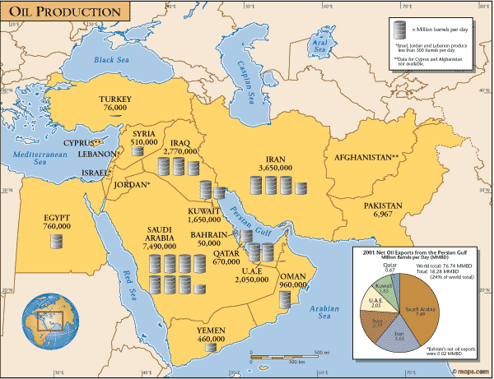

Slide 12
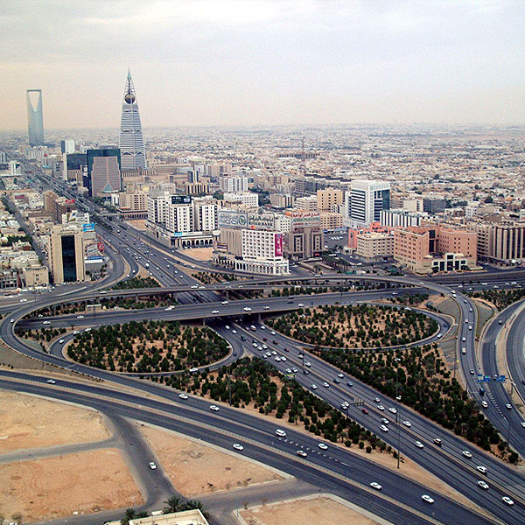
Riyadh – Capital of Saudi Arabia

Slide 13
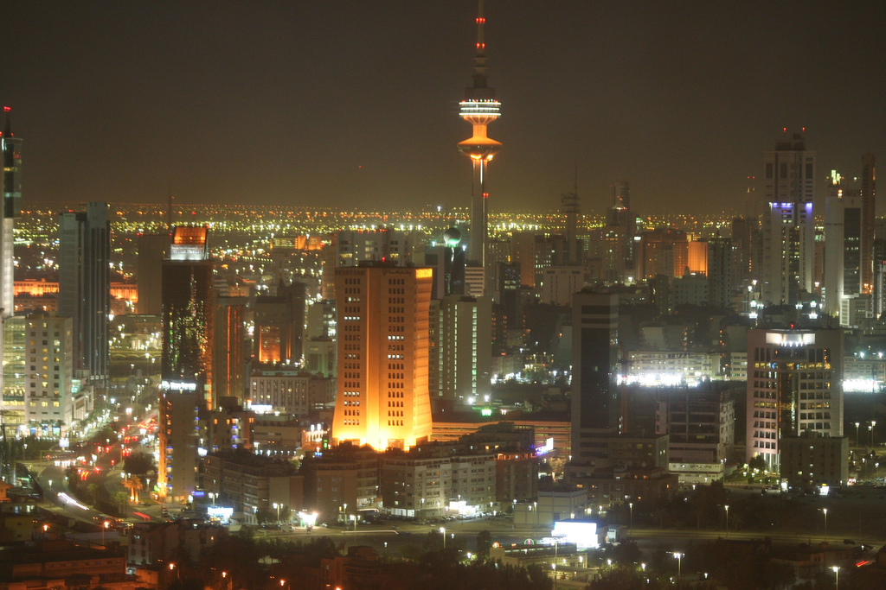
Kuwait City – Capital of Kuwait

Slide 14
Unequal Oil Distribution
Some countries have grown very rich due to their oil production (Saudi Arabia, Iran, Iraq, Kuwait), while countries without oil are struggling (Afghanistan, Jordan, Israel, etc.).
Southwest Asian countries without oil have a much harder time improving living conditions for their population.
This drastic difference in the distribution of oil wealth has led to many conflicts among Southwest Asian nations.

Slide 15
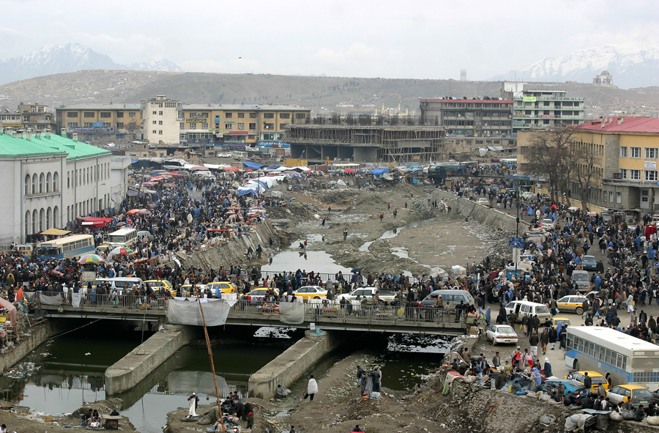
Kabul – Capital of Afghanistan

Slide 16
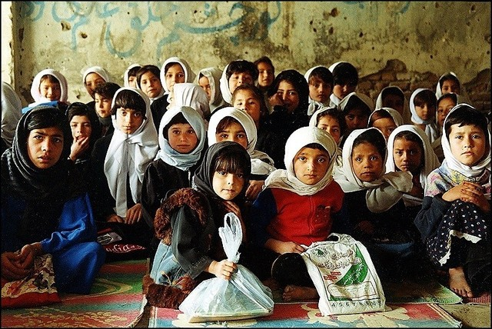
School in Kabul, Afghanistan

Slide 17
Summary
Much of the world’s oil is under Southwest Asia.
Oil reserves are not distributed evenly among the region’s countries.
Saudi Arabia & other countries along the Persian Gulf coast have a lot of oil. They are all wealthy countries.
The wealth from oil sales is not evenly distributed among the citizens of the countries in Southwest Asia.

