Slide 1
Southwest Asia’s
Oil Distribution

Slide 2
Oil in the Middle East
One of the most important natural resources in SWA is oil.
Oil discovered in Iran in 1908.
In the 1930s, more oil was found on the Arabian Peninsula and around the Persian Gulf.
SWA became extremely important to other countries because oil.

Slide 3
Oil in the Middle East
III. SWA region has been completely transformed due to the discovery of oil.
Saudi Arabia and Iran have the largest deposits of oil.
Southwest Asia has the world’s largest known oil reserves.

Slide 4
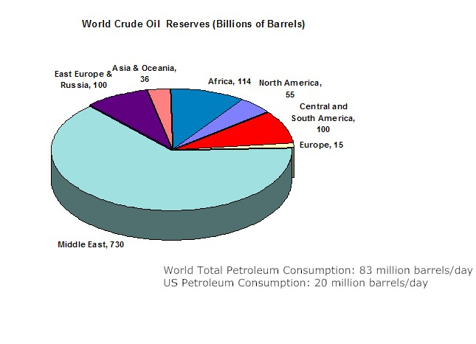

Slide 5
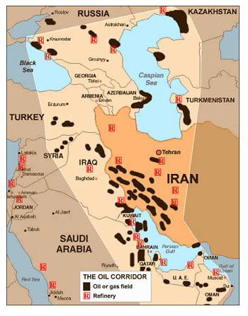

Slide 6
IV. Oil’s Importance
Many countries around the world depend on oil to meet their everyday needs.
Oil (petroleum) is used for:
Fuel
Medicines
Plastics (Think of everything that’s made with plastic!)
Fertilizers & Pesticides
Cleansers
Countries need oil, but most don’t have it, so they must buy it from oil-producing countries.

Slide 7
Oil’s Impact
Because so many countries need oil, Southwest Asia’s oil-producing countries have taken control of the global economy.
B. Many Southwest Asian countries have become dependent on oil sales.

Slide 8
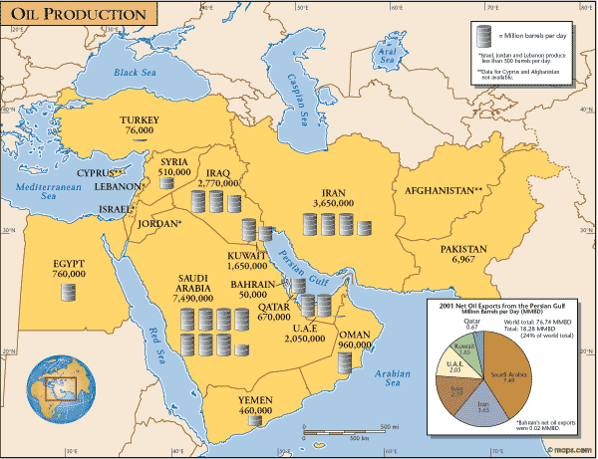

Slide 9
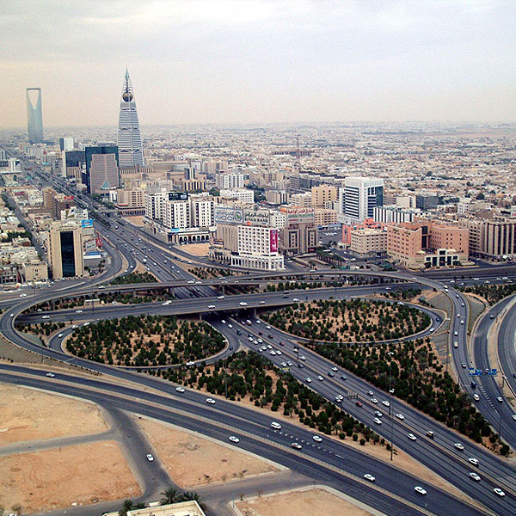
Riyadh – Capital of Saudi Arabia

Slide 10
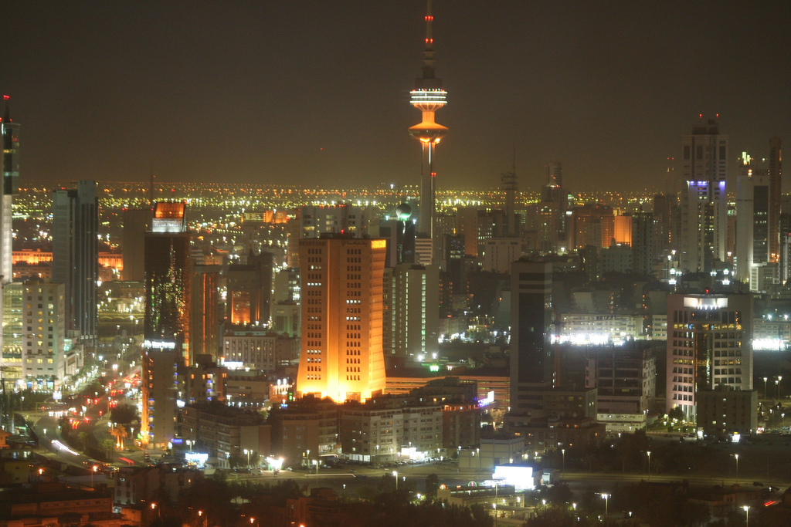
Kuwait City – Capital of Kuwait

Slide 11
V. Unequal Oil Distribution
Countries with oil have grown rich (i.e. Saudi Arabia)
Countries without oil are struggling (Afghanistan).
Unequal distribution of oil wealth has led to many conflicts among Southwest Asian nations.

Slide 12
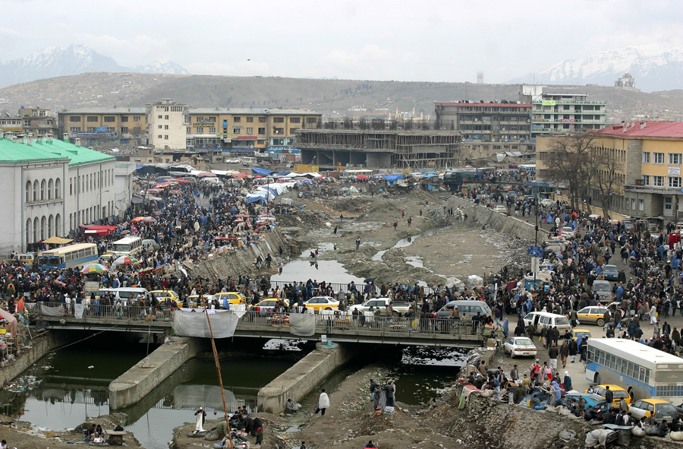
Kabul – Capital of Afghanistan

Slide 13
Summarize in 3,2,1
Where is much of the world’s oil supply located?
Much of the world’s oil is under Southwest Asia.
2. True or False. Are oil reserves distributed evenly among the region’s countries? Explain.
False. Oil reserves are not distributed evenly among the region’s countries. Saudi Arabia & other countries along the Persian Gulf coast have a lot of oil. They are all wealthy countries.
3. Why aren’t all citizens from countries in Southwest Asia, that have oil, wealthy?
The wealth from oil sales is not evenly distributed among the citizens of the countries in Southwest Asia.

Slide 14
Distribution of Oil: Summary in 3,2, and 1
Where is much of the world’s oil supply located?
True or False. Are oil reserves distributed evenly among the region’s countries? Explain.
Why aren’t all citizens from countries in Southwest Asia, that have oil, wealthy?

Slide 15
Distribution of Oil: Summary in 3,2, and 1
Where is much of the world’s oil supply located?
True or False. Are oil reserves distributed evenly among the region’s countries? Explain.
Why aren’t all citizens from countries in Southwest Asia, that have oil, wealthy?

