Slide 1
Fall of the Ottoman Empire and Conflict in SW Asia

Slide 2
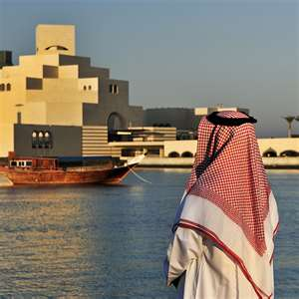
Standard SS7G8
The student will analyze continuity and change in Southwest Asia leading into the 21st Century.

Slide 3
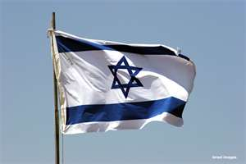
Elements
Explain how European partitioning in the Middle East after the breakup of the Ottoman Empire led to regional conflict.
Explain the historical reasons for the establishment of the modern state of Israel in 1948; include the Jewish religious connection to the land, the Holocaust, anti-Semitism and Zionism in Europe.

Slide 4
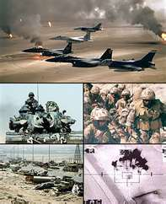
Elements
Describe how land and religion are reasons for continuing conflicts in the Middle East.
Explain U.S. presence and interest in Southwest Asia; include the Persian Gulf conflict and invasions of Afghanistan and Iraq.

Slide 5
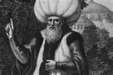
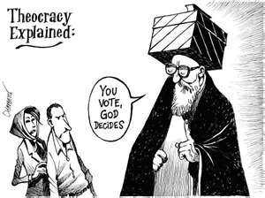
Muslim Empires
Leader – Caliph
Duty to spread Allah’s rule
United Middle East under one government
Created extensive trading system
Theocracy
Government by a religious leader
Iran is a theocracy (-ish) today.

Slide 6
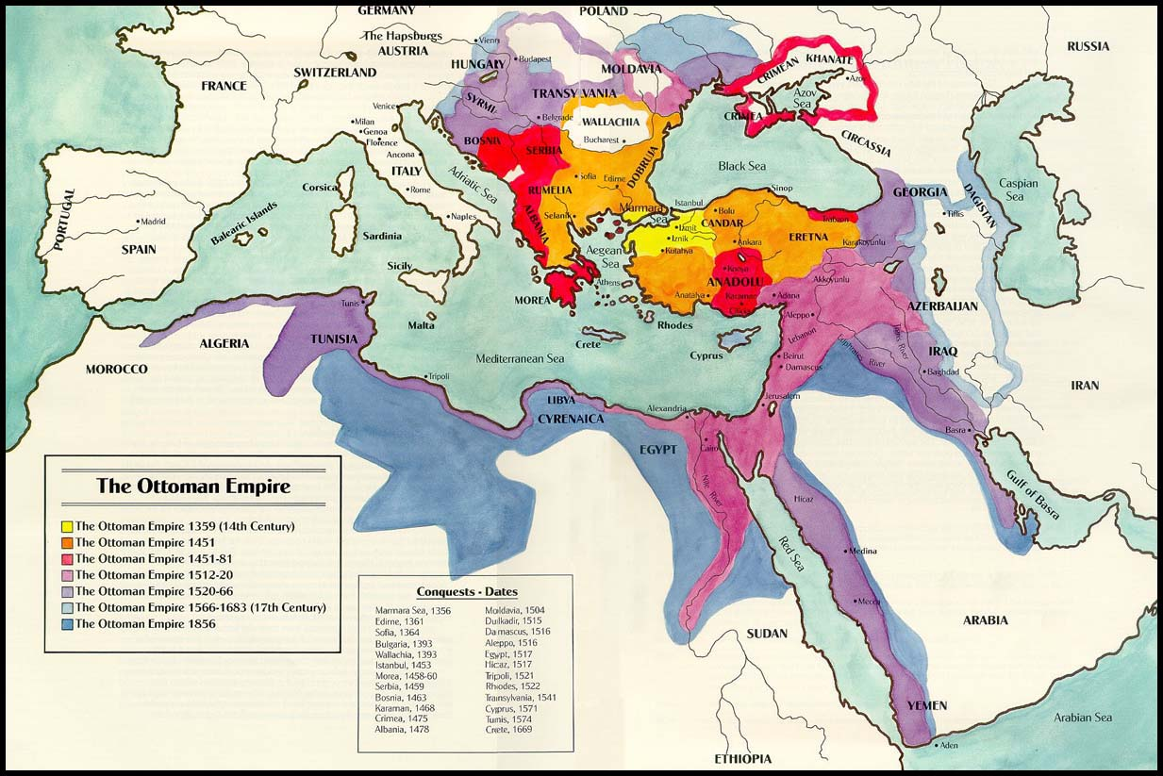
Ottoman Empire’s Lands

Slide 7
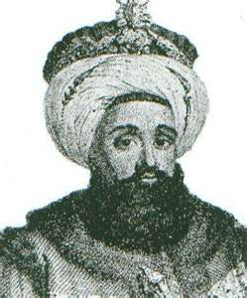
Ottoman Empire
Turkey, North Africa, Southwest Asia, and Southeast Europe
Capital City – Constantinople
Leaders – Sultans
Tolerant of other religions
Legal system – justice
Powerful, stable, wealthy empire

Slide 8
Reasons for the Decline of Ottoman Empire
Weakened by too many wars
Land lost to national groups (nationalism) and Europeans
Ottomans’ technology began to fall behind
Europe
Financial issues – tax collections – high debt
On losing side in World War I

Slide 9
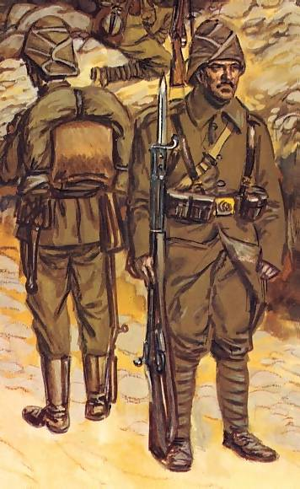
Ottoman Empire & WWI
What’s left of the Ottoman Empire enters WWI (1914-1918) on Austrian-Hungarian Empire & Germany’s side (Central Powers)
motive was to regain some of the land they lost
In 1916, France and England agreed on how to divide up the Ottoman Empire if their side (Allied Powers) won the war: known as Sykes-Picot Agreement

Slide 10
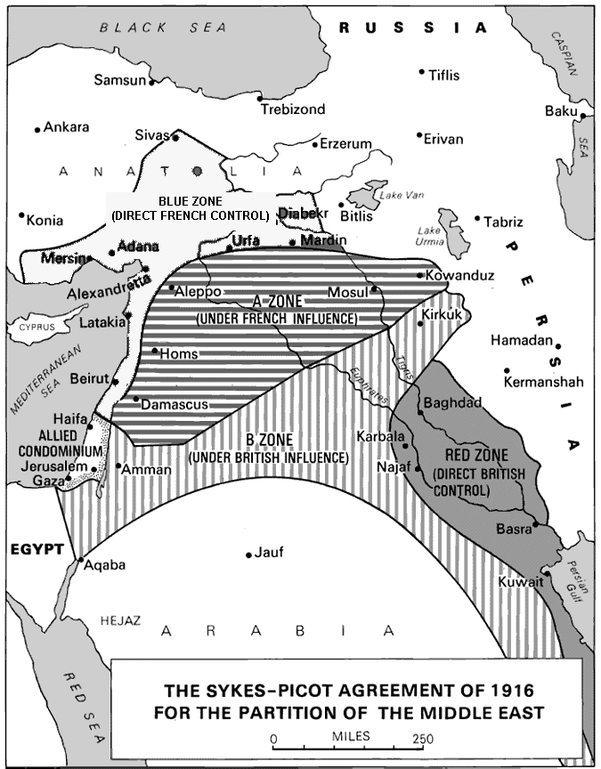
Sykes-Picot Agreement, 1916

Slide 11
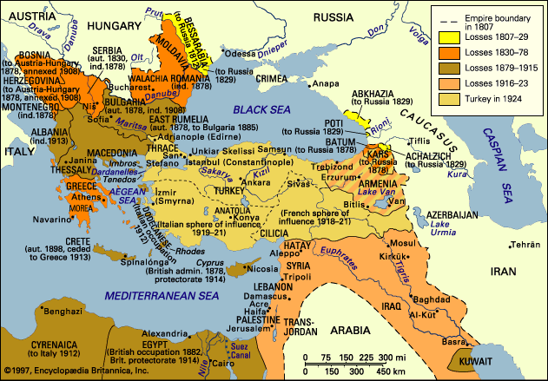
Map of Lost Ottoman Land

Slide 12
Results of WWI & Partitioning
When the Ottomans and the rest of the Central Powers lost…
The Sultanate (1922) and the Caliphate (1924) ended
Republic of Turkey was created out of the Ottoman Empire 1923
All other land that was under the control of the Ottomans was given to France and UK as a mandate
British and French partitioned (divided) the Middle East into countries
THIS CREATES ARTIFICIAL POLITICAL BORDERS
DID NOT NECESSARILY REFLECT THE NATURAL DIVISIONS IN THE REGION – BLENDED GROUPS

Slide 13
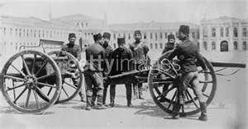
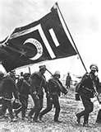
Collapse of Ottoman Empire 1924
Created lack of central authority
European nations step in to establish order
Set boundaries which exist today
Boundaries did not reflect ethnic or natural divisions
Blended different groups
Source of future conflict in region and in Europe

Slide 14
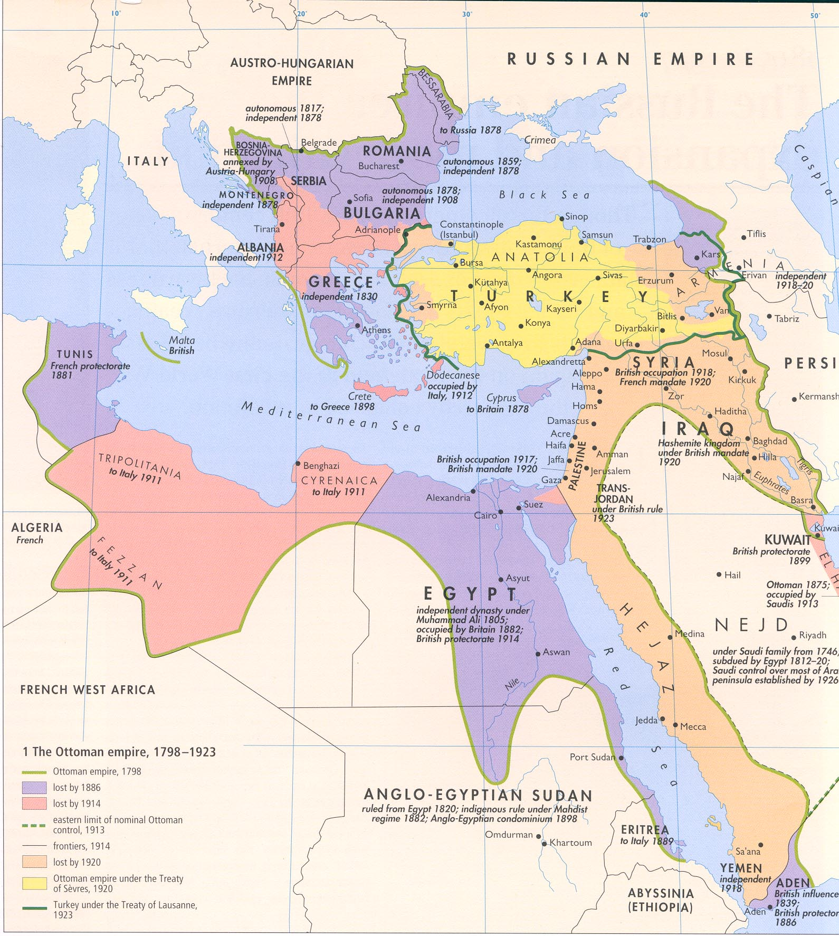
Middle East - 1924

Slide 15
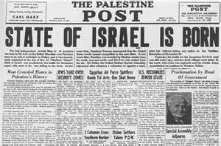
Israel Becomes a State -1948
After winning World War II, Allied leaders desire state for Jews
Zionists – support state for European Jews
Holocaust – Six million Jewish people killed in Europe because of Anti-Semitism
European leaders decide to give Jews their traditional homeland in Palestine

Slide 16
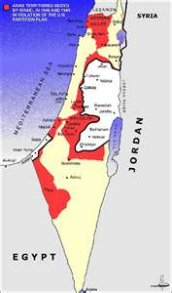
Israel
United States gives immediate support & recognition to the new Jewish state.
Palestinian Arabs who lived in the area were opposed to the new state.

Slide 17
