Slide 1
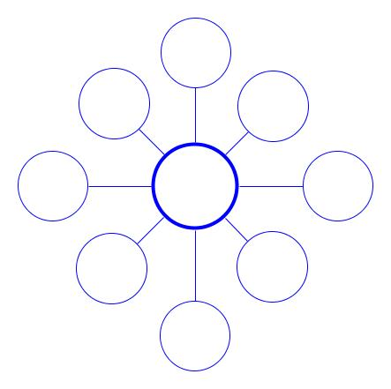
Advanced
Technology
Israel & Saudi Arabia have the most plants because they have high GDP’s
Needs
Scientists/ Engineers
Expensive to build and operate
Environmental Issues: Salt is dumped back into the seas
Desalination
Requires lots of salt water (coastlines)
Expands water that is available
Needs lots of energy to run. Electric, Solar or both
Promotes the recycling of waste water
Source: RT America

Slide 2
Requires
Knowledge of the area
Location,
Location,
Location!
Some groundwater is contaminated
Getting Ground Water
Don’t have the machinery to dig wells
Time-
Consuming
Unequally
Distributed: not available everywhere
To remote (out of the way) to dig
Can dry out, due to climate change and over use.
Source: Charity Water

Slide 3
Requires
Scientist/Engineers (trained workers)
Requires waste water
Environmental Issues:
Chemically treated water is returned to fresh water sources
Easier to
access. Less requirements for where they can be built
Water Treatment Plants
Unequally
Distributed: not available everywhere
Not widely
available
Requires Advanced Technology (Chemicals/ Machinery
Source: National Science Foundation

Slide 4
G
WT
D
G
WT
WT
D
See next slide

Slide 5
Would all communities be able to afford and use these methods? Explain:
No. Ground water is time-consuming, not available everywhere, and can be hard to extract (to take out of) from the ground. Water treatment requires technology, skilled workers, and funding (money). Desalination has to have salt water and very large amounts of money.

