Slide 1
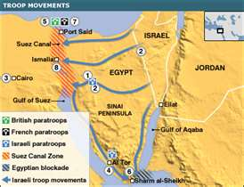
Suez Crisis - 1956
Egypt takes over the Suez Canal to raise money for a dam on the Nile River.
Israel invades Egypt with British and French support.
Egypt sinks 40 ships in Suez Canal.
United Nations resolves conflict.

Slide 2
Six Day War - 1967
Arab nations move troops to the border of Israel.
Israel strikes quickly with U.S. weapons.
Israel captures…
Sinai from Egypt
West Bank from Jordan
Golan Heights from Syria

Slide 3
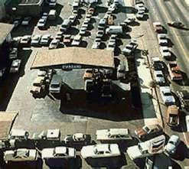
Arab Israeli War 1973
Cause: Revenge for loss of land in 1967.
Arab nations mass forces on borders of Israel.
Israel defeats all attacks
Result: Arabs (OPEC) embargo oil to U.S and Europe; countries that support Israel.

Slide 4
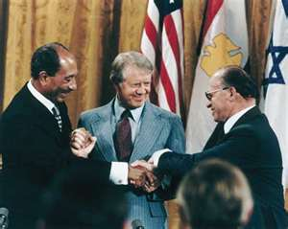
Camp David Accords 1978
President Carter brings leaders of Israel and Egypt to Washington D.C. where peace accord is signed.
President Sadat is assassinated soon after in Egypt.

Slide 5
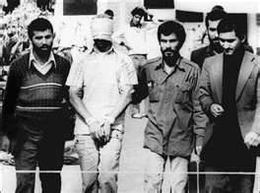
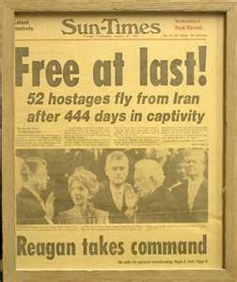
Iran Hostage Crisis 1979
Cause – Shah of Iran is helped by U.S. which is an ally
Effect – Iran militants seize U.S. Embassy
Released after U.S. election of Ronald Reagan

Slide 6
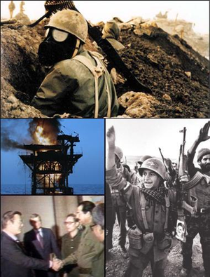
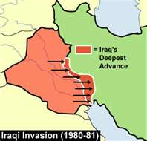
IraN–IraQ War 1980 to 1988
Cause -Iraq desires to be #1 power in Persian Gulf
Iraq attacks Iran
Religious differences
Result -World War I tactics
500,000 dead
No change in borders

Slide 7
Persian Gulf War - 1990
Cause – Iraq invades Kuwait
Saddam Hussein – dictator in Iraq
Coalition invades but does not remove Hussein from office.
Oil fields set on fire.

Slide 8
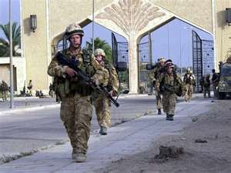
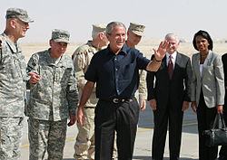
Iraq 2003 - 2011
President Bush (43)
Weapons of mass destruction?
Terrorism
Saddam Hussein - harsh dictator is captured
4,476 American soldiers lost lives
50,000 U.S. soldiers remain to train Iraq security people

Slide 9
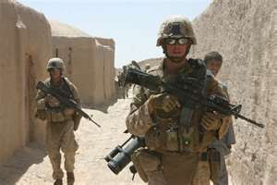
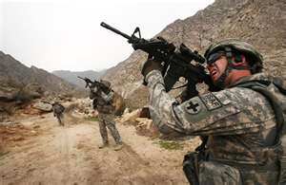
Afghanistan
U.S. and Europeans are at war with terrorism, not the Afghan people.
Operation Enduring Freedom
1787 Americans lost
Found and killed Bin Laden

