Slide 1
Smart Skills Practice
A Social Studies Skill Building Program
Map Review & Analysis
© 2017 Clairmont Press, Inc.

Slide 2
Maps
A map provides information in a graphic way. Types of maps include topographic, physical/political, thematic, and satellite.
Some of the most common maps found in textbooks include climate, weather, regions, movement, transportation, distance, cities, states, countries, waterways, transportation routes, natural resources, resources, and population.

Slide 3
Maps
When reading information on a map, students should:
• identify the type of map,
• read the title to determine its subject and purpose,
• determine what type of information is found on the map,
• look to see if it has a scale that helps determine the distances between two or more points, and
• look at any other information that is included.

Slide 4
Fill in the blank:
Use the following words to answer questions 1-9
Physical Scale
Cardinal Political
Population Density Title
Key / Legend Intermediate
Compass

Slide 5
Map Terms
Key / Legend- contains information needed for the map to make sense. Maps often use symbols or colors to represent things, and the map key explains what they mean.

Slide 6
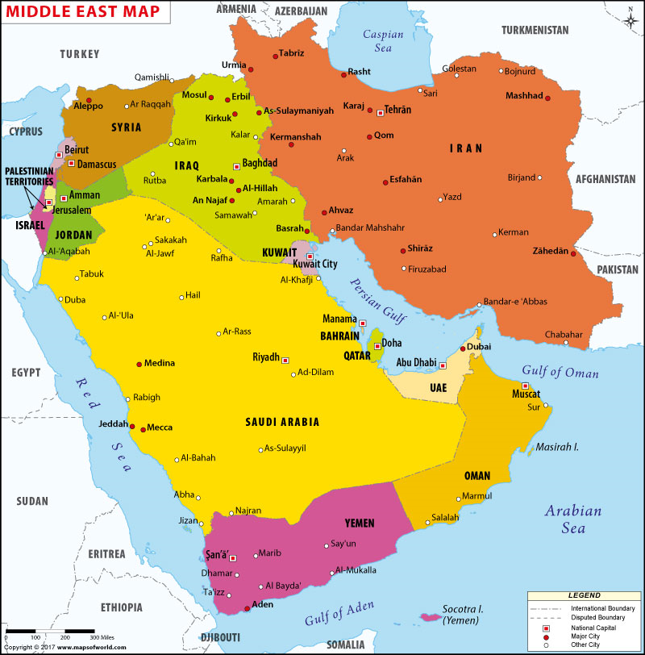
Map Terms
Title- The name of the map. Tells you what you’re looking at
What is the name of this map?

Slide 7
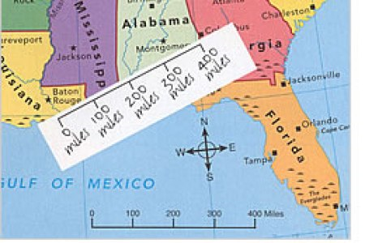
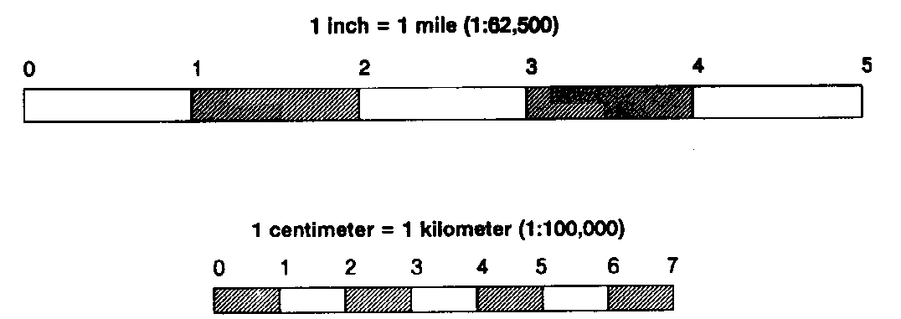
Map Term
Map scale refers to the relationship (or ratio) between distance on a map and the corresponding distance on the ground.

Slide 8
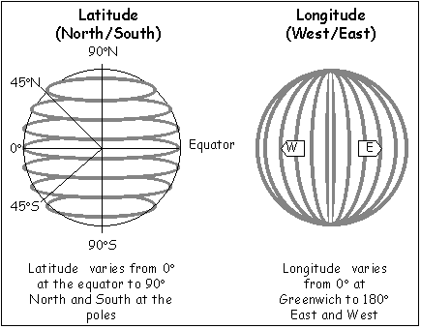
Map Term
Latitude & Longitude:
System of lines used to describe the location of any place on Earth. Although these are only imaginary lines, they appear on maps and globes as if they actually existed.
*Hint: Think of “fat” when you think of “lat”itude.

Slide 9
Map Term
Compass -
an instrument containing a magnetized pointer that shows the direction of magnetic north and bearings from it.

Slide 10
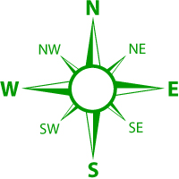
Map Term
Cardinal & Intermediate directions
Cardinal directions include North, South, East, And West.
Intermediate directions are points between N,S,E &W. They include: northeast (NE), southeast (SE), southwest (SW), and northwest (NW).

Slide 11
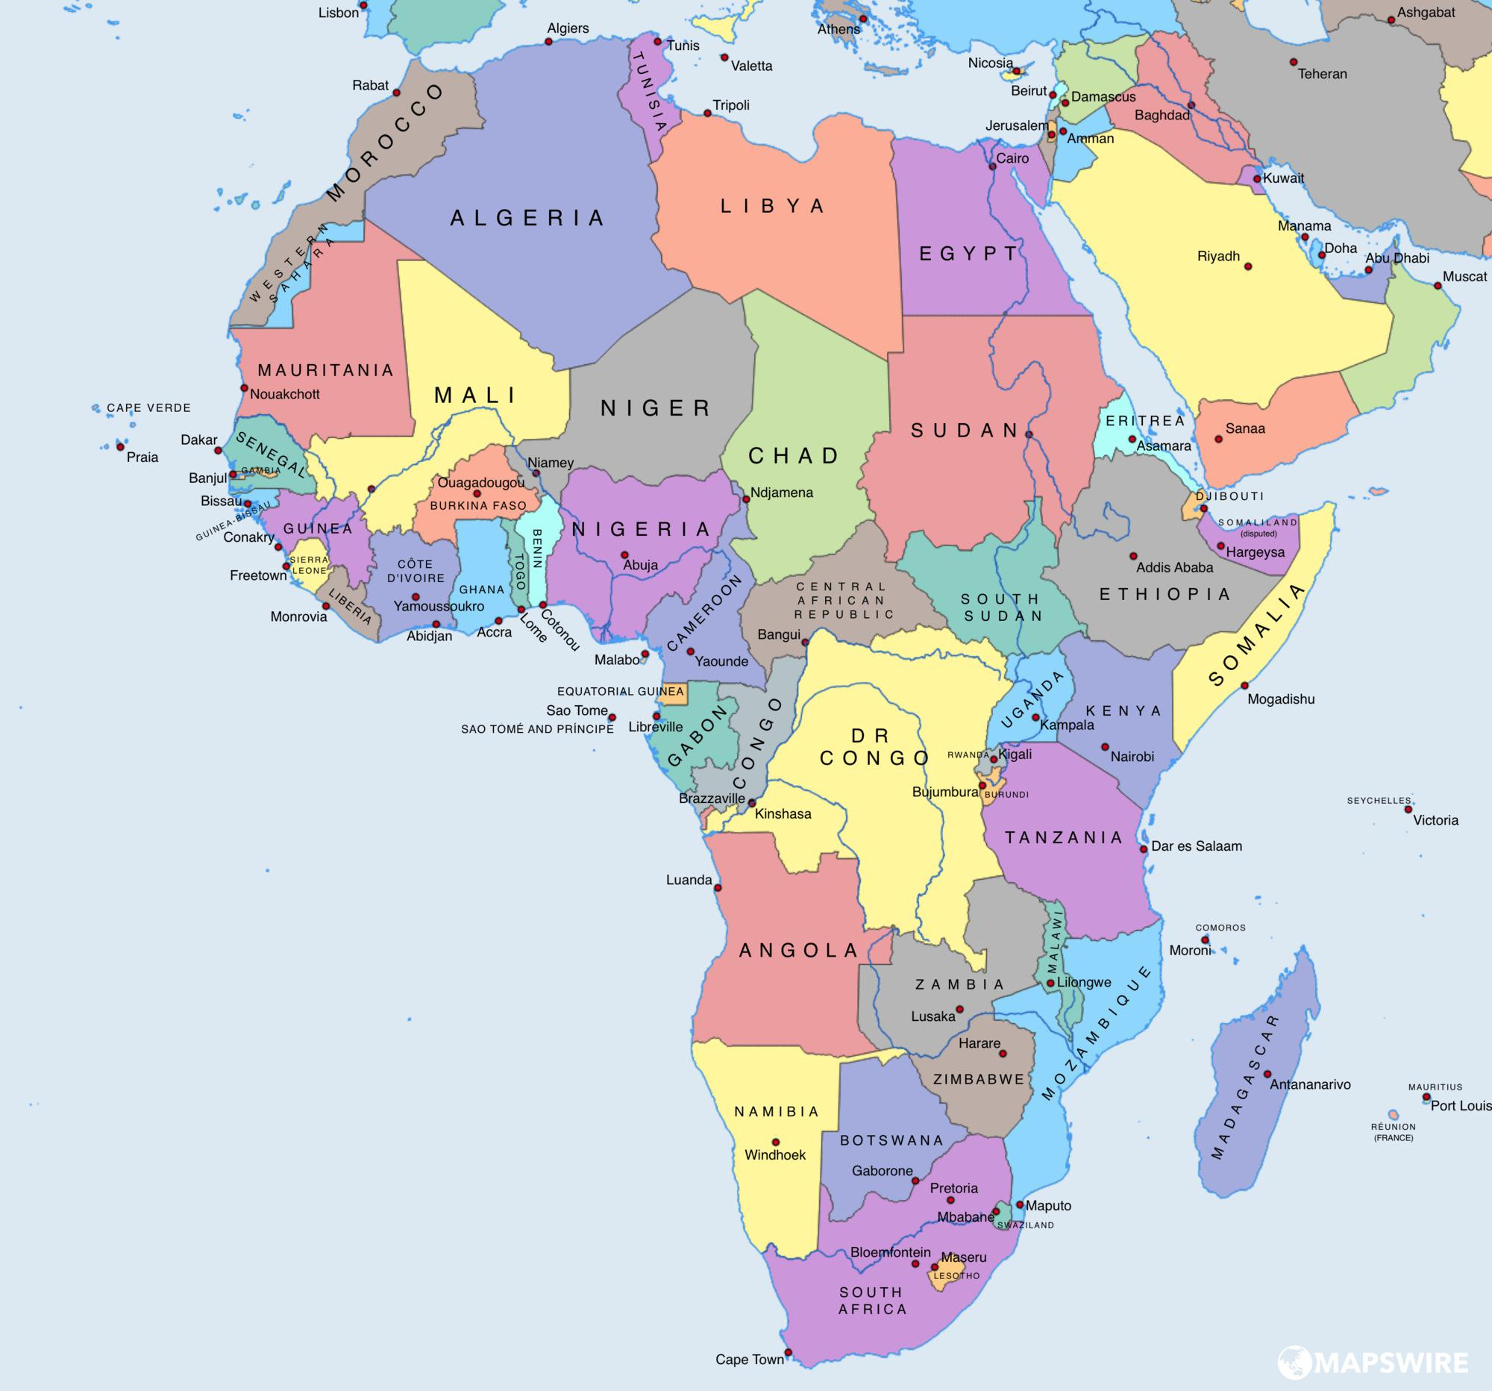
Map Terms
Political Map: shows governmental boundaries of countries, states, counties,and the location of major cities

Slide 12
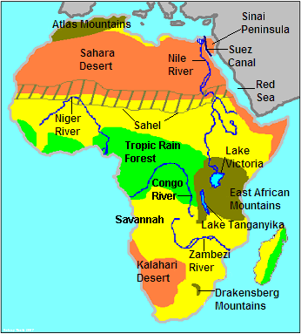
Map Term
Physical Map-
the primary purpose is to show landforms like deserts, mountains and plains.

Slide 13
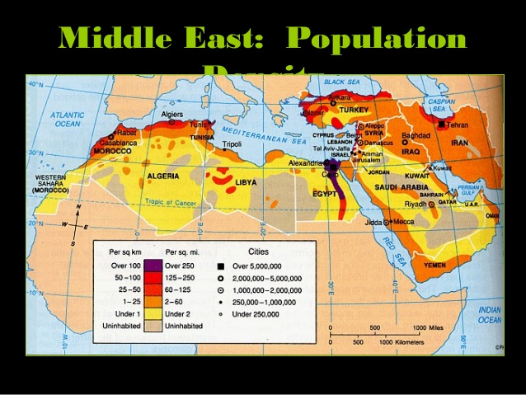
Map Term
Population Density- the number of people living in each unit of area (such as a square mile)

Slide 16
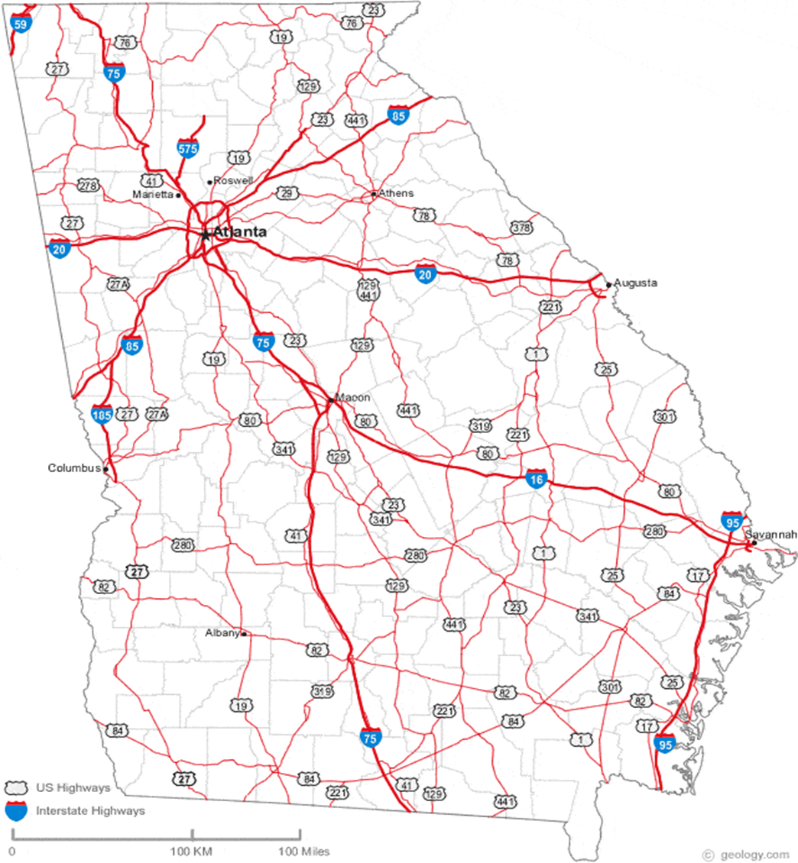

Slide 17
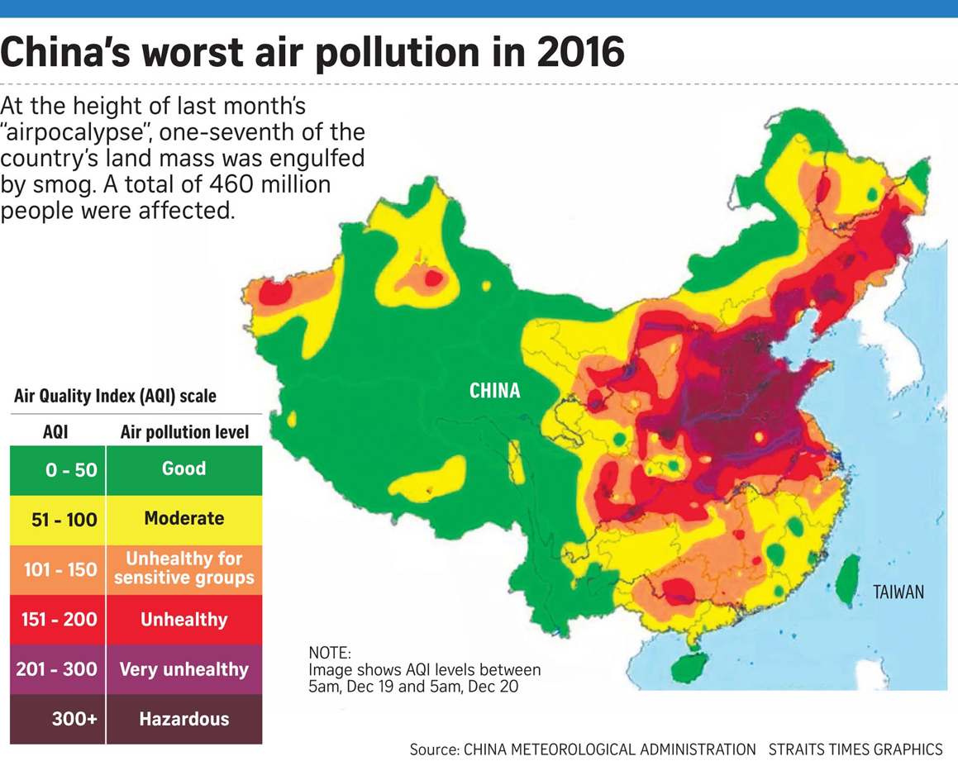

Slide 18
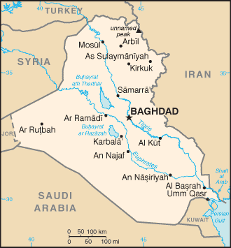
Notes:
Iraq; Turkey, Syria, Jordan, Saudi Arabia, Kuwait, Iran

Slide 19
1. What is the type of map you are analyzing?
2. What is the title of the map?
3. What types of information are on the map?
4. Is there a scale?
If yes, what does it tell you?
5. Is there a legend?
If yes, what does it tell you?
6. What's a real-life application you would use this map in?

