Slide 1
India’s
Independence
Nationalism & Gandhi

Slide 2
Standards
SS7H3 The student will analyze continuity and change in Southern and Eastern Asia leading to the 21st century.
a. Describe how nationalism led to independence in India and Vietnam.
b. Describe the impact of Mohandas Gandhi’s belief in non-violent protest.

Slide 3
"You want a man with the guts to fight back?" "No, I want a man with the guts not to fight back."
Take look at how Gandhi used non-violence to win Independence for India

Slide 4
East India Trading Co.
In the 1601, Great Britain came to India through the East India Trading Company to set up trading forts.
At first, they were only looking to trade goods (ivory, gold, silks, dyes) and spices (cinnamon, saffron, pepper, sugar, vanilla).
By 1760, Britain had gained political and economic power over India.

Slide 5
Inequality
Indians began to resent being ruled by a foreign government.
They were treated as second-class citizens.
The best jobs and education were only available to the British.
Indians were also taxed heavily by the British on goods that were found in their own country.

Slide 6
Nationalism
In the 1800s, a feeling of nationalism began to surface in India.
Nationalism is a belief that people should be loyal to those with whom they share common history and customs. People want to rule themselves.
The first two groups to work for the rights of Indians were the Indian National Congress in 1885 and the Muslim League in 1906.
As they became better organized, they began to call for independence from Britain.

Slide 7
WWI’s Impact
During WWI, millions of Indians joined with the British army.
The British Parliament promised that when the war ended, Indians would be able to have more control of their government.
Unfortunately, nothing changed after the war…

Slide 8
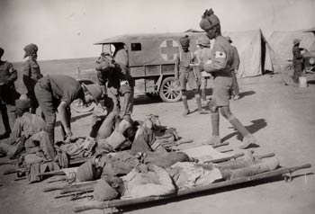
Indian Medic Troops During WWI

Slide 9
Indian Army During WWI

Slide 10
Amritsar
Many Indians were upset with the British false promises.
Those who protested were arrested and sent to jail for up to two years without a trial.
In 1919, outside of the Temple of Amritsar, British soldiers starting shooting a large group of Indians because they were gathering illegally.
During this terrible tragedy, over 400 people were killed and 1200 were injured.
It was this awful massacre that spurred Mohandas Gandhi into action to fight for India’s independence.

Slide 11
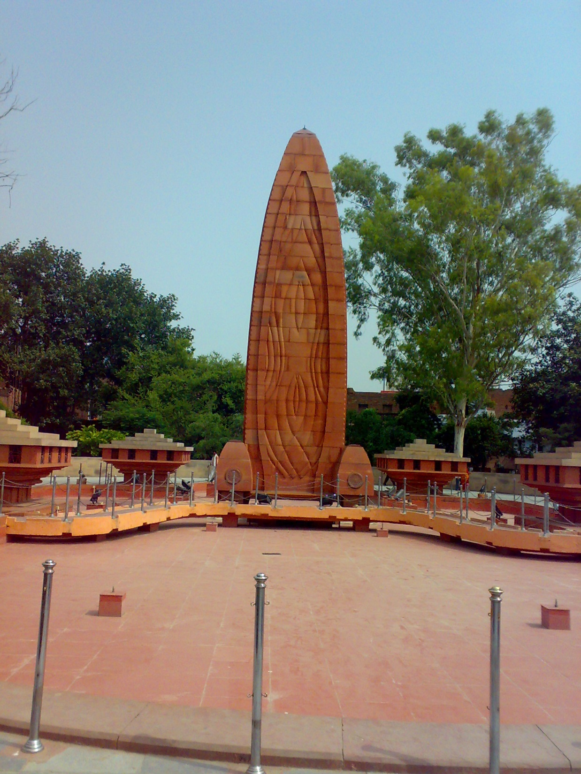
Jallianwala Memorial – Amritsar

Slide 12
Amritsar Massacre scene from the 1983 Movie “Gandhi”

Slide 13
Gandhi
Mohandas Karamchand Gandhi was born in India on October 2nd, 1869 and studied law in England.
After spending time in South Africa during Apartheid, he returned to India in 1914 with a determination that people should be treated equally, no matter their race or religion.
He was shocked by the way Indians were segregated and oppressed by British authorities.
After Amritsar, Gandhi decided to quit practicing law and to devote his life to fighting for the equality of all Indians.
He believed it was time for the people of India to stop obeying the unjust British laws.

Slide 14
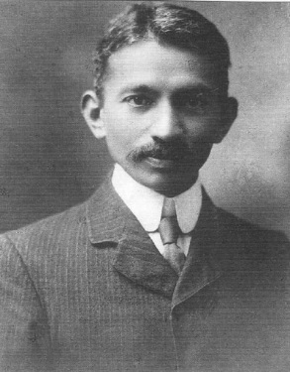
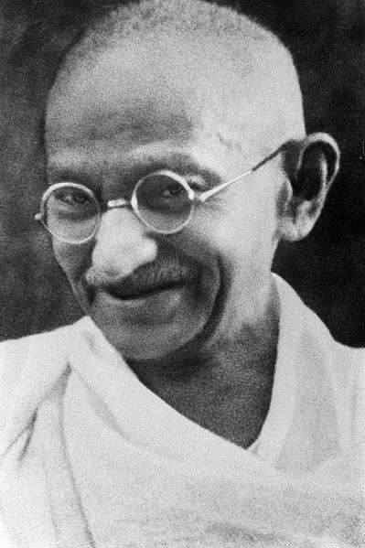
1909
Late 1930s

Slide 15
Gandhi Encounters Racism in South Africa

Slide 16
Nonviolence
Gandhi encouraged his followers to practice nonviolent protests against the British in order to bring about social change.
He developed what he called a system of civil disobedience and believed that it would make the world recognize the injustice in India and force change without using violence.
Gandhi believed that acts of goodness produced positive reactions while violence only produced negative ones.

Slide 17
Gandhi burning Passbooks in South Africa
(civil disobedience)
Gandhi’s Handwriting –
“God is truth the way to truth lies through Ahimsa (non-violence). Sabarmati,
March 13 1927.”
M K Gandhi

Slide 18
Gandhi’s Handwriting –
“God is truth the way to truth lies through Ahimsa (non-violence). Sabarmati,
March 13 1927.”
M K Gandhi

Slide 19
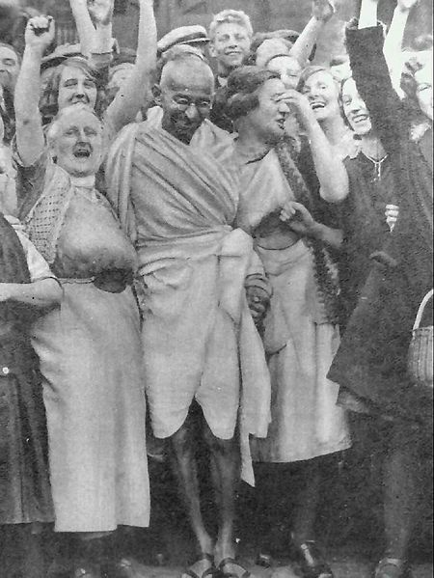
Gandhi with textile workers in 1931.

Slide 20
Social Change
Gandhi led his followers in boycotts, hunger strikes, and nonviolent protests.
In 1930, he led the Salt March that was aimed at closing a British salt factory due to the high tax on salt. The guards responded by clubbing and beating the peaceful protestors.
News of this event spread worldwide and people around the world began to call for the British to grant Indian independence.

Slide 21
“Gandhi” Salt March Scene

Slide 22
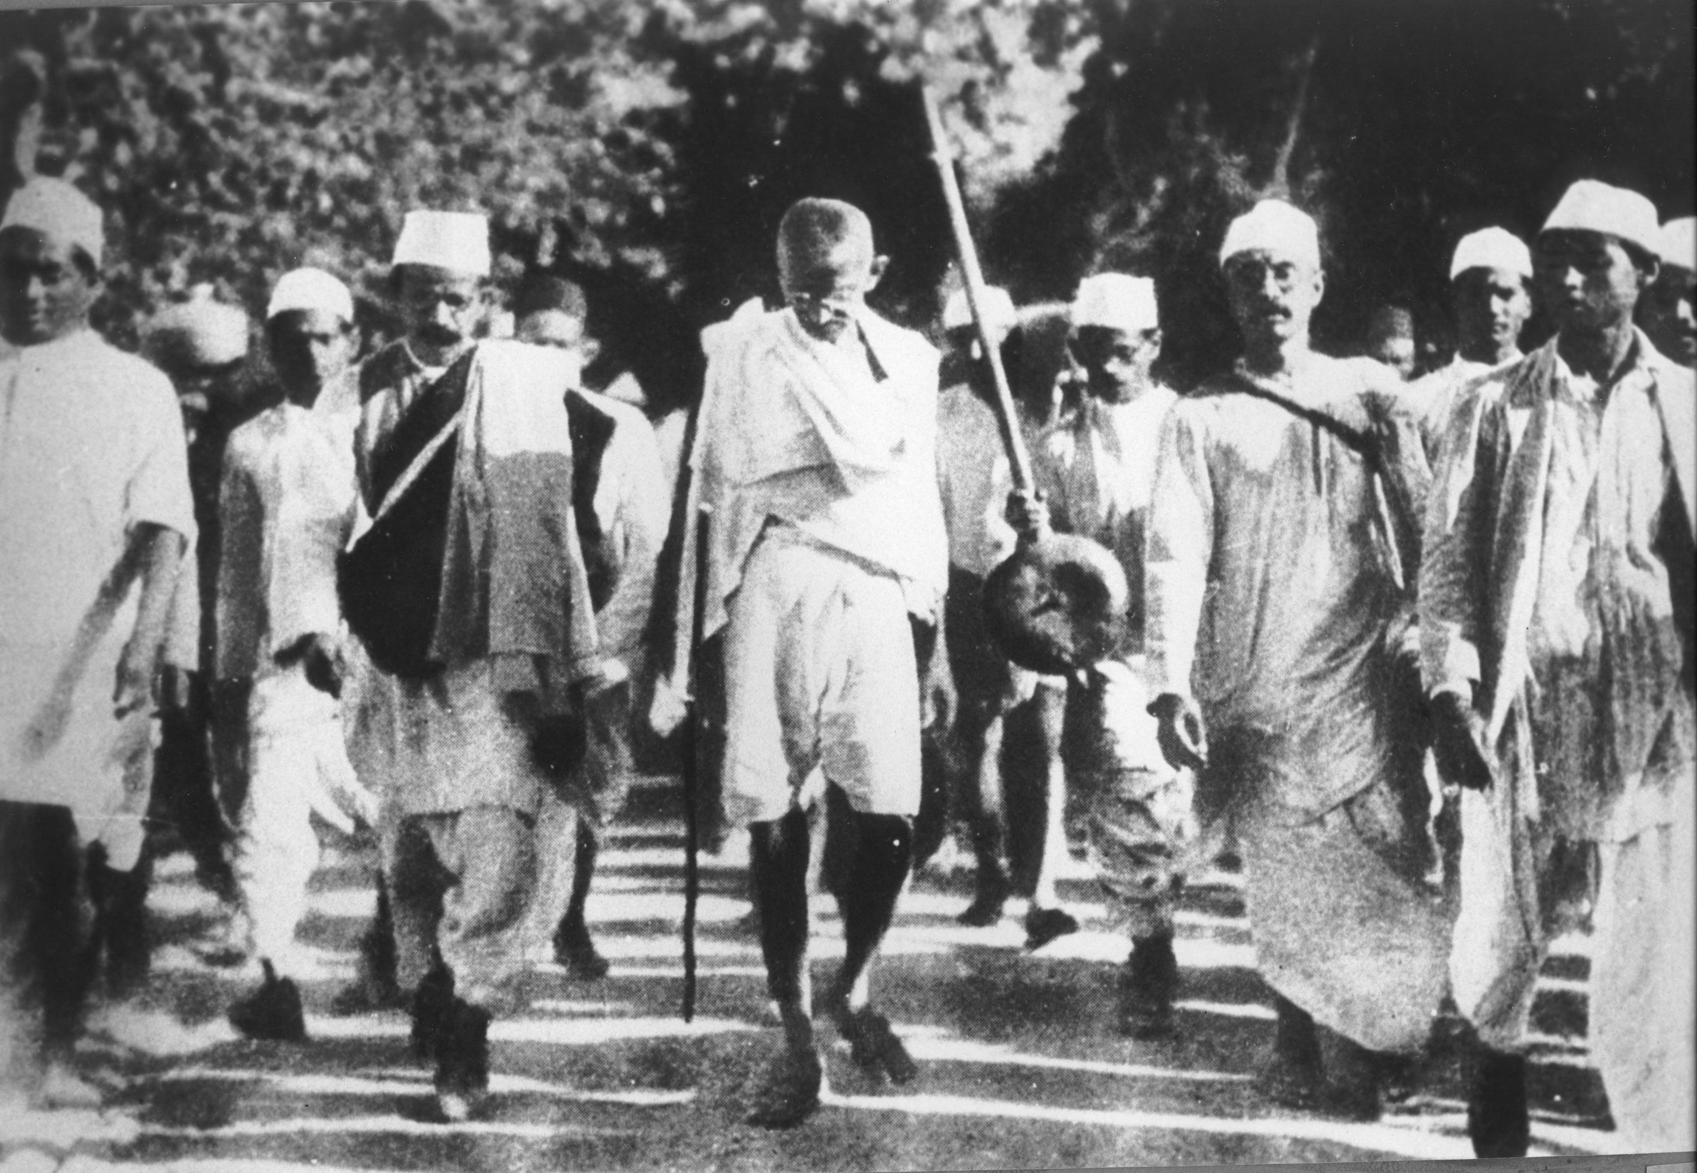
Gandhi during the Salt March, 1930.

Slide 23
Independence
Many Indians followed Gandhi’s nonviolent acts of protest and forced the British to recognize their desire for independence.
After fighting in WWII, Britain no longer had enough money or people to keep India under its rule.
On August 15, 1947, Great Britain formally gave up their colonial claims to India and the Republic of India was established.
Today, many Indians credit India’s independence to the efforts of Gandhi.

Slide 24
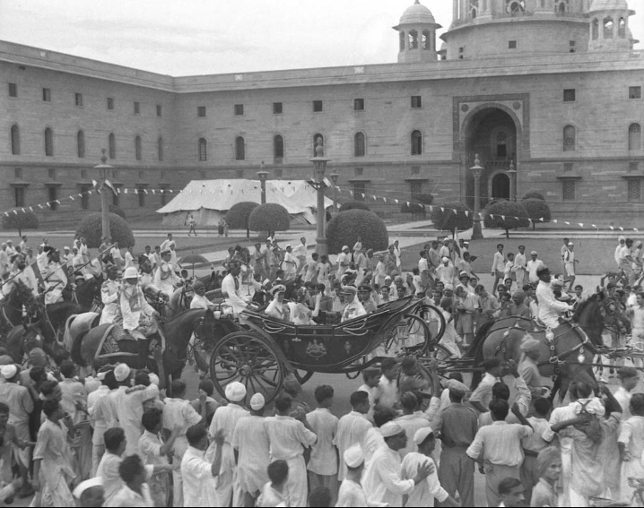
India’s Independence Day

Slide 25
More Problems
Even though India had won its independence, things were not peaceful in the country.
Hindus and Muslims could not reach a solution as to how to rule an independent India.
Eventually, the country was split into India for the Hindus and East & West Pakistan for the Muslims.
The partition of India led to genocide.
Hundreds of thousands of people were killed in widespread violence.

Slide 26
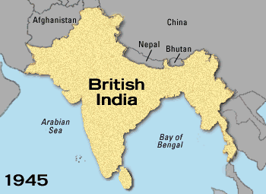
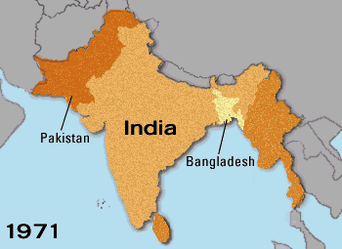

Slide 27
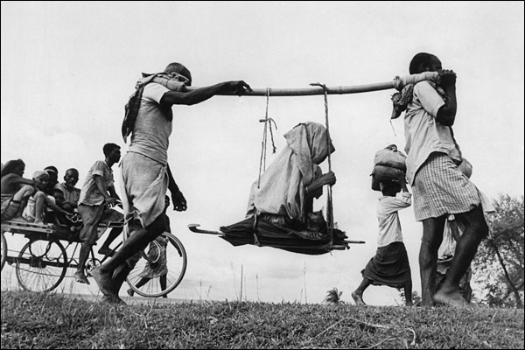
Two Muslim men carrying an old woman to their new home in Pakistan.

Slide 28
Hindus and Muslims Clash at Indian-Pakistan border (start at 6:53-8:30)

Slide 29
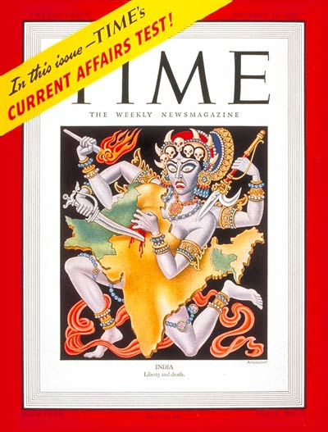
Time Magazine cover representing the partition of India – 1947.

Slide 30
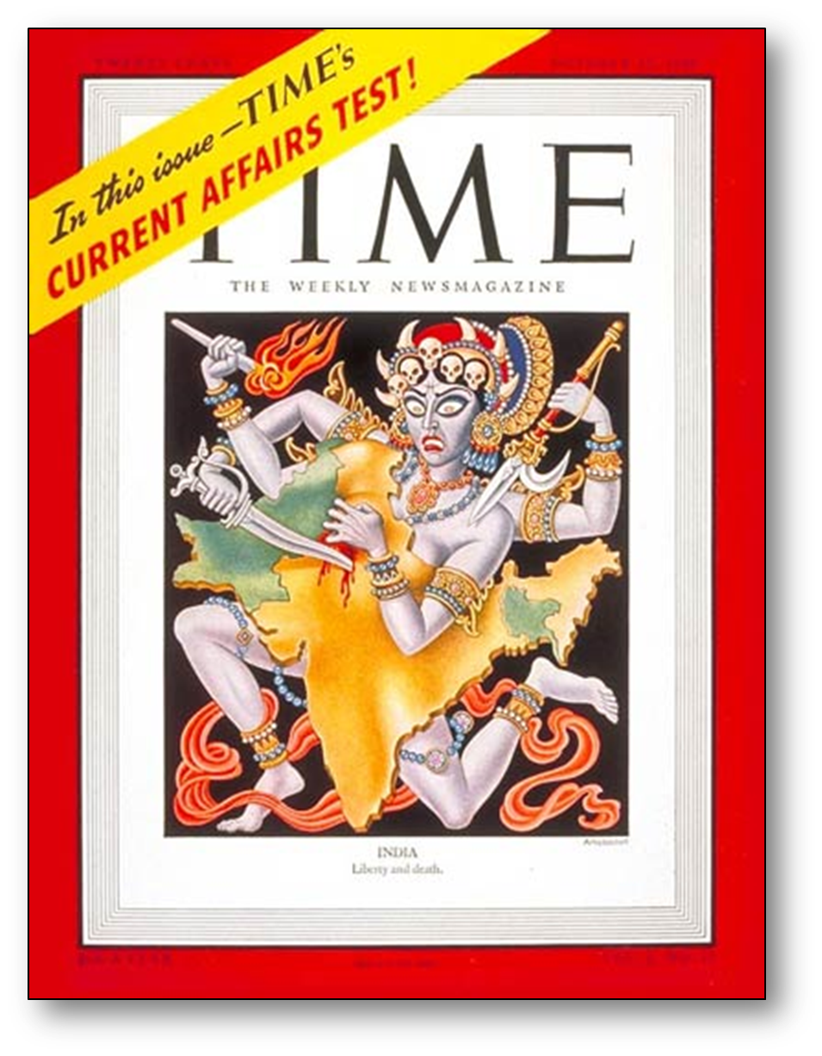

Slide 31
Gandhi
Gandhi was very much disappointed by the partition; he wanted all Indians to live together peacefully in one country.
Even though he was Hindu, he felt that all religious groups should be welcomed in India.
In 1948, at the age of 78, Mohandas Gandhi was assassinated on his way to a prayer meeting in New Delhi.
He was shot three times by a high-ranking Brahmin who resented Gandhi’s concern for Muslims.

Slide 32
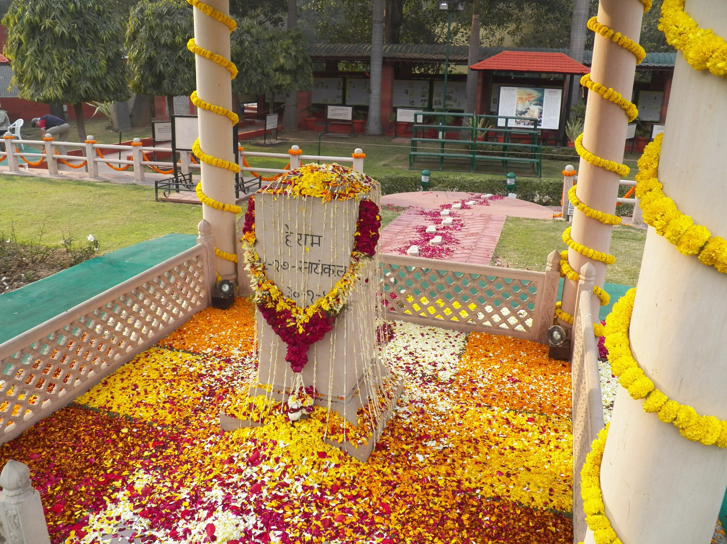
Memorial where Mohandas Gandhi was assassinated at 5:17 PM on January 30, 1948 on his way to a prayer meeting.

Slide 33
BrainPOP- Recap
https://www.brainpop.com/socialstudies/famoushistoricalfigures/mahatmagandhi/?panel=login&refer=%2Fsocialstudies%2Ffamoushistoricalfigures%2Fmahatmagandhi%2Fquiz%2F

Slide 34
Don’t forget to take the ticket out the door!

Slide 35
If time permits…..
Look at the quotes on the following slides
What do they mean?
How can they apply to the world today?

Slide 36
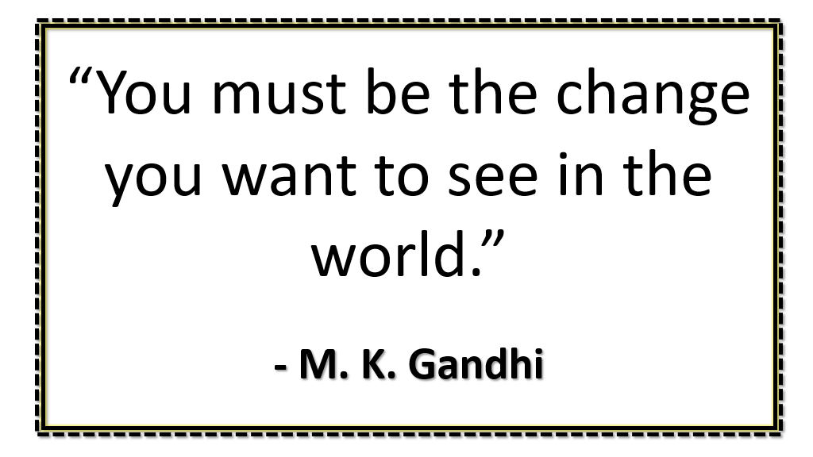

Slide 37
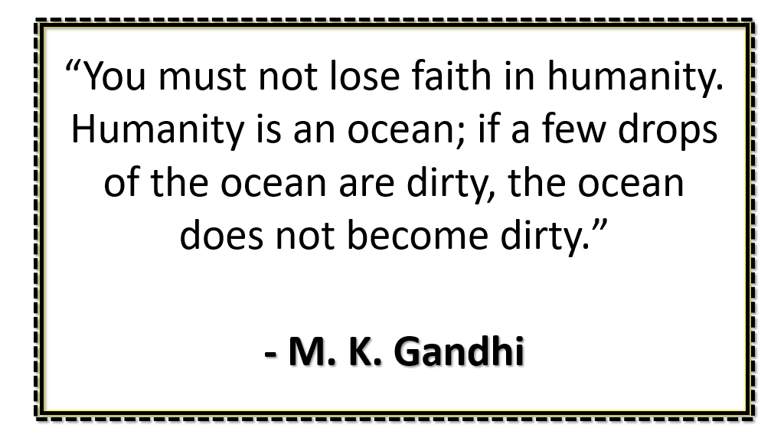

Slide 38
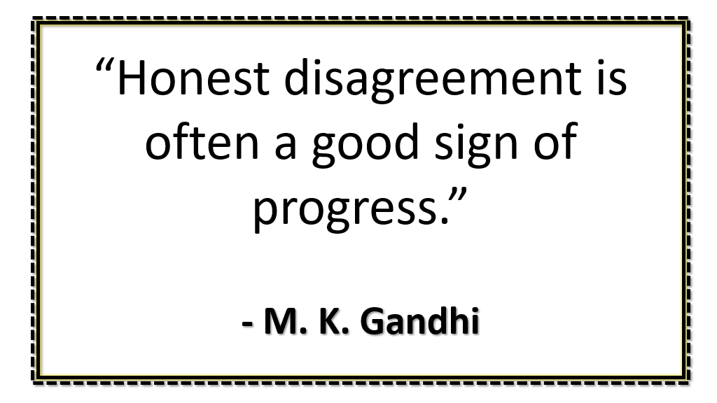

Slide 39
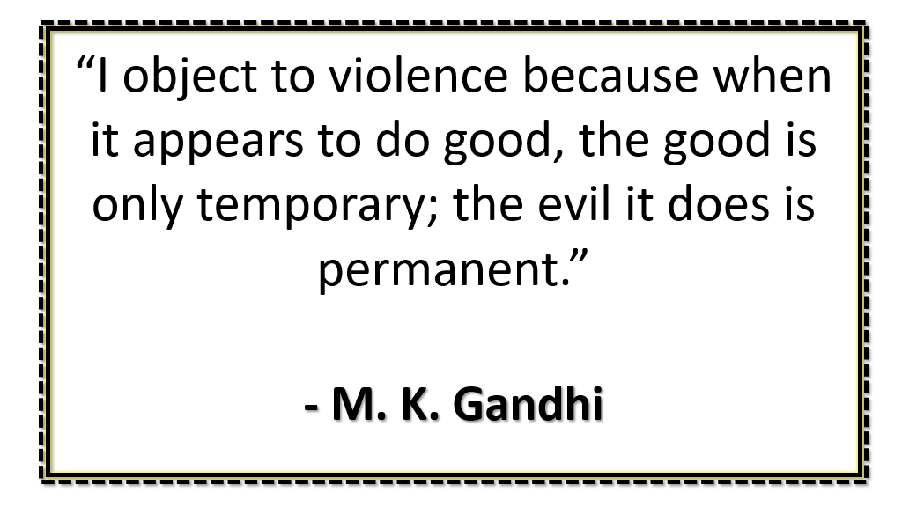

Slide 40
