Slide 1
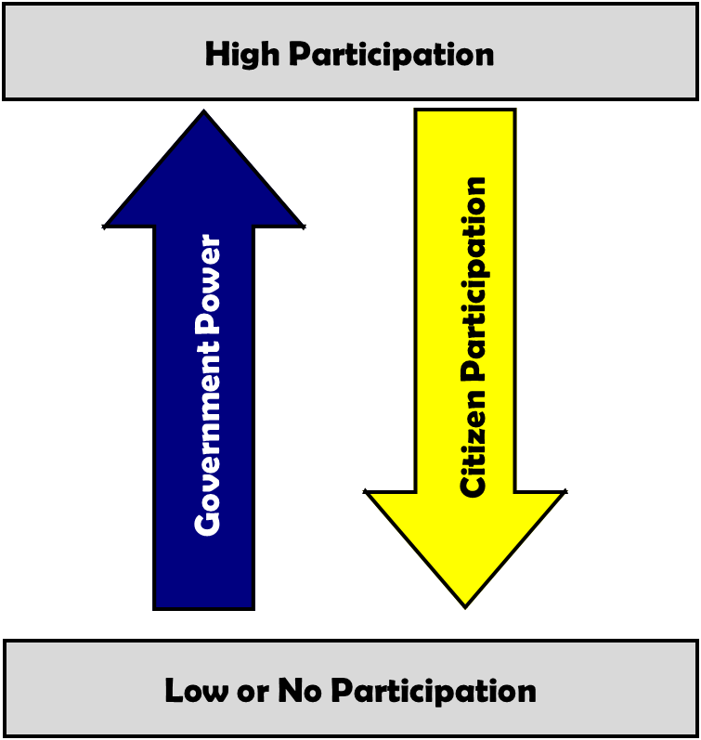
Autocracy
A country or nation that is governed by a single person with unlimited power.

Slide 2
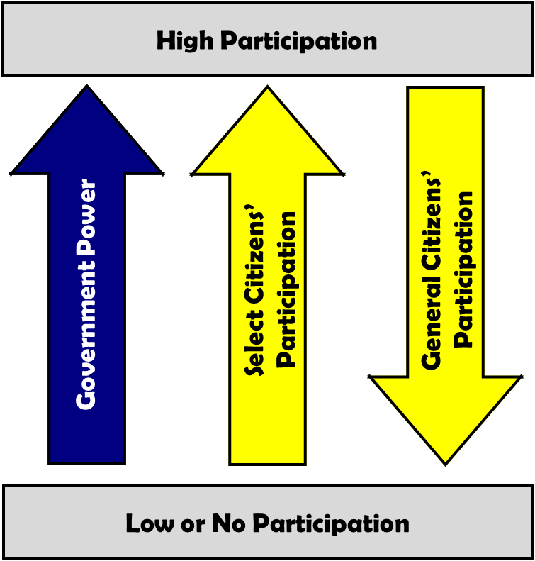
Oligarchy
A government controlled by a small group of people.

Slide 3
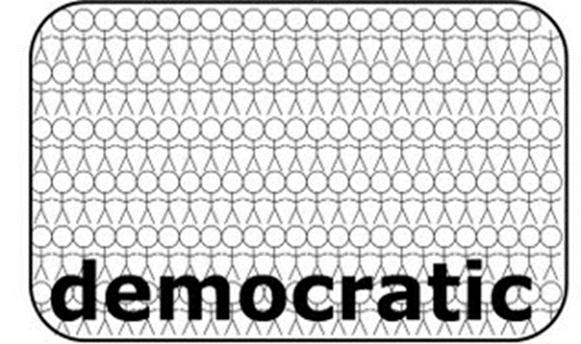
Democracy
A government that receives its power from the people

Slide 4
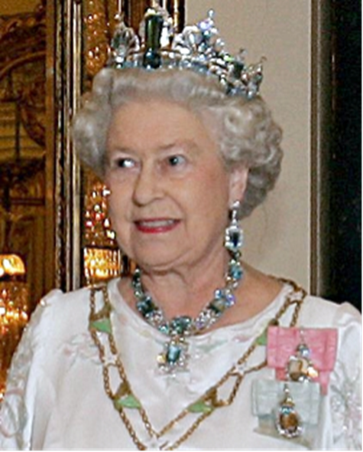
Monarchy
A government ruled by someone who usually inherits the authority

Slide 5
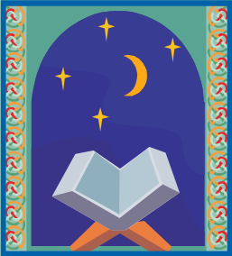
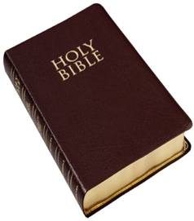
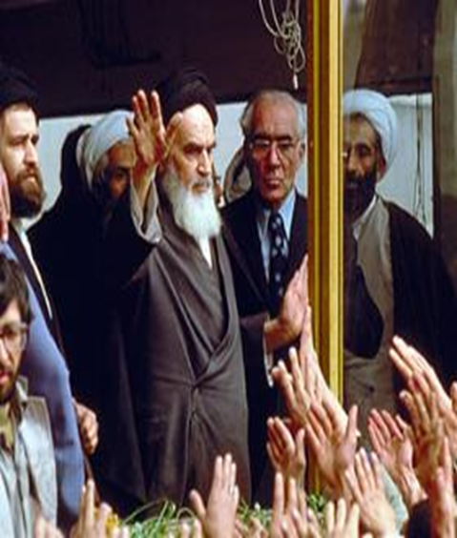
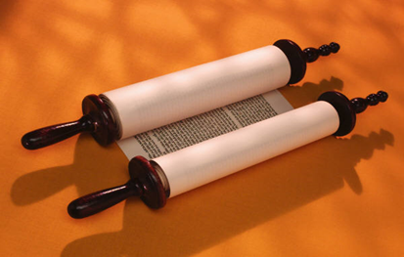
Theocracy
A government ruled by a religious leader or leaders

Slide 6
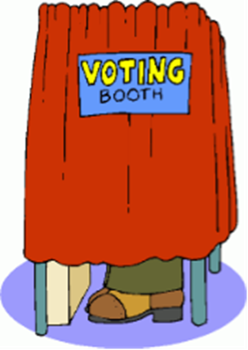
Republic
A government in which the people elect representatives to make the laws

Slide 7
Parliamentary Democracy
A government whose head of government, usually a prime minister, is the leader of the political party that has the most members in the legislative branch

Slide 8
Presidential Democracy
Type of government where the leader is chosen in a separate election from the legislative branch.

