Slide 1
Essential Question: What factors encourage and/or hinder voluntary trade?
Notes:
Instructional Approach(s): The teacher should introduce the essential question

Slide 2
Standard(s):
SS7E2a, SS7E6a, SS7E9a Explain how specialization encourages trade between countries. Compare and contrast different types of trade barriers, such as tariffs, quotas, and embargos.
SS7E2b, SS7E6b, SS7E9b Explain why international trade requires a system for exchanging currencies between nations.
Notes:
Instructional Approach(s): The teacher should introduce the standards that align to the essential question

Slide 3
Countries trade because no country has all of the resources it needs to provide for its people. Moreover, every country has different resources.
Notes:
Instructional Approach(s): The teacher should present the information on the slide

Slide 4
What are resources? With a seat partner, make a list of examples of resources. What happens when you do not have the resources you need?
Notes:
Instructional Approach(s): Teachers – this is not the time to teach students the actual names of different resources. Just brainstorm resources in general. Some examples students might mention: natural resources (more in-depth discussion of this in the next essential question), land, people, water, physical things, geographical features, etc. Discuss what resources they would need to survive and then what would they do if they did not have those resources.

Slide 5
We have a global economy because countries trade with others from all over the world.
The global economy makes countries interdependent.
Notes:
Instructional Approach(s): The teacher should present the information on the slide

Slide 6
The Trading Game Activity
Notes:
Instructional Approach(s): The teacher facilitates a class activity to demonstrate how Voluntary trade allows individuals to obtain the goods and services they desire and for societies to specialize in the production of those goods and services they are most efficient at producing. See the “Trading Game” linked on the resource page for additional instructions

Slide 7
In the Trading Game, you participated in Voluntary Trade. Our global economy is successful because of Voluntary Trade
Notes:
Instructional Approach(s): The teacher should present the information on the slide

Slide 8
Voluntary Trade happens when both countries expect to gain from the trade. The “buyer” country receives goods and the “seller” country makes money.
Notes:
Instructional Approach(s): The teacher should present the information on the slide

Slide 9
What factors encourage and/or hinder voluntary trade?
We will focus on the following:
Currency Exchange and International trade
Specialization
Trade Barriers
Notes:
Instructional Approach(s): The teacher should present the information on the slide

Slide 10
Currency Exchange Activity [Optional Activity]
Notes:
Instructional Approach(s): The teacher should facilitate the optional Currency Exchange Activity (linked on the resource page) if desired.

Slide 11
Use the Factors of Voluntary Trade Graphic Organizer to take notes during this presentation.
Notes:
Instructional Approach(s): The teacher should give each student a copy of the Factors that Encourage and/or Hinder Voluntary Trade Graphic Organizer to use during the lesson to record important information

Slide 12
International trade involves countries from all over the world engaging in voluntary trade.
Notes:
Instructional Approach(s): The teacher should present the information on the slide

Slide 13
Currency Exchange & International Trade
Exchange rates provide a procedure for determining the value of one’s currency in terms of another’s currency.
Without a system for exchanging currencies, it would be very difficult to conduct international trade.
Notes:
Instructional Approach(s): The teacher should present the information on the slide while the students summarize the important information on their graphic organizer

Slide 14
Specialization
Notes:
Instructional Approach(s): Transition slide

Slide 15
Specialization encourages voluntary trade and can be a positive factor in a country’s economy. Specialization occurs when one country can produce a good or service at a lower opportunity cost than another country.
Notes:
Instructional Approach(s): The teacher should present the information on the slide while the students summarize the important information on their graphic organizer.

Slide 16
Reviewing Opportunity Cost
Watch the short slideshow below on opportunity cost
http://www.econedlink.org/interactives/index.php?iid=190
Look at the next slide for demonstrating opportunity cost
Notes:
Instructional Approach(s): The teacher should present the information on the slide

Slide 17
Look at the three sets of items below. From each set, select the item that you would buy if you had the money.
Set 1
New book
New movie
New video game
Set 2
New shirt
New shoes
New pants
Set 3
Movie ticket
Concert ticket
Sporting event ticket
When instructed by the teacher, turn to a seat partner and identify from each set the item that you would buy and the opportunity cost for each set.
Notes:
Instructional Approach(s): The teacher should present the information on the slide and give the students an opportunity to discuss with a partner and have a brief classroom discussion about their responses

Slide 18
Specialization Activity: Specialized Bags, “Card” Specialty or another activity
Notes:
Instructional Approach(s): The teacher should facilitate a specialization activity (select one linked on the resource page or another activity) to demonstrate the important concepts

Slide 19
How does specialization impact trade?
Specialization encourages trade between countries because a country can get what it needs at the lowest cost when it is produced by another country that specializes in that item.
Notes:
Instructional Approach(s): The teacher should present the information on the slide while the students summarize the important information on their graphic organizer.

Slide 20
Distributed Summarizing:
With a seat partner, discuss the following…
What are the potential problems of overspecialization?
Notes:
Instructional Approach(s): Have students turn to a partner and discuss the question on the slide. Partners can be determined by the students or the teacher can provide more specific directions such as turn to the person directly in front/behind you or to the right/left of you, etc. It may be necessary to have a group of three if you have an uneven number of students. Do not allow more than 30 seconds to 1 minute of discussion time. The teacher should be walking around listening and redirecting discussions as needed. The teacher can briefly discuss student responses. A possible response might be that when countries overspecialize, they are good at producing a few products and may not be able to quickly adapt to produce other products if needed.

Slide 21
Sometimes countries set up Trade Barriers to restrict trade because they want to sell and produce their own goods.
Trade Barriers include:
Tariff
Quota
Embargo
Notes:
Instructional Approach(s): The teacher should present the information on the slide.

Slide 22
Trade Barrier: Tariff
Tariffs are taxes placed on imported goods.
Tariffs cause the consumer to pay a higher price for an imported item, increasing the demand for a lower-priced item produced domestically.
Notes:
Instructional Approach(s): The teacher should present the information on the slide while the students summarize the important information on their graphic organizer.

Slide 23
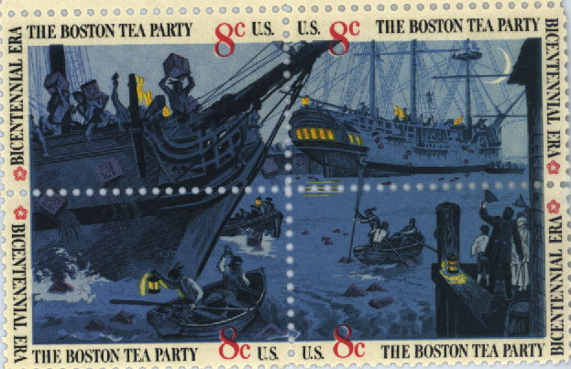
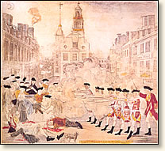
Trade Barriers: Tariffs
American Revolution
Notes:
Instructional Approach(s): The teacher can use the Boston Tea Party as an example of the use of tariffs.

Slide 24
Trade Barrier: Quotas
Quotas are limits on the amount of a good that can be imported into a country.
Quotas can cause shortages that cause prices to rise.
Notes:
Instructional Approach(s): The teacher should present the information on the slide while the students summarize the important information on their graphic organizer.

Slide 25
Trade Barrier: Embargoes
Embargoes forbid trade with another country.
The United States had a trade embargo with South Africa during apartheid (you will learn about this later in the year).
Notes:
Instructional Approach(s): The teacher should present the information on the slide while the students summarize the important information on their graphic organizer.

Slide 26
Trade Barriers: Embargoes
Embargoes usually happen for political reasons. Because the United States does not want to support countries that may support terrorism, it has used embargoes against Iran, Iraq, and Syria.
Notes:
Instructional Approach(s): The teacher should present the information on the slide while the students summarize the important information on their graphic organizer.

Slide 27
Trade Barrier Identification Activity
Notes:
Instructional Approach(s): Individually, with a partner, or as a class, students read different statements and decide whether they describe a tariff, quota or embargo.

Slide 28
Distributed Summarizing
On the bottom of your Trade Barrier Identification Activity sheet, answer the following scenario:
The Canadian Pear Growers Association is concerned about increased competition from imported pears that are larger than those grown within Canada’s borders. The Association wants to lobby for a trade barrier. Some members think a tariff or quota would be most beneficial. Others disagree and suggest an embargo would be best. Which Trade Barrier Would You Recommend? Why?
Notes:
Instructional Approach(s): Individually, with a partner, or as a class, students read the scenario and decide which type of trade barrier would be recommended. Call on students or ask for responses. Take 2-3 minutes to discuss the situation with the class.

Slide 29
Summarizing Strategy
Answer the following questions on a sheet of paper (or handout from teacher)
Describe a time when you exchanged a good for another good.
Identify a hobby, sport, subject, etc. in which you could specialize. Explain why.
Identify something in your life in which you would be willing to pay a tariff. Explain why.
Identify something in your life in which your parent or teacher might place a quota. Explain why.
Identify something in your life in which your parent or teacher might place an embargo. Explain why.
Notes:
Instructional Approach(s): Each student should complete the summarizer. The teacher should use the summarizer to determine the level of student mastery and if differentiation is needed.

