Slide 1
Economics—The Basics
7th SS

Slide 2
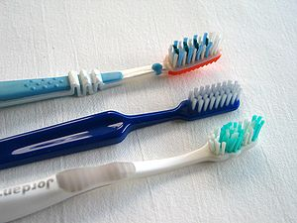
Goods & Services
What is a “good”?
What is a “service”?
Something that you can use or consume, like food or books. You buy a good with the idea that you will use it, either just once or over and over again.
Something that someone does for you, like give you a haircut, fix you dinner, or teach you!

Slide 3
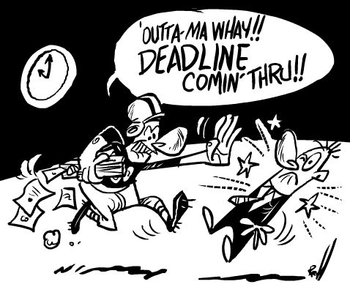
Consumers vs. Producers
Consumer:
Producer:
A person who buys a good or service
A person who creates goods or services

Slide 4
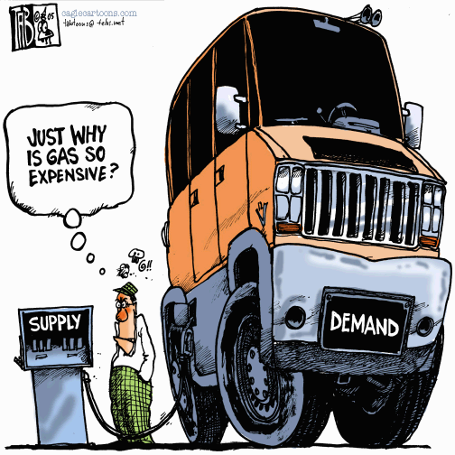
Supply & Demand
Supply
The amount of a good or service that is available for use
Demand
The desire for a certain good or service

Slide 5
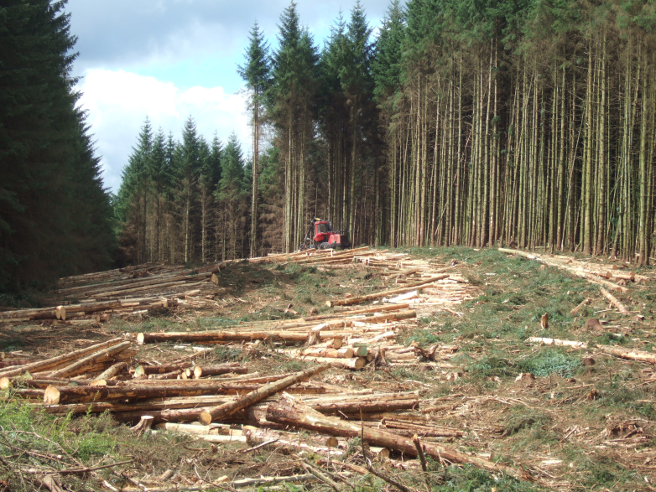
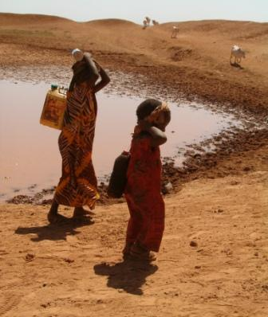
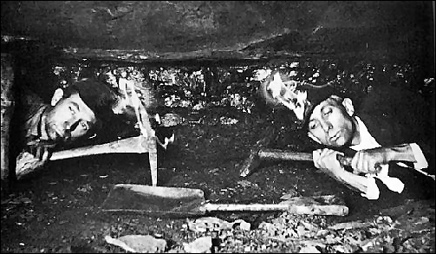
Natural Resources
Naturally occurring materials such as coal, fertile land, and water that can be used by man

Slide 6
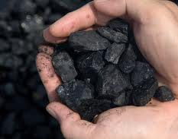
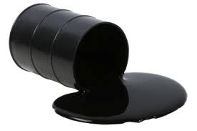
Renewable vs. Nonrenewable Resources
Unlimited/Renewable
Limited/Nonrenewable
Resources that can be replaced as they are used up:
Soil
Air
Water
Wood
Sunlight
Natural resources that cannot be replaced once they are used up:
Oil
Coal
Gas
Uranium

Slide 7
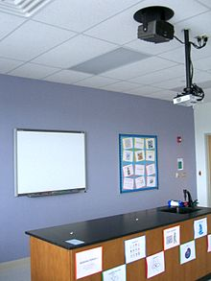
Capital Goods/Resources
Goods made by people and used to produce other goods and services (machines and factories)
Investment in Capital Resources: Business purchases of new plants and equipment

Slide 8
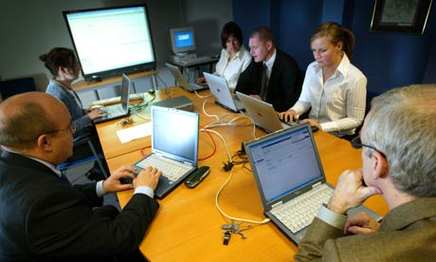
Human Capital/Resources
The quantity and quality of human effort directed toward producing goods and services (labor)
Investment in Human Resources: Activities that increase the skills and knowledge of workers

Slide 9
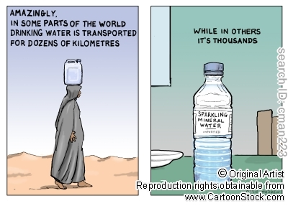
Scarcity
Resources are limited, so people cannot have all the goods and services they want
Limited Resources
+
Unlimited Wants
________________
SCARCITY!!!

Slide 10
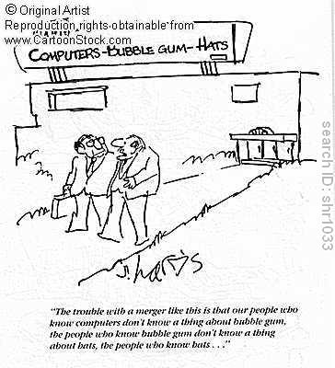
Specialization
When several or many people work together to produce things, and each person focuses (specializes) on only part of the production—the part that each person has the most skill to complete

Slide 11
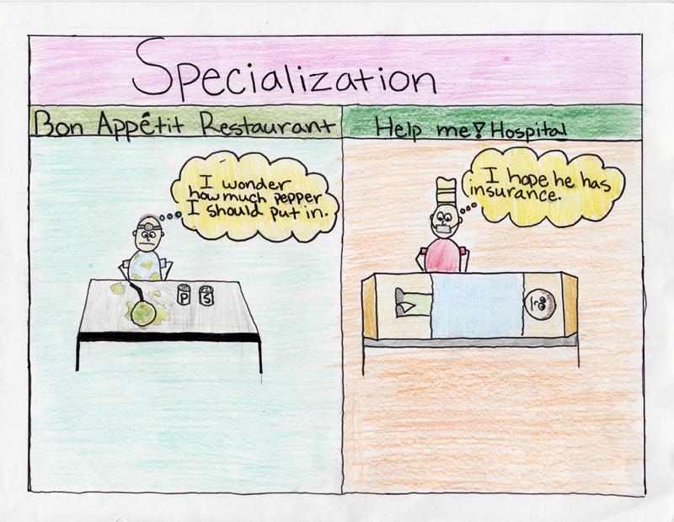

Slide 12
Economic System
Explains how a country answers the three questions of economics:
1) What to produce?
2) For whom to produce?
3) How to produce?
Traditional
Market
Command
MIXED

Slide 13
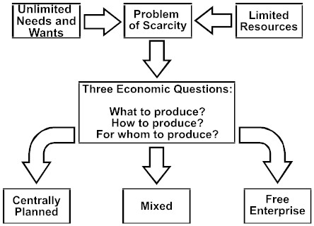
Command Economy
Mixed Economy
Market Economy

Slide 14
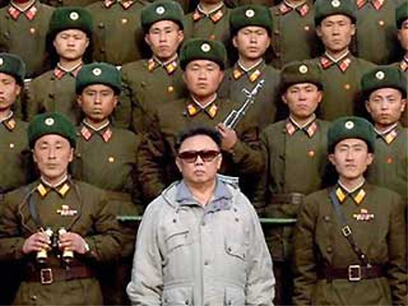
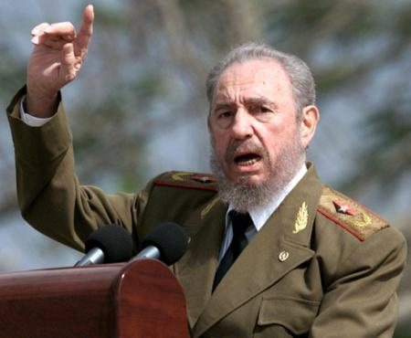
Command Economy
Government decides what is produced, who receives goods and services, and how things are produced
Examples: North Korea and Cuba are close to pure command economies

Slide 15
Market Economy
Consumers and producers determine what’s produced, who receives goods/services, and how things are produced (supply & demand)
Also called “capitalism” or “free market”
Encourages entrepreneurs (creators of new businesses)

Slide 16
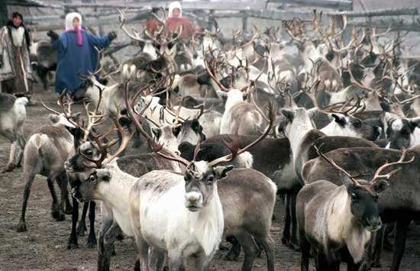
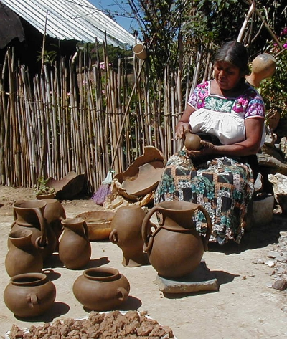
Traditional Economy
Economic decisions are based on a country’s or society’s customs and habits
Old ways of doing things—hunting or farming
Not common

Slide 17
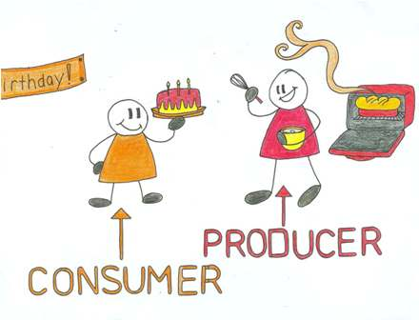
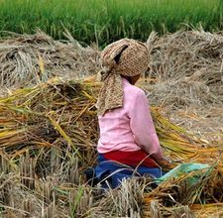
Mixed Economy
When a country combines elements of market and command systems (and sometimes traditional elements as well)
Most societies fall under this category, including ours!

Slide 18
Economic Systems
Pure
Command
Pure
Market
Mixed Economy

Slide 19
Economic Systems
United States
78%
Japan
73%
China
51%
0
100
Pure
Command
Pure
Market
Mixed Economy
Notes:
6th Grade- This information is meant to be used in conjunction with the 6th and 7th grade Teacher Notes. For additional resources, go to GeorgiaStandards.org. (Note: This is not an expectation for students to memorize numbers, but to understand that factors that influence specific countries to move more towards a command or market economy). The numbering system is based on The Heritage Foundation’s Economic Freedom Index 2009 The Heritage Foundation is a conservative organization that has partnered with the Wall Street Journal for over a decade to evaluate each country based on a set of 10 criteria to determine economic freedom. Update information using resources listed in the Teacher Notes.

Slide 20
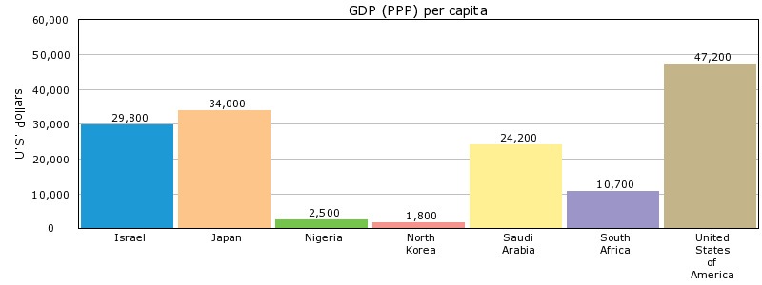
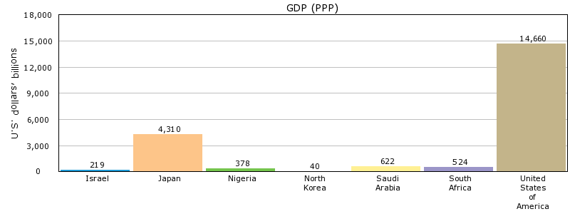
GDP
Gross Domestic Product
Total value of all goods and services produced in a country in a year
Investment in human capital and capital goods usually leads to increased GDP

Slide 21
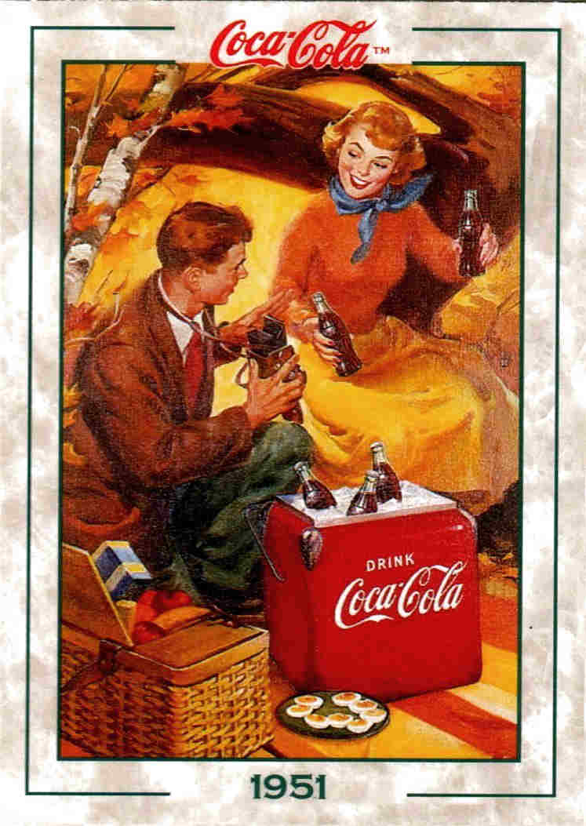
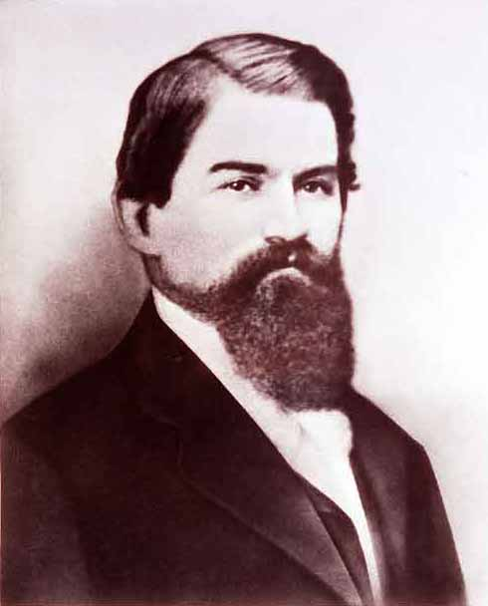
Entrepreneur
A person who combines resources to create new businesses
Entrepreneurs + land, labor, and capital = goods and services
John Pemberton

Slide 22
Trade
Trade = the exchange of goods and services in a market (Domestic—traders inside same country; international—exports and imports)
Exports: Goods produced within one country and sold outside of the country
Imports: Goods/services sold in a country but produced in other countries
Currency = money
Why do we need a system for exchanging currency for international trade?

Slide 23
Trade Barriers
Tariff = a tax on imports or exports
Quota = a restriction or limit on the amount of a good that can be imported (government imposed)
Embargo = a government ban on certain imports for political or economic reasons

Slide 24
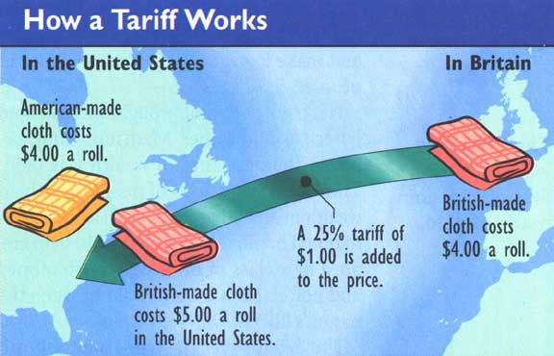

Slide 25
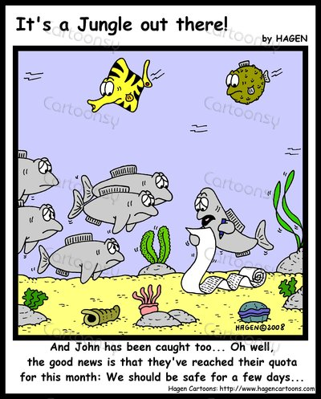
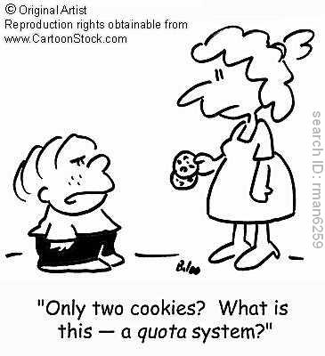
Quota

Slide 26
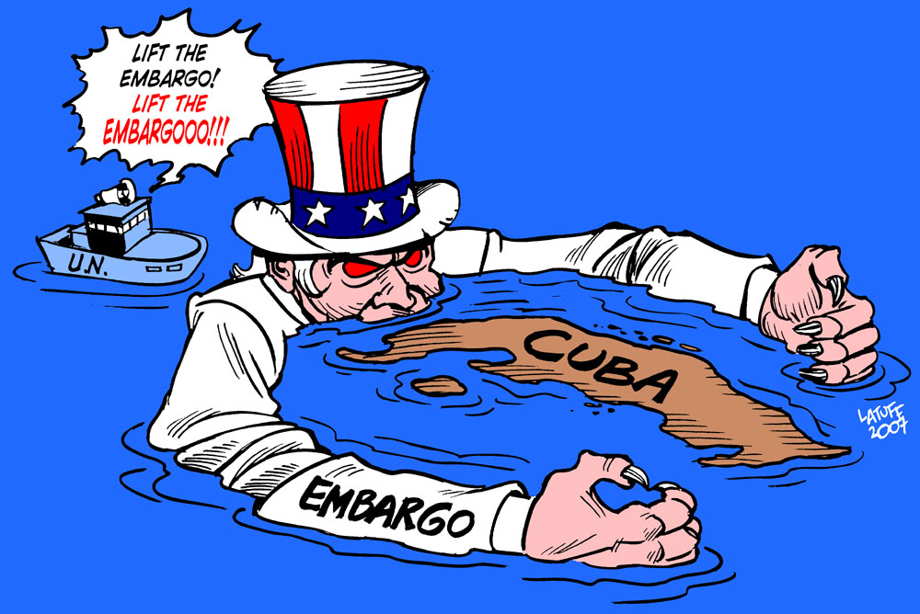
Embargo

