Slide 1
Essential Question:
How do economic systems answer the questions of what, how, and for whom to produce?
Notes:
Instructional Approach(s): The teacher should introduce the lesson essential question.

Slide 2
Standards:
SS7E1a, SS7E5a, SS7E8a
Compare how traditional, command, and market economies answer the economic questions of (1) what to produce, (2) how to produce, and (3) for whom to produce
SS7E1b, SS7E5b, SS7E8b
Explain how most countries have a mixed economy located on a continuum between pure market and pure command.
Notes:
Instructional Approach(s): The teacher should introduce the standards that align to the essential question.

Slide 3

What is Economics?
Before we can discuss economic systems, we need to review the basic concepts of Economics.
Notes:
Instructional Approach(s): The teacher should present the information on the slide. Ask the question, what is economics, but do not answer it or ask for student answers. Click to the next slide where students are instructed to come up with their own definition of economics.

Slide 4
Activator: What is Economics?
Write your own definition of economics.
Things to think about while developing
your definition:
  Products
  Money
  Business
Notes:
Instructional Approach(s): The students should write their own definition of economics on their notes. After 1-2 minutes, the teacher should allow a few students to share their definition.

Slide 5
Economics – the choices we make about how to use limited resources to produce goods & services that meet our unlimited wants & needs.
Notes:
Instructional Approach(s): The teacher should present the information on the slide

Slide 6
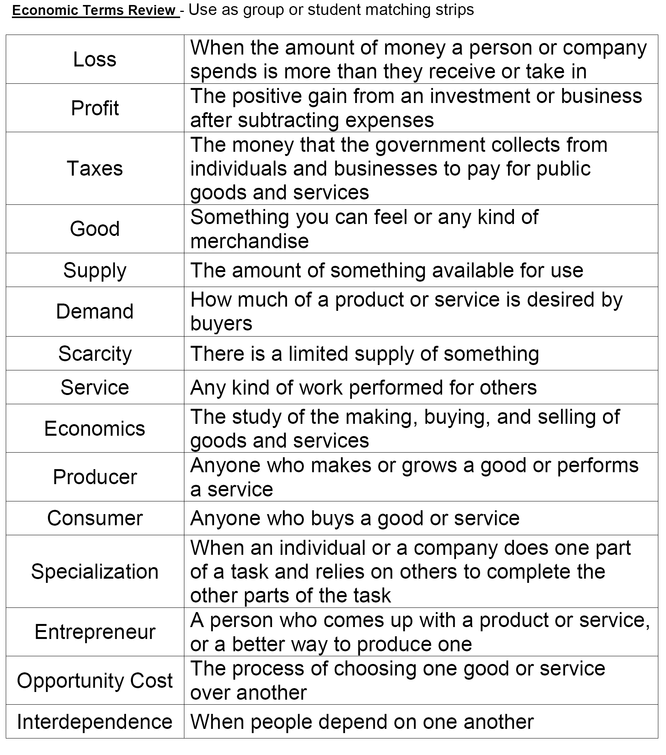
Economic Terms Review Matching Strips
Notes:
Instructional Approach(s): This is an optional student activity that can be used to review the economic terms covered during the review slides. Students can work alone or with a partner to match the correct definition to the correct term.

Slide 7
What is Economics?
Every society has productive resources:
Land/ Natural
Resources
Human Capital/Labor
Capital/Tools
Entrepreneurship
Notes:
Instructional Approach(s): The teacher should present the information on the slide.

Slide 8
What is Economics?
Productive Resources are used to produce:
Goods
Services
Notes:
Instructional Approach(s): The teacher should present the information on the slide.

Slide 9
What is Economics?
However, because of SCARCITY, choices must be made to answer the Three Basic Questions of Economics.
What goods and services will be produced?
How will the goods and services be produced?
Who will consume the goods and services?
Notes:
Instructional Approach(s): The teacher should present the information on the slide. This may be a good point in the lesson to do the Scarce Candy Activating activity.

Slide 10
Economic Systems

Slide 11
Economic Systems
A Country must decide how to distribute its resources to meet the needs of its people.
How a country makes these decisions determines its type of economic system.
Notes:
Instructional Approach(s): The teacher should present the information on the slide.

Slide 12
An Economic System is the way a society organizes the production, distribution, and consumption of goods and services.
Notes:
Instructional Approach(s): The teacher should present the information on the slide.

Slide 13
Vocabulary
Break
In small groups, sort the pictures provided as examples of production, distribution, or consumption
Notes:
Instructional Approach(s): Individually or with a partner, the students should sort the pictures on the “Economic Systems Vocabulary Break: Production, Consumption, Distribution” handout linked on the resource page. Give students no more than 5 minutes to complete the activity. Go over the answers with the class when finished.

Slide 14
Economic Systems
There are 3 basic types of economic systems that have to answer three basic questions:
What to produce?
How to produce?
For Whom to produce?
Notes:
Instructional Approach(s): The teacher should present the information on the slide

Slide 15
Economic Systems
WHAT TO PRODUCE? (What kinds of goods and services should be produced?)
HOW TO PRODUCE? (What productive resources are used to produce goods and services?)
FOR WHOM TO PRODUCE? (Who gets to have the goods and services?
The way a society answers these questions determines its economic system.
Notes:
Instructional Approach(s): The teacher should present the information on the slide

Slide 16
Types of Economic Systems:
1. Traditional Economy
2. Command Economy
3. Market Economy
Notes:
Instructional Approach(s): The teacher should present the information on the slide

Slide 17
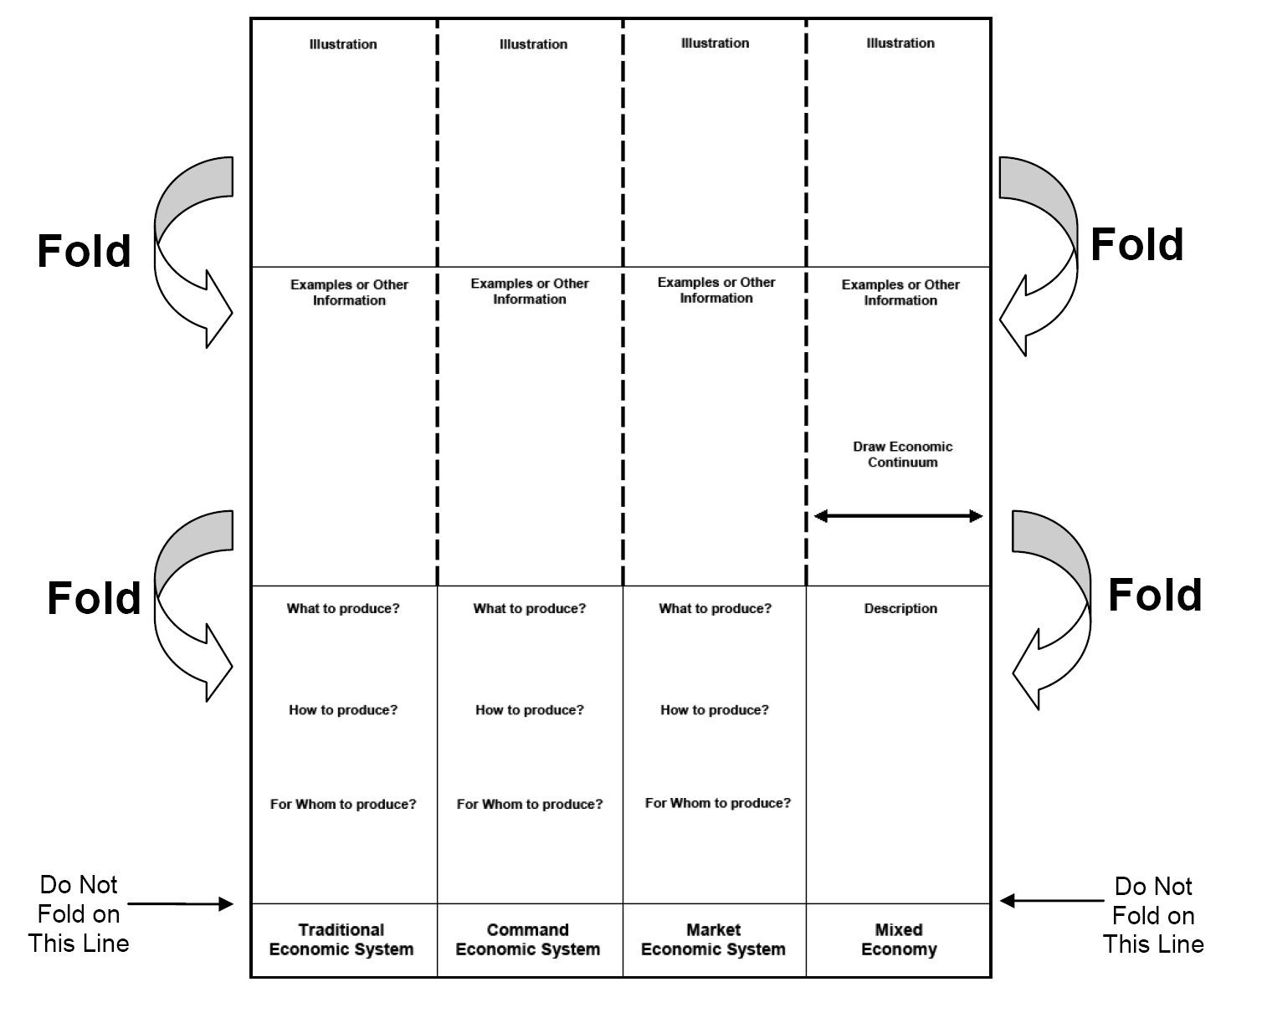
Follow teacher instructions to create your Economic Systems Foldable to use for note-taking

Slide 18
Traditional Economy
An economic system in which economic decisions are based on customs and beliefs
People will make what they always made & will do the same work their parents did
Exchange of goods is done through Bartering: trading without using money
Notes:
Instructional Approach(s): The teacher should present the information on the slide while the students record the important information on their Economic Systems Foldable

Slide 19
Traditional Economy
Who decides what to produce?
  People follow their customs and make only what is needed to take care of oneself
Who decides how to produce goods & services?
  People grow & make things the same way that their ancestors did
For Whom are the goods & services produced for?
  Self and trading purposes (people
  in the village who need them)
Notes:
Instructional Approach(s): The teacher should present the information on the slide while the students record the important information on their Economic Systems Foldable

Slide 20
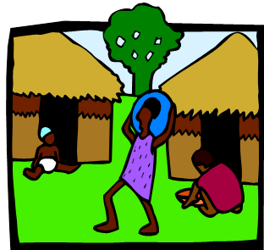
Traditional Economy
Examples:
  Villages in Africa and South America; the Inuit tribes in Canada; the caste system in parts of rural India
Strengths: Predictable job and lifestyle
Weaknesses: Lack resources and limited production
Notes:
Instructional Approach(s): The teacher should present the information on the slide while the students record the important information on their Economic Systems Foldable

Slide 21
Distributed Summarizing
Draw an illustration in your foldable that represents a Traditional Economy.

Slide 22
Command Economy
Government makes all economic decisions & owns most of the property
Sometimes called communism
Examples: Cuba, former Soviet Union, North Korea
This system has not been very successful & more and more countries are abandoning it
Notes:
Instructional Approach(s): The teacher should present the information on the slide while the students record the important information on their Economic Systems Foldable

Slide 23
Command Economy
Who decides what to produce?
  Government makes all economic decisions
Who decides how to produce goods and services?
  Government decides how to make goods/services
For Whom are the goods and
services produced for?
  Whoever the government decides to give them to
Notes:
Instructional Approach(s): The teacher should present the information on the slide while the students record the important information on their Economic Systems Foldable

Slide 24
Command Economy
Strengths: people do not have to worry about employment, housing, education, and healthcare
Weaknesses: consumers own nothing, no choices/freedom, limited innovation by individuals
Notes:
Instructional Approach(s): The teacher should present the information on the slide while the students record the important information on their Economic Systems Foldable

Slide 25
Distributed Summarizing
Draw an illustration in your foldable that represents a Command Economy.

Slide 26
Market Economy
In a market economy, buyers and sellers answer the three economic questions
All resources are privately owned
Who decides what to produce?
  Whatever the market demands that will produce a profit
Who decides how to produce goods and services?
  Private producers (businesses)
For Whom are the goods and services produced for?
  Consumers who demand the product and are willing to pay
Notes:
Instructional Approach(s): The teacher should present the information on the slide while the students record the important information on their Economic Systems Foldable

Slide 27
Market Economy
Strengths: People can start their own businesses, more choice
Weaknesses: The desire for money may lead to poor quality of goods and services, business owners have to risk losing money
Notes:
Instructional Approach(s): The teacher should present the information on the slide while the students record the important information on their Economic Systems Foldable

Slide 28
Distributed Summarizing:
Draw an illustration in your foldable that represents a Market Economy.

Slide 29
Distributed
Summarizing:
Economic System Quotes
Notes:
Instructional Approach(s): Individually, with a partner, or as a class students should read the quotes and identify which economic system to which they would apply

Slide 30
Mixed Economy
Market + Command = Mixed
There are no pure command or market economies. To some degree, all modern economies show characteristics of both systems and are often referred to as mixed economies.
  Most economies are closer to one type of economic system than another
For example, businesses own resources and determine what and how to produce, but the Government regulates certain industries
Notes:
Instructional Approach(s): The teacher should present the information on the slide while the students record the important information on their Economic Systems Foldable

Slide 31
Mixed Economy
Most democratic countries fall in this category (there are no truly pure Market or Command economies).
Examples: U.S., Brazil, Mexico, Canada, UK, etc.
Notes:
Instructional Approach(s): The teacher should present the information on the slide while the students record the important information on their Economic Systems Foldable

Slide 32
Continuum of Economies
Mixed
Pure Command
Pure Market
Notes:
Instructional Approach(s): The teacher should present the information on the slide while the students record the important information on their Economic Systems Foldable

Slide 33
Summarizing
Strategy
Economic Systems Continuum Activity
Notes:
Instructional Approach(s): The students should conduct the Economic Systems Continuum Activity. The teacher should use the activity to determine student mastery of the concepts and if differentiation is needed.

