Slide 1
Economics Vocabulary
The following slides contain vocabulary terms and definitions that you need to know when discussing Economics.
Study each of the following slides for upcoming Economics assessments (tests, quizzes, etc.).

Slide 2
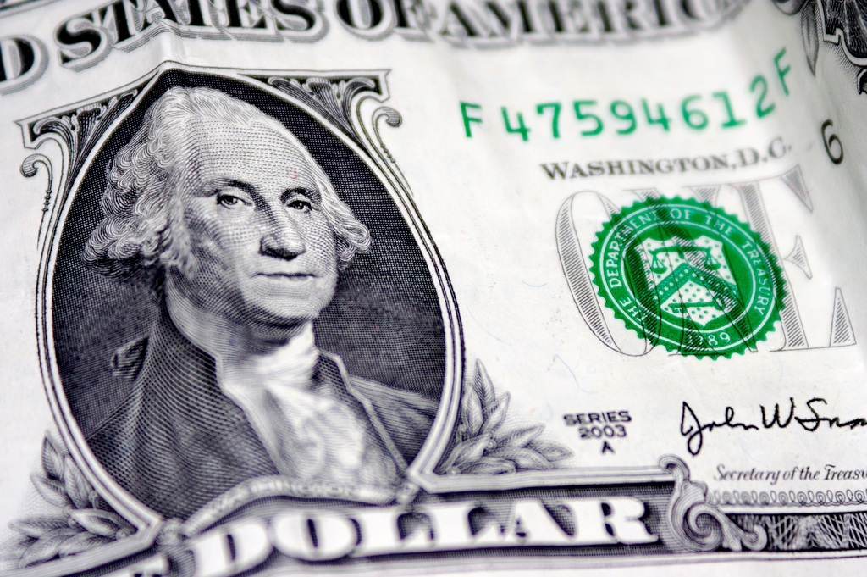
Economics
The study of how people choose to use limited resources to satisfy their unlimited wants.
Describes how a group of people make decide what to make, how to make it, and for whom to make it.

Slide 3

Human Resources/Capital
The knowledge and skills (education) that allow workers to produce goods and services and earn a salary.
Example: The knowledge and skills needed to become a doctor, lawyer, teacher, or car mechanic.

Slide 4
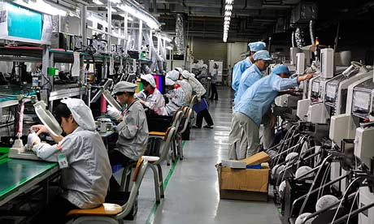
Capital Resources
Goods such as factories, machines, and tools that workers use to make other goods.

Slide 5
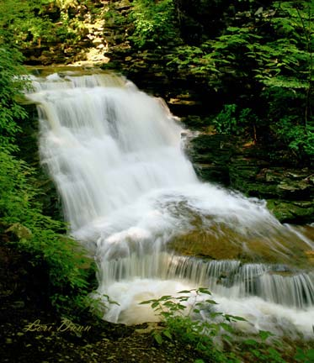
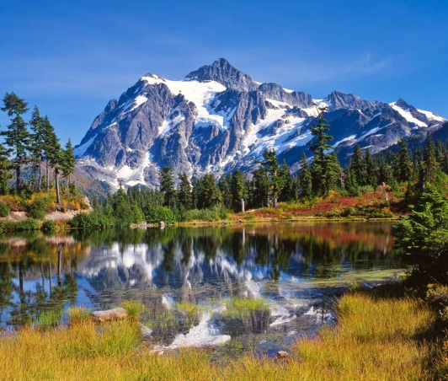
Natural Resources
Raw materials used to support life and make goods
Examples:
  Trees
  Land
  Oil

Slide 6


Entrepreneurship
People who have these qualities risk their time, money, and energy to make a profit.
They might create new products, come up with new ways to make things, or find new ways to reach buyers (ex. iTunes, Facebook).

Slide 7


Goods
Tangible (touchable) objects that satisfy economic wants.
Items that a person may want or need to have.

Slide 8
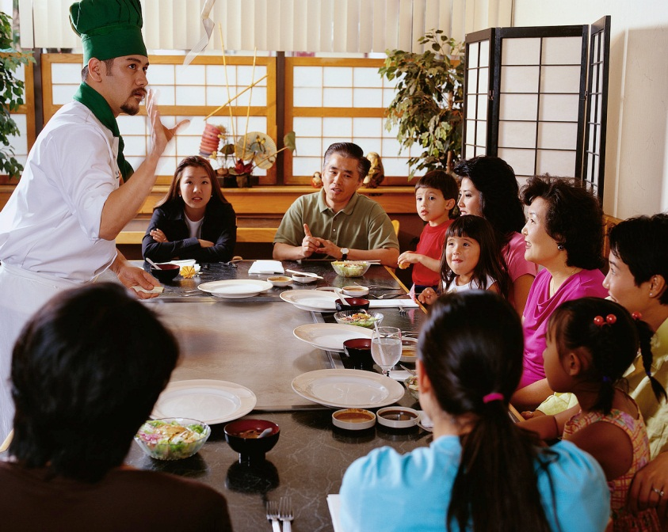

Services
Activities performed by people to satisfy economic wants.
Examples:
  Restaurants provide the service of preparing food for people.
  Teachers provide the service of educating students.

Slide 9
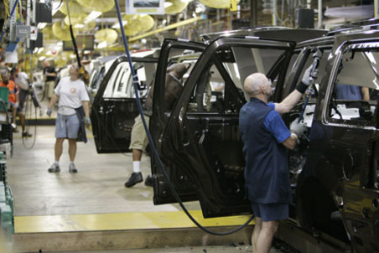
Producer
Someone who uses resources to make a good or service.
Examples:
  The Ford car company, uses raw materials (such as iron, etc.) to create automobiles.

Slide 10
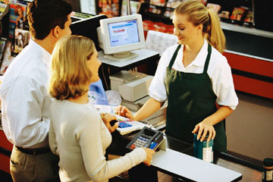
Consumer
Someone who buys or trades a good or service.

Slide 11
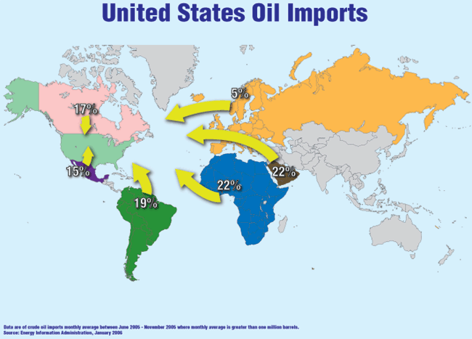
Imports
Goods brought into one country from another through trade or sale.

Slide 12
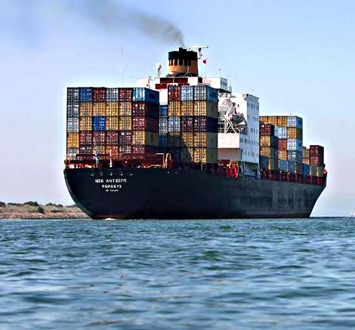
Exports
Goods and services traded with or sold to other countries.

Slide 13
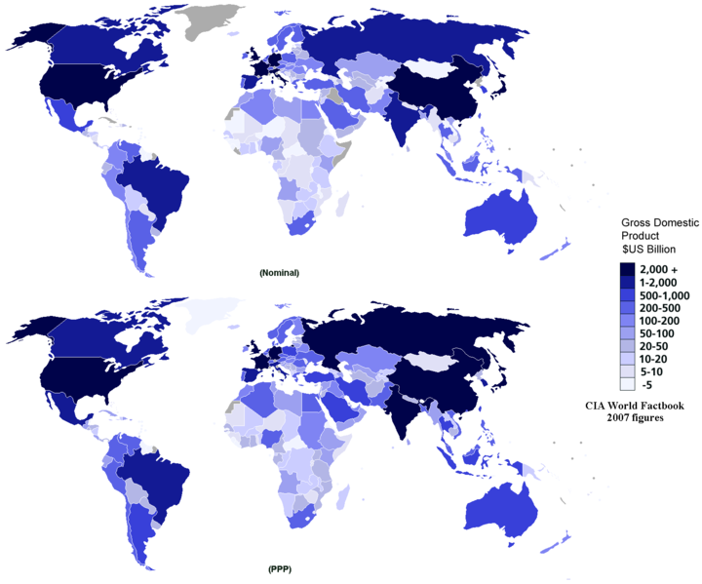
Gross Domestic Product (GDP)
The total value of all goods and services produced in a country every year.

Slide 14
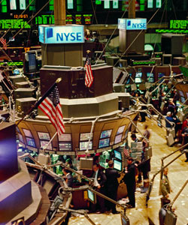
Invest (Investment)
To buy more of something in order to benefit from it in the future.
Examples:
  Stocks (Stock Market)
  Putting money (capital) into a business or company

Slide 15
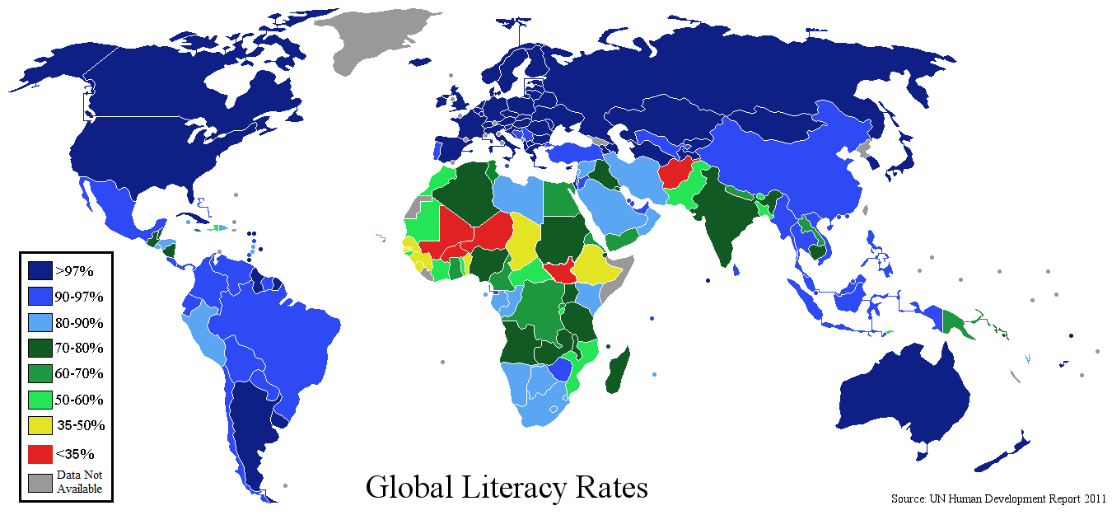
Literacy Rate
The percentage of people who can read and write in a country.
Literacy Rate is usually tied to the country’s GDP (higher literacy rate usually means the country will have a higher GDP).

Slide 16

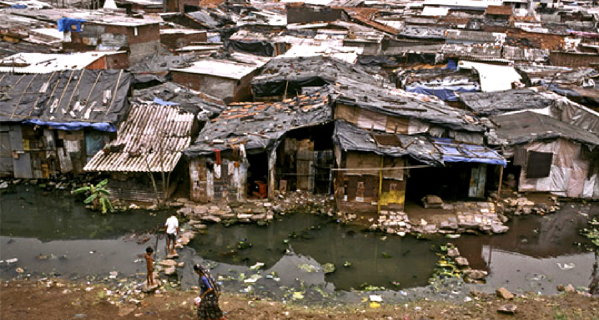
Standard of Living
A person’s level of comfort.
Determined by the amount of goods, services, and luxuries available to a person.
Countries with a higher GDP usually have a higher standard of living.

Slide 17
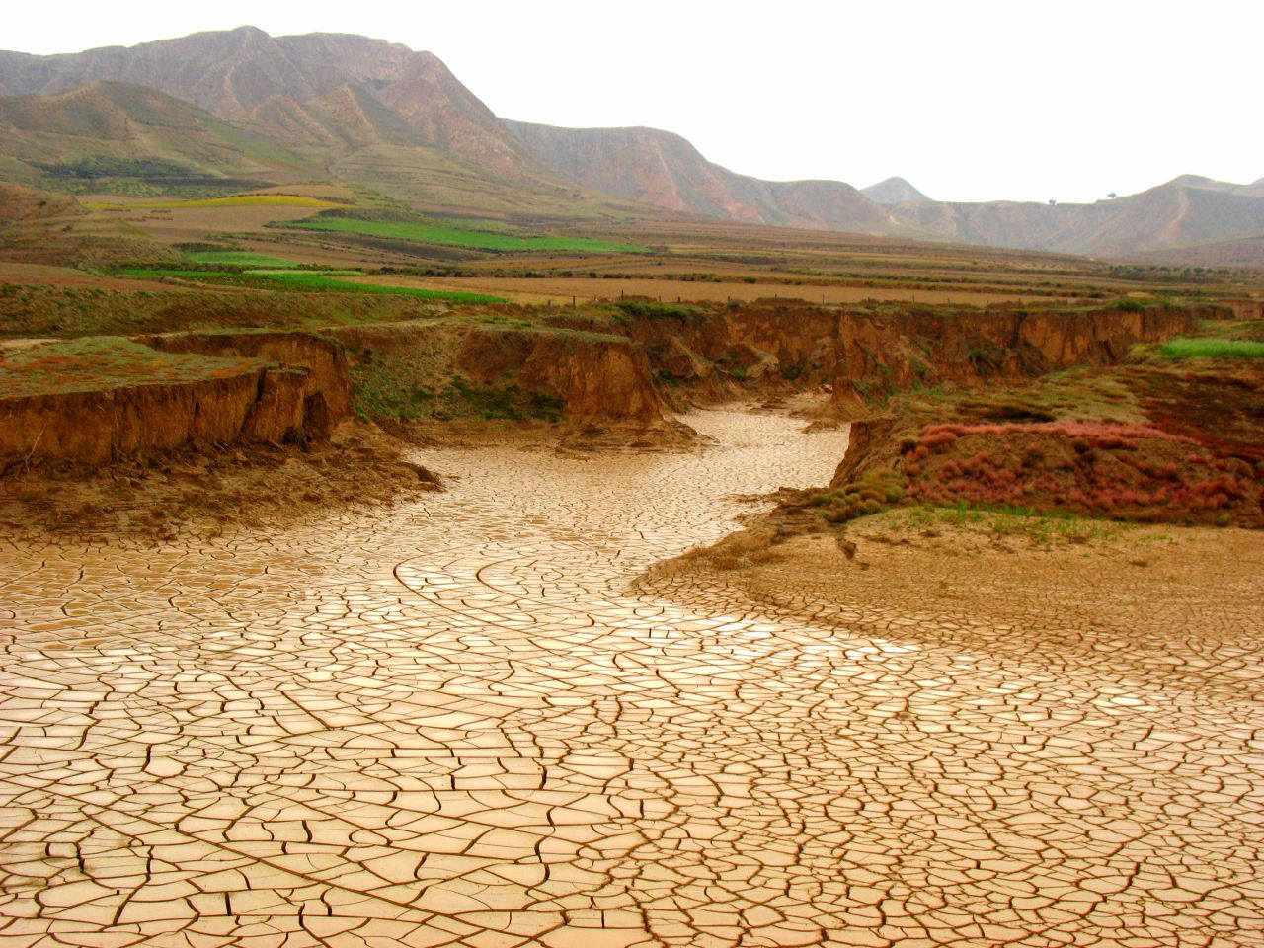
Scarcity
When there isn’t enough of something because humans want more than they can have.

Slide 18
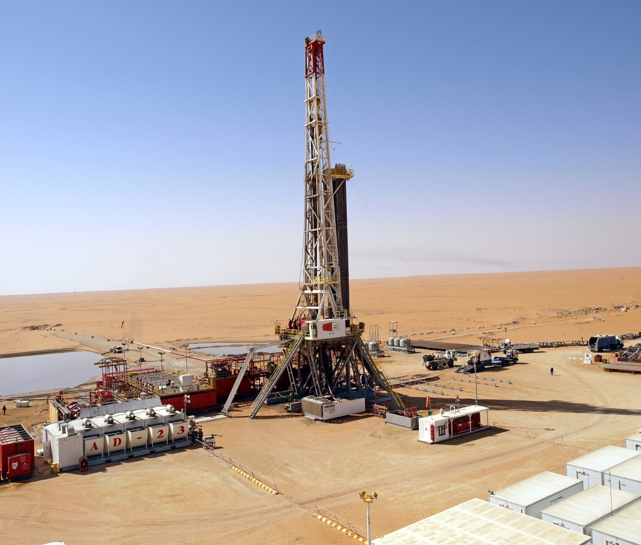
Specialization
When people, businesses, or countries produce specific goods or services in order to produce more.
Many countries specialize in the creation of one product or service, due to the resources they have (human resources, natural resources, etc.) available.

Slide 19

Economic System
The way a nation uses its resources to satisfy people’s needs and wants.
There are 3 major economic systems:
  Traditional Economy
  Command Economy
  Market Economy
Although there are 3 major economic systems, most countries are Mixed Economies.

Slide 20
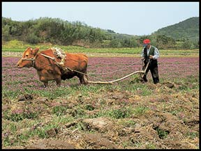
Traditional Economy
An economic system in which social roles and culture decide what goods and services will be produced, how they will be produced, and for whom
People do things the way they always have (following the traditions of their people).

Slide 21
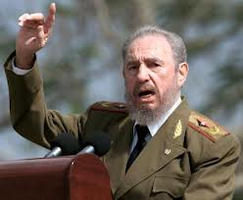
Command Economy
An economic system in which the government decides what goods and services will be produced, how they will be produced, and for whom.
The government has the power to control the economy and command the people to do what the government says.

Slide 22
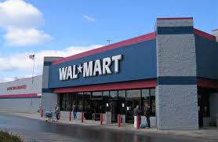
Market Economy
An economic system in which individual choices decide what goods and services will be produced, how they will be produced, and for whom.
This is commonly referred to as a Free Market system, because people have the freedom to do what they want.

Slide 23
Mixed Economy
An economic system that has mixed features of traditional, command, and market systems.
Most countries are Mixed Economies, falling on a continuum somewhere between a Command (0% Free) and Market Economy (100% Free).
0
Pure Command
50
Mixed Economy
100
Pure Market

Slide 24

Voluntary Trade
An economic exchange in which all sides agree to participate because they expect to benefit.
Example: When a person agrees to trade a product or service for money, or another product or service, both sides benefit from the trade.

Slide 25

International Trade
The exchange of goods and services between countries.
International means between two or more nations (countries).

Slide 26
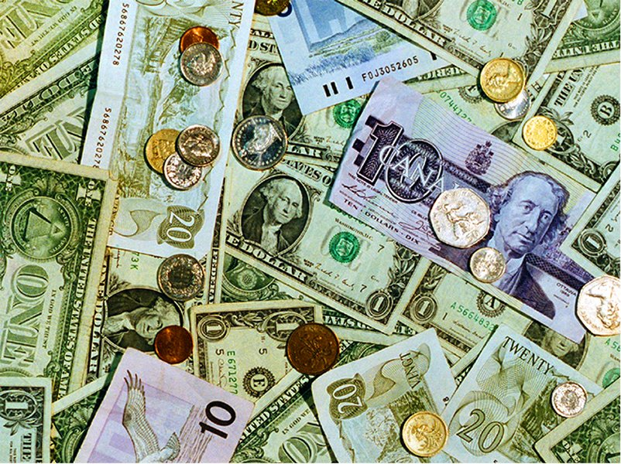
Currency
Money that is used as a way to trade goods and services;
Examples:
  Paper Bills
  Coins

Slide 27
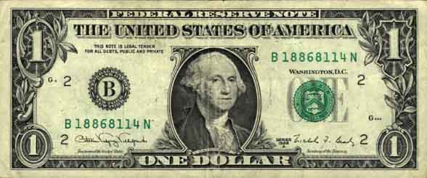
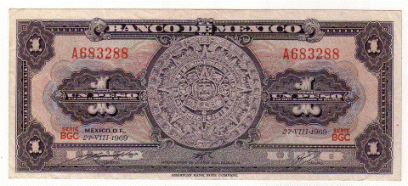
Exchange Rate
How much one country’s money is worth compared to another country’s.
Example:
  16.49 Mexican Pesos = 1 U.S. Dollar (2015).

Slide 28
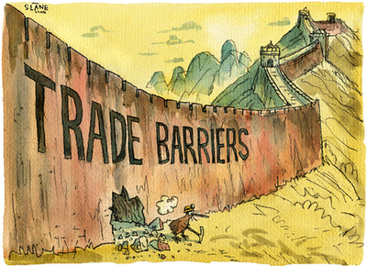
Trade Barrier
Any law or practice that a government uses to limit trade between countries.
This could be in the form of taxes (tariffs), quotas, or embargos.

Slide 29
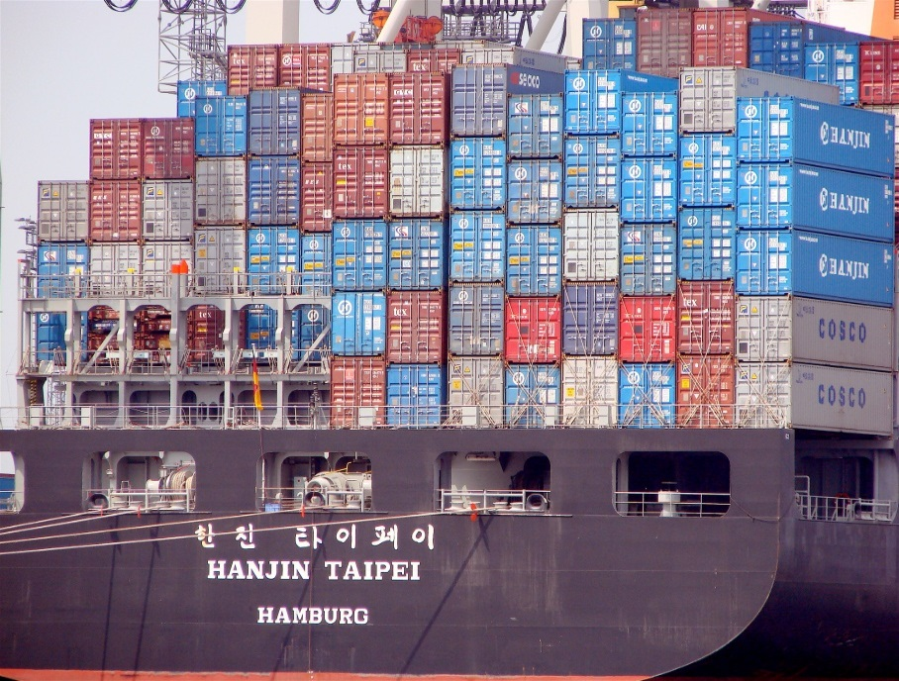
Tariff
A price or tax charged for goods or services brought into one area from another area.

Slide 30

Quota
A limit on the amount of product that may be imported during a given period of time.
Only a certain number of items can be imported.

Slide 31
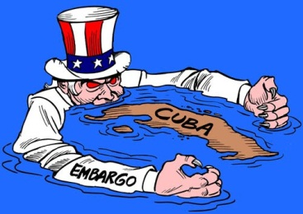
Embargo
When a country refuses to import or export certain goods; often backed by military force.
Example:
  The United States has had an embargo against Cuba since October of 1960.

Slide 32
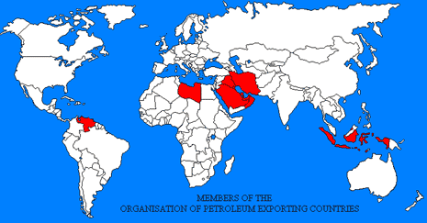
OPEC
Organization of Petroleum Exporting Countries.
Decides the price and amount of oil produced each year in major oil producing countries like Iran, Iraq, Saudi Arabia, and Kuwait.

