Slide 1
How did Communism influence China?
SS7H3d. Describe the impact of Communism in China in terms of Mao Zedong, the Great Leap Forward, the Cultural Revolution, and Tiananmen Square.

Slide 2
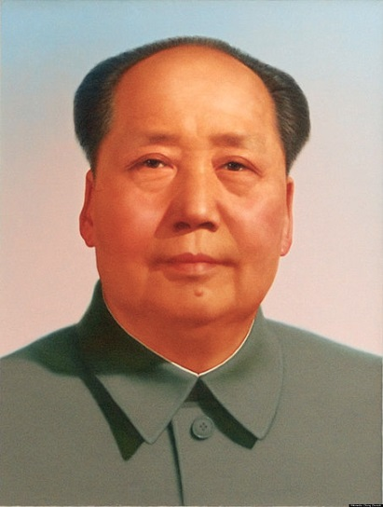
Has China always had a Communist government?
Until 1949, China’s government was led by the Chinese Nationalist Party. So, what happened?
The rise of Mao Zedong

Slide 3
The Rise of Mao Zedong
Watch the video clip on China and the Rise of Mao [7:48]
While watching the video, answer the questions provided by the teacher.
https://www.youtube.com/watch?v=q5zGz730gAI [7:58 China and the Rise of Mao Zedong]

Slide 4
Use your graphic organizer to summarize the events

Slide 5
Communism and Mao Zedong
Mao was appointed the leader of the Chinese Communist Party and the head of China’s government
He had almost complete control over China
In the early years of Communist rule, China and its people saw many reforms that were seen as positive.

Slide 6
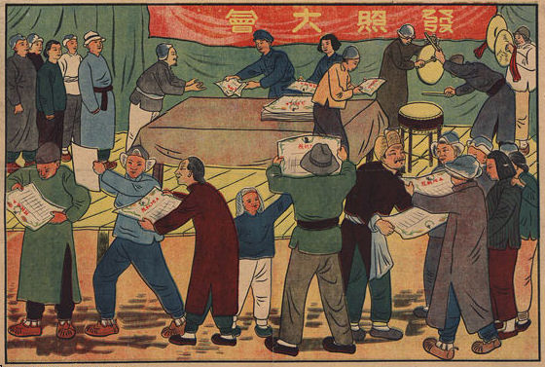
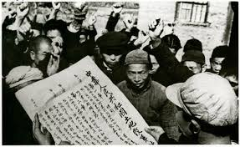
Redistribution of Land
Land was taken from the wealthy landlords and given to the peasants.

Slide 7
A Few Other Reforms
Promoted the status of women
Doubled the school population and improved literacy
Increased access to health care, which dramatically raised life expectancy
Banned forced marriages
https://www.youtube.com/watch?v=VhOKiwX2u_U [10:00 optional video clip describing positive reforms]

Slide 8
Although the rule of the Communist Party started successfully, soon the Chinese people would be victims again.
In January of 1958, Mao Zedong launched the "Great Leap Forward," attempting to increase agricultural and industrial production in the hopes of speeding up China’s economic development.

