Slide 1
How did Communism influence China?
SS7H3d. Describe the impact of Communism in China in terms of Mao Zedong, the Great Leap Forward, the Cultural Revolution, and Tiananmen Square.

Slide 2
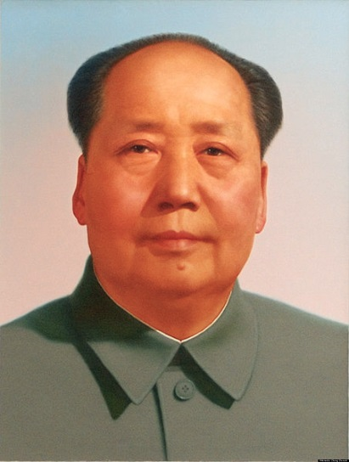
Has China always had a Communist government?
Until 1949, China’s government was led by the Chinese Nationalist Party. So, what happened?
The rise of Mao Zedong

Slide 3
The Rise of Mao Zedong
Watch the video clip on China and the Rise of Mao [7:48]
While watching the video, answer the questions provided by the teacher.
https://www.youtube.com/watch?v=q5zGz730gAI [7:58 China and the Rise of Mao Zedong]

Slide 4
China and the rise of Mao
Describe the attitudes of the people at the beginning of the video (in 1949).
Why did they feel this way?
Mao Zedong was freeing the Chinese people from
Describe China as shown in the video during the first half of the 20th century (before Mao Zedong).
They were happy and excited
They felt they had been liberated
Inequality, poverty, and foreign domination
Lived in the same way they had for generations; most worked the land in desperate poverty and debt; very little to live on; justice for rich not poor

Slide 5
China and the rise of Mao
The Nationalist Party came to power to ease the problems of the Chinese; however, the gap between the wealthy and the poor kept increasing. Who did the Chinese people believe could change their problems and foreign exploitation?
What type of revolution did Mao Zedong picture?
What did Mao Zedong promise?
Based on the video, do you believe Mao Zedong was good for China? Why?
Communist Party
It would spring from the countryside of peasants
Land reform and a China that could stand on its own
Let’s find out…

Slide 6
Use your graphic organizer to summarize the events

Slide 7
Communism and Mao Zedong
Mao was appointed the leader of the Chinese Communist Party and the head of China’s government
He had almost complete control over China
In the early years of Communist rule, China and its people saw many reforms that were seen as positive.

Slide 8
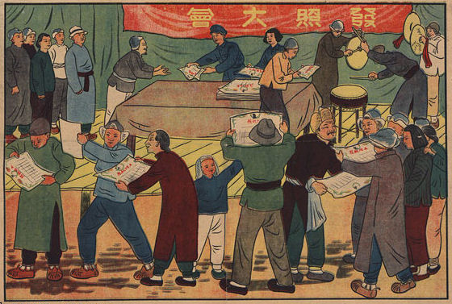
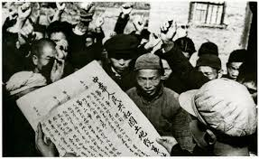
Redistribution of Land
Land was taken from the wealthy landlords and given to the peasants.

Slide 9
A Few Other Reforms
Promoted the status of women
Doubled the school population and improved literacy
Increased access to health care, which dramatically raised life expectancy
Banned forced marriages
https://www.youtube.com/watch?v=VhOKiwX2u_U [10:00 optional video clip describing positive reforms]

Slide 10
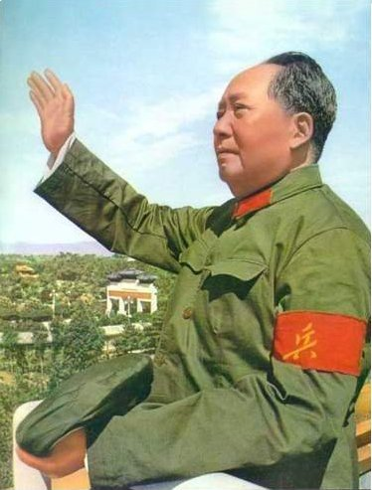
Turn to a seat partner and discuss again: do you believe Mao Zedong was good for China?
Use examples discussed in your reasoning.

Slide 11
Although the rule of the Communist Party started successfully, soon the Chinese people would be victims again.
In January of 1958, Mao Zedong launched the "Great Leap Forward," attempting to increase agricultural and industrial production in the hopes of speeding up China’s economic development.

Slide 12
Great Leap Forward
In an effort to make farming more productive, collective farms with large communes (communities) of people were created to grow crops, run industries, educate the children, and have healthcare.

Slide 13
Great Leap Forward
The people in the communes did not own the land they worked on and the Communist Party controlled their economy, work schedule, and social lives.

Slide 14
Communist Propaganda
Propaganda is information, especially of a misleading nature, used to promote or publicize a particular political cause or point of view.
The Communist Party used a lot of propaganda to promote its reforms.

Slide 15
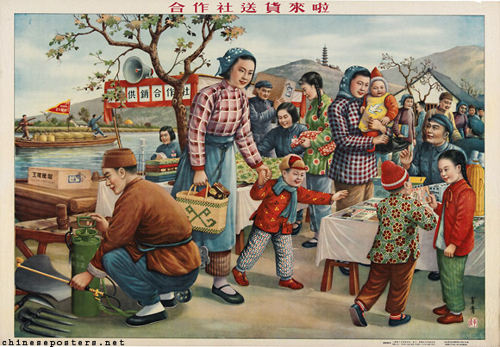
Communist Propaganda of the Great Leap Forward
Do the people look happy in the picture? Should they be?

Slide 16
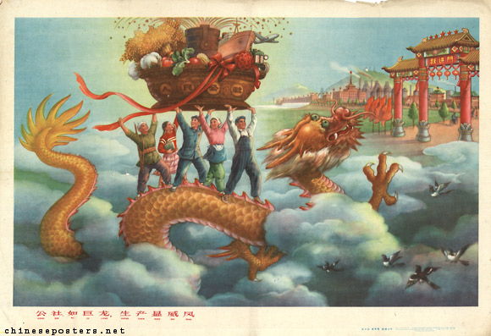
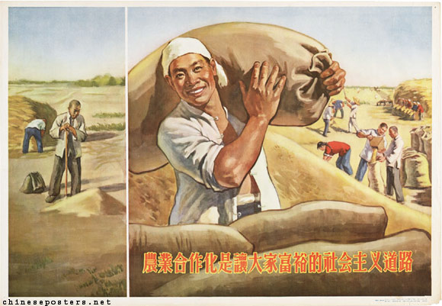
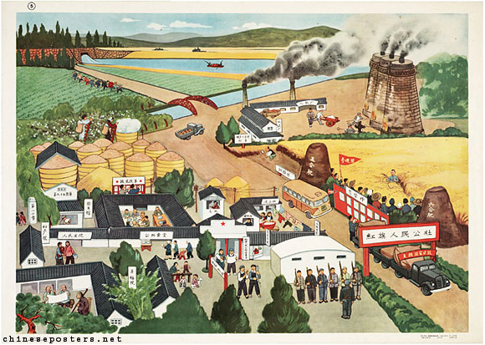
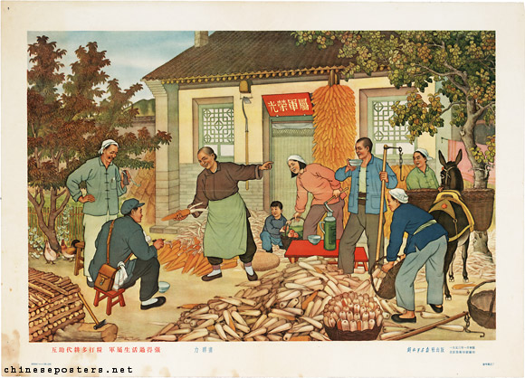
Communist Propaganda of the Great Leap Forward

Slide 17
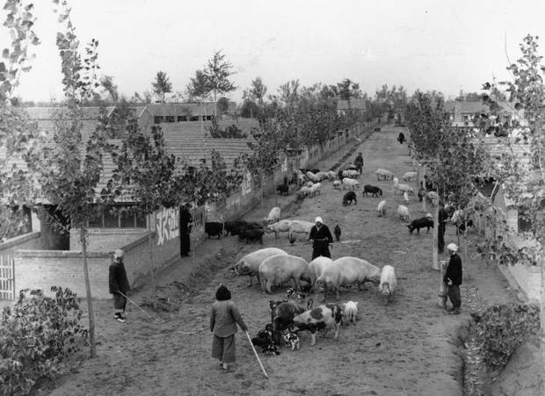
Great Leap Forward

Slide 18
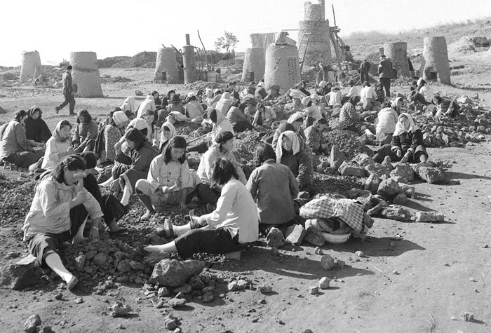
Great Leap Forward

Slide 19
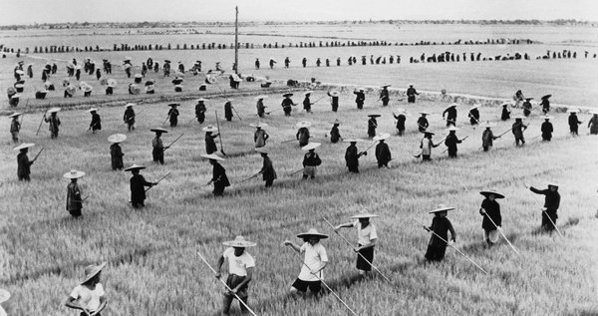
Great Leap Forward

Slide 20
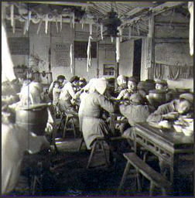
Great Leap Forward

Slide 21
Great Leap Forward
How do the real pictures of the Great Leap Forward compare to the communist propaganda pictures?
What would be the advantages and disadvantages of living and working on a collective farm?

Slide 22
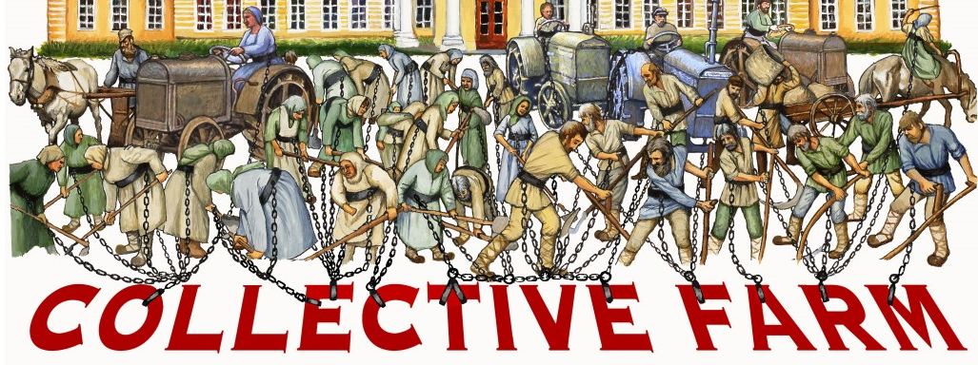
Turn to a partner and explain what the image means.

Slide 23
Effects of the Great Leap Forward
It was a huge disaster that failed within a year
Droughts and floods damaged China’s food supply and the communes failed to provide enough quality industry and food to feed the country
An estimated 20 million people died during one of the largest famines in history

Slide 24
Great Leap Forward
https://www.youtube.com/watch?v=hlbB3cmgPmo
What new information about the Great Leap Forward did you learn from the video?

Slide 25
After the Great Leap Forward
Many Chinese lost confidence in Mao Zedong after the Great Leap Forward
Chinese began calling for reforms again to prevent another disaster
Mao did not like the opposition and was afraid they would make China a capitalist country
In 1966, Mao started the Cultural Revolution to stop all opposition to Communism.

Slide 26
Cultural Revolution
Mao Zedong shut down schools and recruited students into his Red Guards which attacked and punished any person who opposed communism
Factories closed and China’s economy weakened
The government denied healthcare and transportation
It caused more distrust of the communists

Slide 27
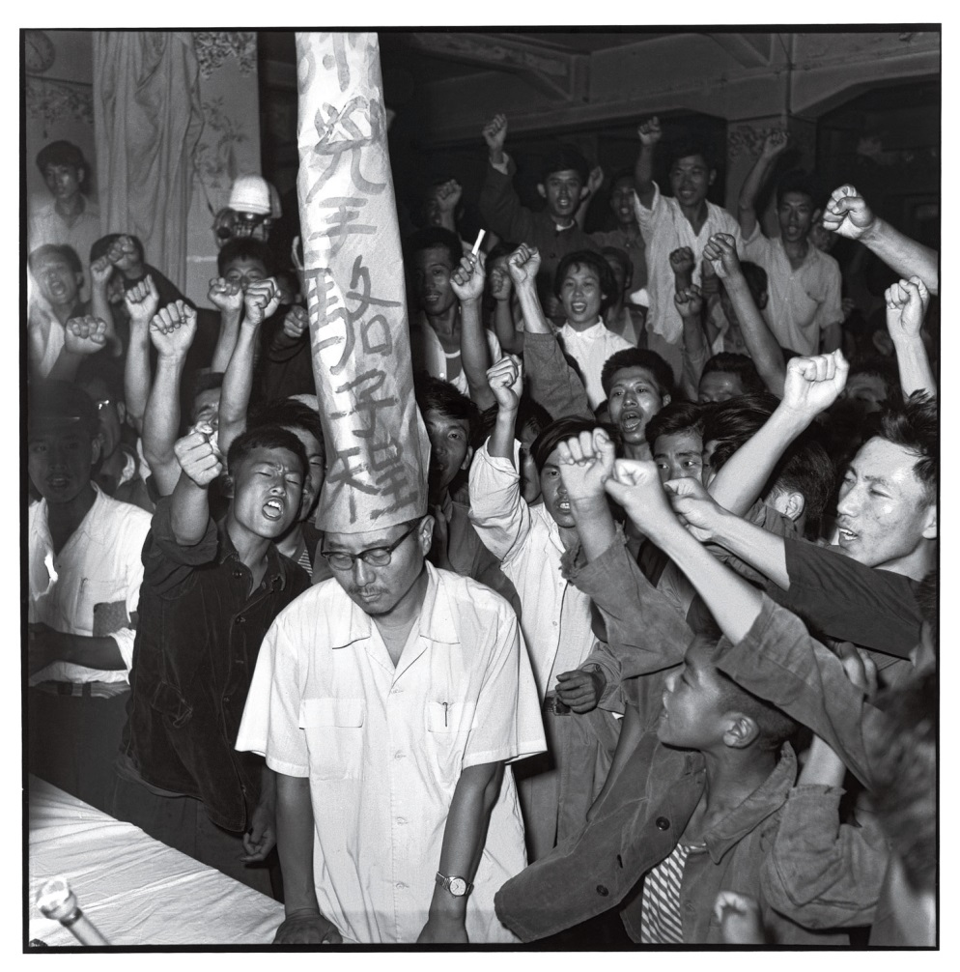
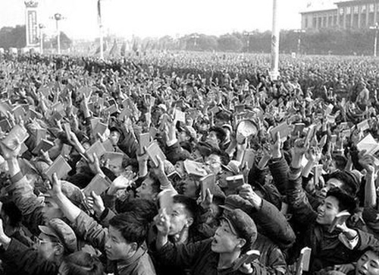
Cultural Revolution

Slide 28
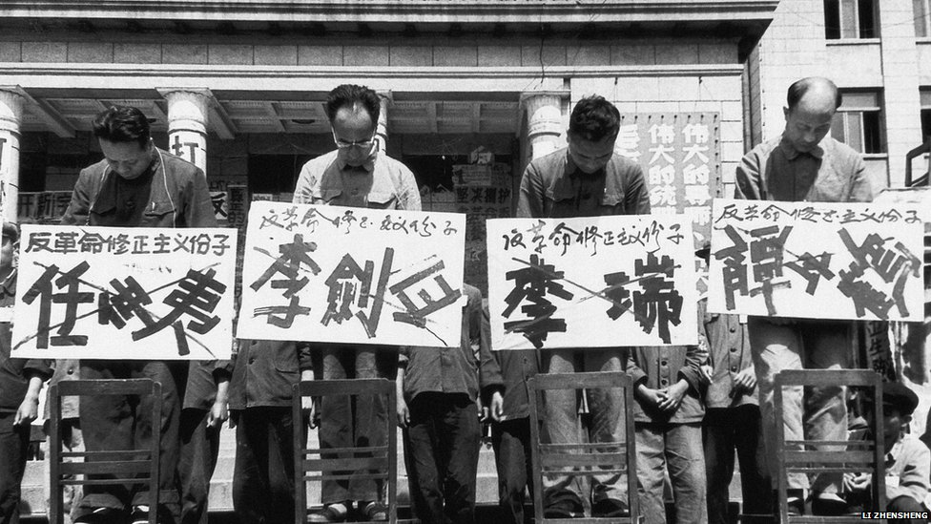
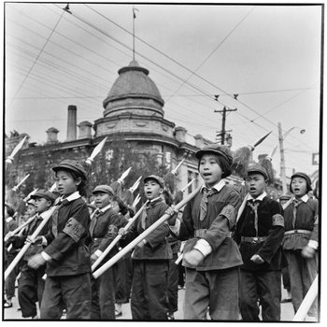
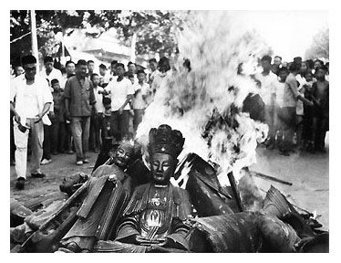
Cultural Revolution

Slide 29
Cultural Revolution
https://www.youtube.com/watch?v=LGpmVs0_Dbc

Slide 30
Turn to a seat partner and discuss again: do you believe Mao Zedong was good for China?
Use examples discussed in your reasoning.

Slide 31
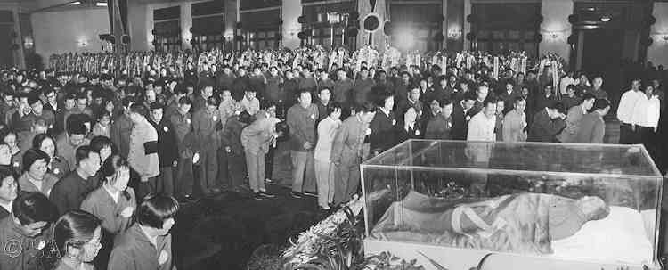
Mao Zedong’s death in 1976 brought an end to the Cultural Revolution

Slide 32
After Mao Zedong
The new leader Deng Xiaoping became leader and made many reforms to Mao’s policies, but the government still stuck to its communist rules and would not give up control over the people
The Chinese people were not given basic rights like freedom of speech or the right to a fair trial

Slide 33
Tiananmen Square
In 1989, protestors filled Tiananmen Square for weeks peacefully speaking against communism and calling for democracy
Protests began to spread all over China
After warning the protestors, the Chinese government sent tanks into the square and opened fire killing hundreds of people

Slide 34
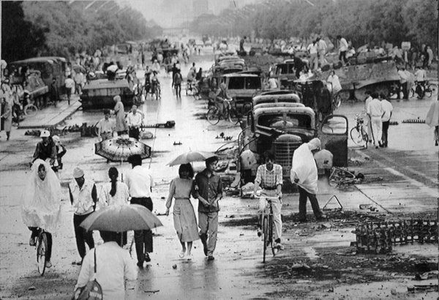
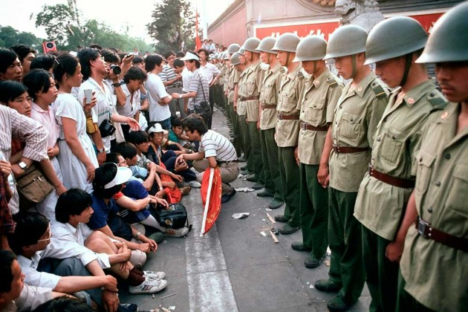
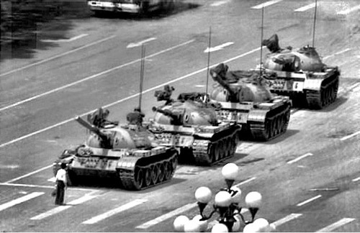
Tiananmen Square

Slide 35
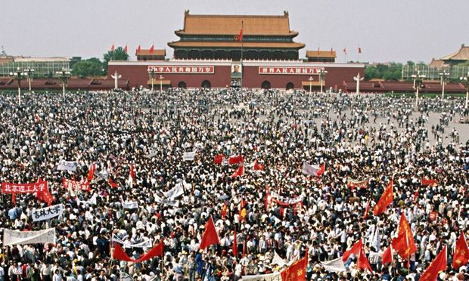
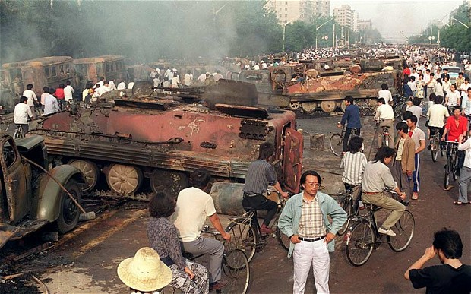
Tiananmen Square

Slide 36
Tiananmen Square
Countries around the world condemned the violence against human rights
The worldwide disapproval of the events at Tiananmen Square convinced the Chinese government to begin supporting and improving human rights

