Slide 1
GDP and Capital Resources

Slide 2
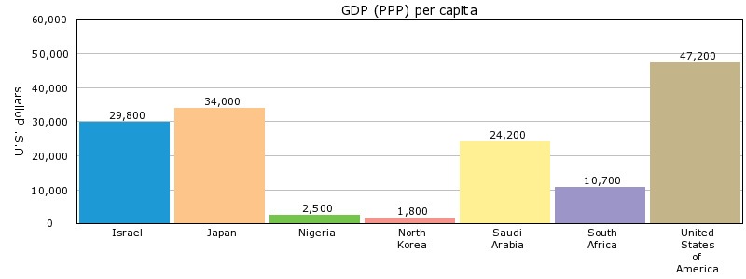
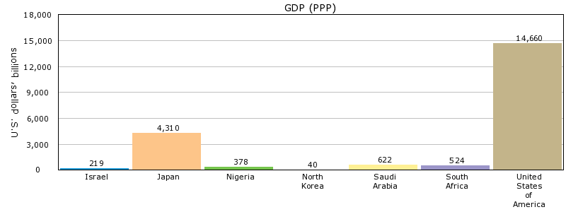
GDP
Gross Domestic Product
Total value of all goods and services produced in a country in a year
Investment in human capital and capital goods usually leads to increased GDP

Slide 3
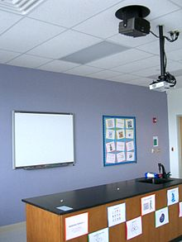
Capital Goods/Resources
Goods made by people and used to produce other goods and services (machines and factories)
Investment in Capital Resources: Business purchases of new plants and equipment

Slide 4
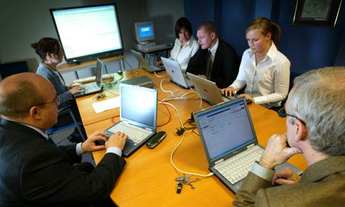
Human Capital/Resources
The quantity and quality of human effort directed toward producing goods and services (labor)
Investment in Human Resources: Activities that increase the skills and knowledge of workers

Slide 5
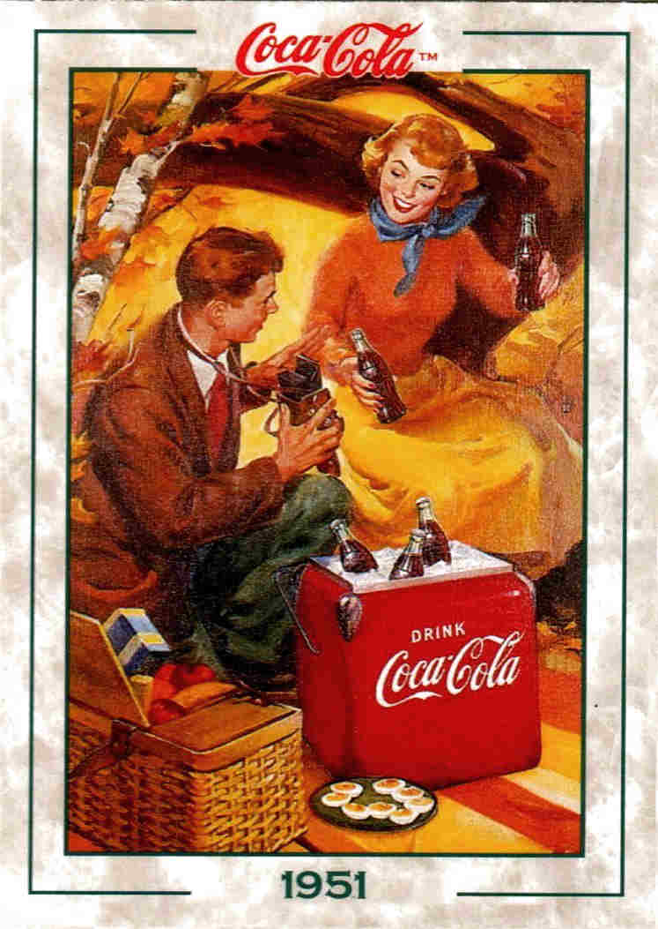
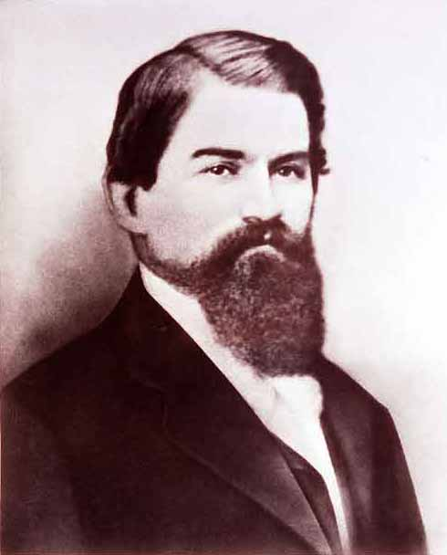
Entrepreneur
A person who combines resources to create new businesses
Entrepreneurs + land, labor, and capital = goods and services
John Pemberton

