Slide 1
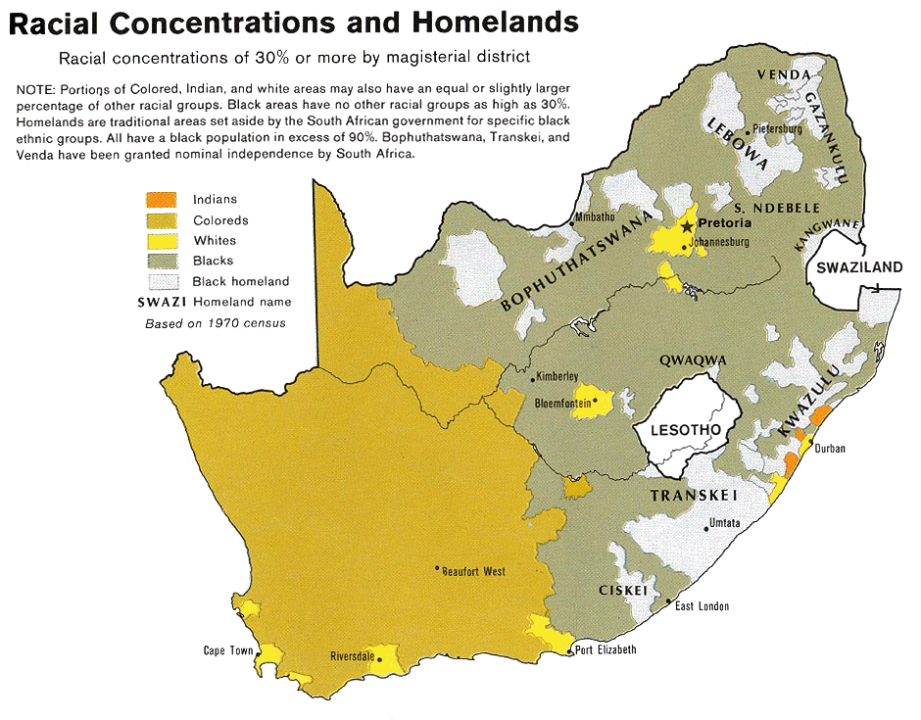

Slide 2
Create a Tree Map to classify what you see in the “Racial Concentrations and Homelands” map…
Racial Concentrations in South Africa, 1970
Whites
Blacks
Coloreds
Live in ___% of the country

Slide 3
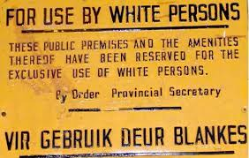
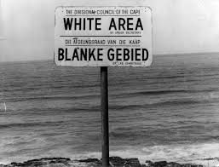
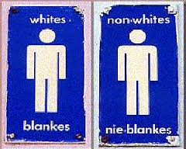
The legal segregation of public places and businesses was part of the policy of apartheid.

Slide 4
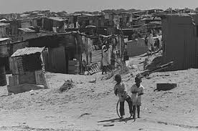
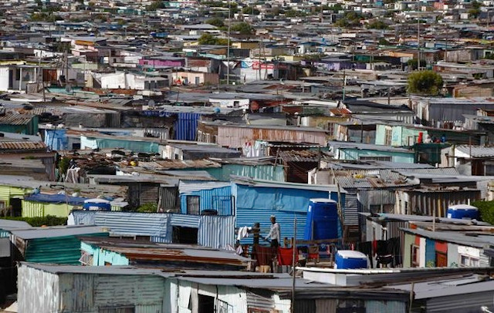
A homeland was a territory set aside for black inhabitants of South Africa and South West Africa (now Namibia), as part of the policy of apartheid.

Slide 5
Based on the given images, create a Bubble Map describing what it might be like to live in Apartheid era South Africa. Be sure to include appropriate point of view in your frame.
Life during Apartheid
Point of View

Slide 7
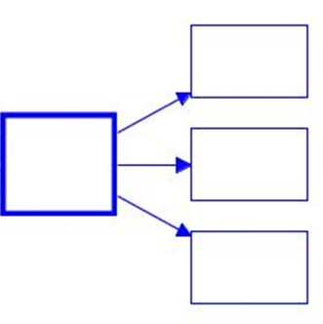
Given the information on the chart, what do you think the impact was on the different racial groups’ quality of life? Create 2 Multi-flow Maps for the 2 points of view.

Slide 8
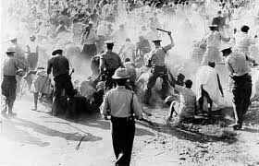
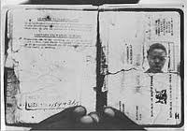
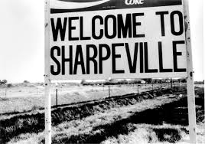
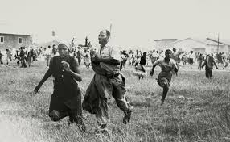

Slide 9
The Sharpeville Massacre & Pass Laws
Pass laws, laws requiring citizens to carry identification, restricted the movement and freedom of non-white ethnic groups. All non-white groups were subject to travel restrictions and were required to carry passbooks with them at all times. South African protests of pass laws began in the 1960s. Thousands of blacks were arrested for failing to carry their passbooks. In 1960, protests in Sharpville resulted in the police massacring 69 people.

Slide 10
Based on the given images and information, create a Bubble Map describing the Sharpeville Massacre. Include what it was about and who was fighting whom.
Sharpeville
Massacre
Point of View
Level 1

Slide 11
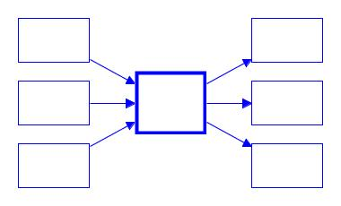
Create a Multi-flow Map organizing the causes and effects of passbooks laws under the Apartheid system.
Reasons why…
As a result of…
Non-whites had to carry passbooks
Level 2

Slide 12
Level 2

Slide 13
Complete these questions on page 7 of your passbook.
Make two lists: Words that have a negative or violent message and those that have a positive or peaceful message.
Look back at the Background Information. What was Mandela doing in 1964? Describe the significance of this quote in Mandela’s life at that time?
Mandela repeated this quote when he was released from prison in 1990. Apartheid was still the law until 1993 though. What was the significance of the quote in 1990?
Level 2

Slide 14
Level 1
Domination – noun. Control, power, or authority over someone else
“White domination” = White people have all the power.
“Black domination” = Black people have all the power.
Cherished – verb. Valued; respected
Mandela values the ideas of democracy and freedom where there is equality for all people.
Realized – adjective. Achieved; reached; completed
Mandela lives for the idea of freedom and hopes he lives long enough to see everyone in South Africa live freely.
Mandela cares so much about freedom in his country that he is willing to die to see it achieved.

Slide 15
Complete these questions on page 7 of your passbook.
Make two lists of words. One list is for words that are violent and bad. The other list is for words that are peaceful and good.
In 1964, Mandela said these words before he was sent to prison for fighting against the government. Why would he have said these things then?
Mandela repeated this quote when he was released from prison in 1990. Apartheid was still the law until 1993 though. Why would he have repeated the same words from 1964?
Level 1

Slide 16
“Every so often people are confronted by the need to change. If we do not adapt quickly, we simply won’t survive... We could have weathered the storm, and lived in national isolation, but often the most dangerous choice is to not take the risk to change. We in South Africa chose to manage change and to transform the country into something better. The management of change is a time for cool heads, and requires persistence and determination. Nelson Mandela showed similar resolve. He never lost his vision for a better South Africa.”
- F. W. de Klerk
Background Information: This quote is from F. W. de Klerk in 2010, looking back on the end of Apartheid in South Africa. Apartheid ended in 1993, largely because of de Klerk’s cooperation with Nelson Mandela.
Level 2

Slide 17
Complete these questions on page 8 of your passbook.
Who is the “we” de Klerk keeps referring to? How do you know?
What significant change is this quote talking about?
Who are the “cool heads” that helped make this change a reality?
Does de Klerk seem to appreciate Nelson Mandela? What evidence of this do you see in the quote?
Does de Klerk seem happy about the change South Africa made in 1993? What in the quote leads you to believe so?
Level 2

Slide 18
“Every so often people are confronted by the need to change. If we do not adapt quickly, we simply won’t survive... We could have weathered the storm, and lived in national isolation, but often the most dangerous choice is to not take the risk to change. We in South Africa chose to manage change and to transform the country into something better. The management of change is a time for cool heads, and requires persistence and determination. Nelson Mandela showed similar resolve. He never lost his vision for a better South Africa.”
In other words…
“Sometimes people need to change. If we do not change quickly, we won’t survive… We could have stayed the same and lived differently than other countries, but often the most dangerous choice is to not change. In South Africa, we decided to change and make the country better. When you are changing, you have to think through your decisions. And change requires that you don’t give up and that you stay strong. Nelson Mandela didn’t give up and he stayed strong. He always wanted a better South Africa.”
Level 1

Slide 19
Complete these questions on page 8 of your passbook.
Who is the “we” de Klerk keeps referring to?
What significant change is this quote talking about?
Who are the people that helped make this change a reality?
Does de Klerk seem to respect Nelson Mandela? What evidence of this do you see in the quote?
Does de Klerk seem happy about the change South Africa made in 1993? How do you know?
Level 1

